Slide 1

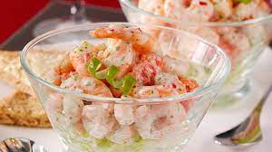
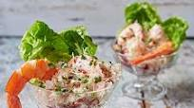
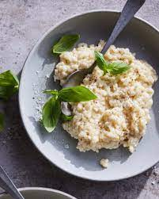
Hotel of Trinity
Christmas Party Menu
We prefer pre-ordering services.
Time availability (24/7, over the Christmas period.)
Student name: Maria Costinela Hurmuzache
Tutor name:Charlotte Joyner
Student ID: 2125468
Starter
Crayfish and Prawn cocktail with fresh bread ………. £5
Chicken liver served with welsh red onion marmalade …….. £10
Butternut squash soup with parsnip crisps (v)………. £7
Cranberry filo parcels with spiced apple chutney (v)……… £5
Belly pork with black pudding crump ………. £10
King prawn …………. £15
Main course
Chicken with Ouzo (prepare with lemon, cream, and ouzo) ………. £20
Lamb shank (prepare with vegetable and wines) ………. £15
Stifado (beef prepared with vinegar, herbs, and onions) …….. £12
Grilled aubergines (prepare with tomato sauce and herbs) (v)……… £10
Goats cheese Risotto with garlic bread (v)……… £10
Seasonality of ingredients: Over the Christmas period, we will offer a variety of seasonal dishes to our customers with discounts.

Slide 2
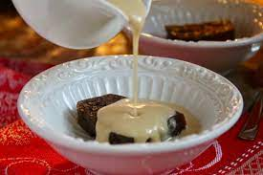


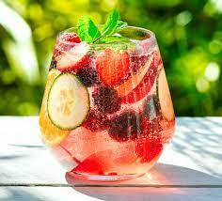
Desserts
  Traditional pudding with brandy and sweet vanilla sauce……….. £5
  Vanilla ice cream……. £5
  Orange and chocolate cheesecake……… £5
  Raspberry chocolate with top of Chantilly cream…….. £5
  Tiramisu…………. £6
Beverages
  Scotch whisky………….…£4
  Buck fast Tonic Wine……………...£2
  Soft drinks………£3
  Stout………………£3
  Mead………..……£4
  Fruity Mocktail…………£1
Offer 1: £30
King prawn (VE).
Lamb shank (VE).
Vanilla ice cream.
Scotch whisky
Offer 2: £20
Butternut squash soup (v).
Grilled aubergines (v).
Tiramisu.
Wine
Entertainment
Music
Slam poetry
Interactive art
Aerial skills
Discount for families
We are offering 30% off for families.
Allergens Statement
There are certain parts that are missing from this compilation. Informing your server of any food allergies or intolerances is essential. A higher risk of foodborne disease, especially for those with preexisting medical conditions, is associated with eating raw or undercooked meats, poultry, shellfish, seafood, or eggs. If your immune system is weak, this is especially true for you.
Vegan Sign: [v]

Slide 3
References
Rebecca., 2022, October 13. 8 essential restaurant menu design tips. Retrieved November 17, 2022, from 99designs website: https://99designs.co.uk/blog/tips/menu-design-roundup-tips/
Snaiderman, 2021, September 2. 10 Restaurant Menu Design Tips You Should Follow. Retrieved November 17, 2022, from Toasttab.com website: https://pos.toasttab.com/blog/on-the-line/8-tips-for-effective-menu-design
7 traditional British dishes you need to try. 2022. Retrieved November 17, 2022, from Twinenglishcentres.com website: https://www.twinenglishcentres.com/blog/7-traditional-british-dishes-you-need-to-try
insanelygood. 2020, December 2. 24 Traditional British Dessert Recipe Collection. Retrieved November 17, 2022, from Insanely Good Recipes website: https://insanelygoodrecipes.com/british-desserts/
‌

