Slide 1

Anorexia Nervosa
Introduction and ICD-11 classification
Anorexia nervosa is a serious eating disorder involving significantly low body weight and persistent behaviors that prevent weight restoration, including restrictive eating and other weight-control behaviours. Fear of weight gain may be present but is not universal. It is classified under feeding and eating disorders in ICD-11 (code 6B80) (World Health Organization, 2024).
Treatment must address physical and psychological needs. Despite progress, challenges remain in early identification, specialist access and long-term recovery (NICE, 2017).
Historical understanding and treatment
Anorexia nervosa was formally described in the nineteenth century by William Gull (1874) and Ernest-Charles Lasègue (1873). Earlier accounts of self-starvation were documented by Richard Morton (Pearce, 2004; Vandereycken and Van Deth, 1994). Early treatment emphasised physical symptoms, weight restoration, rest and medical supervision.
During the twentieth century, psychological and family-based approaches became more influential. Bruch (1973) explored autonomy and identity, while earlier approaches often overlooked patients’ experiences and social influences (Treasure, Claudino and Zucker, 2010).
Modern multidisciplinary care reflects the interaction of biological, psychological and social factors (Treasure, Claudino and Zucker, 2010).

Slide 2
Contemporary Care Stigma and Critical Analysis
Stigma and inequalities in accessing care
Gender stereotypes can delay recognition in men (Austen and Griffiths, 2019; Roberts, Ciao and Czopp, 2018). Ethnic minority groups may face barriers to appropriate treatment (Sinha and Warfa, 2013). BMI alone should not determine access (NICE, 2017). The Ombudsman identified missed warning signs in NHS services (PHSO, 2017); equitable access is also supported by the Equality Act 2010
Recommendations
Prioritise early referral, challenge stereotypes, involve people with lived experience and strengthen multidisciplinary care and continuity across services (NICE, 2017; NICE, 2018
Conclusion
The treatment of anorexia nervosa has evolved from a predominantly physical approach towards holistic, multidisciplinary and person-centred care. However, relapse, stigma and inequalities in accessing specialist services remain significant challenges. Early intervention, equitable access and ongoing support are essential for improving long-term recovery outcomes (Treasure, Duarte and Schmidt, 2020; NICE, 2017).
Contemporary treatment
Contemporary care combines psychological therapy, nutritional rehabilitation and physical monitoring. For adults, NICE recommends CBT-ED, MANTRA or SSCM. For children and young people, FT-AN is an important option (NICE, 2017; Jewell et al., 2016). Care is tailored to clinical risk and personal circumstances, with family or carer involvement where appropriate (NICE, 2017).
Critical analysis: why did treatment change?
Historical care prioritised physical restoration; modern services also address psychological and social needs. However, relapse, unequal access and variable outcomes remain challenges (Treasure, Claudino and Zucker, 2010; NICE, 2017). No single adult therapy is clearly superior for everyone (Treasure, Duarte and Schmidt, 2020). Compulsory treatment can create tension between autonomy and protection (Mental Health Act 1983).

Slide 3
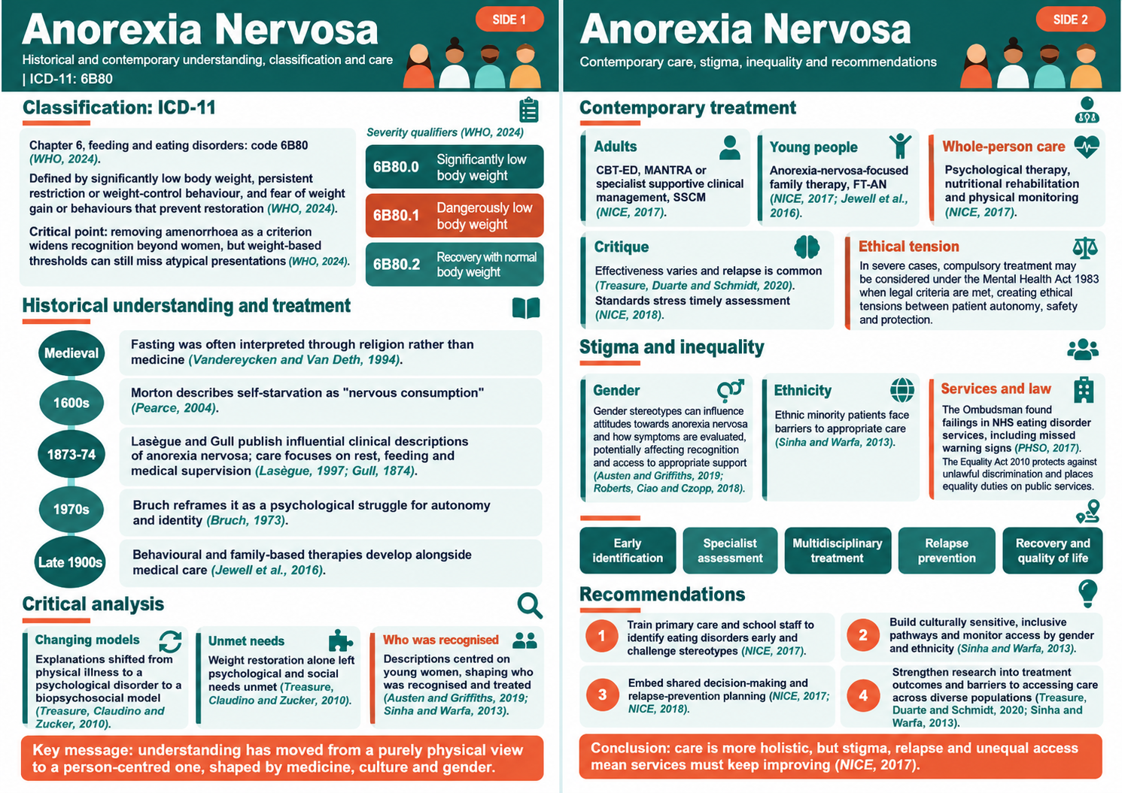

Slide 4
References
Austen, E. and Griffiths, S. (2019) 'Why do men stigmatize individuals with eating disorders more than women? Experimental evidence that sex differences in conformity to gender norms, not biological sex, drive eating disorders’ stigmatization', Eating Disorders, 27(3), pp. 267–290.Available at: https://doi.org/10.1080/10640266.2018.1499337 (Accessed 26 October 2026).
Bruch, H. (1973) Eating disorders: Obesity, anorexia nervosa, and the person within. New York: Basic Books
Legislation.gov.uk (2026). Equality Act 2010 c.15. Available at: https://www.legislation.gov.uk/ukpga/2010/15/contents (Accessed: 22 October 2026).
Gull, W.W. (1874) 'Anorexia nervosa (apepsia hysterica, anorexia hysterica)', Transactions of the Clinical Society of London, 7, pp. 22–28. Available at: https://doi.org/10.1002/j.1550-8528.1997.tb00677.x Accessed 26 October 2026).
Jewell, T., Blessitt, E., Stewart, C., Simic, M. and Eisler, I. (2016) 'Family therapy for child and adolescent eating disorders: A critical review', Family Process, 55(3), pp. 577–594. Available at: https://doi.org/10.1111/famp.12242 (Accessed:
Lasègue, E.C. (1873) 'De l’anorexie hystérique', Archives Générales de Médecine, 21, pp. 385–403. Available at: https://www.freud-lacan.com/documents-ged/de-lanorexie-hysterique/ (Accessed: 25 October 2026).
Legislation.gov.uk (2026). Mental Health Act 1983 c. 20. Available at: https://www.legislation.gov.uk/ukpga/1983/20/contents (Accesed: 22 October 2026).
National Institute for Health and Care Excellence (NICE) (2017) Eating disorders: Recognition and treatment. NG69.Available at: https://www.nice.org.uk/guidance/ng69 (Accessed: 20 October 2026).
National Institute for Health and Care Excellence (NICE) (2018) Eating disorders. QS175. Available at: https://www.nice.org.uk/guidance/qs175 (Accessed: 20 October 2026).
Parliamentary and Health Service Ombudsman (PHSO) (2017) Ignoring the alarms: How NHS eating disorder services are failing patients. London Available at: https://publications.parliament.uk/pa/cm201719/cmselect/cmpubadm/855/855.pdf (Accessed: 20 October 2026).
Pearce, J.M.S. (2004) 'Richard Morton: Origins of anorexia nervosa', European Neurology, 52(4), pp. 191–192. Available at: https://doi.org/10.1159/000082033 (Accessed: 20 October 2026).
Roberts, S.R., Ciao, A.C. and Czopp, A.M. (2018) 'The influence of gender on the evaluation of anorexia nervosa', International Journal of Eating Disorders, 51(10), pp. 1162–1167.Available at: https://doi.org/10.1002/eat.22917 (Accessed: 20 October 2026).
Sinha, S. and Warfa, N. (2013) 'Treatment of eating disorders among ethnic minorities in western settings: A systematic review', Psychiatria Danubina, 25(Suppl. 2), pp. S295–S299. Availble at: https://www.psychiatria-danubina.com/UserDocsImages/pdf/dnb_vol25%20Suppl%202_no/dnb_vol25_noSuppl%202_295.pdf (Accessed: 21 October 2026).
Treasure, J., Claudino, A.M. and Zucker, N. (2010) 'Eating disorders', The Lancet, 375(9714), pp. 583–593.Availble at: https://doi.org/10.1016/S0140-6736(09)61748-7 (Accessed 21 October 2026).
Treasure, J., Duarte, T.A. and Schmidt, U. (2020) 'Eating disorders', The Lancet, 395(10227), pp. 899–911. Available at https://doi.org/10.1016/S0140-6736(20)30059-3
Vandereycken, W. and Van Deth, R. (1994) From fasting saints to anorexic girls: The history of self-starvation. London: Athlone Press
World Health Organization (WHO) (2024) Clinical descriptions and diagnostic requirements for ICD-11 mental, behavioural and neurodevelopmental disorders. Availabe at: https://www.who.int/publications/i/item/9789240077263 (Accessed: 20 October 2026).

