Slide 1

Title Page
Name: Riccardo Sterling
Student ID: 2334990
Programme: BA (Hons) Leadership and Management Skills for the Workplace
Module Code: LCLM 5006
Module Title: Developing Emotional Intelligence Skills
Assignment Title : Component 1: Poster Presentation
Lecturer : Taonga Kaonga Sobere - Snithers

Slide 2
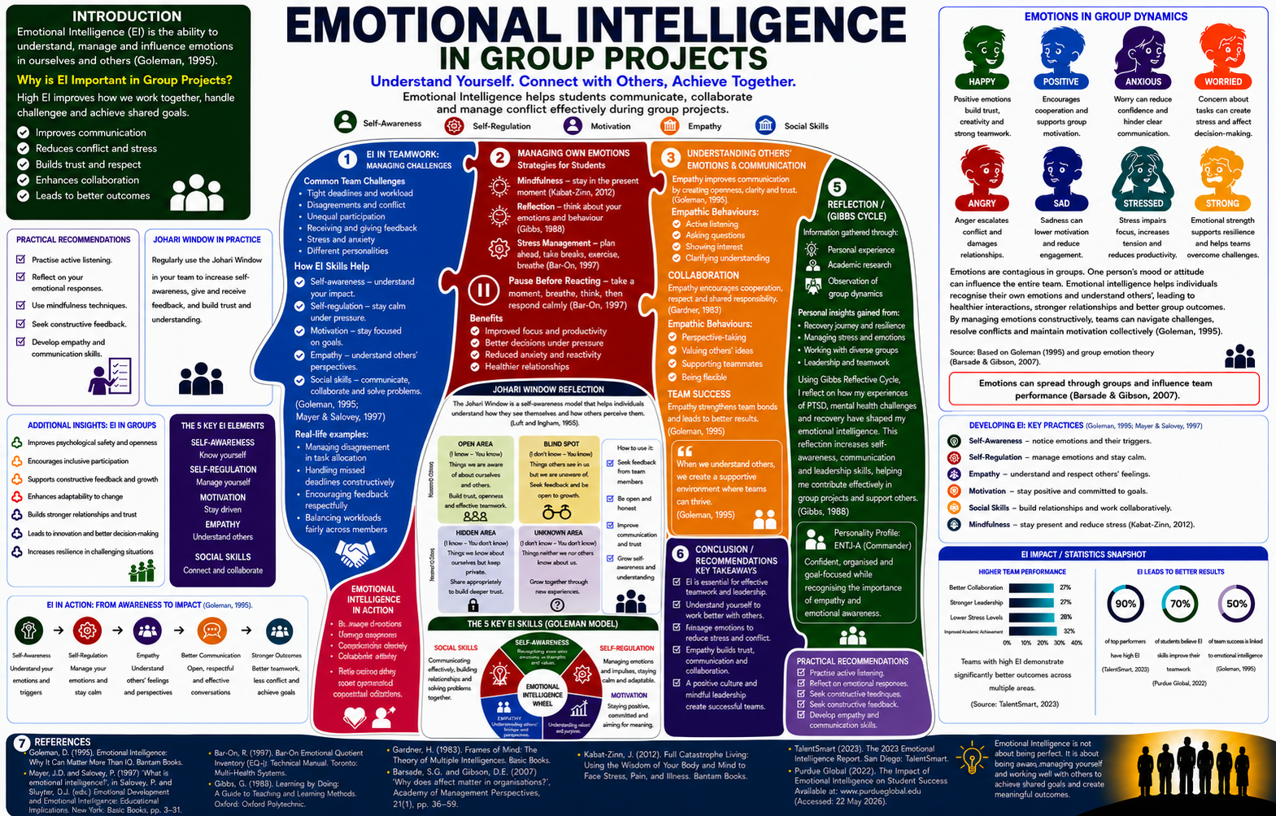
:
Title Page
University of Wales Trinity Saint David
Name: Riccardo Sterling
Student ID: 2334990
Programme: BA (Hons) Leadership and Management Skills for the Workplace
Module Code:LCLM 5006
Module Title: Developing Emotional Intelligence
Assignment Title: Component 1: Poster Presentation
Lecturer : Taonga Kaonga Sobere – Snithers

