Slide 1

Lecturer: Jolly Nwankwo
Module code: BMHP6022
Student name: Sana Sahir
Student ID: 2113594
Barough: Barnet
Circulatory diseases

Slide 2


Introduction
hklaureateforum.org|
A community refers to a collective of individuals who possess similar interests, values, and objectives. They are typically located in the same physical vicinity or connected through a shared virtual platform, such as a neighbourhood or online forum. They assist and engage with one another to attain shared welfare and promote social unity (MacQueen et al, 2001).
The community project aim to raise awareness and prevent from Circulatory diseases.

Slide 3
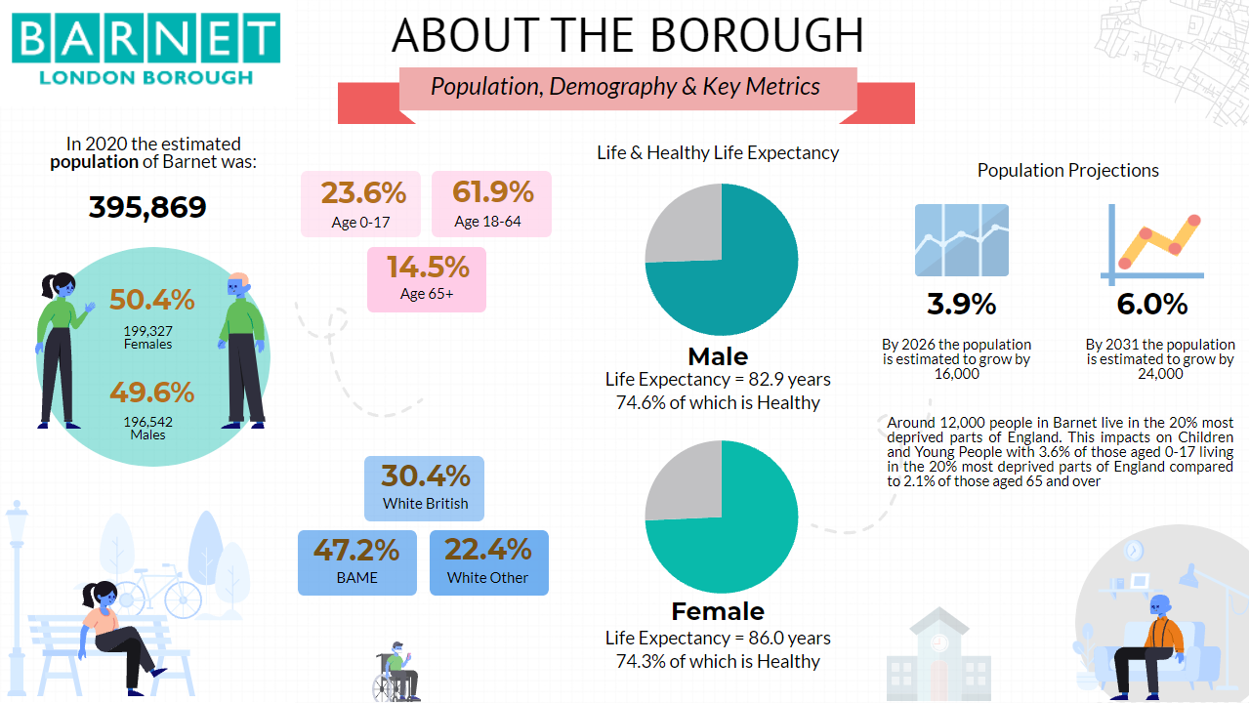
Demographics
Barnet is a borough located in the northern part of London. Barnet ranks number one in terms of population among the 32 London boroughs.
Demographics illustrate Barnet as a diverse and vibrant borough with a mix of age groups, ethnic backgrounds, and socioeconomic statuses (“Barnet Council”,2022).
open.barnet.gov.uk

Slide 4

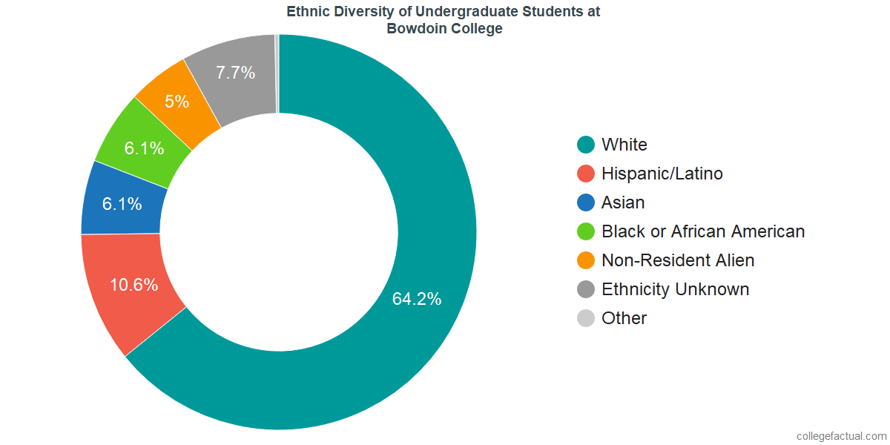
Demographics
Ethnic Composition:
White: 54%
Asian/Asian British: 21%
Black/African/Caribbean/Black British: 12%
Mixed/Multiple Ethnic Groups: 6%
Other Ethnic Groups: 7%
Religion:
Christian: 41%
Muslim: 10%
Jewish: 15%
Hindu: 7%
No religion: 20%
Other religions: 7%

Slide 5


Demographics
Languages:
Predominantly English spoken, with other common languages including Polish, Gujarati, Turkish, and Somali.
Housing:
Owner-occupied: 60%
Rented from private landlords: 25%
Social housing: 15%
Education:
High proportion of residents with higher education qualifications.
Several schools, colleges, and Finchley’s Middlesex University within the borough.
In Barnet Approximately 402,700 residents (as of the year 2023).
frederickinterpreting.com

Slide 6

support community development
https://www.bluecrestwellness.com
Increasing Health Screenings and Regular Check-ups:
Coordinate community health fairs offering complimentary or affordable screenings for blood pressure, cholesterol, and diabetes (American Heart Association, 2010).
Encourage routine medical examinations by utilising nearby clinics and healthcare professionals.
Enhancing Public Health Education:
Organise and deliver workshops and seminars focused on cardiovascular health, including discussions on risk factors and strategies for prevention.
Create and disseminate educational materials (brochures, pamphlets, online resources) on circulatory health (CDC,2024).

Slide 7

support community development
Promoting Physical Activity:
Establish community-oriented exercise initiatives such as organised walking groups, cycling clubs, and fitness classes.
Establish and uphold parks and recreational amenities to promote physical activity (WHO, 2017).
Encouraging Healthy Eating:
Promote the establishment of community gardens and farmers' markets to ensure the convenient availability of fresh produce.
Implement nutritional education initiatives in schools and local community centres (PHE, 2022)
drmageshcardiologist.com

Slide 8

support community development
Implementing Smoke-Free Policies:
Implement and uphold local regulations to decrease the prevalence of tobacco consumption in public areas.
Offer smoking cessation programmes and provide resources for residents (NHS digital, 2024).
Strengthening Community Partnerships:
Work with local businesses, schools, and non-profits to promote public health. Invite community leaders and residents to plan and execute health promotion activities (Raj et al, 2021).
uknhs.uk

Slide 9


stakeholders
NHS
Healthcare Providers and Organizations:
Local council
Community-Based Organizations (CBOs)
Educational Institutions
Businesses and Employers
Media and Communication Channels
Individuals and Families
https://hsqe.co.uk

Slide 10
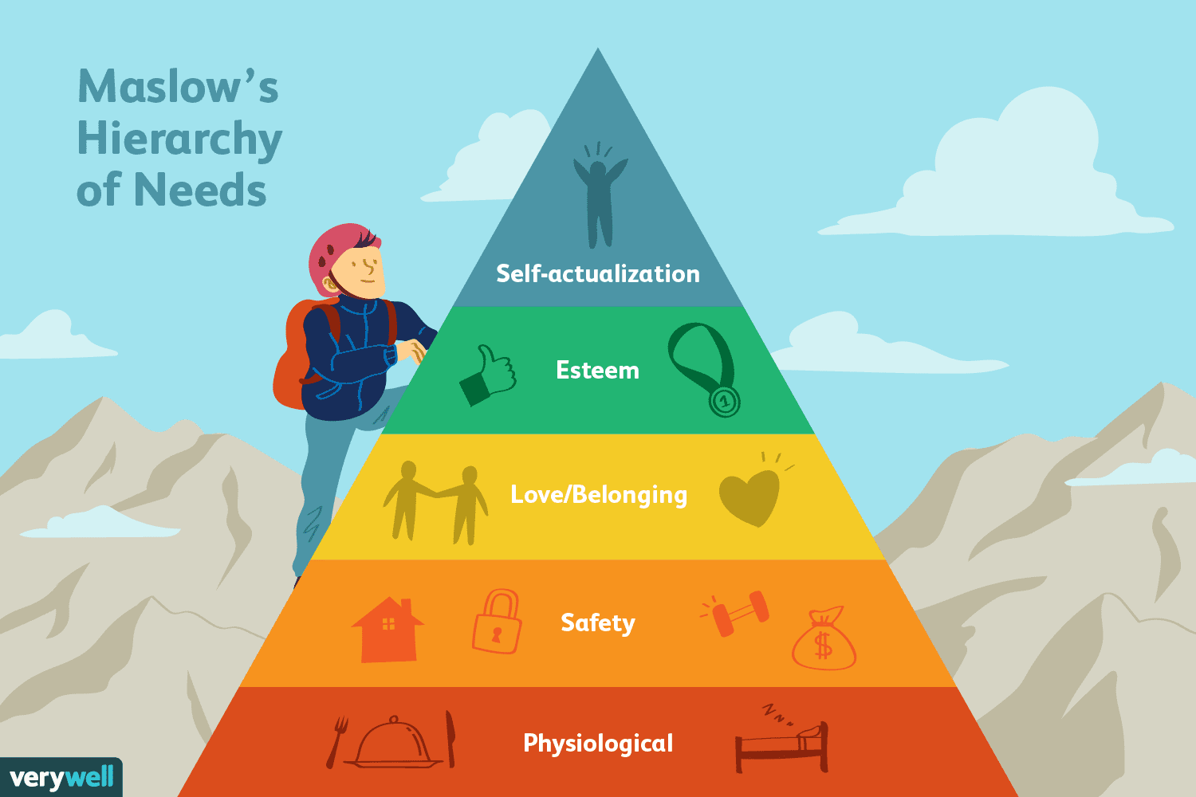
Theories
Maslow's Hierarchy of Needs applied to cardiovascular diseases emphasizes physiological needs like nutrition, exercise, and rest as fundamental for a healthy heart.
The hierarchy highlights the importance of safety, stressing the reduction of stress and anxiety to mitigate cardiovascular risk.
Social support and relationships play a crucial role in helping individuals cope with cardiovascular conditions and promoting self-care practices for improved heart health (McLeod, 2020)
Verywell Mind

Slide 11





Digital media
soaltescpnsbagus.com
pngimg.com
logodownload.org
seeklogo.net
1000logos.net
Public health campaigns can use social media to educate the public about CVD risk factors, symptoms, and prevention (NHS England,2014). Social media can also help CVD patients find emotional and practical support through support groups.
#PublicHealthAwearness
#LoveyourHeart
#Cardiovasculardiseaseawareness
#Healthyeating
#BarnetHeartHealth

Slide 12

legislation and policy
Policies
NHS Long Term Plan (2019)
Public Health England’s "Health Matters: Obesity and the Food Environment" (2017)
NHS Smoke-Free Policies
Legislations
Health and Care Act 2022
Health and Social Care Act 2008
Care Act 2014
Equality Act 2010
assignmentfirm.com

Slide 13
Barriers/obstacles to community development
Lack of Resources
Social Inequality
Limited Access to Services
Political Instability
Lack of Community Engagement
Environmental Challenges
Cultural Barriers

Slide 14
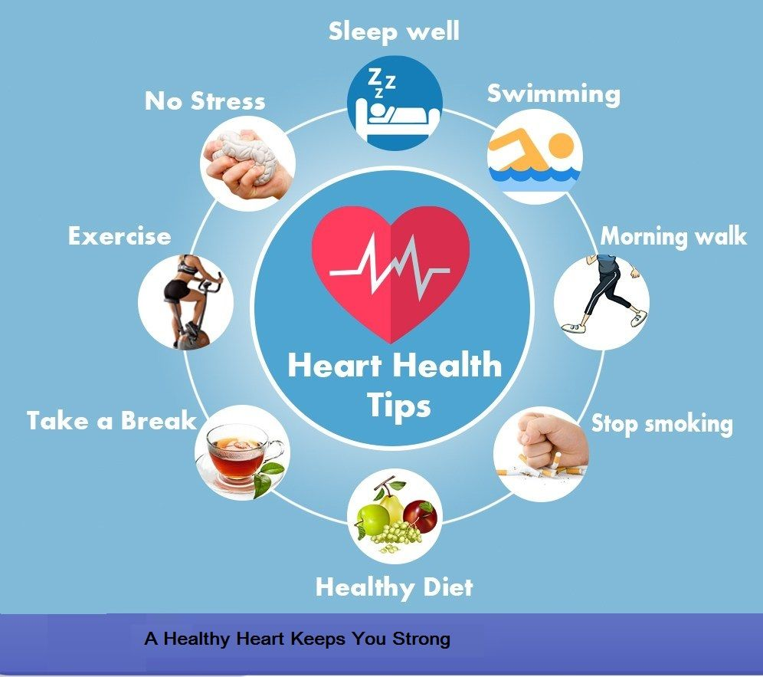
Recommendations
Dietary Health
Regular exercise
Quit Smoking
Limit Alcohol Intake
Control Blood Pressure:
Manage Cholesterol Levels:
Monitor and Control Blood Sugar:
Medications
Routine Check-ups
Reduce Stress
Pinterest.co.uk

Slide 15

Conclusion
The Barnet community project highlights the significance of implementing comprehensive strategies for cardiovascular health.
The project aims to enhance public health outcomes by emphasising balanced diets, regular physical activity, and comprehensive health education.
Social media can boost health messages and ensure a well-informed and proactive community. These health programs must also address funding, social inequality, and infrastructure issues.
Collaboration matters. The NHS, local authorities, community organisations, educational institutions, businesses, and residents must work together to advance this initiative. By promoting health and well-being, Barnet can lower cardiovascular disease rates and improve quality of life.
This project aims to reduce cardiovascular disease and build a healthier, more resilient Barnet community.
vectorified.com

Slide 16
References
MacQueen, K M, et al. “What Is Community? An Evidence-Based Definition for Participatory Public Health.” American Journal of Public Health, vol. 91, no. 12, Dec. 2001, pp. 1929–38, www.ncbi.nlm.nih.gov/pmc/articles/PMC1446907/, https://doi.org/10.2105/ajph.91.12.1929
World Health Organization. “Physical Activity.” World Health Organization, World Health Organization, 5 Oct. 2022, www.who.int/news-room/fact-sheets/detail/physical-activity.
Public Health England. “Health Matters: Obesity and the Food Environment.” GOV.UK, Public Health England, 2017, www.gov.uk/government/publications/health-matters-obesity-and-the-food-environment/health-matters-obesity-and-the-food-environment--2.
American Heart Association. “Heart-Health Screenings.” Www.heart.org, 22 Mar. 2019, www.heart.org/en/health-topics/consumer-healthcare/what-is-cardiovascular-disease/heart-health-screenings.
CDC. “About Heart Disease.” Heart Disease, 29 Apr. 2024, www.cdc.gov/heartdisease/about/index.html.
NHS digital. “Statistics on NHS Stop Smoking Services in England - NHS Digital.” NHS Digital, 19 June 2024, digital.nhs.uk/data-and-information/publications/statistical/statistics-on-nhs-stop-smoking-services-in-england.
.

Slide 17
References
“Integrated Care Systems (ICS) | NHS Confederation.” Www.nhsconfed.org, 25 June 2024, www.nhsconfed.org/publications/integrated-care-systems-ics#:~:text=Integrated%20care%20systems%20%28ICSs%29%20are%20partnerships%20that%20bring.
“Health and Care Act 2022.” Legislation.gov.uk, 25 June 2024, www.legislation.gov.uk/ukpga/2022/31/contents.
Cherry, Kendra. “Maslow’s Hierarchy of Needs.” Very well mind, 2 Apr. 2024, www.verywellmind.com/what-is-maslows-hierarchy-of-needs-4136760
Lockey, Andrew, et al. “Impact of Adult Advanced Cardiac Life Support Course Participation on Patient Outcomes—a Systematic Review and Meta-Analysis.” Resuscitation, vol. 129, Aug. 2018, pp. 48–54, https://doi.org/10.1016/j.resuscitation.2018.05.034

