Slide 1

Student name: Wuendy Fabiola Paz Ramirez
Student ID: 2442409
Module name: Psychology in Health and Social Care
Module code: LCHS4010
Lecturer name: Dr Farah Wiita
Assignment due date: 20 March 2026

Slide 2
Declaration of use of AI OR declaration of non-use of AI
AI tools were used only for proofreading and generating images.
All academic content and analysis were written in my own words.

Slide 3

Introduction
Jenny is sixteen years old.
For the past five years, she has taken care of her mother.
This presentation uses Erikson’s psychosocial theory.
It explores Jenny’s development and possible support.

Slide 4
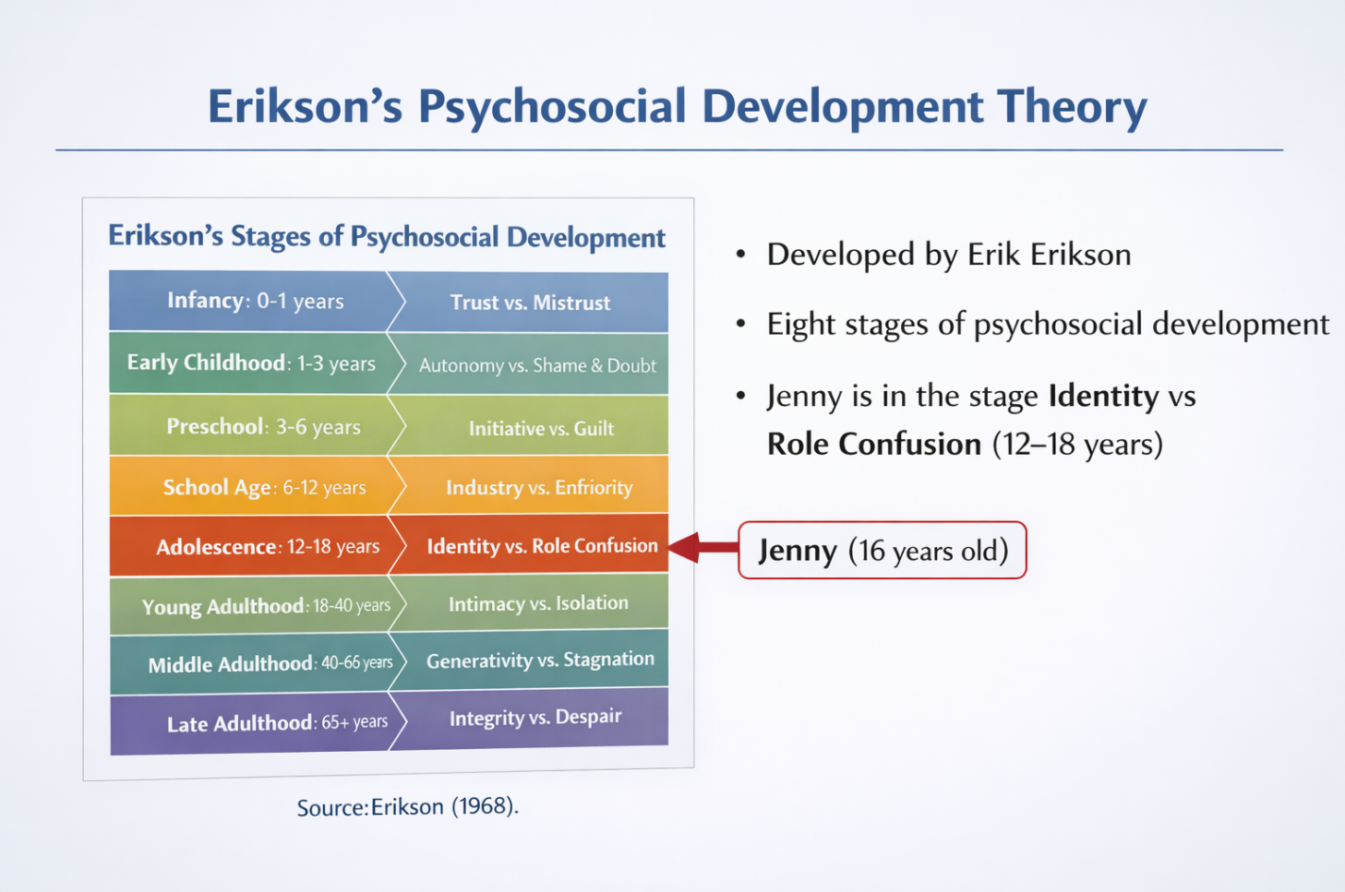
Erikson’s Psychosocial Development Theory
Developed by Erik Erikson.
Eight stages of development.
Each stage includes a psychosocial crisis.
These stages influence personal development.
(Erikson, 1968)

Slide 5

Identity vs Role Confusion.
Erikson explains that during adolescence (around 12-18 years), young people experience the stage called identity vs role confusion.
Young people begin to understand who they are.
They begin to develop independence.
They think about their future.
Successful resolution leads to a strong identity.
(Erikson, 1968; Santrock, 2019)

Slide 6
Link Between Theory and Jenny
Jenny has adult responsibilities
She cares for her mother
Less time for social activities
Possible impact on identity development
(Erikson, 1968; Santrock, 2019)

Slide 7

Impact on Jenny’s Development
Emotional stress
Increased responsibility
Less time with friends
Potential impact on academic performance.
(Santrock, 2019)

Slide 8
Biological and Environmental Factors
Biological Factors
Environmental Factors
Death of her father
Caring responsibilities
Family stress
Limited social life
Adolescence
Hormonal changes
Emotional and physical changes
(Berk, 2018)

Slide 9

Strategies to Support Jenny
Support strategies
Young carers support services
Emotional counselling
Support from school
Social services help for her mother
(Children’s Society, 2022)

Slide 10
Strengths of Erikson’s Theory
Explains emotional development
Focuses on identity during adolescence
Helps understand challenges faced by adolescents
(Erikson, 1968)

Slide 11
Conclusion
This presentation discussed Jenny’s situation as a young carer.
Erikson’s psychosocial development theory was used to understand her development.
Support strategies such as counselling and young carers services were suggested.
Erikson’s theory has strengths but also some limitations.
Supporting young carers is important to protect their well-being and development.

Slide 12
References
Berk, L.E. (2018). Development Through the Lifespan. Boston: Pearson.
Erikson, E.H. (1968). Identity: Youth and Crisis. New York: W.W. Norton.
Newman, B.M. and Newman, P.R. (2020). Development Through Life. Boston: Cengage.
Santrock, J.W. (2019). Life-Span Development. New York: McGraw-Hill.
Sawyer, S.M. et al. (2018). The age of adolescence. The Lancet Child & Adolescent Health, 2(3), pp.223–228.
The Children’s Society (2022). Young Carers in the UK. Available at: https://www.childrenssociety.org.uk (Accessed: 10 March 2026).

