Slide 1
BA Leadership and Management Skills for the Workplace
Developing Emotional Intelligence Skills for the Workplace
(BMSW6106)
Session 1
Module Induction

Slide 2
In this session we will…..
Set class rules
Overview the module

Slide 3

Getting to know ourselves
Let’s do a ‘virtual elevator pitch’
I am Dr. Tarila (Tari) Zuofa
t.zuofa@uwtsd.ac.uk

Slide 4
Classroom code of conduct
Refer to the classroom code of conduct
Key highlights-professionalism, transparency, respect, commitment
Notes:
Get the students to prepare their list and discuss them.
Then synchronise the points from each group to prepare a master list of class rules.
Generalise the expectations as mentioned in the key points of the slide

Slide 5

Module Overview
Title: Developing Emotional Intelligence Skills
for the Workplace
Module Code: BMSW6106
Credits: 20 (Level 6)

Slide 6
Activity
Prepare a list of topics that you would expect to learn from this module.

Slide 7
Aims and Learning Outcomes
Aims: To develop students’ understanding of the importance of emotional intelligence in the workplace and the relationship between emotional intelligence, effective management communication and business advantage.
Learning Outcomes
explore concepts of emotional intelligence and its relevance to the workplace;
understand and apply of models of emotional intelligence and evaluate theorists;
critically appraise the importance of emotional intelligence and mindfulness in the workplace.

Slide 8
Scheme of Work
Week 1 | Induction/ The concept of Emotional Intelligence
Week 2 | Components of Emotional Intelligence
Week 3 | Models of Emotional Intelligence
Week 4 | Emotional Intelligence and Performance at Work
Week 5 | Workshop
Week 6 | Leading, Culture, Ethics and Emotional Intelligence
Week 7 | Strategies for Enhancing Emotional Intelligence
Week 8 | Mindfulness
Week 9 | Revision
Week 10 | Individual Presentation

Slide 9
Assessment
Task 1: 10-12 minute individual presentation
Submission: 10/07/20 Presentation: 13/07/20
Task 2: Individual Report: 3500 + 10%
Submission: 24/07/20

Slide 10

The Assignment Brief is on Moodle

Slide 11
BA Leadership and Management Skills for the Workplace
Developing Emotional Intelligence Skills for the Workplace
(BMSW6106)
Emotional Intelligence

Slide 12
In this session
We will:
Describe Emotions and the common categories of Emotions.
Evaluate the concept of Emotional Intelligence
Appraise the common benefits of Emotional Intelligence

Slide 13
Emotions
Emotions transitory feelings or affective reactions that influence our behaviour.
Researchers have defined 8 categories of emotions, including: anger, sadness, fear, enjoyment, love, surprise, disgust and shame.
The purpose of emotions in general are to focus our attention and motivate us to action.

Slide 14
Activity
Think of a feeling you’ve had lately… What is it telling you to focus on? To do?
Can this be linked to any of the 8 categories of emotions?

Slide 15
What is Emotional Intelligence ?

Slide 16
Activity
Emotional Intelligence: What is it? Write down your definition
  (10 words or less)
  It does not need to be a complete sentence.

Slide 17
Activity
Emotional Intelligence: What is it?
Now, let us listen to the definitions of others
Are there any common words

Slide 18
Emotional Intelligence: What is it?
… let us compare to several “academic definitions” of the concept

Slide 19

Defining “Emotional Intelligence”
There is no ONE way of defining EI

Slide 20
Defining Emotional Intelligence
A person’s abilities to perceive, identify, understand, and successfully manage emotions in themself and others.
An individual's capability to identify and regulate emotions in themselves and others.

Slide 21
Defining Emotional Intelligence
The ability to monitor one's own and others' feelings and emotions, to discriminate among them and to use this information to guide one's thinking and actions” (Salovey and Mayer, 1990)
The ability of the person to recognize and express emotion, assimilate emotion in thought, understand and reason with emotion, and regulate emotion in yourself and others (Mayer, Caruso and Salovey, 2016)

Slide 22
Emotional Intelligence-key message
Everyone must learn how to understand and manage emotions in themselves and others.
Being able to effectively manage ourselves and our relationships with others.

Slide 23
Activity
Complete the checklist on Moodle
Be prepared to share your answers

Slide 24
Activity
Why do you think it is would be helpful to be emotionally intelligent?
Is it something you have, you are born with?
Can you develop this ability?

Slide 25
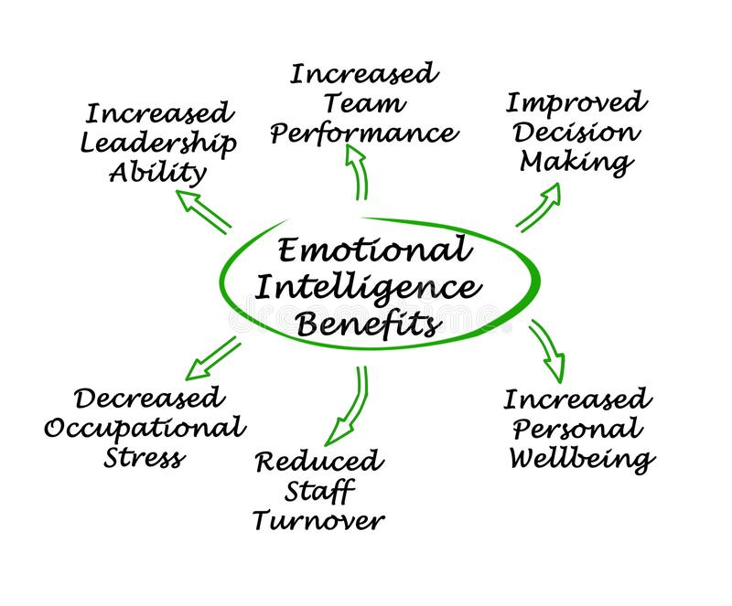
Benefits of Emotional Intelligence

Slide 26


