Slide 1
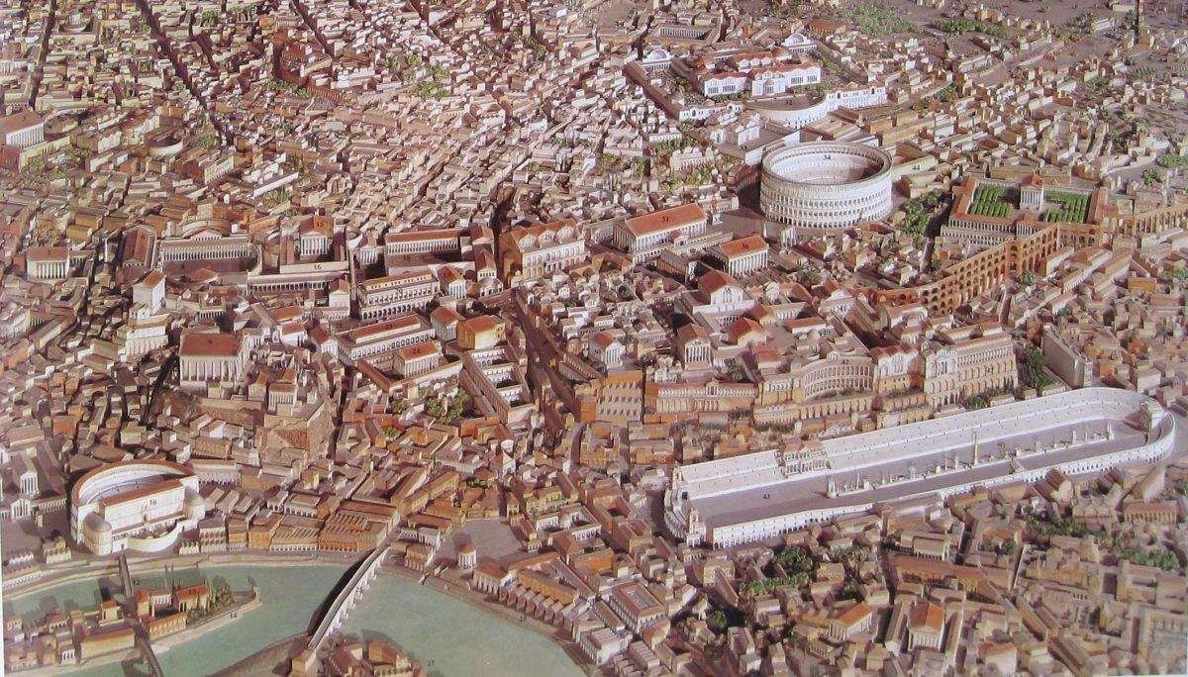
Everyday Life in Ancient Rome
Session one – part 1
Introduction
HPAH4001

Slide 2
What is Social History?
Social history – a study of a society and its cultural habits and values.
  How were these societies organised?
  What practices, concepts and institutions underpinned them.
  An attempt to understand the various levels of society and not just the elite.
Compare – Political-military history - a study of major political events and individuals who shaped them.
See also Economic history – arguably falls within social history - diverse areas from demography, productive capacity (esp. agricultural) and other phenomena such as trade.

Slide 3
Thematic Focus
Beliefs:
Religion
Funerary practices
Health and mortality:
Medicine and disease
Sanitation and housing
Intellectual activity:
Education
Philosophical and scientific enquiry
Survival:
Warfare
Politics
Economics
Society
Artistic expression:
Sculpture, painting, mosaics, etc.
Monumental architecture
Social stability:
Law
Order
Civil strife
Environmental disaster
Pleasure and morality:
Bathing
Banqueting
Sexuality
Entertainment
Social Structures:
Slavery and manumission
Social hierarchy
Gender expectations

Slide 4
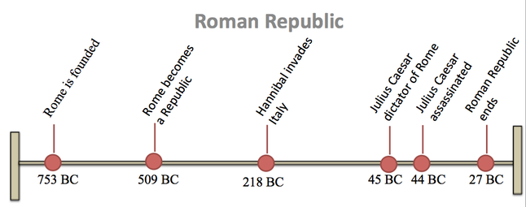
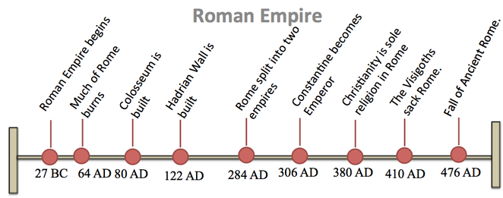
Chronology
RISE AND PEAK OF ROME – C.200 BC – AD 200.
Foundation and Rome under the Kings – 753-509 BC.
Early-Republic – c.500-c.mid-third century BC.
Mid-Republic – 264-146 BC (Punic Wars, 264-41, 218-201, 149-46 BC)
Late Republic – c.130‘s BC to 31/30 BC (Actium).
Imperial Period – Augustus to Alexander Severus.
“Third Century Crisis”.

Slide 5
The Source Material
Literary sources: history, geography, poetry, legal texts, political and rhetorical texts, etc.
Epigraphy/Papyrology:
  inscriptions on marble, stone, bronze, graffiti, and brick-stamps, ostraka, clay tablets, etc.
  study of writing on perishable materials such as parchment, wooden tablets, papyrus, etc.
Archaeological evidence: material unearthed in excavations, including non-perishable and perishable materials (latter rare).
Iconographic evidence: statues, images on pottery, wall-paintings, mosaics, reliefs, figurines, etc.
Numismatic: the study of coins and all aspects relating to them (this also includes the iconography on the coins).

Slide 6
Why Social History?
For its own sake – an inherent interests in how peoples in ancient Romans lived.
The reception, reinterpretation and reimagining of Roman culture in various periods throughout history.
  philosophy, literature, medical ideas, politics, art, etc.
Allows for a far more sophisticated and in-depth understanding of the histories of this culture as a whole: including in political-military and economic spheres.

Slide 7
Culture and Politics Intertwined
“…his favourite roles being those of Oedipus, Thyestes, Heracles, Alcmeon and Orestes. The masks that he wore were sometimes made to resemble the characters he was portraying and sometimes bore his own likeness; but the women's masks were all fashioned after the features of Sabina, in order that, though dead, she might still take part in the spectacle…” – Cassius Dio 63.9.5.
Kills his mother Clytemnestra – cf. Nero and Agrippina.
Morning for the loss of his deceased wife Sabina – purportedly kicked in the stomach while pregnant
Publicly performing on stage extremely controversial activity for a Roman emperor.

Slide 8
Understanding the Ancient World

Slide 9
Notions of Time
Modern conventions by which ancient history is dated
  Periodisation (e.g. Imperial period / Early Empire / High Empire)
  BC (Before Christ) and AD (Anno Domini – year of our Lord) modern alternatives BCE and CE.
Ancient calendars often based on religious or political system.
Usefully for use the Romans often designated the year by who the consuls were and sometimes referred to period from the foundation of the city (AUC).
Consulships (consular list begins in 509 BC).
- Ides of March in the year when the consuls were Julius Caesar for the fifth time, and Marcus Antonius = 15 March 44 BC - (assassination of Caesar).

Slide 10
Calendars
Roman calendar during Imperial period (reformed by Caesar)
Ianuarius
Februarius
Martius
Aprilis (Neroneus)
Maius
Iunius
Iulius (originally Quintilis)
Augustus (originally Sextilis)
September (Tiberius)
October (Livius)
November
December
Compare the Athenian calendar
Hecatombaeon– Jul/Aug
Metageitnion- Aug/Sep
Boedromion- Sep/Oct
Pyanepsion- Oct/Nov
Maemacterion- Nov/Dec
Poseideon- Dec/Jan
Gamelion- Jan/Feb
Anthesterion- Feb/Mar
Elaphebolion- Mar/Apr
Mounychion- Apr/May
Thargelion- May/Jun
Scirophorion- Jun/Jul

Slide 11
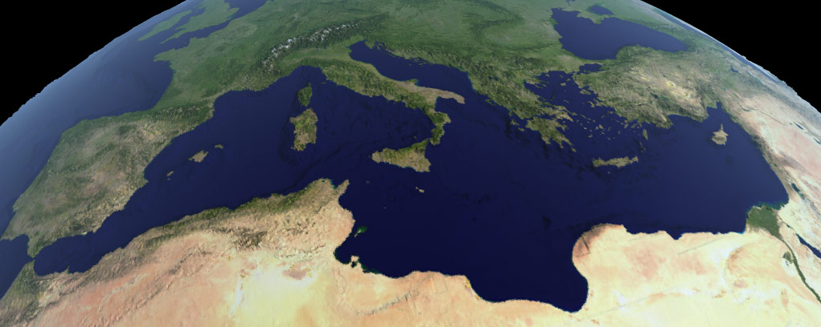
Conceptions of the World
Knowledge increases with conquest and trade.
Mediterranean remains best understood region.
The oikoumenē (Greek term) – the inhabited world.

Slide 12
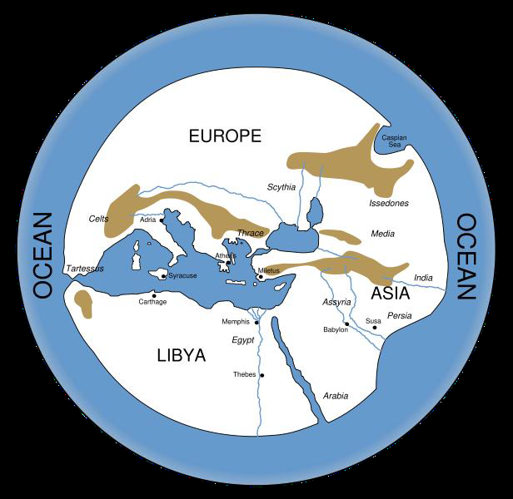
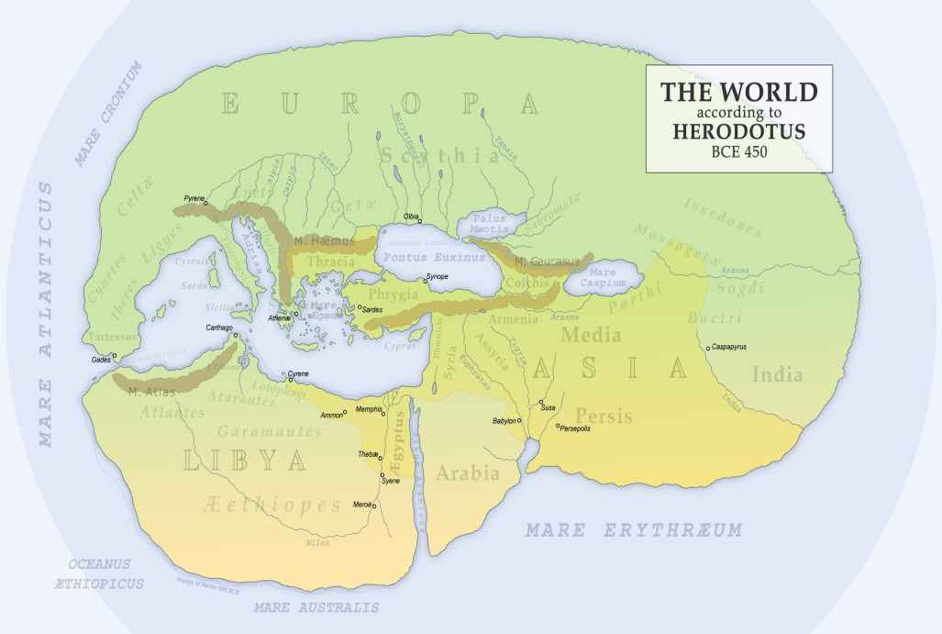
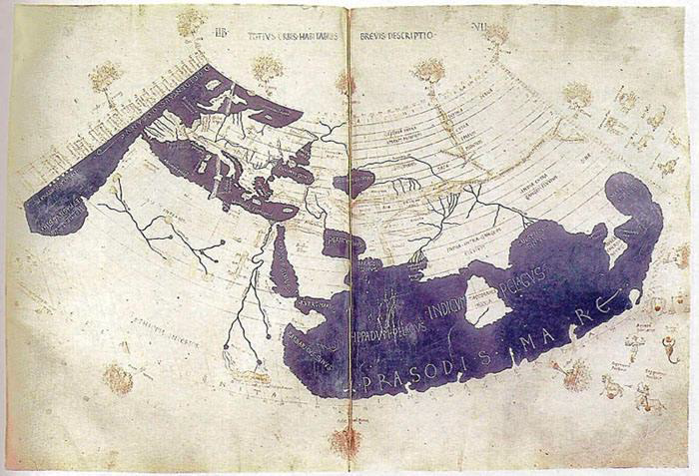
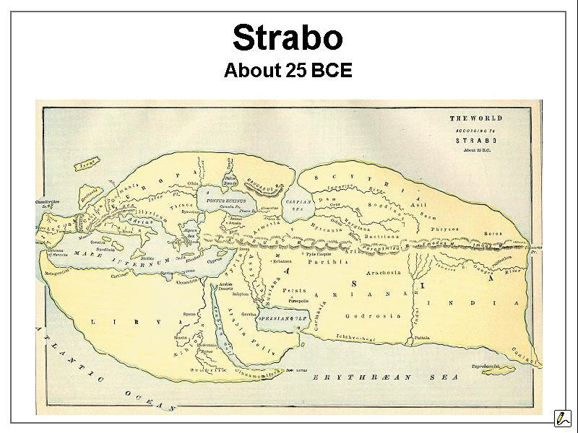
Based on Hecataeus‘ Circuit of the World – c.500 BC
Based on Claudius Ptolemy‘s Geography c.150 AD

Slide 13
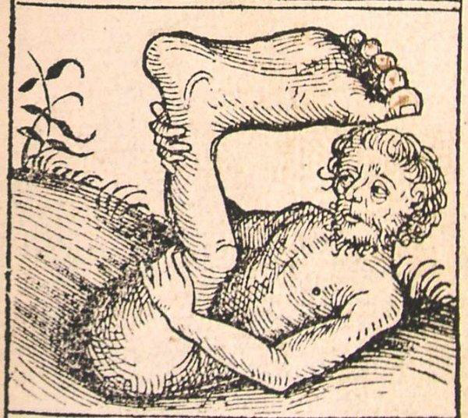
“Ctesias writes … of a tribe of men called the Monocoli, who have only one leg and hop with amazing speed. These people are also called the Shadow-feet, because when the weather is hot they lie on their backs stretched out on the ground and protect themselves by the shade of their feet.” – Pliny Natural History 7.21-23.
Image from the Nuremberg Chronicle (1493).

Slide 14
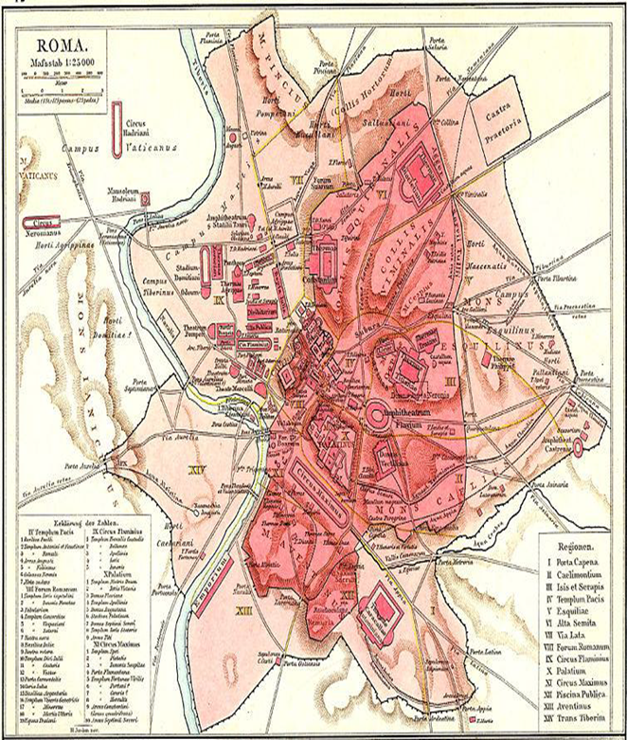
The City as Civilisation
Main centre around, Capitoline and Palatine hills:
  Seven hills:
    Palatine, Capitoline, Aventine, Caelian, Esquiline Viminal, and Quirinal hills.
Estimates for population of Rome during first and second centuries AD – c. 750,000 to somewhat over 1 million people.
Compare:
  Alexandria 300,000-600,000?
  Roman Carthage 500,000?
  Antioch-on-the-Orontes (Syria) 200,000?
  Most cities in the Mediterranean world far smaller.

Slide 15
Module Format

Slide 16
Lecture-Workshop Format
Block teaching module – c. 3 hour sessions.
Short lectures with workshop activities.
  Suggestions for preparatory reading are on Moodle, you may find it useful to do prior to the sessions.
  Additionally some general bibliography relating to the themes covered will be included at the end of the lecture slides.
  A number of different participatory activities will be included in the module.

Slide 17
Assessment Portfolio
Part 1
  Assessment: Multiple choice quizzes – 5 in total, top two highest marks awarded – 40%
    Session 4, 6, 8, 10 and 13
Part 2
  Assessment: Oral review (5 mins) – 10%
    Session 5
Part 3
  Assessment: Group presentation (15 minutes, with 5 minutes of questions) 25%
    Session 12
Part 4
  Assessment: Take home exam (1,000 words) – 25%
    Session 16

Slide 18
Useful Reading
Naerebout, F. G. and Singor, H. W. 2014: Antiquity: Greeks and Romans in Context. London: Wiley. – read introduction.
Ripat, P. 2014: “The Development of Roman Social History”, in Themes in Roman Society and Culture (eds., Gibbs, M., Nikolic, M., and Ripat, P.), Oxford: 1-22.

