Slide 2
Lloedd a Mannau i Ddysgu
Spaces and Places to Learn
Symud a Dysgu / Movement and Learning 29.4.2019
Iwan Ellis-Williams
l

Slide 3
Cyd destun AGA / ITE Context
Anghysur/anghyseinedd
Nid yw’n anghyffredin.
Damcaniaethau perthnasol
Eich stori
Gwireddu
Ymdrech
Offer defnyddiol
Addasu o tuag at y cysurus
Discomfort/Dissonance
It’s not unusual!
Relevant theories
Your story
Realisation
Effort
Useful tools
Adaption – towards increased comfort
Notes:
Discomfort - Natural human reaction – Festinger 1957 – avoidance
School system seems to cause a lot of it for some ITE students -
Not new – Gulbenkian Rep 1989 (teachers lack arts confidence) – Morgan/Bourke 2008– T’s wrongly link poor experiences = inability to teach. Smith 2013 reduction in arts importance. Russell Bowie 2013 – International phenomenon in Aus/SA/Malysia/Canada/ Ireland
Cognitive Conflict - All of us will have to teach these areas in future
Mindset - We all have the capacity to change our mindsets from fixed to growth (Gouge and Yates agree creativity is developmental and not a gift to some) - Dweck (we start off with FM about many things in ITE)
Language for learning – Adey and Shayer 2002 – Dev. A Language for L in these situations. Hattie 2018 – Need to develop a language to solve and talk about problems.
Resilience – Masten – Power of the ordinary – helping yourself and helping each other. Hattie - when students teach each other.
Environment – Beltman et al (2012) Environments imp for resilience – early teacher dev affects self efficacy. Our environment is vital.
Learning Pit – Nottingham (2017) concept of how we can deal with difficult learning in supportive groups.
Adaption -

Slide 4
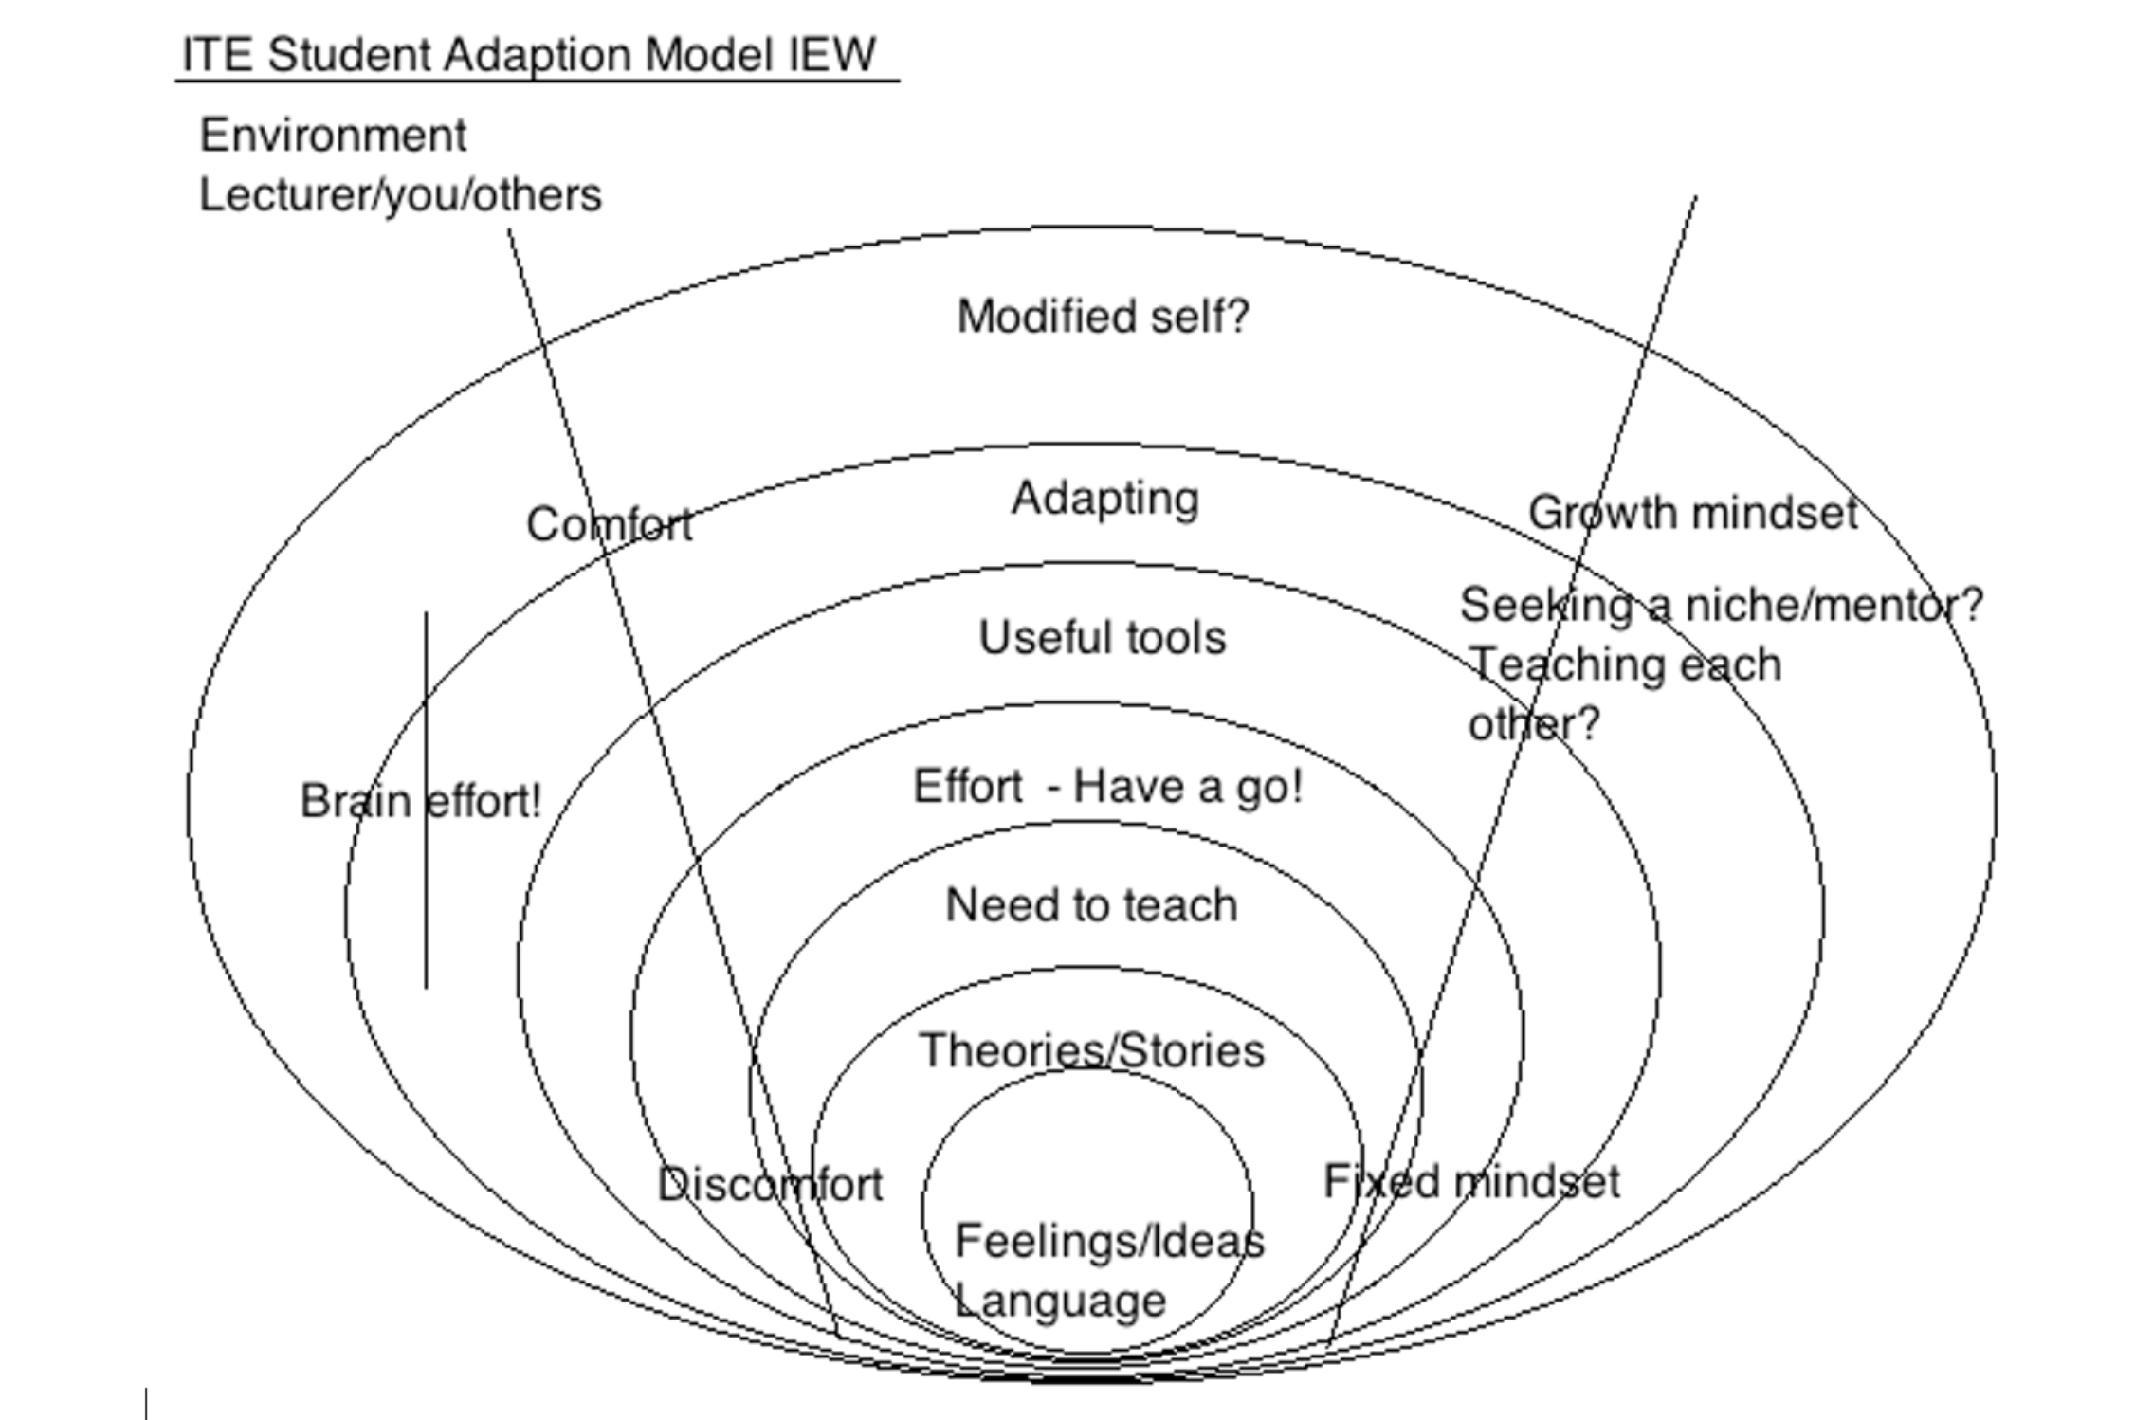
ITE Arts Positive Adaption Model/Model Addasiad Celfyddydol Bositif AGA

Slide 5
Edrych yn ôl / Looking back
4 pwrpas a symud
Profiadau symud o ansawdd uchel.
Disgwyliad o berfformio diogel.
Datblygiad Corfforol a Chreadigol CS.
Add Gorff CA2
4 purposes and movement
High quality movement experiences.
Expectation of safe performance
Physical and Creative Development in FPh.
PE at KS2
Notes:
FPh – Sgils across AoL’s - Oracy / Maths / Creative / Welsh / K+U world
Issues - Risk - Challenge - Time to practice (across the 7 areas) - indoors and outdoors. - Daily activity - (90’s music creative dance thing)
CS2 - Competitive - Health Fitness and Well being - Adventure - Creative
Perform efficiently (effeithlon) - Consistant - accuracy - Know what makes something successful - speak articulately - work out risk - adhere to rules - see connections to good health
Prac these did - Madagascar/Jac y Do – Skip – jump rope / Human Knot – heoght orfer – rope elephant / Hoop relay and ‘No’ game

Slide 6
Symud a Dysgu DD / Movement and Learning LO’s
I brofi ystod pellach o sgiliau sylfaenol gydag offer.
I godi ymwybyddiaeth o gysylltiadau damcaniaethol at weithgareddau dysgu.
I ystyried materion pedagogoaidd sy’n codi o gynllunio a threfnu profiadau ansawdd uchel i ddysgwyr.
I ystyried syniadau personol ar gyfer yr aseiniad.
To experience a further range of basic skills with equipment.
To raise awareness of theoretical links to learning activity.
To consider pedagogical issues arising from planning and organizing high quality experiences for all learners.
To consider personal assignment ideas.
Notes:
BF Skinner (1904-1990)- Behaviourism (stimulus/response – reward/punishment)
J Piaget 1896 - 1980 - Constructivism (Children construct image of world through experience – updating ‘schemas’ like a smartphone on a regular basis as life moves on.)
A Bandura 1925 - Social Learning Theory - Noticed children selecting ‘modelled’ behaviours to imitate by others in their own environment.
Lev Vygotsky 1896 - 1934 - Agreed with Piaget on constructivism that L was created socially by children but Vygotsky also considered adult intervention to be significant.
Dyson and Casey (2016) - Co-operative Learning - Features – Interdependence on each other / face to face interactions / Doing your bit (taking responsibility) / Interpersonal and group skills / Team talk
Kirk D. and McPhail A., (2002) Teaching Games for Understanding and Situated Learning: Rethinking the Bunker and Thorpe Model. Journal of Teaching in Physical Education. Vol 21. P.p. 177-192 - - - Appreciate game / Talk tactics / Talk decision making / Consider skill-performance / Modify if necessary

Slide 7
Ystyried offer / Considering equipment
Materion cadw
Cyfrifoldeb (ADGDF)
Risg
Cario /defnyddio/gosod
Dychwelyd at y storfa
Gosod disgwyliadau uchel
Storage issues
Responsibility (ESDGC)
Risk
Carrying /using /placing
Returning to storage
Establish high expectations
Notes:
ESDGC - Choices and decisions / Consumption and Waste / Health / Climate change (responsibility) - Natural Environment / Identity and culture / Wealth and poverty
Estyn Supplementary Guidance 2013 - Health and Well Being of Future Generations Act 2015
This act talks of (for Wales) Global Responsibility / Prosperous/Resilient / Healthier /More equal / Cohesive Communities / Vibrant culture and thriving Welsh Lang
Consider practical issues regarding resources
Question following PTE exp - Consider use of equipment on yard or field – Share experiences. How transferable are classroom management skills from indoors to outdoors? Any implications - 5 minute chat and feedback.
Discuss Risk Assessment - Do one for today – slips and trips / clashes of bodies etc - control measures – judgement. - Do it with other people

Slide 8
Sgiliau (ag offer bychan) / Skills (with small equipment)
Ochrgamu/Rowlio dan ysgwydd/Dal gwrthrych/Cicio pêl/Taflu â dwy law/Bownsio pêl/Taflu dros ysgwydd/ Driblo â’r traed / Driblo â’r dwylo/Trapio â’r traed/ Taro gwrthrych â’r dwylo neu fat
Dodging / Underarm roll / Catching an object / Kicking a ball / two handed throw / bouncing a ball / overarm throw / dribbling with feet / Dribbling with hands /trapping with feet / Striking an object with hands or bat
Notes:
30 minute carousel in groups of three - Become expert in your skill card – Demo/model and teach the rest of the group. Organise equipment and space for
Dodging / Underarm roll / Catching an object / Kicking a ball / two handed throw / bouncing a ball / overarm throw / dribbling with feet / Dribbling with hands /trapping with feet / Striking an object with hands or bat
Consider element of useful Peer/ Self - assessment
And 4 purposes Pedagogy - What is it? What will we do that is different? More detailed analysis in 2nd lecture
Healthy confident – Enterprising creative contributors – Ethical informed citizens - Ambitious capable learners

Slide 9
Syniadau Aseiniad Ymweliad a’r Traeth / Beach Visit Assignment Ideas
Defnydd gerddi/parth
Twrnament Tywod
Gemau grŵp/ dosbarth cyfan
Materion diogelwch
Use of gardens/zones
Beach Olympics
Group/whole class games
Safety considerations
http://www.rospa.com/rospaweb/docs/advice-services/leisure-safety/groupsafety-watermargins.pdf
Notes:
Explore YCC links beach History?
http://www.pembreycountrypark.wales/things-to-do/history-of-pembrey-country-park/
Manufacture of gunpowder at Pembrey 1881 / Royal Ordnance Factory WW1 / WW2 last bombs disposed of by 1960’s – closed 1965 – LBC began turning into the Park we know today from the 1970’s onwards.
Safety Considerations - Water Margins - Tide – dogs – people – pollution - jelly fish – hidden rocks/debris - weather considerations (and any other).

Slide 10
Gêm dosbarth / Class game
Bŵm!!
Helpwch eich gilydd i ddarganfod llwybr diogel trwy’r bomiau sy’ heb ffrwydro
Boom!!
Help each other find a safe route for the class through the unexploded bombs!
Notes:
Play Iwan’s prepared route
Then split group in two to prepare two more routes?
Any creative modifications? Try developing it with post it notes.

Slide 11
Cyfeirnodau / References
Gadd J., Rhys-Jones K., Rainer P. and Meadows S. (2009) Play to Learn: Technical Skills Manual. Welsh Assembly Government
Department for Education and Skills. (No date). Group Safety at Water Margins. Available at: http://www.rospa.com/rospaweb/docs/advice-services/leisure-safety/groupsafety-watermargins.pdf
Well Being of Future Generations Act (2015) Welsh Government. Available at: https://futuregenerations.wales/wp-content/uploads/2017/02/150623-guide-to-the-fg-act-en.pdf
Supplementary Guidance: Education for Sustainable Development and Global Citizenship. (2013). Estyn. Available at: https://www.estyn.gov.wales/sites/default/files/documents/Supplementary%20guidance%20-%20ESDGC.pdf
Carmarthenshire County Council (2018) Pembrey Country Park and Beach. Website. Available at: (http://www.pembreycountrypark.wales/things-to-do/history-of-pembrey-country-park/

