Slide 1

Welcome to the University’s new Online Learning module at L5.
Changemakers: Creativity & Value Creation.
Enhancing Creativity & Innovation in the 21st Century.
This Photo by Unknown author is licensed under CC BY-SA-NC.

Slide 2
Introduction
Welcome to the module: Changemakers: Creativity and Value Creation.
In today’s slide deck we will be looking at the module’s:
    Aim, Content and L&T strategy.
    Student groups.
    Assessments.
    Structure of the module.
    Online content.
    This week’s Activities.
    Informal Q&A session.

Slide 3
Version 2
Last Sept. the University launched new online learning modules throughout all its undergraduate programmes. We are running v.2 of the module, updates include:
- Reduced online learning content and weekly learning activities.
+ More content to support the ‘Computing Innovation Project’.
+ New Assignment tasks that support the ‘Computing Innovation Project’.
+ More time for students to work on their ‘Computing Innovation Project’.

Slide 4
Module Aim:
The aim of the module is: To develop the concepts and practice of creativity and value creation for the development of innovative, aspiring and progressive solutions.
Upon the successful completion of this module, you will be able to:
  Demonstrate knowledge and a critical understanding of innovation & creativity and recognise the values & the contribution creativity makes to the common good.
  Conceive, articulate and apply creative thinking to develop novel solutions.

Slide 5

Module Overview:
Creativity Innovation and New Technologies add value and enhance many areas of our lives.
The module looks at the contribution of innovation and creativity.
How it shapes society and the way we live and work.
It takes an integrative approach, demonstrating the relationship between many academic perspectives, the module draws on evidence, theories, concepts and frameworks from a multidisciplinary viewpoint.
The module is designed to help you gain innovation and project skills, to identify and pursue opportunities, to develop ideas and generate value. These skills include creative problem-solving to develop practical innovative solutions.
During the course of the module you will be tasked with creating an idea and developing a solution that could add value to society.

Slide 6
The Module – Simply put:
The module is about:
Innovation.
New & Emerging Technology.
Personal interest.
A ‘Computing Innovation Project’ of your choice.
Time and Project Management.

Slide 7

L&T Strategy:
The Module is entirely online.
Supported by Weekly Support Tutorials via MS Teams. Links to join are on Moodle.
Learners to progress through each Assignment task sequentially.
Support resources will be located on Moodle.
Assessment = 2 Assignments.

Slide 8


Groups & Teams links:
View: Student Group Spreadsheet located in the Module on Moodle.
MS Teams tutorials:
  Group 1 - Tues. 11am:
  Click here to join the meeting.
  Group 2 - Tues. 2pm:
  Click here to join the meeting.

Slide 9
Assessment = 2 Assignments
Assignment 1 = Produce an e-portfolio to show your project idea and planning.
  Assignment 1 includes 4 tasks:
  Innovation & ideation Mind Map (250 words) - on the content of Topic 1 of Unit 1 on Moodle.
  Project Ideation (250 words) - where you select and describe your idea.
  3a.: Project Poster – where you illustrate your idea and Project scope.
  3b.: Project Planning Chart – where you plan & illustrate your project stages.
  Upload each of your task answers to your Online project portfolio.
  You will be guided to complete each Assignment task as we proceed each week.
Assignment 2 = a Video presentation to showcase your Project design and practical work.

Slide 10

Assignment Location & review:
1. Show location on Moodle.
2. Show Turnitin links.
3. Review each Assignment.
Tutor: Open and share.
Note: Assignments are Available to download from Moodle.
* Subject to minor changes due to the verification process.

Slide 11

Assignment 1: Project Ideation & Planning
Assignment 1 = Online e-Portfolio.
Task 1: Innovation & ideation Mind Map (250 words).
Task 2: Project Ideation (250 words).
Task 3: 3a.: Project Poster.
Task 4: 3b.: Project Planning Chart.
Submission date: Thursday 14th June.

Slide 12

Assignment 2 = Design & Practical work
Assignment 2 = 4–5min. Video presentation.
Video presentation to showcase your Project’s Design & Practical work.
Submission date: Thursday 15th July.

Slide 13

Pin: Indicative structure of the module:
Wk 1: A1T1 = Moodle Unit 1 Topic 1 and ideation.
Wk 2: A1T2 = Project ideation.
Wk 3: A1T3 = Project Planning: Project Poster & Chart.
Wk 4: Assignment 1 Support and submission (14th June).
Wk 5: A2T1&2 = Project Design work.
Wk 6: A2T3 = Project Development work.
Wk 7: A2T3 = Project Development work.
Wk 8: A2T3&4 = Project Development work.
Wk 9: Assignment 2 Support and submission (15th July).

Slide 14

Online content: Unit 1 Topic 1
This week we will proceed through the module’s generic Online learning content in Topic 1 - How Innovation Changes the World, located in the Unit 1 - Ideas & Values tile on Moodle.
Topic 1 consists of 3 Session Activities (Approx. 45min each):
  Session 1: Innovation & Society.
  Session 2: Creating the Future.
  Session 3: Creativity & Society.
Each Session includes 1/2 Activities where you will be asked to post the answer in either the module forum, private blog or Padlet Wall.
  There are 10 marks available for going through Topic 1’s Online content and completing the activities.

Slide 15
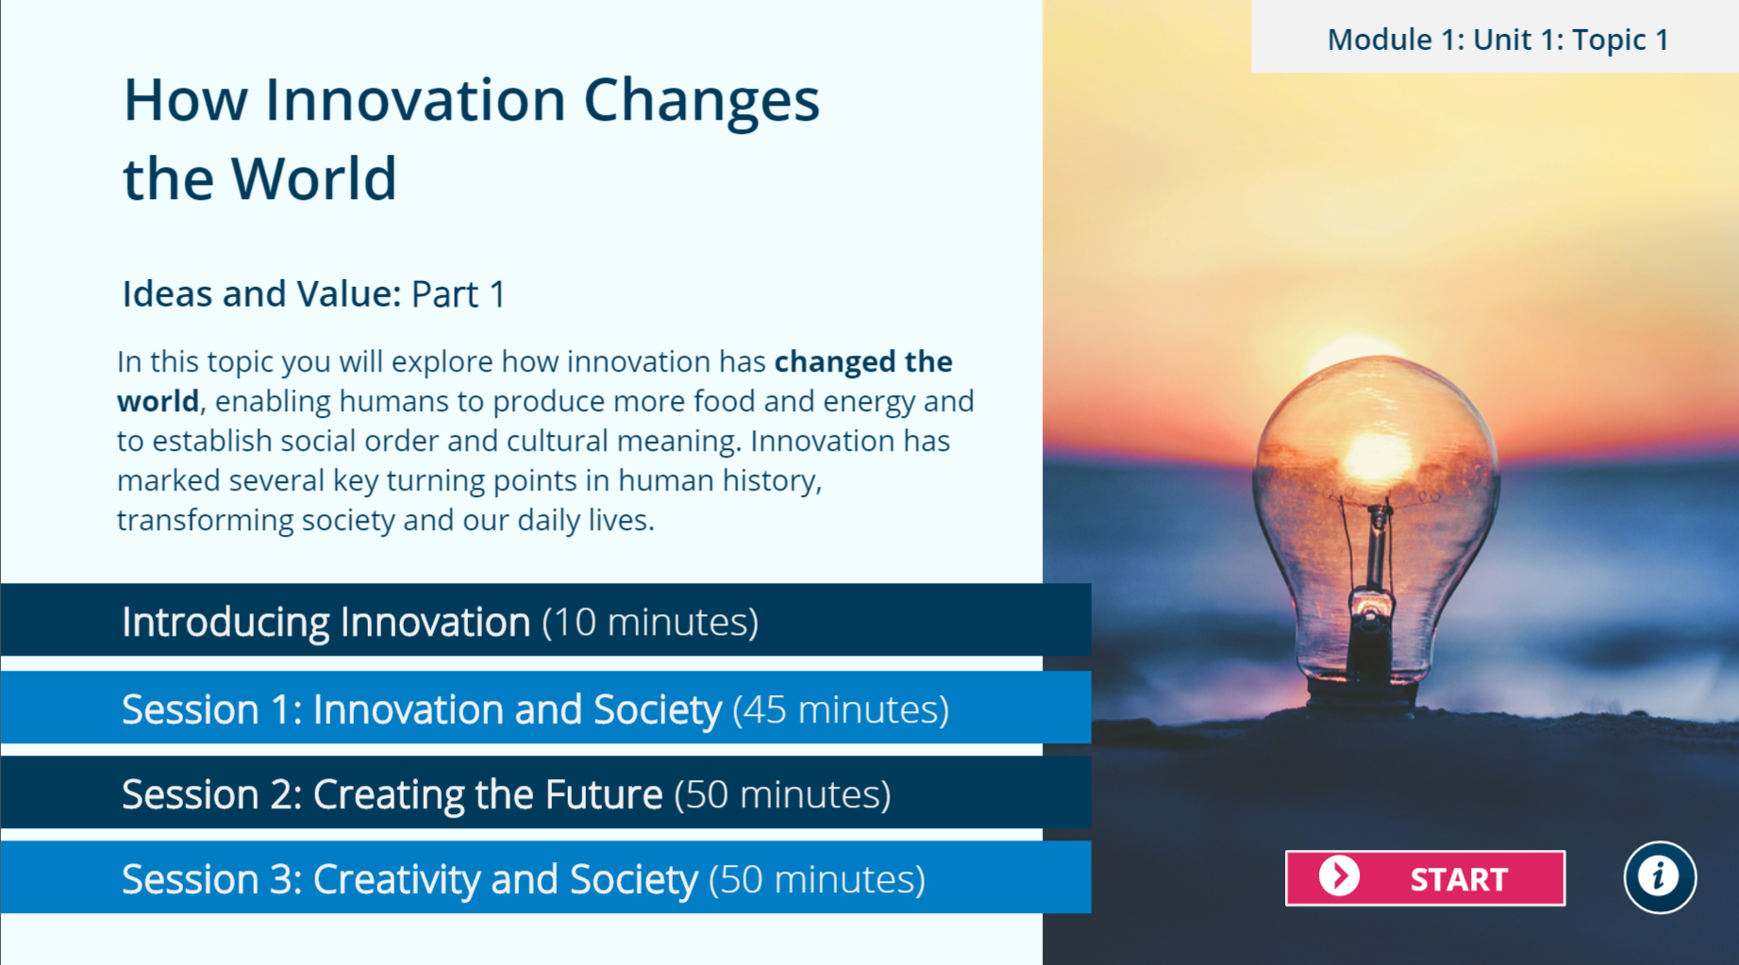

Moodle view:

Slide 16






Week 1 Tip: Favourite Snacks & Beverage.
This Photo by Unknown Author is licensed under CC BY-SA
This Photo by Unknown Author is licensed under CC BY-NC-ND
This Photo by Unknown Author is licensed under CC BY-SA
This Photo by Unknown Author is licensed under CC BY-SA
This Photo by Unknown Author is licensed under CC BY-SA

Slide 17

Forum emails:
You can unsubscribe from forum posts when you start to receive email notifications in your student inbox that others are posting in the forum.
* UNSUBSCRIBE *

Slide 18

Task 1 of Assignment 1:
Topic 1 of Unit 1 on Moodle = Mind Map of 250 words.
Create a mind map that refers to some of the topic’s concepts & some of your answers to activities from Topic 1 of Unit 1 on Moodle.
You can decide which concepts & answers to include.
Your mind map should be no more than 250 words and produced using freely available Online Mapping technology of your choice or an Office 365 Application.
The mind map should include citations and a reference list node (using the IEEE referencing standard).

Slide 19

Task 1 tip 2: Mind Map.
Creating a Mind map: There are many free Mind mapping tools available to download or use online such as:
  Coggle.it
  GitMind.com
  Ayoa.com
  Canva.com (see MindMap templates)
  Google free Mind Map Apps to integrate in Google docs.
  Office365 Apps such as PowerPoint and even Word can be used, although NOT recommended.
  Bg. Note: Mindmeister.com is a very good and popular Online Mindmap tool. However only the premium plan allows you to include an image. As a result, you could look at using an alternative Mapping tool such as the ones above that allow you to do this for free.

Slide 20
Online content:
The remainder of the module content is contextualized for ‘Computing innovation projects’ and will be located in the ‘Additional/Support resources’ tile on Moodle.
These resources will be introduced to you each week during the Online support sessions via MS Teams.

Slide 21
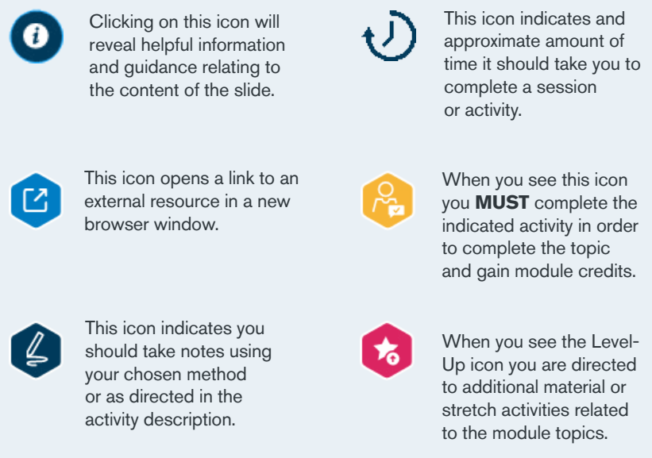
Navigating Through the content:
More info:
As you work through the online content you will see the following icons:
Helpful information and guidance.
Open link to an external resource.
Make notes using your chosen method or as directed.
Approximate amount of time to complete the activity.
Essential Activity completion to gain marks.
Level-Up icon for optional additional learning material.

Slide 22

The Key to Success
The key to success in this module is to try and make Weekly progress.
You will not be able to leave it until the last minute.

Slide 23
This week’s Activities to complete:
Topic 1 of Unit 1 Online Learning content on Moodle; &
Task 1 of Assignment 1: Mind Map.
Schedule in your diary /\.

Slide 24
Register.
Tutor note: Save / Download participant list from teams.

Slide 25

Questions.
Q&A.

Slide 26

Student Social & Peer Support
(Chat & Support each other)

Slide 27
The End.

Slide 28
Archive slides
Next.

Slide 29
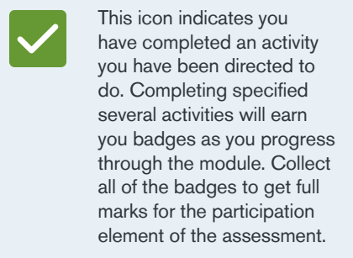
Navigating Through the Module
COMPLETION OF ACTIVITIES will EARN YOU MARKS AND BADGES towards the participation assessment element of the module.
You will need to post in the forum, blog and padlet when prompted to earn the rewards.

Slide 30
Project Idea and Innovation:
Your ‘Changemakers project’ is an opportunity for you to learn and develop new & up-to-date skills.
You can use new or emerging technologies or existing traditional technology in a contemporary way.
You could learn a new technology of interest to you e.g. such as AR/VR testing, Web App. Dev. (PWA Progressive Web Application), Mobile App dev, Game des./dev. or Cloud tools (e.g. testing new Cloud based AI tools), Containers or Container Management (Docker / Kubernetes) or if you'd always wanted to learn python and wanted to use it for AI, or Game des/dev, Create/Contribute to an Online Open Source Project, a electronics solution using a Rasp.Pi/Arduino, CyberSec tools for penetration testing and system hardening, a Digital Marketing solution, etc.. you could do something like this for your project and document what you have learned and why** you have done it. These are only a few examples.
  Bg. note: If using CyberSec or Digital Marketing tools, as these projects may not involve creating a prototype, after testing such tools you could write a short article/blog post on some best practices learned and gained from the experiments for SMEs/Charities/CICs to meet the social benefit aspect of the module.
You will need to state a purpose for your project e.g. that the Technology could help to serve society / the community / an Organisation / a group of people in some way. Perhaps to offer an Application/tool product or service that would add value and benefit society, to raise awareness, to heal a pain, to educate and provide a learning and development opportunity or a social group ./ networking opportunity – to bring people together, or to simply solve a problem.
Ultimately the project will help you to learn new skills and whatever you create will also have an intended outcome of benefiting society in some way.

Slide 31
Computing Innovation Project
Your project should help you to develop new up-to-date skills.
Your project should be of interest to you and Computing related.
In addition to learning new skills, your project will need to have a purpose, to add value and benefit society in some way.
Due to the time limitations, be careful to limit the scope of your project.

