Slide 1
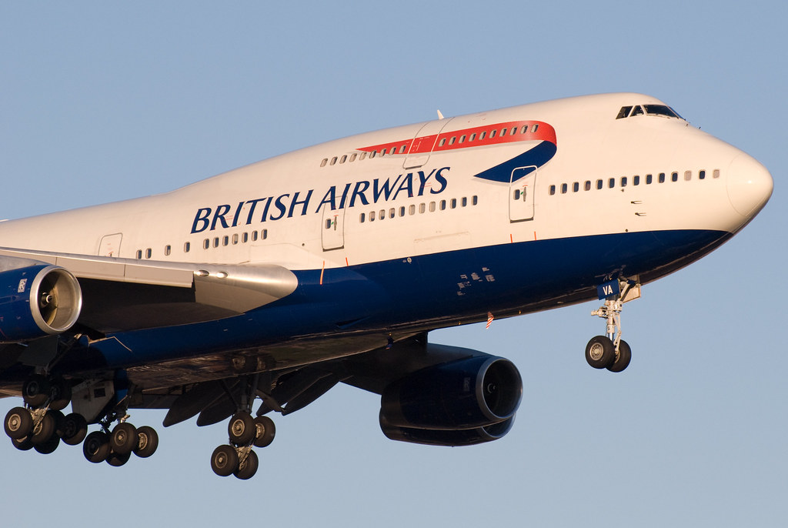
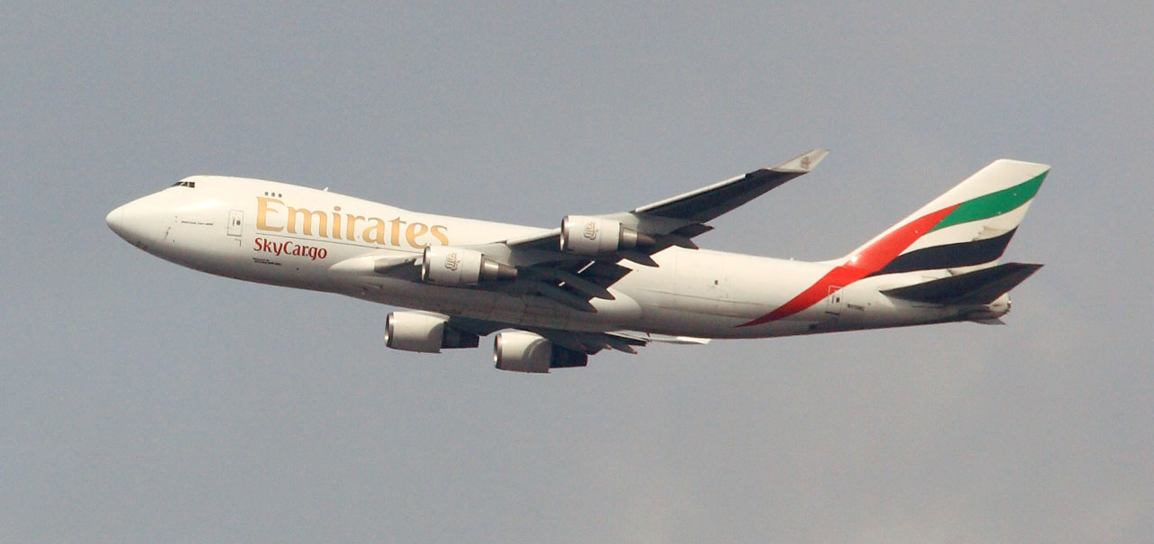
Task 2- individual presentation
Strategic Knowledge Management: A Comparative Analysis of Emirates and British Airways
Student Name: Samir Mhanna
Student Number: 2119514
Lecturer Name: Samuel Ofori
Knowledge and Information Management Skills for the Workplace
Module Code: (BMSW5106_BIRM)
2023

Slide 2
Introduction
In the competitive aviation industry, effective Knowledge Management is key to operational excellence and strategic innovation (Kassem and Ganepola, 2022).
Knowledge Management involves systematically gathering, organizing, sharing, and analyzing information to enhance decision-making and efficiency within an organization (Ode and Ayavoo, 2020).
This presentation explores a side-by-side analysis of how Emirates and British Airways, are two leading giants in the aviation sector uniquely approach and implement their Knowledge Management strategies.

Slide 3

Emirates and British Airways: A Comparative Overview
Emirates:
  Founded in 1985, headquartered in Dubai, UAE.
  Operates the largest fleets of Airbus A380s and Boeing 777s.
  Pivotal in establishing Dubai as a global aviation hub.
British Airways:
  UK's flagship carrier established in 1974.
  Main hub at London Heathrow, serving over 160 destinations.
  Known for innovation, customer service, and safety focus.
Shared Highlights:
  Leaders in international aviation with a global network.
  Committed to sustainability and customer-centric services.
  Invest heavily in technology and knowledge management for operational excellence.

Slide 4
Knowledge Management System SWOT Analysis of Emirates and British Airways
 | Emirates | British Airways
Strengths | Robust IT infrastructure, knowledge sharing culture, extensive training programs. | Comprehensive training programs, collaborative knowledge sharing. Experience in managing knowledge across a global network
Weaknesses | Challenges in KMS integration across departments, inconsistent practices. | Bottlenecks due to legacy systems, inconsistent KMS application.
Opportunities | Leverage advanced technology, expand knowledge sharing initiatives. | Modernize KMS with tech upgrades, enhance decision-making efficiency.
Threats | Cybersecurity risks, need for constant technology updates. | Competitive market pressures, and stringent data privacy regulations. ( source designed by the Author)

Slide 5
Critical Evaluation of Knowledge Management Systems
Emirates Airlines:
KM Value Chain:
  Acquisition: Research and feedback integration into service development.
  Storage: Secure, optimized databases for cross-departmental access.
  Dissemination: Dynamic training and online portals for staff knowledge sharing.
  Application: Agile service revisions based on new knowledge insights.
  Integration: Harmonious flow between reservations, operations, and feedback.
  Access: Crew Portal for information retrieval and staff learning.
  Innovation: Continual refresh as part of the digital transformation strategy.
  Strategic Implementation: Operational adjustments driven by KM insights.
  Culture: Emphasis on continuous learning and knowledge application. ( source designed by the Author)
British Airways:
KM Value Chain:
  Acquisition: Proactive insight gathering from various channels.
  Storage: Efficient systems enabling rapid knowledge retrieval.
  Dissemination: Structured training for swift workforce adaptability.
  Application: Agile application of knowledge for competitive edge.
  Foundation: Fly software for informed customer and operational services.
  Resilience: Renewed focus on building robust IT systems post-challenges.
  Decision Making: Business strategies informed by real-time KM data.
  Workforce Empowerment: Knowledge-sharing culture fostering innovation. ( source designed by the Author)

Slide 6
Addressing Challenges & Advancing KMS
 | Challenges: | Recommendations: | Action Points:
Emirates | Departmental silos affecting knowledge integration. Cybersecurity risks highlighted by the 2018 data breach. | Implement integrated KM systems for cross-departmental collaboration. Invest in advanced cybersecurity measures and staff training. | Foster a culture of openness, promoting innovation and organizational unity. Establish a rapid response team for cybersecurity incidents.
British Airways | Data privacy and security in the context of GDPR. Balancing automation with the essential human touch in services. | Enhance data protection with encryption and compliance to standards. Enhance employee training to support interpersonal skills alongside automation. | Transparent communication with customers regarding data usage and protection. Upskill employees for new roles in the wake of automation. ( source designed by the Author)

Slide 7
Conclusions
Strategic KM Mastery: Both airlines have honed strategic KM practices that underscore their industry leadership.
Technological and Human Synergy: Emirates excels with technological integration, while British Airways champions a human-centric KM approach.
Future Challenges: Emphasis on the need for Emirates to improve cross-departmental connectivity and for British Airways to reinforce its IT resilience.
Continual Innovation: Success for both airlines hinges on evolving KM strategies that embrace emerging IT advancements.

Slide 8


Slide 9
References and Bibliographies
Ode, E. and Ayavoo, R. (2020) ‘The mediating role of knowledge application in the relationship between knowledge management practices and firm innovation’, Journal of Innovation & Knowledge, 5(3), pp.210-218.
Kassem, R., Salama, A. and Ganepola, C.N. (2022) ‘CSR, credibility, employees' rights and legitimacy during a crisis: a critical analysis of British Airways, WizAir and EasyJet cases’, Employee Relations: The International Journal, 45(1), pp.1-20.
British Airways. (2023). About BA. Available at: About BA | Information | British Airways (Accessed 19 October 2023).
Emirates. (2023). About us. Available at: About us | Emirates United Kingdom (Accessed 17 October 2023).
Doliente, S.S., Narayan, A., Tapia, J.F.D., Samsatli, N.J., Zhao, Y. and Samsatli, S. (2020) ‘Bio-aviation fuel: a comprehensive review and analysis of the supply chain components’, Frontiers in Energy Research, (8), pp.110.
Emirates. (2023). Annual report. Available at: Media Centre Emirates (Accessed 1 November 2023).
Kumar, S. and Anuj Thapliyal, S. (2022) ‘How can British Airways better utilize management information systems to address its organizational weaknesses?’ Central European Management Journal, 30(3), pp.387-391.
Logothetis, M. and Miyoshi, C. (2018) ‘Network performance and competitive impact of the single hub–A case study on Turkish Airlines and Emirates’, Journal of Air Transport Management, (69), pp.215-223.
Redpath, N., O'Connell, J.F. and Warnock-Smith, D. (2017) ‘The strategic impact of airline group diversification: The cases of Emirates and Lufthansa’ Journal of Air Transport Management, (64), pp.121-138.

