Slide 1
Welcome to ECAD6007
The Learner – Who am I teaching?

Slide 2
This session
Introduce the context of the module
The role of reflection
Methods of reflection

Slide 3
Module leads
Karl Jones – karl.jones@uwtsd.ac.uk
Ian Jones- ian.jones@uwtsd.ac.uk

Slide 4
Module content
Theories of Learning
Well-being, rights and voices
Physical literacy
Additional Learning Needs
Emotional literacy and mental health
Behaviour
Assessment and progress
Cognitive development
Observing the learner
Critical analysis and professional applications

Slide 5
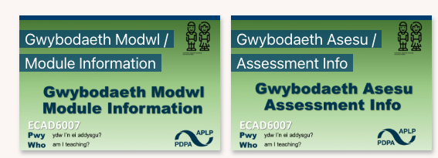



Slide 6
The structure
Gain insight into role of reflective practice
Learn relevant theories relating to the learner
Observe teaching and learning in a school environment
Use these elements to inform next steps in teaching

Slide 7
Finish the statements
When I finish the course I will be….
The role of the PGCE is to……….

Slide 8
Teaching as a craft and a profession
Teaching as a craft
“Teaching is a craft and it is best learnt as an apprentice observing a master craftsman or woman. Watching others, and being rigorously observed yourself as you develop, is the best route
to acquiring mastery in the classroom”
(Gove, 2010)
Teaching as a profession
“The teacher who is able to engage with theory and the findings of educational research shares with the craft worker teacher a capacity for self- direction. By contrast, though, the professional teacher is able to judge right action in various school and classroom contexts from a more reliable basis for judgment than intuition or common sense. A teacher who is able to make good situational judgments does not rely on hearsay or unreflective prejudice. They draw on a well-thought-through and coherent conceptual framework, on knowledge of well-substantiated empirical research, and on considered ethical principles, to arrive at decisions in the classroom context."
(Orchard et al, 2015)

Slide 9
The review
Because of the dominant focus on what newly qualified teachers must be able ‘to do’ at their end of their programmes, there is virtually no explicit recognition of the role of research or critical reflection in teachers’ professional learning.
(Furlong, J. 2015, p12)

Slide 10
The role of this module
“Winch et al.(2013 ) therefore argue that what is missing from both the simplified craft view and the narrow technical view is the capacity for critical reflection; this, they suggest, is the hallmark of the ‘professional teacher’. Good teaching, they argue, develops from interrogating one’s practice and making explicit the assumptions and values that underpin it."
(BERA 2014, p20)

Slide 11
Over the course of this module we will…
Explore the role and nature or critical reflection
Engage with theory relating to the learner
Understand how we can make links between our practice and theory
Consider how we can use this to inform future developments

Slide 12
Over the course of this module we wont…
Have all the answers
Know all the questions
The PGCE is the first (albeit huge!) step in your career as a teacher – start to worry when you feel you have all the answers!

Slide 13
Being a reflective individual
Dewey (1933) said the three attributes of a reflective individual are:
  open-mindedness,
  responsibility
  and wholeheartedness
What do these mean?
Do you have these attributes?

Slide 14
Reflection and models
Reflective thinking involves essentially three processes:
experiencing something
thinking (reflecting) on the experience
learning from the experience.

Slide 15
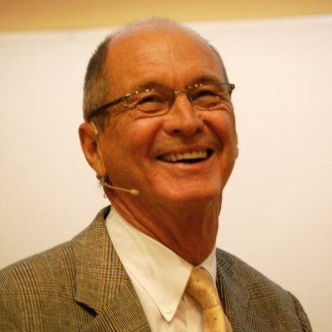
Models of reflective practice:
Kolb, 1975 & 1984
The Learning Cycle emphasizes reflective observation as a way to analyse and draw conclusions from an experience. The aim is to take this learning into new experiences, completing the cycle.

Slide 16
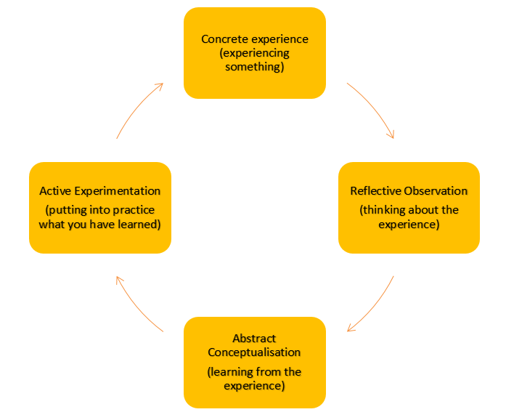

Slide 17
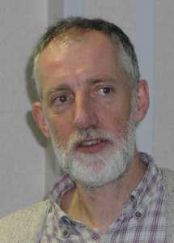
Models of reflective practice:
Gibbs, 1988
The Reflective Cycle has six distinctive stages, leading from a description of the event/experience through to conclusions and consideration for future events.
Notes:
escription "What happened? Don't make judgements yet or try to draw conclusions; simply describe." Feelings "What were your reactions and feelings? Again don't move on to analysing these yet." Evaluation "What was good or bad about the experience? Make value judgements." Analysis "What sense can you make of the situation? Bring in ideas from outside the experience to help you”. "What was really going on?” "Were different people's experiences similar or different in important ways?" Conclusions (general) "What can be concluded, in a general sense, from these experiences and the analyses you have undertaken?" Conclusions (specific) "What can be concluded about your own specific, unique, personal situation or way of working?" Personal action plans "What are you going to do differently in this type of situation next time?” "What steps are you going to take on the basis of what you have learnt?”

Slide 18
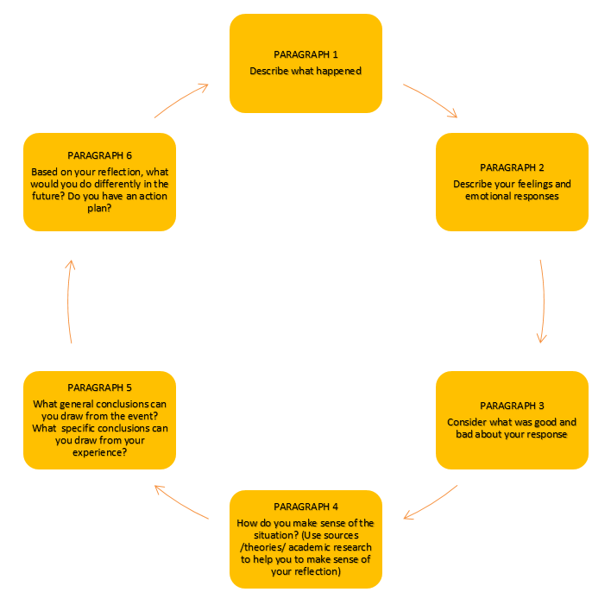

Slide 19
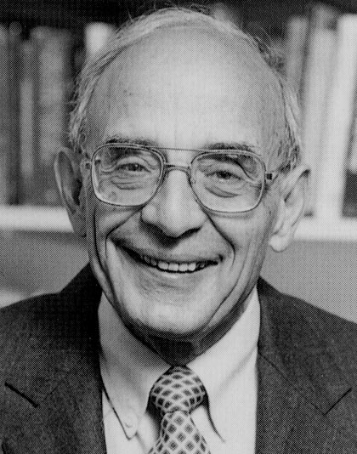
Models of reflective practice:
Schön, 1978
This model has the strength of considering reflection in action (during an event/experience) with those that happen in hindsight (after the event).

Slide 20
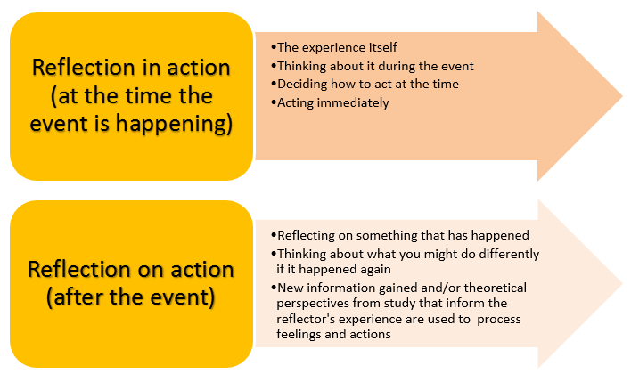

Slide 21
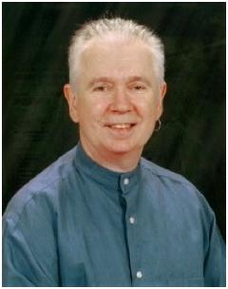
Models of reflective practice:
Brookfield, 1998 & 2005
This model proposes four lenses that can be engaged by teachers in a process of critical reflection: (1) the autobiographical, (2) the students' eyes, (3) our colleagues' experiences, and (4) theoretical literature.
(Brookfield’s Lenses)

Slide 22
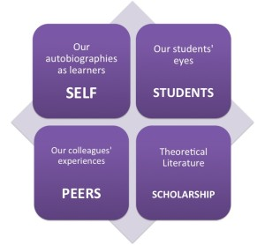

Slide 23
So what is the point?
What is the role of a teacher?
Where does reflection sit in this?
Is it enough to simply reflect?

Slide 24
Barriers
What are some of the barriers to effective reflection in your PGCE year?

Slide 25
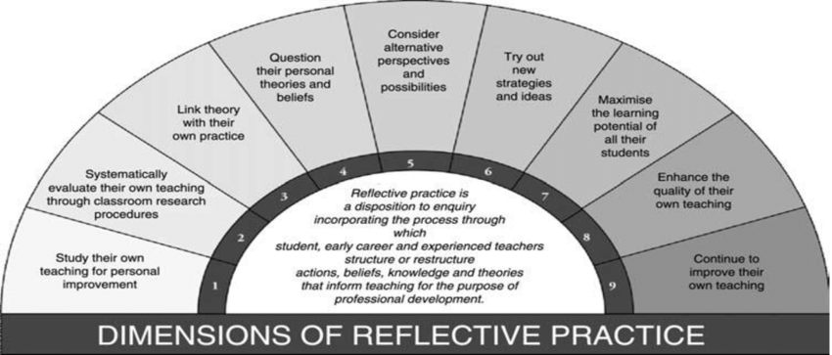
Myer’s 9 dimensions of reflective practice

Slide 26
Classroom based observations
As part of this module, you will be making use of classroom-based observations as a basis of reflection
You will observe, in a school environment, school-based practitioners, and use these as a basis of reflection

Slide 27
Activity
Why do you need to examine your personal theories and beliefs when observing?
What is the importance of considering multiple perspectives?
How can your own experiences impact what you observe?

Slide 28
Finish the statements
When I finish the course I will be….
The role of the PGCE is to……….

