Slide 1

Title: Component 1- Group Presentation on Different Information Systems for Tesco
Student name: EVANS DADZIE ID no. 2414242
Student name: CAMELIA ALINA LUCHIAN ID no. 2418818
Student name: AURITA CRISTOVAO ID no. 2430409
Student name: Marian Bogdan Burzo ID no.2335150
Module Code & Title: LCLM5004 Managing Business Information
Lecturer: Amer Kareem

Slide 2
Overview
Introduction
Introduce different Information Systems
Analyse and Compare Systems
Ethical Considerations
Real-World Case Studies
Recommendation
Conclusion
References

Slide 3
Introduction to Information Systems
Content:
Information Systems (IS) are integrated components that collect, process, store, and disseminate data to support business operations.
Key Roles:
  Improve Efficiency through automation
  Enhance Decision-Making with timely insights
  Create Competitive Advantage via innovation and customer focus
This presentation analyses TPS, MIS, and CRM, discusses ethical issues, and provides recommendations for Tesco (Laudon and Laudon, 2022).

Slide 4
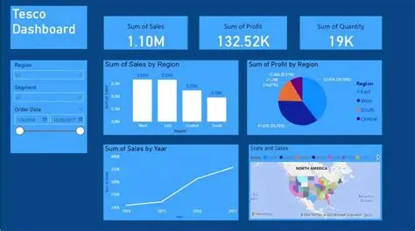
1 Introduce different Information Systems: TESCO
Evans Dadzie
The most widely recognised types of Information Systems are:
Transaction Processing Systems (TPS) Handle routine, high‑volume daily transactions. (Stair & Reynolds, 2020)
Management Information Systems (MIS) Convert raw data into structured managerial reports. (Boddy et al., 2020)
Decision Support Systems (DSS) Provide analytical tools for complex, semi‑structured decisions. (Turban et al., 2018).
Executive Information Systems (EIS) Offer high‑level dashboards for strategic decision‑making.

Slide 5
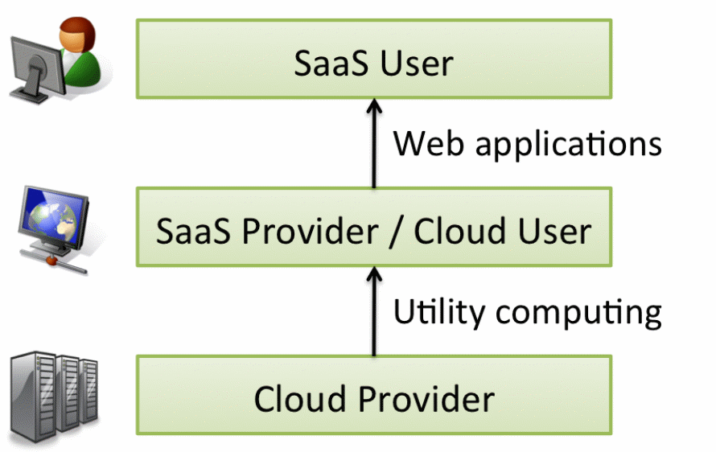
SaaS
SaaS stands for Software as a Service.
It is a cloud computing service model that delivers software applications over the internet.
Users can access these applications through a web browser or an app, usually on a subscription basis. . (Krintz, 2021)

Slide 6

Salesforce
Focused on quick setup no hardware needed
Offered CRM access and updates entirely in the cloud
Used bold marketing to challenge big, clunky, old-school providers
Salesforce’s Pioneering Role In SaaS
According to Parkmond (2026), Salesforce operates as both a SaaS and PaaS solution.

Slide 7
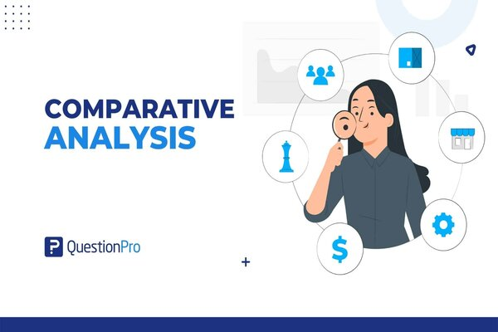
1.TPS (Transaction Processing System) in Tesco
2.Analyse and Compare Systems
Camelia Luchian
Functions: Captures, processes, and records high-volume daily transactions (e.g., EPOS sales, payments, real-time inventory updates) (Laudon and Laudon, 2022).
Benefits: Delivers speed, accuracy, and efficiency; reduces errors and supports seamless retail operations at scale.
Limitations: Operational focus only; vulnerable to downtime and high maintenance costs; lacks strategic analysis.
Tesco Impact & Comparison: Essential foundation feeding data to MIS and CRM; enables Tesco’s high-volume operations.

Slide 8
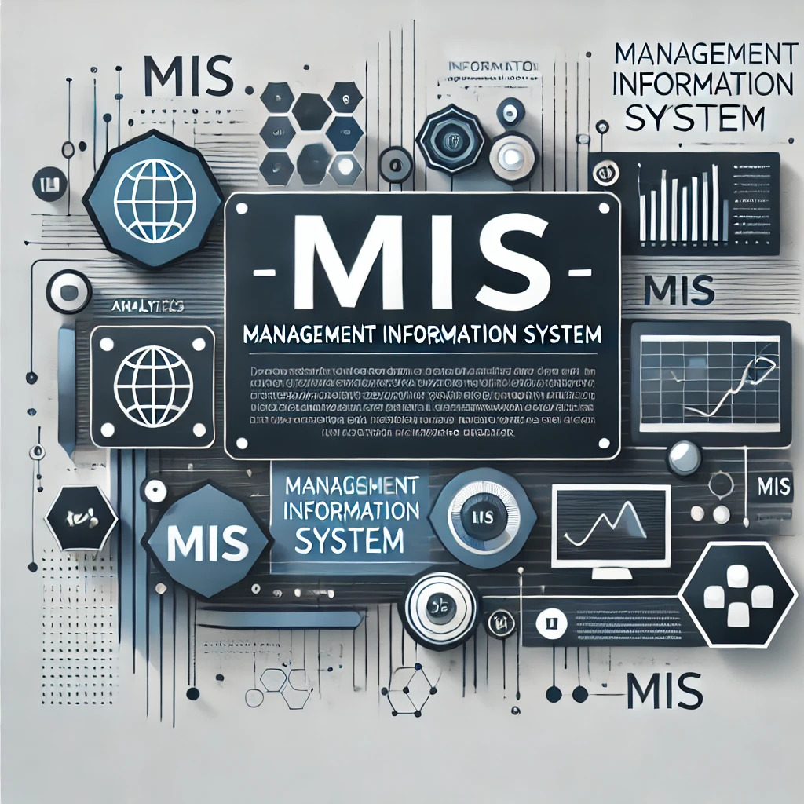
2.MIS (Management Information System) in Tesco
2.Analyse and Compare Systems
Functions: Summarises TPS data into reports and dashboards for planning, control, and decision-making (e.g., sales analysis, supply chain optimisation) (Pepard and Ward, 2024).
Benefits: Improves managerial decisions, forecasting, and resource allocation for competitive advantage.
Limitations: Dependent on TPS data quality; risk of information overload; limited for complex unstructured problems.
Tesco Impact & Comparison: Builds analytical layer on TPS; supports strategic retail management unlike purely transactional TPS (Chaffey, Hemphill and Edmunds, 2023).

Slide 9
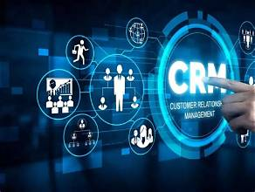
3. CRM (Customer Relationship Management) in Tesco
2.Analyse and Compare Systems
Functions: Analyses customer data (e.g., Clubcard) for personalised marketing, loyalty programmes, and multi-channel engagement.
Benefits: Boosts retention and sales (e.g., Clubcard members spent ~28% more); drives customer-centric strategies.
Limitations: Privacy/security risks, high costs, and potential bias in data-driven personalisation.
Tesco Impact & Comparison: Uses TPS/MIS data for targeted actions; completes the system by focusing on customer relationships for market leadership(Kotler, Keller and Chernev, 2025; Laudon and Laudon,2022)

Slide 10
3.Ethical Considerations in Business Information Systems
Risk Mitigation
Security includes data encryption and supports multi-factor authentication.
Role-based access controls
Regular access to Cyber security Awareness Training.
Guidance and/or governance of AI systems and ethical use of AI.
Conduct of supervision, following GDPR and compliance audits.
It is through Effective Governance that Organizations can get Maximum Benefits out of Information Systems while Ensuring Security of Data, Employee Rights, and Customer Confidence (Mäntymäki et al., 2022).

Slide 11
3.Ethical Considerations in Business Information Systems
AURITA CRISTOVO
Key Areas | Key Issues
Data Privacy | Customer and Employee Data Protection and GDPR compliance (Oluoha et al., 2023)
Cybersecurity | Data Breaches, ransomware, phishing attacks (Liu and Babar, 2026)
AI Decision-Making | Algorithmic bias, lack of transparency, accountability (Daza and Ilozumba, 2022)
Employee Monitoring | Productivity tracking, privacy issues, employee trust (Ball, 2021)

Slide 12
4.Real-World UK Case Studies
Marian Burzo
 | Rolls-Royce Holdings ERP | Tesco CRM | Next plc MIS
Challenge | Legacy systems, fragmented operations | Personalised customer engagement | Omnichannel inventory and requirement
Implementation or Solution | SAP R/3 ERP incorporation | Clubcard CRM and consumer analytics | Management dashboards and reporting
Ethical Issues | Change management Data integrity | Consumer privacy GDPR compliance | Data accuracy Secure information access
Key Lesson | Technology, along with change management | Ethical use of client data | Consistent data drives better choices
Business Impact | Combined processes, enhanced supply chain visibility | Advanced loyalty, targeted marketing | Better forecasting, enhanced stock control

Slide 13
Conclusion
Information Systems are essential for modern business success, driving efficiency, informed decision-making, and competitive advantage.
TPS, MIS, and CRM work best when integrated, as demonstrated by Tesco.
Ethical considerations must remain central to implementation.
Key Takeaway: Strategic and responsible use of IS will enable sustainable growth and market leadership (Kotler et al., 2025).

Slide 14
Recommendation
Adopt an integrated TPS + MIS + CRM system for seamless data flow.
Invest in secure, cloud-based solutions with staff training.
Establish a Data Ethics Committee to manage privacy and bias risks.
Begin with a pilot implementation before full rollout.
Expected Outcomes: Higher efficiency, better decisions, improved customer experience, and stronger competitive position (Peppard and Ward, 2024; Chaffey et al., 2023).

Slide 15
REFERENCES
Chaffey, D., Hemphill, T. and Edmunds, D. (2023) Digital Business and E-Commerce Management. 8th edn. Pearson.
Kotler, P., Keller, K.L. and Chernev, A. (2025) Marketing Management in the Digital Age. 17th edn. Pearson.
Laudon, K.C. and Laudon, J.P. (2022) Management Information Systems: Managing the Digital Firm. 18th edn. Pearson.
Peppard, J. and Ward, J. (2024) The Strategic Management of Information Systems: Building a Digital Strategy. 5th edn. Wiley.
Krintz, C. (2021) Software‑as‑a‑Service (SaaS). In: Springer. Available at: [Springer database] (accessed 5 July 2026).
Parkmond, C. (2026) Understanding Salesforce: Is Salesforce SaaS, PaaS, or Both? TechAnnouncer, 16 March. Available at: https://techannouncer.com/understanding-salesforce-is-salesforce-saas-paas-or-both/ (Accessed 5 July 2026).
Stair, R. and Reynolds, G. (2020) Principles of Information Systems. 13th edn. Boston: Cengage Learning.
Turban, E., Sharda, R. and Delen, D. (2018) Decision Support and Business Intelligence Systems. 10th edn. Harlow: Pearson.
Boddy, D., Boonstra, A. and Kennedy, G. (2020) Managing Information Systems: Strategy and Organisation. 7th edn. Harlow: Pearson.
Oluoha, O.M., Odeshina, A.B.I.S.O.L.A., Reis, O.L.U.W.A.T.O.S.I.N., Okpeke, F.R.I.D.A.Y., Attipoe, V.E.R.L.I.N.D.A. and Orieno, O. (2023) A privacy-first framework for data protection and compliance assurance in digital ecosystems. Iconic Research
Liu, C. and Babar, M.A. (2026) Corporate cybersecurity risk and data breaches: A systematic review of empirical research. Australian Journal of Management, 51(1), pp.62-92. Available at: https://journals.sagepub.com/doi/pdf/10.1177/03128962241293658
Daza, M.T. and Ilozumba, U.J. (2022) A survey of AI ethics in business literature: Maps and trends between 2000 and 2021. Frontiers in Psychology, 13, p.1042661. Available at: https://www.frontiersin.org/journals/psychology/articles/10.3389/fpsyg.2022.1042661/pdf
Ball, K. (2021) Electronic monitoring and surveillance in the workplace. Available at: https://publications.jrc.ec.europa.eu/repository/bitstream/JRC125716/jrc125716_electronic_monitoring_and_surveillance_in_the_workplace_final.pdf

