Slide 1
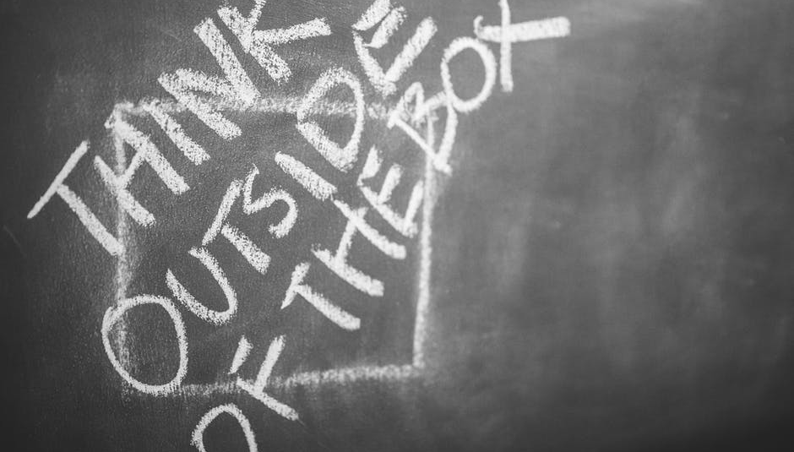

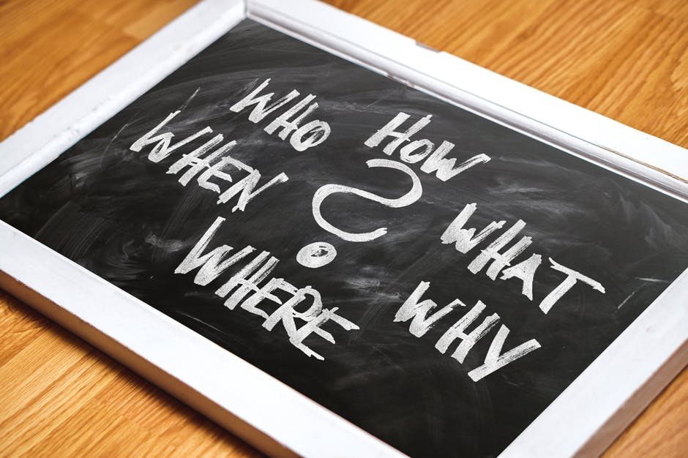
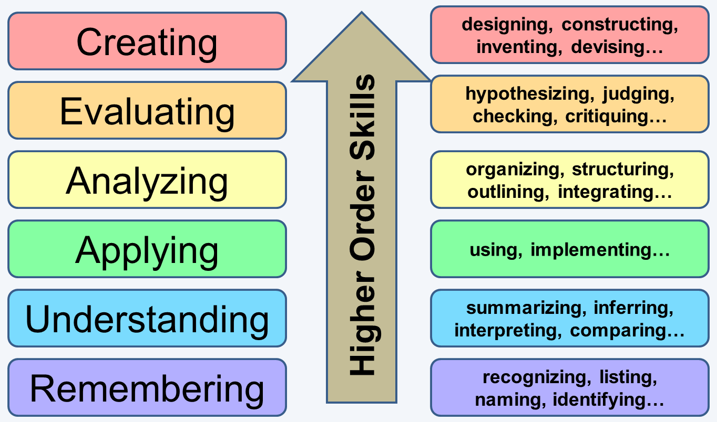
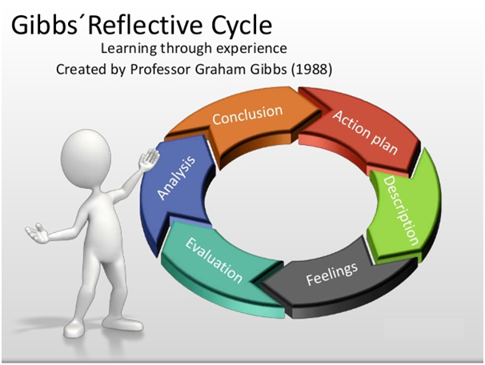
Critical thinking in education
Skills and personal qualities that influence its development
By Lesley Martin
Introduction
Creating
Reflection
Make notes and compare them against feelings. Consider the options. Process, record, evaluate and reflect on your findings.
The purpose of this academic poster is to look at the range of skills and personal qualities that influence the development of critical thinking in education. It will include existing theories and approaches and demonstrate the importance of academic reading, writing and listening. It acknowledges a variety of the current sources available using the Harvard referencing system.
Bloom for example believes creating to be the most difficult category. This is where a good critical thinker should have the confidence to be able to gather new or original ideas together, in order to present an accurate judgement. This may involve areas such as investigation, design, development or conjecture and being able to think outside of the box. (Cottrell 2013, p.188) suggests a good way to achieve this would be to “imagine you are developing a detective-like mind”.
The 5W1H approach is one way to help develop these skills Jasper (2006).
Essential considerations
Students also need to consider metacognition. This is where they need to think about their own thinking and put it into perspective.
To enhance critical thinking skills, students need to ensure they have the appropriate strategies in place for the following key areas:
Reading: Is critical, know exactly what needs to be read; Be selective when choosing your reading list; Check source for suitability; Learn how to retrieve information quickly; Decide which points are important and relevant on each page. Cottrell (2013).
Writing: Students writing skills will continually improve with practice; They should use the appropriate academcic writing styles to match their work, namely descriptive, argumentative, evaluative/analytical and personal/experimental.
Listening: Focus on the content. Confirrm understanding and question anything not relevant. Observe body language and maintain eye contact. Evaluate what and how something is delivered and do not just take anything at face value.
What is critical thinking?
According to (Judge, Jones and McCreery, 2009, p.1) “Critical thinking is essentially a questioning, challenging approach to knowledge and perceived wisdom”.
Analysing
Analysis on the other hand looks at the breaking down of information into smaller parts and examines and questions the information in more detail. Cottrell (2013) believes it also involves numerous other processes. He believes in comparing information received from various sources, for example theorists or writers and investigating how they arrive at their different conclusions. This involves exploring all avenues and establishing all of the facts in order to present an accurate, objective analysis. A critical thinker must be prepared to be open-minded and ask critical questions. This does not mean they should critisise what someone believes or has written, but simply question it in more detail. They should be prepared to set aside their own personal biases and any preconceived ideas they may have and see things from a whole new perspective.
What makes a good critical thinker?
Here are two theories: Firstly, Bloom’s Taxonomy.
This method helps to develop students thinking, broaden their outlook and question the validity of information, for example:
Who wrote it? Was it written by a credible and reliable source? Is it based on factual evidence or opinion? Was it built on thorough research carried out by a reputable historian or someone who had biased or exaggerated views about the topic in question? Are they using words or techniques in order to sway their audience? Was it written by a primary or secondary source?
When did they write it? Was it written by someone alive at the time of the event? Someone who was there when the incident occurred may have been able to produce a more accurate account of what happened, as opposed to someone who wrote it years later. Again it would depend on what perspective they were using and whether or not it was a reliable source.
Why did they write it? Was it written as an educational tool or simply to entertain its audience? Is it biased or based on opinion? Is the writer looking at it from an open-minded point of view or simply from one side of the argument? It is all about being able to weigh up the pros and cons.
Where did they get their evidence from? Was it a reputable book, journal or website? Wikipedia for example is definitely not a reputable or reliable source as it can be updated by anyone at any time, so may not necessarily be based on factual evidence.
What was its relevance? What did the author stand to gain by being honest, dishonest with their point of view?
How was it written? Did the writer use formal or informal text? How did they obtain their evidence?
Some additional key terms to reflect upon and help improve your critical thinking skills are: Identification, research, identifying biases, inference, determining reference and curiosity,
as referenced by Estrad (2018)
Evaluating
Barriers to critical thinking?
Evaluation looks at the justification of a stance or decision. It differentiates between what is good or bad and the experience, without making assumptions or having any preconceived ideas, in order to form a judgement. It involves investigating ideas and information from an objective perspective, then questioning the information in light of ones own values, attitudes and personal philosophy. Judge, et al. (2011). It is a way of expressing what a person is trying to achieve.
Students must remain impartial and be flexible in order to obtain as much information as possible before reaching a conclusion and not be afraid to challenge someone’s point of view, provided they are being constructive. Being able to read between the lines is crucial.
All of these skills and qualities are there to support the student. They are there to help them to open up their minds and think about and question, the concepts of what they are reading, writing and listening to and not just take everything at face value. It is a means of getting them to look and think about the bigger picture. Hindsight is a wonderful thing!
Personal feelings, opinions and mindsets can all stand in the way of someone becoming a great critical thinker. Taking things at face value and believing everything that is written is also a common mistake. Students should never make assumptions, but try to keep an open mind whilst gathering all of the facts, in order to reach a valid conclusion. This is crucial as without all of the facts the outcome to a situation could be very different.
Ambiguity and subjectivity are another two factors that can impact on critical thinking Judge, et al (2009). Ambiguity is where a word can have more than one meaning and subjectivity is where people still disagree about its meaning, even after any ambiguity has been removed.
This is a classification system created by Dr. Benjamin Bloom in (1956) to show the different levels of human perception. Bloom states that the classification of higher-order thinking can be broken down into six categories, namely: Remembering, understanding, applying, analyzing, exploring and creating.
Gibbs on the other hand uses a ‘Reflective Cycle’, created in (1988) to illustrate his theory. This includes: Action plan, description, feelings, evaluation, analysis and a conclusion.
Conclusion
In conclusion, (Judge, et al. 2009, p4) states that “critical thinking is the ability to think about your own thinking”, “recognize its strengths and weaknesses”, “reconsider your viewpoint” and “reconstruct your thinking” in an enhanced manner. These are known as transferable skills. They are all vitally important, as students are able to adapt them when addressing various problems in countless situations at any given time within their education and everyday lives. Arthur et al (2006).
If students are willing to question and apply these skills, theories and qualities to their studies, they will help them to guarantee success in the future and they will have a much greater chance of achieving their future goals in their personal and academic lives.
Everyone has the right and opportunity to become a great critical thinker, but it is up to the individual as to how and when they chose to apply it, no one can force or do it for them.
This is a fundamental lifelong skill not just to be expended whilst in education.
The benefits of critical thinking in education
Applying critical thinking skills, techniques and strategies allows students to evaluate evidence from more than one perspective. It helps them to identify criteria and access original or revised material that is current and up to date. It allows them to carry out more in-depth research from various sources including books, newspapers and journals to name but a few, so they can base their evidence on more accurate statistics.
No matter what stage of life or how much experience someone has, critical skills can only enhance ones progression Estrad (2018).
Gibbs uses a reflective approach as opposed to a hierarchical system. He thinks about what happened, and how it made the other person think and feel? Jasper (2003).
Both Bloom and Gibbs theories allow students to consider further the skills and qualities required to influence the development of critical thinking in education. Each of these aspects plays a part in critical thinking and is weighed according to its relevance and importance. Here are some examples:

Slide 2
Reference List
References:
Brand, S. Available at: http://ezsnips.squarespace.com/blooms-taxonomy (Accessed 22 October 2018)
Estrad, W. (2018) 6 Critical Thinking Skills You Need to Master Now Available at: https://www.rasmussen.edu/student-life/blogs/college-life/critical-thinking-skills-to-master-now/ (Accessed 23 October 2018).
Mike. Available at: https://www.myassignmentservices.com/blog/wp-content/uploads/2018/06/gibbs-reflection-cycle.png (Accessed 22 October 2018).
Jasper, M. (2003) Beginning Reflective Practice. Cheltenham: Nelson Thrones Ltd.
Johnson, S. Available at: https://www.pexels.com/photo/close-up-photography-of-eyeglasses-near-crumpled-papers-963056/ (Accessed 22 October 2018).
Judge, B. Jones, P. and McCreery, E. (2009) Critical Thinking Skills for Education Students. Exeter: Learning Matters Ltd.
Kaboompics .com. Available at https://www.pexels.com/photo/think-outside-of-the-box-6375/ (Accessed 22 October 2018).
pixabay.com. Available at: https://www.pexels.com/photo/board-chalk-chalkboard-close-up-415068/ (Accessed 22 October 2018).

