Slide 1
Ethical issues in psychology
Catherine Gourlay, Hannah Clayton, Stephanie Reynolds, Connie Griffiths, Kyra Sebastian
HANNAH CLAYTON (2003591)

Slide 2

INTRODUCTION
”Ethical issues are issues because there is a conflict between the needs of researchers … and the needs of individual participants who have rights to be treated fairly” (Flanagan et al., 2016)
WHAT WE ARE ALL GOING TO DISCUSS:
- Ethical Guidelines
- Ethical Issues
- Unethical experiments
- Costs and benefits of conducting unethical research
- Can unethical experiments be justified ?
HANNAH CLAYTON (2003591)

Slide 3

ETHICAL GUIDELINES
BPS = British Psychological Society
Most recent Code of Ethics and Conduct – 2018
4 main principles:
- Respect (standards of : Privacy, Confidentiality, Valid consent)
- Competence (high standard of work)
- Responsibility (risk of harm – physical and psychological)
Integrity (honesty and accuracy)
(The British Psychological Society, 2018)
(Flanagan et al., 2015)
HANNAH CLAYTON (2003591)

Slide 4
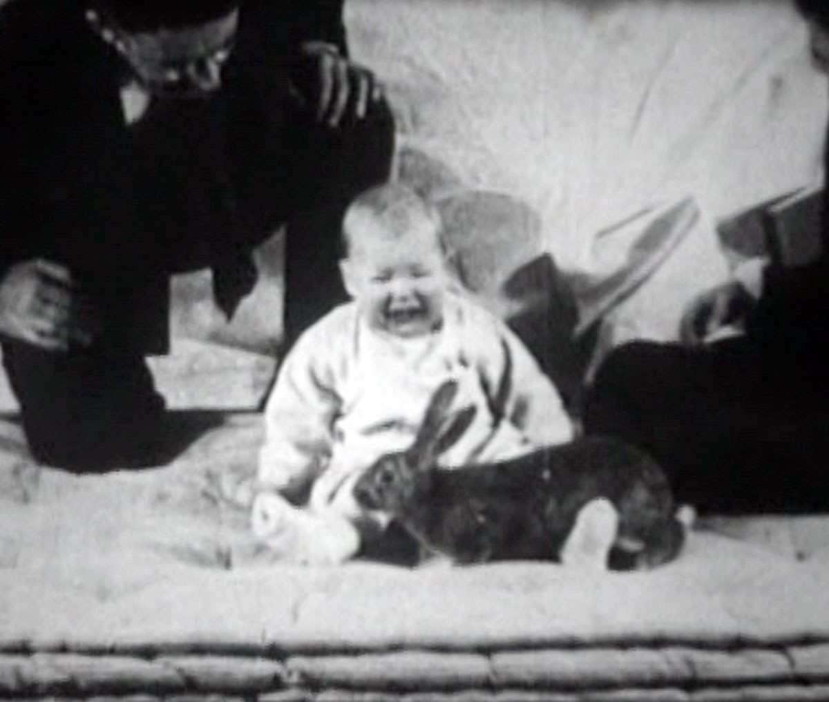
WATSON & RAYNER (1920) - LITTLE ALBERT
Example of an experiment lacking responsibility (psychological harm involved)
“One of the most famous unethical experiments”
SUMMARY OF THE EXPERIMENT (CONTROLLED OBSERVATION):
Investigation to see if emotional reactions can be conditioned
Subject = Little Albert – 9 months old
Presented him with a white rat – did not show fear
Presented him with a white rat and a loud noise (steel bar- he cried)
After numerous sessions, he associated the rat with the loud noise
Continued this process with other objects
(Flanagan et al., 2015)
(Jarret, C., 2014)
HANNAH CLAYTON (2003591)

Slide 5
COST / BENEFIT ANALYSIS
CAN THIS EXPERIMENT BE JUSTIFIED?
- Controversial not only because of its ethical implications …
- ”results … reported in an inaccurate and oversimplified way” (Jarret, 2014)
Example : feared rats and white furry objects BUT results were far more inconsistent
- Methodology not controlled well
- Controversy over his identity (Douglas Merritte)
Neurologically impaired – adds to the ethical issues
(Jarret, 2014)
ETHICAL ISSUES (COST)
- No valid consent from parents
- Created fear for Little Albert – Psychological harm (Lack of responsibility)
- Lasting effects?
- No form of desensitization for Albert and his fear
BENEFITS
- Humans can be conditioned
- Supports Pavlov’s (1897) experiments –Shows his results are generalizable to humans
- phobias = true conditioned emotional reactions
HANNAH CLAYTON (2003591)

Slide 6
CONCLUSION
Costs outweigh the benefits
Main benefit – humans can be conditioned – help with phobias
No valid consent!
Grand scheme – deliberately causing psychological harm to 9-month-old
Would not happen nowadays !
Overall – this experiment cannot be justified. (other experiments benefits have outweighed the costs)
HANNAH CLAYTON (2003591)

Slide 7
REFERENCES
The British Psychological Society. (2018). Code of ethics and conduct (2018). https://www.bps.org.uk/news-and-policy/bps-code-ethics-and-conduct
Flanagan, C., Hartnoll, L., Murray, R., & Hill, J. (2015). Psychology AS. Oxford University Press.
Flanagan, C., Cox, K., Hill, Hill, J., Liddle, R., Murray, R, (2016). Psychology a level book 2. Oxford University Press.
Jarret, C. (2014). The 10 most controversial psychology studies ever published. https://digest.bps.org.uk/2014/09/19/the-10-most-controversial-psychology-studies-ever-published/
Timeline. (2017). [Little Albert image]. https://timeline.com/little-albert-fear-experiment-9152586f245
The British Psychological Society. (2018). [Code of ethics image]. https://www.bps.org.uk/news-and-policy/bps-code-ethics-and-conduct
HiCilpart. (n.d.). [Ethics figure]. https://www.hiclipart.com/free-transparent-background-png-clipart-sjxsa
HANNAH CLAYTON (2003591)

