Slide 1
An Introduction to the Dead Sea Scrolls: Who, What, Where, When?
Dr Jessica M. Keady (UWTSD)
Lecturer in Biblical Studies and Gender
j.keady@uwtsd.ac.uk

Slide 2
Outline of Class
Welcome and Introductions
Hebrew Bible/Old Testament Dates
Who did they belong to?
What are the Dead Sea Scrolls?
Where were they found?
When were they discovered?

Slide 3
Welcome and Introductions

Slide 4
Hebrew Bible/Old Testament
Dates and Context

Slide 5
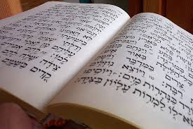
The Text of the Hebrew Bible
The books of the Hebrew Bible / Old Testament date from (roughly):
1,000 BCE – 164 BCE
They therefore span nearly 1,000 years
Multiple dates, multiple authors, and multiple contexts
There are no ‘original’ manuscripts, only later copies and translations

Slide 6
The Text of the Hebrew Bible
Before 1947, there were two main sources for the text of the Hebrew Bible/Old Testament:
The first source is the Masoretic Text (MT)
Language - Hebrew
Earliest surviving text: 10th and 11th centuries CE

Slide 7
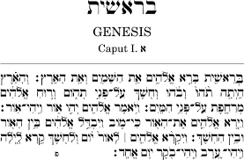
The Book of Genesis (Hebrew)

Slide 8
The second source is the Septuagint (LXX)
Language - Greek
Earliest surviving text: 4th and 5th centuries CE

Slide 9
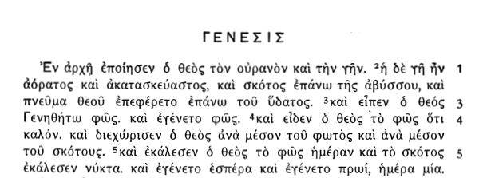
The Book of Genesis (Greek)

Slide 10
The Dead Sea Scrolls
Then 72 year ago, everything changed …
1947 – Discovery of the Dead Sea Scrolls
Some 900 documents
Multiple copies of the biblical texts from ca. 200 BCE to 70 CE

Slide 11

Dead Sea Scrolls
Just to put that in to perspective ….
The Dead Sea Scrolls are around 500 years earlier than the surviving Greek Septuagint copies and over 1000 years earlier than the surviving Hebrew Masoretic Text copies

Slide 12
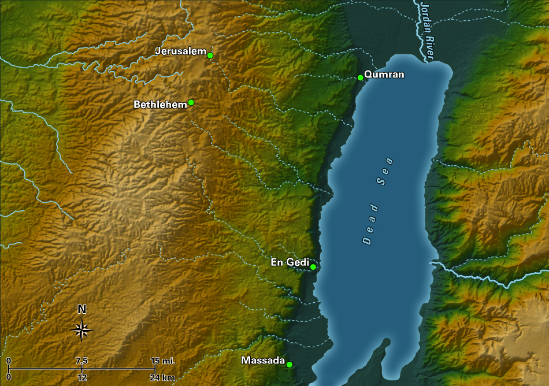

Slide 13
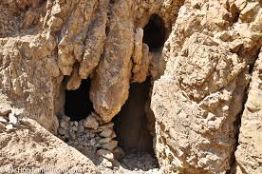
The Discovery of the
Dead Sea Scrolls
Cave 1
Muhammed ed-Dhib and his Cousin as Adults

Slide 14
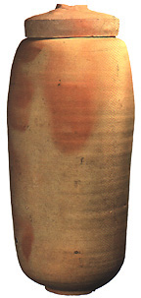
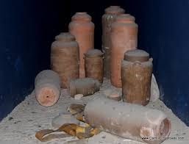
Jars

Slide 15
NATURAL CAVES
Caves
1, 2, 3, 6, & 11

Slide 16
MANMADE CAVES
Caves
4, 5, 7, 8, 9, & 10

Slide 17
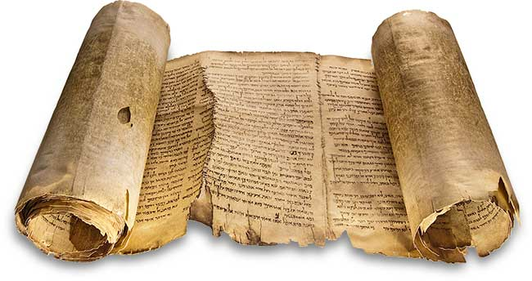
The Great Isaiah Scroll (1QIsa))

Slide 18
The Psalm Scroll (11Q5)

Slide 19
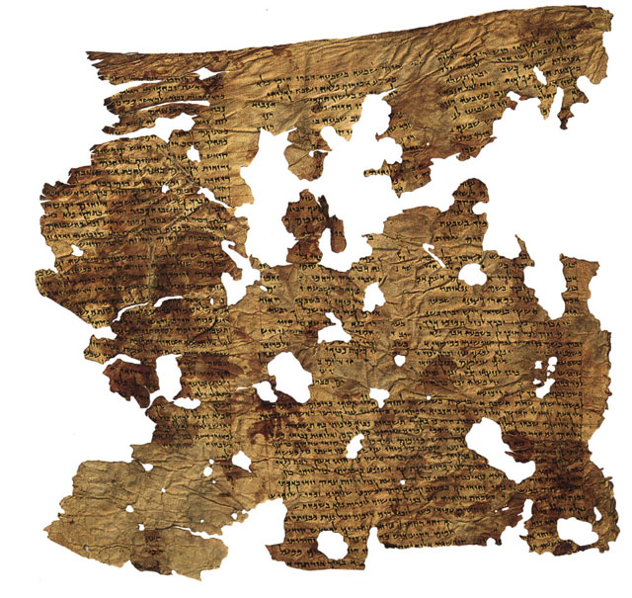
The Enoch Scroll
The Enoch Scroll (4Q201)

Slide 20
4QMiscellaneous Rules (4Q265)
http://www.deadseascrolls.org.il/explore-the-archive/manuscript/4Q265-1?locale=en_US

Slide 21
Diversity in Second Temple Judaism
Diversity in in the ancient world is the result of responses to Hellenism and foreign domination.
Josephus mentions four groups:
The Pharisees
The Sadducees
The Essenes
The ‘Fourth Philosophy’

Slide 22
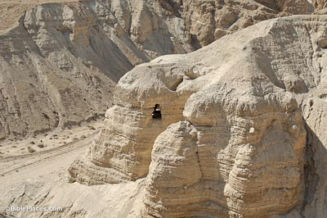
The Essenes and the Dead Sea Scrolls
Emphasis on purity and purification
Sense of separation from communities
Sharing of property
Strict observance of the Sabbath

Slide 23
Josephus on the Essenes
Antiquities 18:18-22
The doctrine of the Essenes is they want to leave everything in the hands of God. They regard the soul as immortal and believe that they ought to strive especially to draw near to righteousness. They send votive offerings to the temple, but perform their sacrifices employing a different ritual of purification …. They hold their possessions in common, and the wealthy receives no more enjoyment from property than the one who possesses nothing….

Slide 24
Khirbet Qumran

Slide 26
Pantry

Slide 27
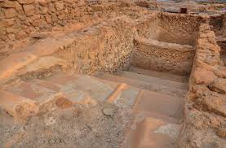
Ritual Purity (mikveh)

Slide 28
Sectarian Texts
The Community Rule (1QS)

Slide 29
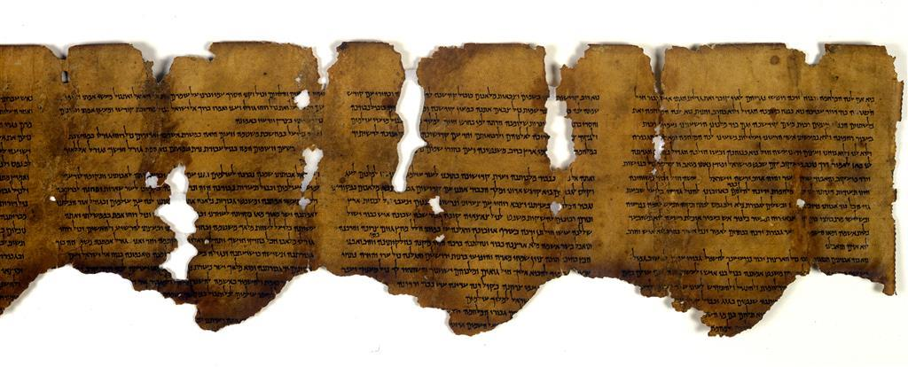
War Texts
The War Scroll (1QM)

Slide 30
Fragmentary Damage to the Scrolls

Slide 31
Reconstruction and Publication

Slide 32
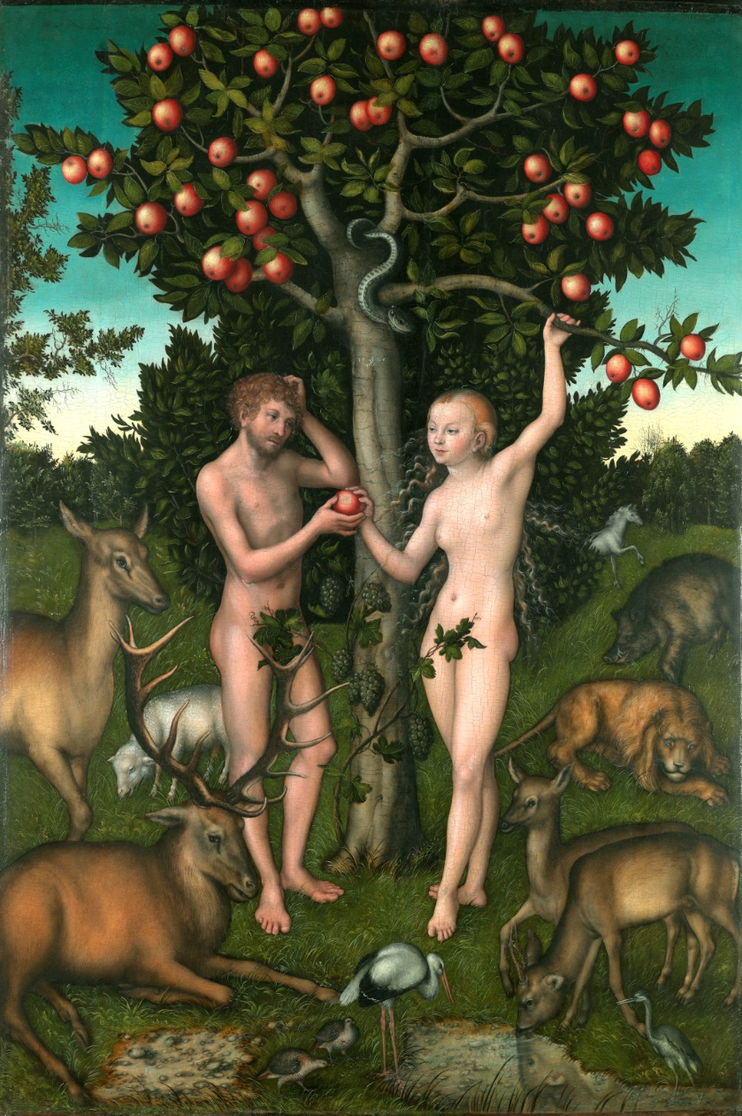
Genesis 1-2
Genesis 1-2: Two different accounts of creation
Genesis 1: separation and life (creation in 6 days, followed by a day of rest – Sabbath/Shabbat)
Genesis 2: the Garden of Eden
Lucas Cranach the Elder (1472-1553), Adam and Eve, 1526, The Samuel Courtauld Trust, The Courtauld Gallery, London

Slide 33
4QMiscellaneous Rules
(4Q265 frag. 1 lines 11 – 17)
‘In the first week [Adam was created but he had no holiness un]til he was brought to the Garden of Eden. And a bone from his bones was taken for the woman, but she had no holiness until she was brought to him in the Garden of Eden after eighty days because the Garden of Eden is holy and every growing thing in its midst is h[oly. Therefore a woman who] bears a male child she shall be unclean for seven days; as at the time of her menstruation she shall be unclean. And she shall remain for thirty-three days in the blood of her purification. And if she bears a female child, then she shall be unclean for two weeks, as in her menstruation; and for sixty-six days she shall remain in the blood of her purification. [No holy thing shall she t]ouch, not come into the sanctuary, until the days of her purification are completed.’

Slide 34
To summarise
What are the Dead Sea Scrolls?
Where were they found?
Who did they belong to?
When were they discovered?

