Slide 1
Critical Reflection of my learning for Project Management
By Jordan Hitchcock
Notes:
Today I will be taking you through a critical reflection of my own learning from the past few weeks of the Project Management for Sustainability Module.

Slide 2
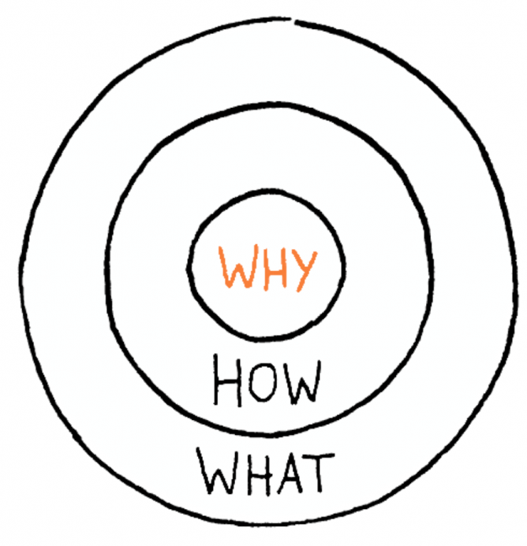
Introduction to Project Management
‘Build a tower, build a team’
How great leaders inspire action- The Golden Circle
“People don’t buy what you do, they buy why you do it.”
Notes:
As a class we began the module with 3 introductory videos. The first video was a TED Talk on youtube by Tom Wujec from Autodesk titled ‘Build a tower, build a team’. This was a good introductory video as straight away it taught is the importance of good project management skills and what can go wrong if these skills are lacked. The idea of the video was based around the ‘marshmallow problem’ where team members are given dry sphaghetti, one yard of tape and a marshmallow and they have to build the tallest structure possible with this and the marshmallow must go on top. The video emphasises the usefulness of project management even when performing relatively simple tasks.
The second video we watched was titled ‘How great leaders inspire action’ by Simon Sinek, author and motivational speaker. He focused on the theory of ‘The Golden Circle’. Sinek believes that the Golden Circle is what makes some companies better than the rest. The idea was that you start from the outside and make your way in. Every company knows WHAT they do, this is the products they sell or the service they provide. Next, some of the organisations know how they do it. This is where we can see companies beginning to separate from each other. Finally, in the middle is WHY. Very few organisations know WHY they do it. What is their purpose, what is their belief? Making money is the result of their belief. “People don’t buy what you do, they buy why you do it.” (Sinek, S. 2010) This inspired me massively and taught me to always think of WHY I am doing something.

Slide 3
What is Project Management?
Used everywhere
“Forecasting, planning, organising, commanding, coordinating and controlling.”- Henry Fayol
“The skill of moving from ideas to results”- Peter Hobbs
“Project management is the application of processes, methods, skills, knowledge and experience to achieve specific project objectives according to the project acceptance criteria within agreed parameters” APM
Notes:
What is Project Management?
First of all it is important to understand the project management is used everywhere. There would have been a project management team for the construction of this building, that table, my phone, everything. Wherever a new product is created or a service acquired, there would have been a team of people who had to manage how the project was completed.
French management theorist, Henri Fayol came up with the definition that project management is the process of ‘forecasting, planning, organising, commanding, coordinating and controlling.’ (Pettinger, 1994) Fayol passed away in 1925, however to this day is a very highly respected theorist and is the founder of Fayolism, a theory of management which focused deeply on the role of management within an organisation. I enjoyed researching his work a lot as I found it very intriguing, Fayol is also known as one of the founding fathers of the management theory as he was the first recognised individual to attempt to produce a theory and its principles.
Staff development coach and author Peter Hobbs described Project Management as “the skill of moving from ideas to results” (Hobbs, 2015.) This definition, although simple is true about project management.
A definition from the Association of Project Management is “is the application of processes, methods, skills, knowledge and experience to achieve specific project objectives according to the project acceptance criteria within agreed parameters” (APM, 2019.) This is a relatively long winded definition yet again, I feel that this definition completely covers what project management is.
My personal favourite definition would be Fayols, I feel that this definition includes all that is involved with Project Management but its straight to the point and short where as I feel that Hobbs’ definition does not go into enough detail and would describe to a beginner what project management is fully. The definition created by APM is very good and it includes the use of knowledge and experience to achieve the objectives which I think is true, experience can help a lot when managing a project.

Slide 4
The Waterfall Method
Like a waterfall
“as soon as a stage of the project is finished, the team moves on to the next stage; there is no (or little) backtracking.” Umar Farooq
Step | Description
Requirements | An analysis of the clients’ needs is carried out
Conception | Ideas are created
Planning | A list of tasks is created, timeframe and budget taken into account
Implementation | The process of completing the project to reach the end goal
Verification | The project has been completed and all final checks are being made to ensure client satisfaction
Notes:
When deciding upon which method of project management, it is important to consider the customers needs and what the client actually want from the project.
The simple idea behind the waterfall method is just like that of a waterfall. Once the water has fallen, it cannot go back. This is the same for completing tasks. If there were 5 tasks you could complete the first, then the second, third and so on and cannot go back once a task is completed. Umar Farooq describes the waterfall method as”as soon as a stage of the project is finished, the team moves on to the next stage; there is no (or little) backtracking.” (Farooq, U. 2017)
Waterfall method is best suited to the production of cars. NO chnge.

Slide 5
Agile Method
“is a people-focused, results- focused approach…that respects our rapidly changing world” Stackify
Allows room for change
Commonly used for software development
Requires employees to work closely
Brief- prototype 1- prototype 2- prototype 3
Notes:
The agile method is the opposite to the waterfall method. The agile method “is a people-focused, results- focused approach…that respects our rapidly changing world” ( Stackify, 2017)
The Agile method, unlike the waterfall method allows room for change as the customers needs are put first. Being agile is having the ability to move quickly and easily, this is where the name comes from as the method allows for the project to be flexible and adaptable to change.
The agile method is commonly used for software development projects as changes and updates can be regularly made depending on whether the customer is happy with the product. This requires the employees to work closely to ensure that all team members have a clear vision of their goals and can work towards them, communication is important as if objectives change then it can lead to members doing the wrong work.

Slide 6
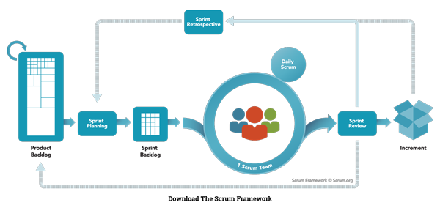
Scrum
A form of Agile method
Product backlog
Sprint backlog
Daily scrum
Image gathered from https://www.scrum.org/resources/what-is-scrum/
Notes:
Scrum is a form of agile method and is used to keep the team organised and up to date. The client briefs the project team on a set of requirements that they want the product to meet, this is called the product backlog.
The team members then take one of the requirements set by the client and aim to implement this idea first. This is known as the sprint backlog.
Just like a game of rugby, team members have daily scrums which are kept short and they discuss what their plans are for the day to ensure that everyone has a clear vision.

Slide 7
PRINCE2 Method
Created by the UK Government
PRojects IN Controlled Environments
“PRINCE2 is made up of 7 themes, principles and processes. The processes are the how, the principles are the why and the themes are the what” Axelos
Notes:
PRINCE2 is a project management method that was created by the UK Government in order to help them manage project more effectively and efficiently.
PRINCE2 is an acronym for PRojects IN Controlled Environments
The method gives a planning approach that is product based and divides the whole project into smaller and more manageable tasks for the members of the team.
“PRINCE2 is made up of 7 themes, principles and processes. The processes are the how, the principles are the why and the themes are the what” (AXELOS, 2017.)

Slide 8
Waterfall Method
Advantages | Disadvantages
Simple to understand | Lack of flexibility
Easy to set up | Little room for change
Logical and structured | Customer only sees end product
Easy to see deadlines | Possible customer unsatisfaction
Agile Method
Advantages | Disadvantages
Faster- Less time spent, less money spent | Difficult to predict work load
Increased customer satisfaction | Can be taken off track if customer is not clear
Values employee input | Requires knowledgeable and experienced staff
Eliminates rework
PRINCE2 Method
Advantages | Disadvantages
Generic- can be suited to any project | Requires senior management support
Makes employees accountable to work | Requires experience
Involves steak holders input | Difficult/ expensive to adopt

Slide 9
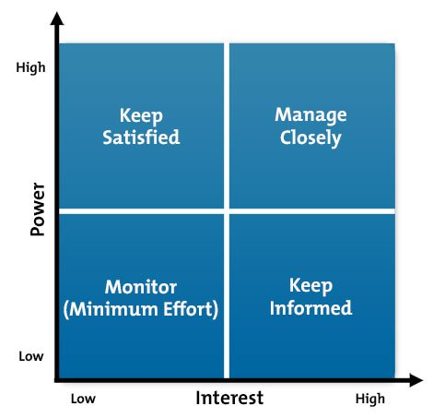
Stakeholders
“A person, group or organisation that has interest or concern in an organisation” Business Dictionary
Stakeholder support and interest is key
Stakeholder Analysis
This image was gathered from https://www.mindtools.com/media/Diagrams/stakeholdergrid1new.jpg
Notes:
A stakeholder as defined by the Business Dictionary is “A person, group or organisation that has interest or concern in an organisation” (Business Dictionary, 2019) This can be anyone from a customer, the local community or employees of the business. Literally anyone with an interest in the business.
If all stakeholders of a business are able to be satisfied then the business is likely to be lot more successful as everyone who is affected by the business will be happy.
A steakholder analysis if often carried out in order to identify all the stakeholders.
Analysis begins with identifying the stakeholders, next you asses their power, influence and interest in the business then define their needs and requirements.

Slide 10
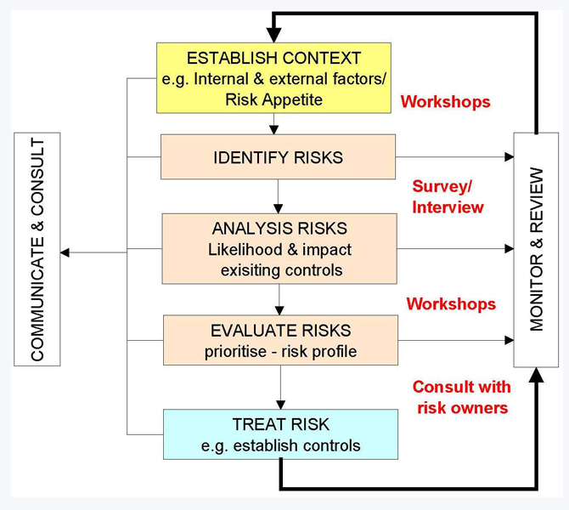
Risk
www.uws.edu.au/__data/assets/image/0010/535645/risk_management_process_670x600.jpg
Notes:
Every company in the world faces risk. Whether that’s from competitors, no customers, legislation etc. Everyone faces it. Risk management can become essential within some businesses to help minimize/ avoid any damage.

Slide 11
References
Image gathered from https://eohhighveld.co.za/wp-content/uploads/2017/11/The-Golden-circle-1-1200x854.png
https://www.youtube.com/watch?v=qp0HIF3SfI4&feature=youtu.be TEDTalk youtube video hosted by Simon Sinek, posted 4 May 2010. 4:34- 4:38
Chapter 2: Scientific Management Page 11 of Introduction to Management by Richard Pettinger 1994.
DK Essential Managers: Project Management by Peter Hobbs, 2015 Page 7
Online article gathered from https://www.apm.org.uk/resources/what-is-project-management/ What is Project Management? By Association of Project Mangement

Slide 12
What is the Waterfall Methodology | Process, Advantages and Disadvantages Online article written by Umar Farooq for BusinessStudyNotes accessed on 28/11/19 at 13:40 from www.businessstudynotes.com/finance/project-management/waterfall-methodology-process-advantages-disadvantages/
What is Agile Methodology? How It Works, Best Practices, Tools by Stackify online article accessed on 28/11/19 at 14:19 from https://stackify.com/agile-methodology/
What is PRINCE2? (in 100 seconds) 0:36-0:46 Youtube video by AXELOS Global Best Practice posted on 13/04/17 accessed from https://www.youtube.com/watch?v=61RnrsWQE7A
Stakeholder by Business Dictionary online article accessed on 28/11/19 at 21:07 www.businessdictionary.com/definition/stakeholder.html

