Slide 1
Passport Portfolio.
Nia Abby Mugford – 2404769.

Slide 2

All About ABTA
-- travel with confidence
- ABTA code of conduct
- financial
- about ABTA
- working with the industry

Slide 3

FCDO.

Slide 4

Visit Wales.

Slide 5
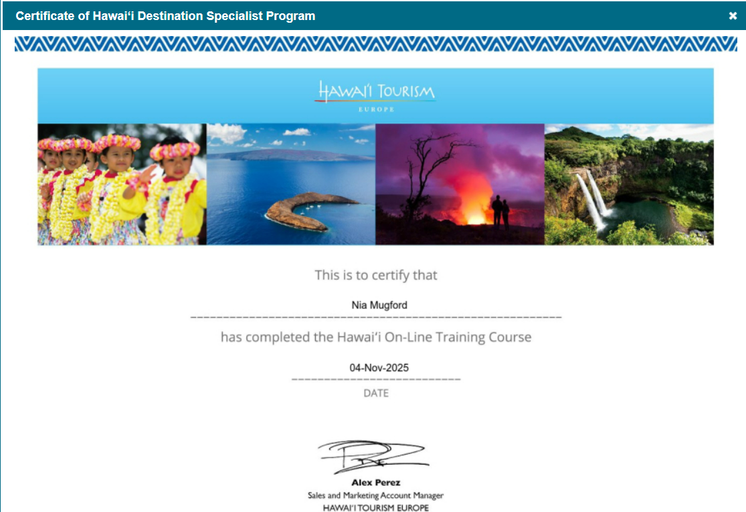
Travel Uni
(Hawaii)
- hawaiian islands

Slide 6

Travel Uni
(Korea)
- food and culture history and heritage travel toolbox nature, adventure and wellness

