Slide 1

Student name:Misjona Kovaci
Student ID:2226356
Module name: Empowering the Older Person
Module code: BMHP6027-LONDON
Lecturer’s name: Christopher Mafuva
No AI was used in the creation of my poster.

Slide 2
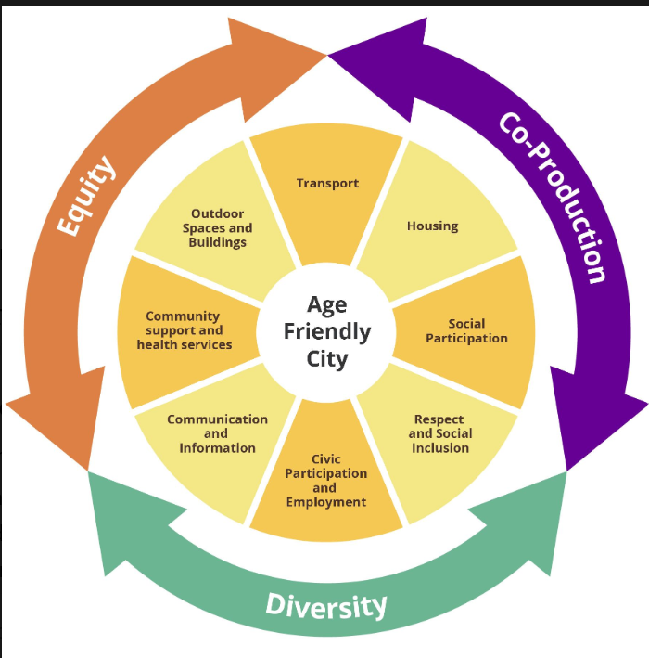

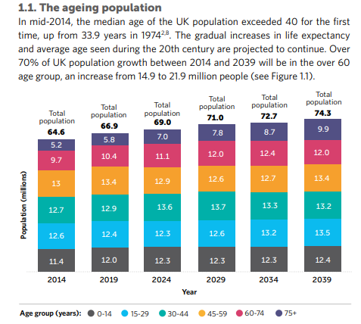
Evaluating the Care and Support Needs of Older People
1. Functional Ability
Functional ability enables older people to carry out daily activities, maintain independence and improve their quality of life. It is influenced by both personal health and the surrounding environment (Woo, 2017; Welch et al., 2021).
Evidence suggests that rehabilitation, assistive technology and community-based services can help maintain physical and cognitive function, allowing older adults to remain active for longer (Welch et al., 2021).
A supportive environment, including appropriate lighting and reduced noise, can improve wellbeing and encourage participation in everyday activities, although individual needs may vary (Mu et al., 2025).
2. Independence
Independence is important for maintaining dignity, confidence and overall wellbeing in later life. Many older people prefer to remain living safely in their own homes for as long as possible (Nivestam et al., 2025).
Preventive home visits, health education and community support can help identify risks early and reduce avoidable hospital admissions, promoting independent living (Nivestam et al., 2025).
Independence should be supported through personalized services that balance safety with individual preferences and promote confidence (Taylor et al., 2025).
3. Freedom and Choice
Older people should be involved in decisions about their care and treatment, ensuring that their values, preferences and personal goals are respected (NHS England, 2019).
Shared decision-making helps individuals understand available options and make informed choices, leading to greater satisfaction and better engagement with care (NHS England, 2019).
Promoting freedom and choice empowers older people and supports person-centred care, although healthcare professionals should provide appropriate guidance when complex decisions are required (NHS England, 2019).
4. Person-Centred Support
Person-centred support focuses on understanding each person's individual needs, preferences and life goals rather than concentrating only on medical conditions (Persson Kylén et al., 2025).
Collaborative care planning encourages older people, families and healthcare professionals to work together, improving communication and continuity of care (Persson Kylén et al., 2025).
Integrating personalised care with shared decision-making can improve health outcomes and empower older people to take an active role in managing their own health (NHS England, 2019).
  Figure 1. WHO Age-Friendly Cities Framework showing the eight domains that support healthy and active ageing (World Health Organization, 2007)
Introduction
Figure 3. Illustration of person-centred care and shared decision-making to support older people (Royal Open College, 2026).
The UK has an ageing population, with people living longer than previous generations. This creates new challenges for health and social care services (Government Office for Science, 2016).
As people age, they are more likely to develop long-term conditions, frailty and dementia, increasing the need for health and social care support (Wittenberg et al., 2020).
Healthy ageing is not only about living longer; it also involves maintaining good physical health, mental wellbeing, independence and social participation (Whitely et al., 2016).
Healthy ageing also focuses on enabling older people to remain active, independent and engaged in their communities (World Health Organization, 2007).
Empowering older people through person-centred care helps them make informed choices, remain independent and improve their quality of life (Government Office for Science, 2016).
This poster critically evaluates the care, empowerment and support needs of older people and explores evidence-based approaches used in the UK to promote healthy ageing and independence.
Challenges Encountered by Older People in Maintaining Independence and Functional Ability
Frailty and Physical Decline
  Frailty can reduce strength, balance and mobility, making everyday activities more difficult. This increases the need for health and social care support while reducing independence (Hojjati Kermani et al., 2025).
Social Isolation and Loneliness
  Limited social contact may affect both physical and mental wellbeing. Loneliness has been linked with poorer health outcomes, lower quality of life and a greater risk of losing independence (Hawthorne, 2006).
Ageism and Inequality
  Negative attitudes towards ageing can influence access to healthcare and social support. Older adults may experience discrimination, reducing opportunities to make choices and participate fully in society (Kydd and Fleming, 2015; Centre for Ageing Better, 2023).
Poor Nutrition
  Poor dietary habits may increase the risk of frailty and muscle weakness, making it more difficult for older people to remain active and independent. Early nutritional support can help maintain physical function (Hojjati Kermani et al., 2025).
Recommendations and Conclusion
Theoretical and Policy Approaches
Activity Theory (1963)
Remaining physically, socially and mentally active supports healthy ageing, improves wellbeing and helps older people maintain independence (Morgan and Kunkel, 2011).
Continuity Theory (1968)
Maintaining familiar routines, relationships and personal values helps older adults adapt to ageing and supports person-centred care (Morgan and Kunkel, 2011).
Care Act 2014
Promotes wellbeing, prevention and personalised care, helping older people remain independent through individual needs assessments and tailored support (Care Act 2014).
NHS Shared Decision Making (2019)
Encourages older people to take part in decisions about their care, improving autonomy, choice and personalised support (NHS England, 2019).
Increase access to person-centred and community-based care to help older people remain independent and active (Welch et al., 2021; NHS England, 2019).
Promote shared decision-making so that older people are involved in planning and making choices about their own care (NHS England, 2019).
Improve preventive services, including home visits, rehabilitation and health promotion, to maintain functional ability and reduce avoidable hospital admissions (Nivestam et al., 2025).
Provide training for health and social care professionals to reduce ageism and deliver respectful, personalised care (Kydd and Fleming, 2015).
Empowering older people requires person-centred care, early support and active participation in decision-making. By promoting independence, functional ability and personalised services, health and social care providers can improve wellbeing and quality of life for older adults.
  Figure 2. UK population estimates and projections by age group (Government Office for Science, 2016, based on ONS population projections).

Slide 3
References
Age Uk (2017). What Is ageism? | Discrimination & Rights | Age UK. [online] AgeUK. Available at: https://www.ageuk.org.uk/information-advice/work-learning/discrimination-rights/ageism/.(Accessed: 29 August 2026).
Care Act 2014 (2014) Care Act 2014. Available at: legislation.gov.uk (Accessed: 29 August 2026).
Centre for Ageing Better (2023) Ageism: What's the harm? Available at: https://ageing-better.org.uk/sites/default/files/2023-02/Ageism-harms.pdf (Accessed: 26 August 2026).
Glendenning, F. (ed.) (2018) Teaching and Learning in Later Life: Theoretical Implications. Abingdon, Oxon: Routledge. Available at: Routledge (Accessed: 29 August 2026).
Goldsmith, T.C. (2016) ‘Evolution of aging theories: Why modern programmed aging concepts are transforming medical research’, Biochemistry (Moscow), 81(12), pp. 1406–1412. Available at: https://doi.org/10.1134/S0006297916120026 (Accessed: 29 August 2026).
Government Office for Science (2016) Future of an Ageing Population. London: Government Office for Science. Available at: GOV.UK (Accessed: 29 August 2026).
Hojjati Kermani, M.A., Awlqadr, F.H., Talebi, S., et al. (2025) ‘The association of ultra-processed food intake on age-related muscle conditions: a systematic review and dose–response meta-analysis with meta-regression’, Journal of Health, Population and Nutrition, 44, article 271. Available at: https://doi.org/10.1186/s41043-025-00986-0 (Accessed: 29 August 2026).
Kydd, A. and Fleming, A. (2015) Ageism and age discrimination in health care: Fact or fiction? A narrative review of the literature’, Maturitas, 81(4), pp. 432–438. Available at: https://doi.org/10.1016/j.maturitas.2015.05.002 (Accessed: 29 August 2026).
Lester, B. (2024) Combating ageism: Evaluating the impact of age-positive training in healthcare’, Innovation in Aging, 8(Supplement_1), p. 1196.
Morgan, L.A. and Kunkel, S.R. (2011) Aging, Society, and the Life Course. 4th edn. New York: Springer Publishing Company.
Mu, X., et al. (2025) The Effects of Indoor Acoustic and Visual Environments on the Mental Health of Older Adults: A Systematic Review.
NHS England (2019) Shared Decision Making: Summary Guide. NHS England. Available at: https://www.england.nhs.uk/wp-content/uploads/2019/01/shared-decision-making-summary-guide-v1.pdf. (Accessed: 29 August 2026).
Nivestam, A., et al. (2025) Key Areas of Preventive Home Visits and Their Importance for Older Adults: A Scoping Review.
Persson Kylén, S., et al. (2025) Evaluation of Collaborative Oral Health Care Planning to Promote Healthy Ageing.
Royal Open College (2026) How to Promote Empowerment in Health and Social Care. Available at: Royal Open College (Accessed: 29 August 2026).
Taylor, J., et al. (2025) Participation, Autonomy and Control are Shared Concepts within Older People's Interpretations of Independence.
Welch, V., et al. (2021) Health, Social Care and Technological Interventions to Improve Functional Ability of Older Adults Living at Home.
Whitely, E., Popham, F. and Benzeval, M. (2016) ‘Comparison of the Rowe–Kahn Model of Successful Ageing with Self-Rated Health and Life Satisfaction: The West of Scotland Twenty-07 Prospective Cohort Study’, The Gerontologist, 56(6), pp. 1082–1092.
Wittenberg, R., Hu, B., Jagger, C., Kingston, A., Knapp, M., Comas-Herrera, A., King, D., Rehill, A. and Banerjee, S. (2020) ‘Projections of Care for Older People with Dementia in England: 2015 to 2040’, Age and Ageing, 49(2), pp. 264–269.
Woo, J. (2017) Concepts and Frameworks of Healthy Ageing.
World Health Organization (2007) Global Age-Friendly Cities: A Guide. Geneva: World Health Organization. Available at: https://apps.who.int/iris/handle/10665/43755 (Accessed: 26 June 2026).

