Slide 1
November 2022
Sainsbury’s UK:
Structure,
Main Products and Strategies
Presented by:
R Manda
C Buzduga
R Ursachi

Slide 2
Outline
Introduction
Sainsbury’s PLC structure and Products
Sainsbury’s current business strategy
Recommended Strategies
References
Appendix

Slide 3
Introduction (cont.)
Sainsbury’s was chosen as research topic for the present group working project.
The following group working skills were used and developed during the project:
Communication - group members had to discuss and communicate among them to decide how to split the workload and which topics to cover
Time management - this was a challenging, but an important skill as all group members have other activities apart from their studies. Time management helped to adhere to the dead-lines
Problem-solving - one of the most important skills as everyone had different views and understanding of the project and workload and it was important to work together and solve the disagreements.

Slide 4
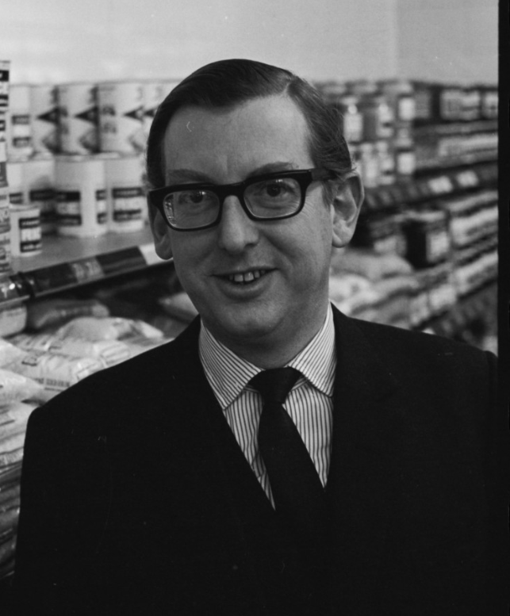
Introduction (cont.)
J Sainsbury plc, trading as Sainsbury's, is the second largest chain of supermarkets in the United Kingdom, with a 14.9% share of the supermarket sector (Grocery Market Shares in Great Britain (GB) 1997-2022, 2022)
Sainsbury’s was founded in 1869 by John James Sainsbury and his wife Mary Ann Sainsbury, in London, England, and grew rapidly during the Victorian era. It grew to become the largest grocery retailer in 1922, pioneered self-service retailing in the UK and was the largest UK retailer of groceries for most of the 20th century (The Sainsbury’s History, Official Website)

Slide 5
Introduction (cont.)
Number of employees: 180,000 (2021)
Number of locations: 1,428 shops (March 2019)
Revenue: £29.048 billion (2021)
Net income: £(280) million (2021)
As of 2021, the largest overall shareholder is the sovereign wealth fund of Qatar, the Qatar Investment Authority, which holds 14.99% of the company.
Sainsbury’s supply chain now operates from 13 regional distribution centres, with two national distribution centres for slower moving goods, and two frozen food facilities (Sainsbury’s Official Website)
Source: Sainsbury’s Official Website
https://www.about.sainsburys.co.uk/about-us

Slide 6
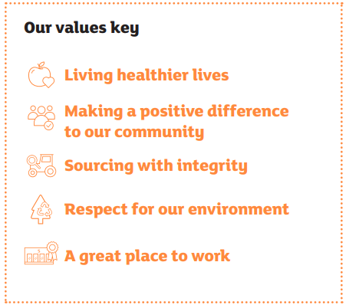
Introduction (cont.)
Sainsbury’s Values:
Source: Sainsbury’s Official Website
https://www.about.sainsburys.co.uk/~/media/Files/S/Sainsburys/sainsburys-ar2019-values.pdf

Slide 7
Sainsbury’s PLC Structure and Products
The holding company, J Sainsbury plc, is split into three divisions:
Sainsbury's Supermarkets Ltd (including convenience shops, Sainsbury's Cafes, National and Regional Distribution Centres, Petrol Stations)
Sainsbury's Bank
Argos
Source: Sainsbury’s Official Website
https://www.about.sainsburys.co.uk/about-us

Slide 8

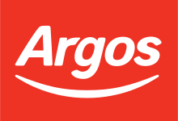
Sainsbury’s PLC Structure and Products (cont.)
Brands that deliver on behalf of J Sainsburys Plc:
Nectar - Sainsbury’s way of saying thank you to their customers:
18m active Nectar points collectors
Over 300 Nectar partners to collect with
Argos - one of the biggest UK retailers with over 60.000 products in store and online.
Over 1.000 shops in the UK
over 1bn visits to Argos website every year
Source: Sainsbury’s Official Website https://www.about.sainsburys.co.uk/brands-that-deliver/

Slide 9

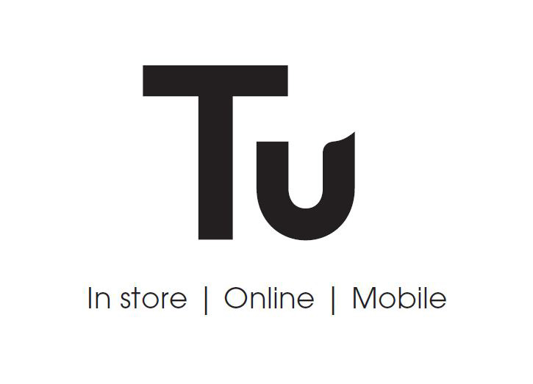
Sainsbury’s PLC Structure and Products (cont.)
Brands that deliver on behalf of J Sainsburys Plc:
Habitat - high quality home products:
3 showrooms
1 Design Studio in London
over 4.500 unique products
Over 600 stores
Tu Clothing- 6th largest clothing retailer in the UK
3.000 items
Over 400 stores
5 years on TU Clothing online
Source: Sainsbury’s Official Website https://www.about.sainsburys.co.uk/brands-that-deliver/

Slide 10

Sainsbury’s PLC Structure and Products (cont.)
Brands that deliver on behalf of J Sainsburys Plc:
Sainsbury’s Bank - the first supermarket bank that opened in the UK.
Loans, Credit Cards, Savings, Mortgages, Insurance, Travel Money
1.370+ ATMs in the UK
200+ Travel Money Offices
2.100 colleagues in the UK
8+ Financial Products
Source: Sainsbury’s Official Website https://www.about.sainsburys.co.uk/brands-that-deliver/

Slide 11
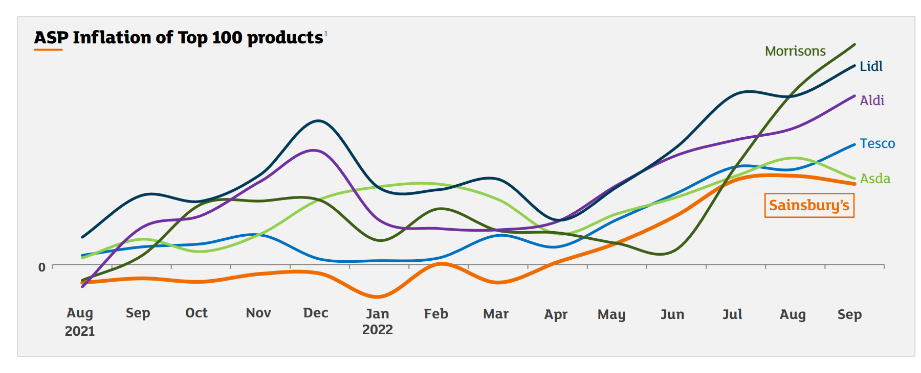
Sainsbury’s current business strategy
Sainsbury’s Average Selling Prices (ASP) are not growing as fast as it happens for its main competitors:
Source: Sainsbury’s Official Website https://www.about.sainsburys.co.uk/news/latest-news/2021/28-04-21-preliminary-results

Slide 12
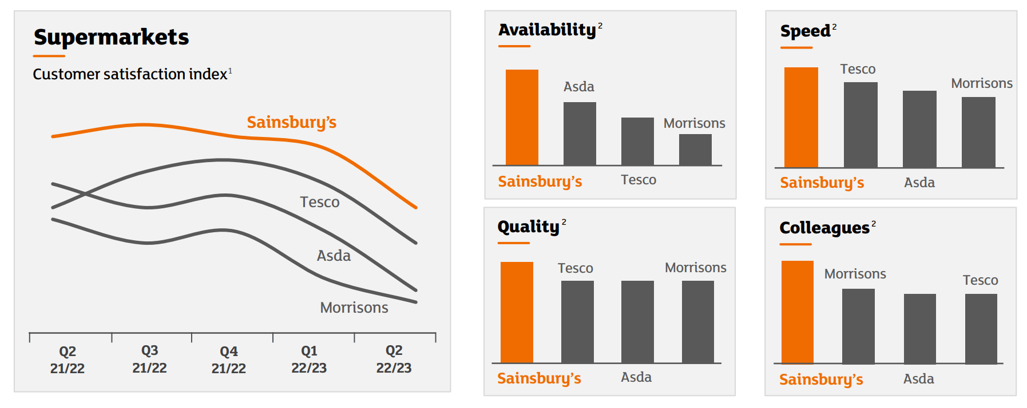
Sainsbury’s current business strategy (cont.)
Ahead of competitors on customer satisfaction:
Source: Sainsbury’s Official Website https://www.about.sainsburys.co.uk/news/latest-news/2021/28-04-21-preliminary-results

Slide 13
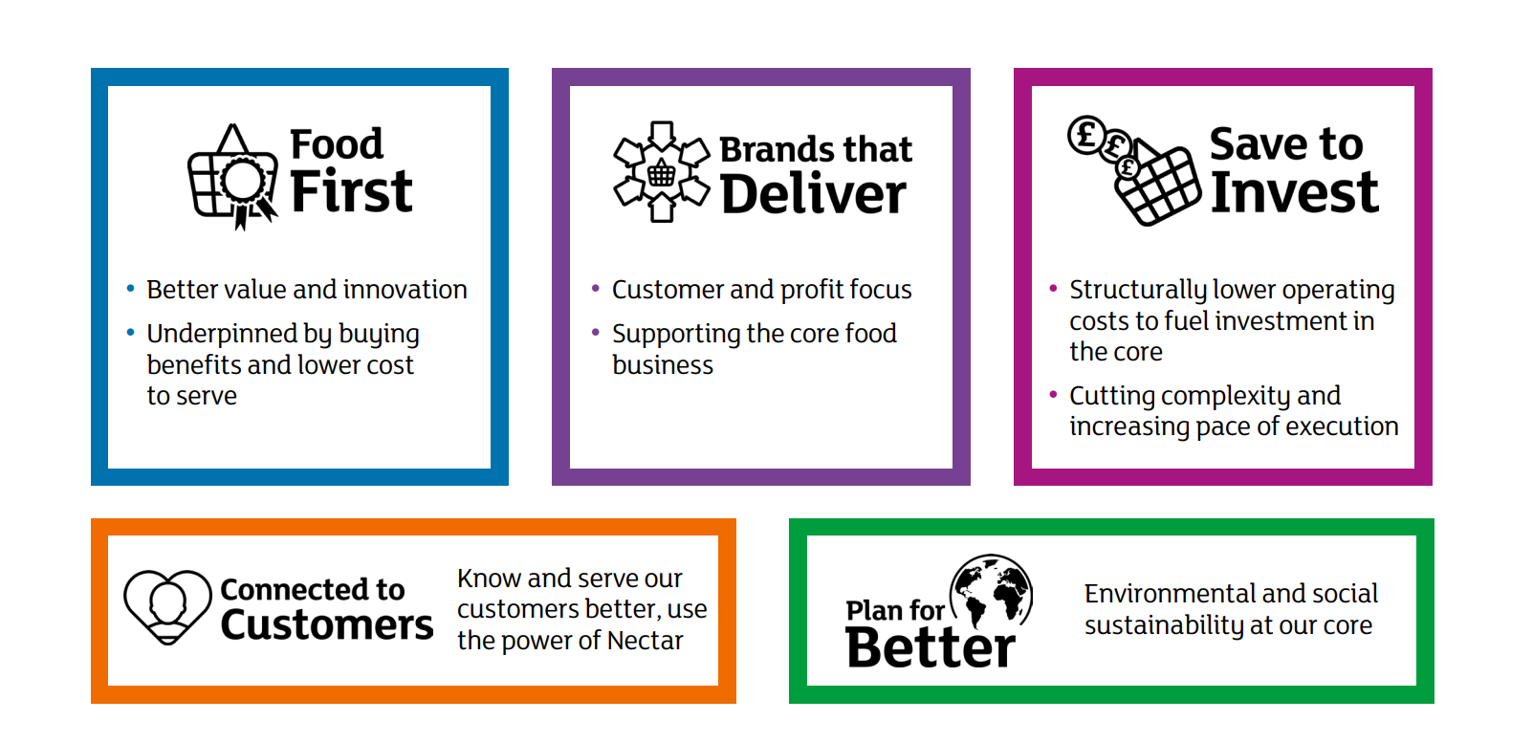
Sainsbury’s current business strategy (cont.)
Sainsbury's priorities:
Source: Sainsbury’s Official Website https://www.about.sainsburys.co.uk/news/latest-news/2021/28-04-21-preliminary-results

Slide 14
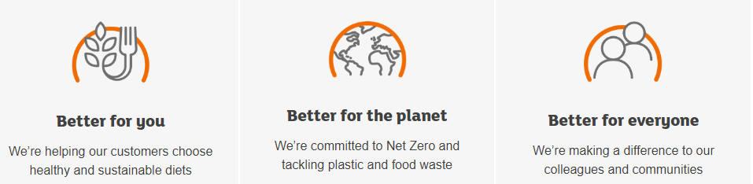
Sainsbury’s current business strategy (cont.)
Sainsbury’s Plan for Better:
Source: Sainsbury’s Official Website https://www.about.sainsburys.co.uk/~/media/Files/S/Sainsburys/documents/sainsburys-priorities.pdf

Slide 15
Sainsbury’s current business strategy (cont.)
Sainsbury’s Plan for Better:
In 2015 the United Nations published the UN Sustainable Development Goals (SDGs) - 17 ambitious goals which aim to end poverty, protect our planet and increase prosperity and peace for all.
As part of our Plan for Better Sainsbury’s supports and contributes to these goals:
investment into local communities
reducing emissions to tackle climate change
promoting sustainable agricultural practices in their supply chains
ensuring diversity and inclusion within organisation
Source: Sainsbury’s Official Website https://www.about.sainsburys.co.uk/~/media/Files/S/Sainsburys/documents/sainsburys-priorities.pdf

Slide 16
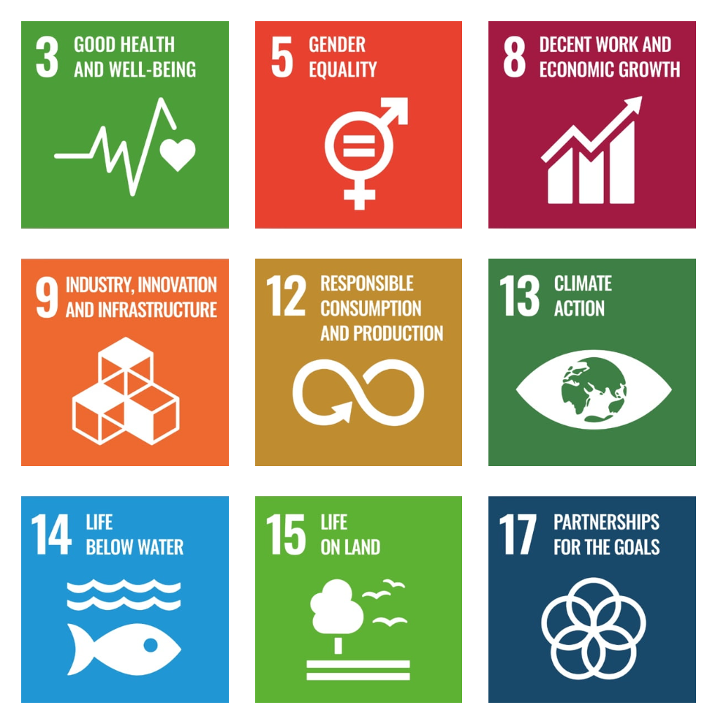
Sainsbury’s current business strategy (cont.)
Sainsbury’s
Plan for Better:
Sainsbury’s sustainability
agenda is aligned to the
UN SDGs goals so that they can
help create a more
sustainable future for all.
Source: Sainsbury’s Official Website https://www.about.sainsburys.co.uk/~/media/Files/S/Sainsburys/documents/sainsburys-priorities.pdf

Slide 17
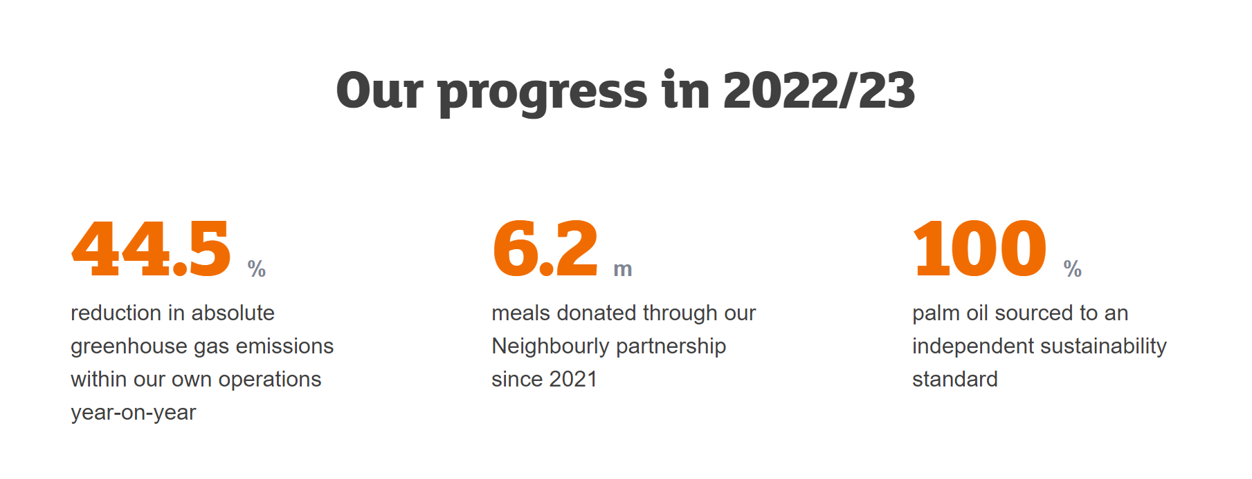
Sainsbury’s current business strategy (cont.)
Sainsbury’s Plan for Better:
Source: Sainsbury’s Official Website https://www.about.sainsburys.co.uk/~/media/Files/S/Sainsburys/documents/sainsburys-priorities.pdf

Slide 18
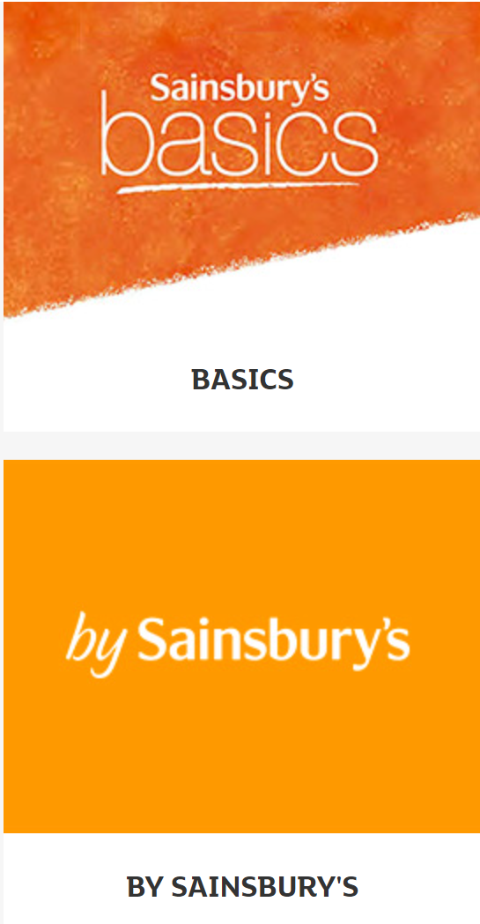
Recommended Strategies
Sainsbury’s current strategies are quite robust and adapted to the new post-pandemic and cost of living crisis realities as illustrated in the above flowcharts.
There are however a few things that can be improved to attract even more customers and increase customer satisfaction:
Strengthen Sainsbury's own brand - this will help to reduce the food waste even more and these products are always cheaper than branded ones which will attract more customers.

Slide 19

Recommended Strategies (cont.)
Improve the existing Nectar Loyalty Program - to beat its competitors, Sainsbury’s should offer something unique and more financially attractive. For example, after spending £500 through Nectar Loyalty program a customer ends up with a £2.50 voucher, while Tesco Club Card Loyalty Program offers £1 for each £100 spent at Tesco.

Slide 20
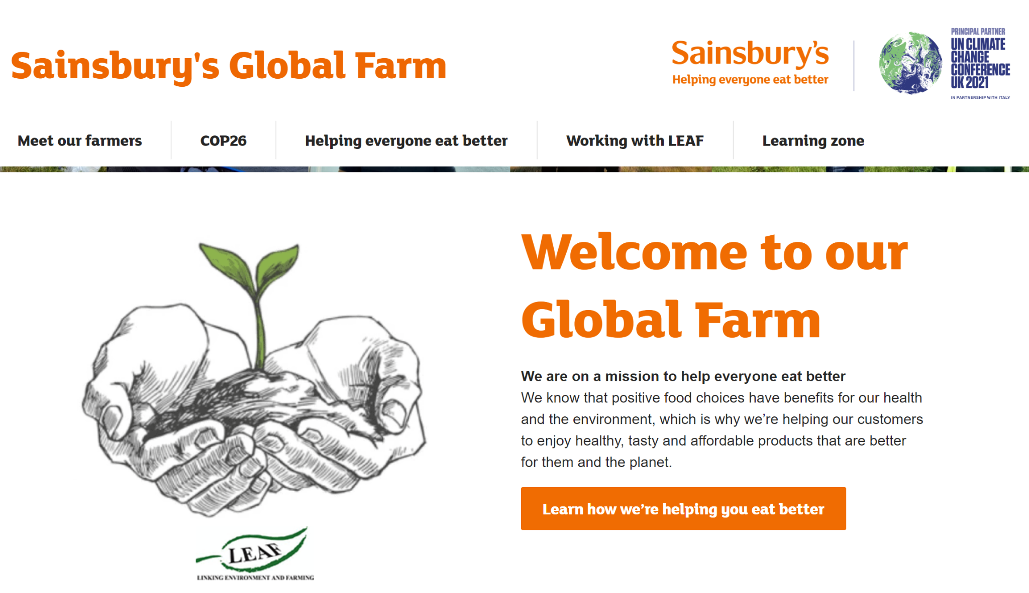
Recommended Strategies (cont.)
Actively promote Sainsbury’s Global Farm and make the products sourced from British farmers and growers more visible on the shelves

Slide 21
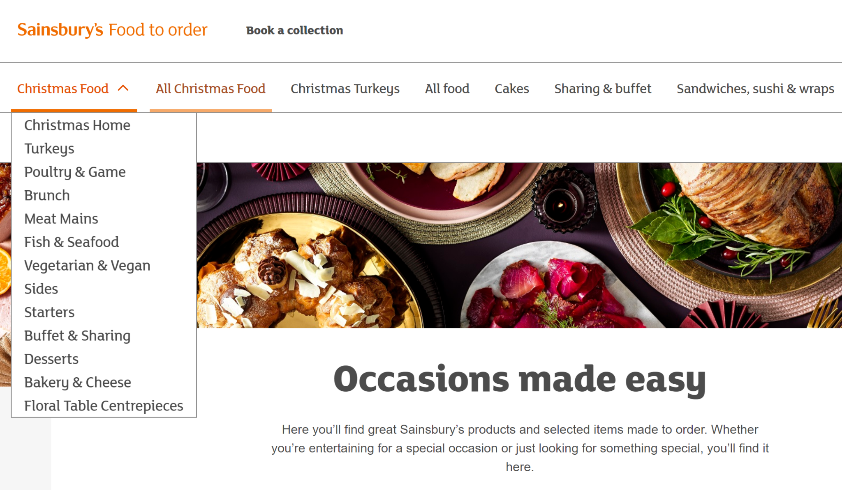
Recommended Strategies (cont.)
Actively promote Sainsbury’s Food to Order platform and make this service more visible and accessible from other Sainsbury’s platforms.

Slide 22
References
Grocery Market Shares in Great Britain (GB) 1997-2022: https://retailwit.com/grocery-market-shares-in-great-britain-gb-1997-2022/
J Sainsbury plc, Interim Result for 2022/23. Available at: https://www.about.sainsburys.co.uk/~/media/Files/S/Sainsburys/documents/reports-and-presentations/2022/Interims%202223/J%20Sainsbury%20plc%20Interim%20Results%202223%20Presentation.pdf
Sainsbury's Marketing Strategy & Marketing Mix (4Ps), available at: https://www.mbaskool.com/marketing-mix/services/16809-sainsburys.html
Sainsbury’s official website: https://www.about.sainsburys.co.uk/about-us

Slide 23
THANK YOU!

