Slide 1
Module Title: Professional Career Development within H&SC
Module Number: LCHS 4009 (LON)
Assignment No: ASSIGNMENT 1
Student Name:Ginalyn E. Leal
Student ID: 2515491
Lecturer’s Name:Soban Sadiq

Slide 2
AI Acknowledgement
AI was used just to confirm / checked my own analysis and academic standards , every text created by AI has been thoroughly reworked, and all major concepts, arguments, and conclusion are my own.

Slide 3
Introduction
Good afternoon everyone. My name is Ginalyn E. Leal, currently studying for an HE Certificate in Health and Social Care at the University of Wales Trinity Saint David, London Campus my student no.2515491.
Presentation Objectives:(Gibbs Reflective Cycle)
The description
My feelings
The evaluation
The analysis
The conclusion
My action plan for future practice

Slide 4
What is your chosen skill?
  My chosen skill: Reflection
  Examining past experiences, actions and choices to determine what worked, what could be improved , and what you have learned.
  In the Practice
  Listening feedback from others and using it to improve.
  Thinking about what went well and what could have been done differently.
  Setting goals to develop knowledge, skills, and confidence.
  Taking time to review situations after they happen
  Where and how to Developed
  By applying what I have learned to improve my practice in future situation.
  During placement by reflecting on a patient care and daily experiences.
  Through University assignments and personal study.
  Conversations with tutors and placement supervisors and going over my own worked after shifts

Slide 5
Importance of Reflective in Professional Practice
Reflection learn from the experience, improve practice, and keep care safe, compassionate and person-centred.
Supports safe care and quality outcomes :
Aligns with professional standards (NMC /Social Care Wales )
Catches gaps or mistakes before they cause harm.
Helps adapt practice to meet changing needs.
Explain how your chosen skills benefits:
Service Users:
Reduces risks of repeated errors; build trust
Care becomes more personalised and consistent
Staff and Colleagues:
Encourages shared learning across the team
Boosts skills and confidence; lower burn out
Organization:
Reduces complaints and costly incidents

Slide 6
continuation:
Risks is occurs if not used:
Stagnant skills and falling regularly standards
Repeating errors or outdated practice
Poor judgement , missed risks, lower team accountability
Examples:
Focused handover

Slide 7
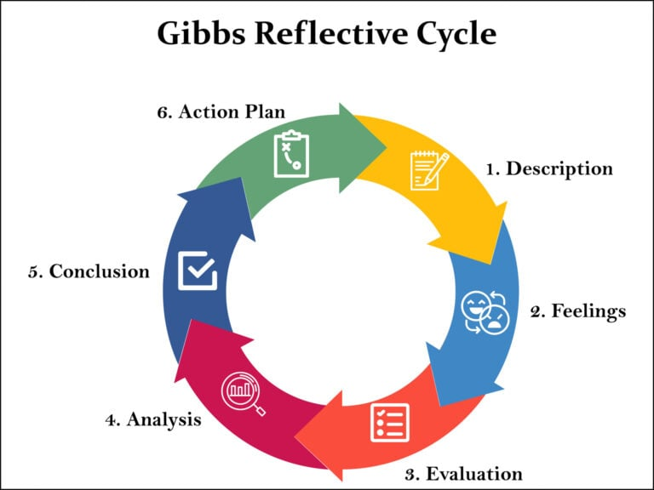
Model or framework linked to your chosen skill
Linked Model: Gibb’s Reflective Cycle
Briefly explain:
  What is this model?
  A systematic, six-step cyclical model created by Graham Gibbs( 1988) to facilitate reflective thinking ,about experiences transforming practice into learning and enhanced action.
  What are its key stages or components?
  1.Description: Give a detailed count of what transpired without passing judgement or offering an opinion
  2.Feelings: Record your feelings and ideas both during and after the event
  3.Evaluation: Determine what worked and what needs improvement
  4.Analysis :Examine the causes of events and make connection s to fact and professional norms
  5.Conclusion: List the lessons you learned and the things could have done differently.
  6.Action Plan: Describe hoe this circumstance will help your skill and you do differently if it happens again (Bulman and Schutz,2023).
Explain:
  How does this model help professionals understand or use this skill in practice?
  By encouraging honest self-evaluation and more depth thought, Gibbs Reflective Cycle aids professionals in making sense of their experiences.
Keep this brief – focus on how the model supports good practice.

Slide 8
Model and Framework(Continuation)
It facilities learning to both successful and difficult circumstances, which enhances communication, decision making, and career advancement.
I can recognize my strength and weaknesses by going each step and devise worthwhile initiatives. This strategy transforms everyday encounters into enchanced for going improvement and increased effectiveness. Person centred –practice.
The model good practice supports:
Eliminates Bias
Links theory with practice
Incorporates emotions
Promotes enchancement
Encourages collaborations

Slide 9
Applying Reflection in practice
Where would you use this skill?
Role: Registered NURSE
Setting: Elderly Inpatient in care ward
What might be the situation?
An 82- year –old resident with dementia becomes distressed and refuses personal care, after you changed your usual routine to cover a colleague’s shift
How you use reflection:
Take a moment to reflect on the exchange
In contrast to prior encounters
Draw learning to change practice
How reflection use actions:
Take your time, thoroughly explain every step, and get the patient’s family’s approval before proceeding
Update the care plan to reflect their requirement for consistent routine and advance explanation of care activities (Nursing and Midwifery Council, 2018)
  How does the skill guide your actions?
What is the impact on care
  Patient experience: Is honoured and they feel heard, safe, and less nervous.
  Safety and quality: Improves caregiver-resident connections and lower the of agitation or falls
  Outcomes: You get more empathy and self- assurance in adjusting care; future care is more individualised.

Slide 10
How does this skill support my future career?
Reflection: Why this skill matters?
For Employability:
Differentiates you from other candidates
Meets core NHS/ Social Care Wales recruitment standards
Supports teamwork, reduces errors and builds trust
Proves practical, safe and ethical competence
For health and social care roles;
Reduces risk of harm and ensures safeguarding compliance
Upholds legal duties (Care Act 2014, Health and Social Care Act 2008)
Works effectively with multi-disciplinary teams
Delivers person- centred, rights- respecting care
Personal reflection:
Strength: Already self- assured: successfully used in placements with favorable comments
Development goal: Improve abilities in stressful of emergency circumstances

Slide 11
Continuation:
Link to learning outcomes:
Readiness for practice: Facilities safe ,responsible participation from the start
Personal development: Promotes continuous CPD and increase self-awareness
Career: Planning facilities future advancement and is transfserable across care role

Slide 12
Conclusion
Employing models such as Gibb’s Reflective Cycle guarantees that reflection is comprehensive, equitable ,and results and actionable beneficial changes instead of merely reviewing past experiences.
It provides enhanced ,patient- focused care, fosters improved teamwork, and staff wellbeing, and minimizes risks while boosting compliance for organization
It is a crucial career : it enhances employability, satisfies regulatory standards and aids in your development as forthcoming care professional.
In the end , reflection transforms daily experiences into more compassionate ,secure and efficient care.

Slide 13
References List
.
Bulman, C. and Schutz, S. (2023). Reflective Practice in Healthcare.6th edn. London SAGE Publications.(Accessed: 27 June 2026)
Gibbs, G .(1988). Learning by Doing: A Guide to Teaching and Learning Methods . 0xford Further Education Unit. (Accessed: 3 July 2026)
Nursing and Midwifery Council (2018). The Code: Professional Standards of Practice and Behaviour for Nurses, Midwives and Nursing Associates NMC. Available at: https://www.nmc.org.uk/ standards/code/. (Accessed: 15 July 2026)

Slide 14
Assignment 1 – MARKING
Evidence of research
A minimum of two sources of published information must be included and be correctly referenced using UWTSD Harvard referencing style.
2) Knowledge and Understanding Skills
Students need to demonstrate an understanding of the chosen skill.
3) Analytical and Cognitive Skills
Students need to coherently structure their presentation and expand on the points made in their slides.
Students need to justify the relevance of the skill in relation to professional practice within health and social care.
4) Practical skills
At least one practical example of how a chosen key skill(s) can be used in a chosen job role (for example, understanding how effective communication can impact patient care)
Students should include one relevant model relevant to a chosen key skill (for example, Tuckman’s model of team development or Fishbone, etc)
5) Transferable Skills for Life and Professional Practice
Presentations should be engaging in their design, organisation and style.
Students should use a professional tone to present and answer any questions from their assessor

