Slide 1
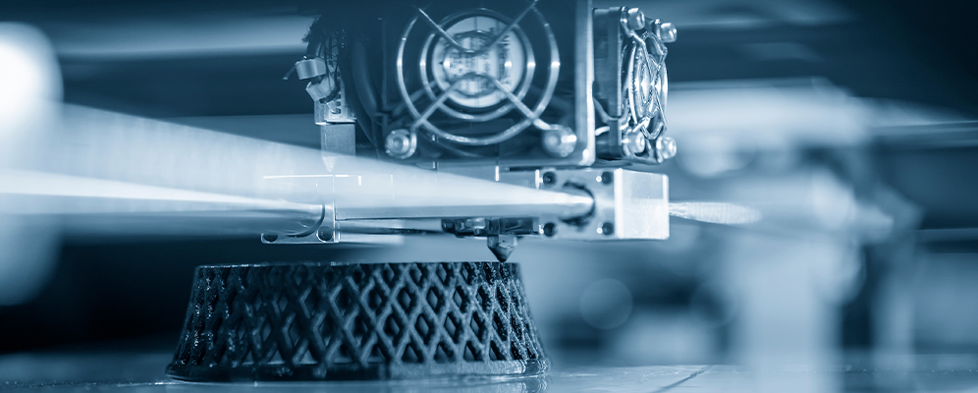
Design for Additive
Manufacturing
Jordan R. Jenkins

Slide 2


For Smart Phone & Tablet (recommended)
Download Poll Everywhere from the app store
Launch the app
Under “Join Presentation” enter: jordanjenkin530
For PC & Laptop
Go to PollEv.com
Enter: jordanjenkin530
Notes:
Poll Title: Join instructions
https://www.polleverywhere.com/join_instructions

Slide 3
Session Overview
Recap on the fundamentals of additive manufacturing.
Review ‘Design for X’ principles, with particular attention paid to Design for Additive Manufacturing (DfAM).
Introduce key material properties, including: isotropy & anisotropy in additive manufacturing.
Discuss how the application of additive manufacturing can bring about design opportunities, including topology optimisation.

Slide 4
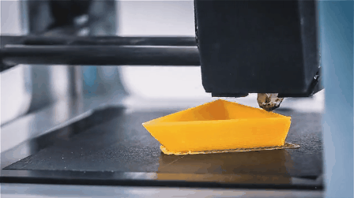
Recap – What is Additive Manufacturing?
A layer-based automated manufacturing process, often referred to as 3D printing, capable of producing 3D-objects directly from 3D-CAD geometry.
Additive manufacturing seems new to many, but it has actually been around for several decades.
In the right applications, additive manufacturing delivers improved performance, complex geometries, single step processes and consolidated tooling & assemblies.

Slide 5
Recognised Industrial Technique or Exotic Niche?
(It’s not just a rapid prototyping tool you know!)
Since the first additive manufacturing systems came about (Hull’s Stereolithography apparatus–1984), many within manufacturing have viewed it as an exotic niche or a tool limited to rapid prototyping.
However the refinement of existing processes, development of new processes, and a ever increasing range of print materials has led to an increased adoption of such processes for the manufacture of finished/consumer grade products.
Additive manufacturing is widely considered to be core Industry 4.0 technology (and a enabler of ‘batch-size one’).

Slide 6
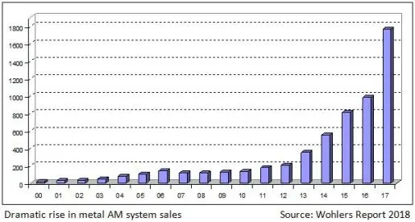
The Rise of Additive Manufacturing

Slide 7
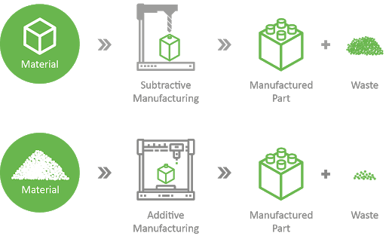
Additive Vs Subtractive Methods

Slide 8
Additive Vs Subtractive Methods
Additive Manufacturing | Subtractive Manufacturing
Creates the object geometry by sequentially adding layers. | Removes material to create the component geometry.
Can produce parts that require detail within internal and enclosed geometries, attributed to the layers-by-layer fabrication. | Not ideal / feasible for parts with particular intricacies and details, cannot easily create complex internal or closed geometries.
3D printers can be linked directly to execution software and programs executed remotely (fully automated) | CNC operator/programmers required to generate tool paths and setup/tend machines (often partially automated)
Reduced reliance on machine tending and physical process monitoring. | Loading/unloading, G-code/toolpath generation & checking, component specific tooling and work holding etc.
Components often require post processing & surface finishing (removing supports, sanding & media blasting). | Components can often be finished in-process.
Notes:
Whilst

Slide 9
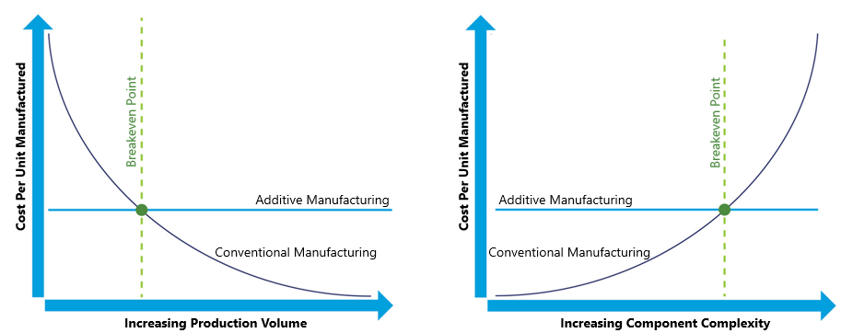
The Volume vs Complexity Dilemma
Notes:
What are these graphs showing you?
Subtractive is best suited to = high production volume – generally low complexity
Additive is best suited to lower production volumes – generally more complex components.

Slide 10
Additive Manufacturing Classifications
Material Extrusion
Powder Bed Fusion
Material Jetting
Sheet Lamination
Vat Polymerisation
Direct Energy Deposition
Binder Jetting
Notes:
Material extrusion or fused deposition modelling (FDM) is the most common additive manufacturing process. Polymeric material is drawn/ extruded through a nozzle (called the print head) at high temperature. The nozzle translated in x & y to create the model geometry layer by layer and the build platform (bed) translates vertically before each layer is deposited. The incident material melts the previously deposited layer, fusing them to create a bond.
Powder bed fusion = A laser or electron beam melts powdered metallic or polymeric material to fuse it together. The laser is directed by a series of steering mirrors. Once each layer is fused, A new layer of powder is spread across the previous layer by the roller and this process is repeated until the entire model geometry is formed. Common techniques include: Direct metal laser sintering (DMLS), electron beam melting (EBM), selective heat sintering (SHS), selective laser melting (SLM), and selective laser sintering (SLS).
Material Jetting = Material is ejected (jetted) from the nozzle (print head) onto the build platform, where it solidifies. the model is built layer by layer as material is deposited. Material use is limited, usually to low melting point polymers and wax. Interestingly, the technology used the same type of print heads found in normal inkjet paper printers.
Sheet Lamination = Sheet material is placed on the a cutting bed, material is bonded in place over the previous layer using adhesives or welding procedures. The desired shape is cut from the sheet using a laser or blade. The next layer is added and the process is repeated. Examples include: ultrasonic additive manufacturing (UAM) and laminated object manufacturing (LOM). UAM uses sheets of metal foil, which are bound together using ultrasonic welding, whereas LOM uses paper/plastic, bound using adhesive.
Vat polymerisation = A vat of liquid polymer resin is selectively cured using UV or Laser Light, to harden the material and construct the model layer by layer. Common examples include Stereolithography and digital light processing.
Direct energy deposition (DED) covers a range of processes including laser net shaping, directed light fabrication, direct metal deposition and 3D cladding. Material is sprayed from the nozzle onto the faces of the object where it is melted/fused using a laser, electron beam or plasma arc. It’s a highly complex process typically used to repair or add additional material to existing components, it often requires post processing using subtractive methods.
Binder Jetting = A liquid binding agent is selectively deposited or sprayed onto a powder bed, which joins the powder together to form the 3D part. No heat is required. The build platform lowers and a roller applies the next layer of powder and process repeats until object is complete. The selection of binder is determined by the type of powder used.

Slide 11
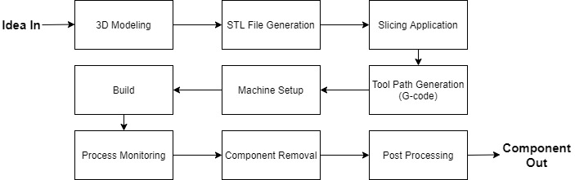
Generic AM Workflow
Notes:
3D model creation – 3D models of components are generated in CAD software, based off the (PDS) product design specification
STL file creation – STL files remove construction data of the model and breaks the surfaces down into a series of triangular facets, allowing geometry of individual layers to be obtained.
Slicing the 3D model / STL file means discretising or dividing the design into individual layers ready for printing.
Based off of the Slicing data, the system software generates tool paths for each print layer, the language used is simple g-code, the same as most CNC machines.
Machine Setup – printing materials are loaded into the machine and build parameters are entered, specific to the machine and part. E.g. setting variations in layer thicknesses and print speed.
Build – fabrication of the component begins. this procedure is completely automated, and entirely handled by the machines internal computer control system
Process monitoring, the machine uses a series of sensors/transducers to monitor the printing process, if there is any excessive variation in the print parameters, the print may be aborted to save print materials.
Part removal – involves removing the component from both the build platform and the support structure. Parts are typically adhered to the print bed an as such, solvents or hand tools are often required.
Post processing – post processing procedures are often required to remove remaining support materials, and general cleaning, polishing and media blasting processes are used to attaint the desired surface finish.

Slide 12
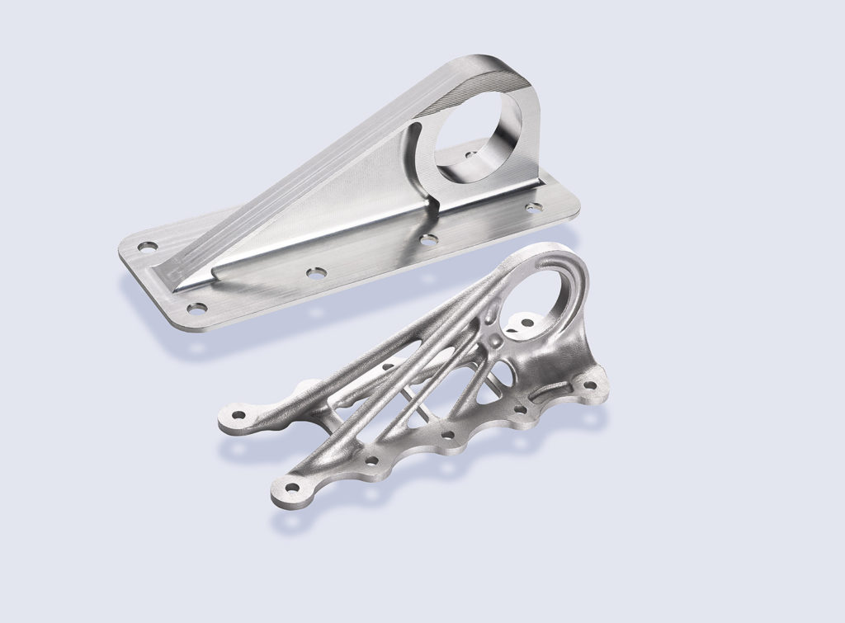
Ten Additive Manufacturing Benefits
Can easily achieve complex design geometries.
Allows for rapid prototyping (speed and cost).
Improved design freedom and optimisation (lighter, stronger & cheaper).
Reduced material waste and energy consumption.
Reduced tooling constraint/specificity & Continuous product improvement opportunity.
Less reliance on inventory (consolidated materials).
Ever Improving cost of entry.
Consolidation of components/assemblies.
Often more cost effective for small production volumes than producing bespoke tooling.
Recreate and optimise legacy parts.
(Airbus 3D printing enabled topology optimisation)
Notes:
Bespoke tooling

Slide 13
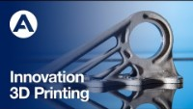
Airbus Example – (Make a note of some AM Benefits)
(Available at https://youtu.be/Cy3V3KR1LWc)

Slide 14
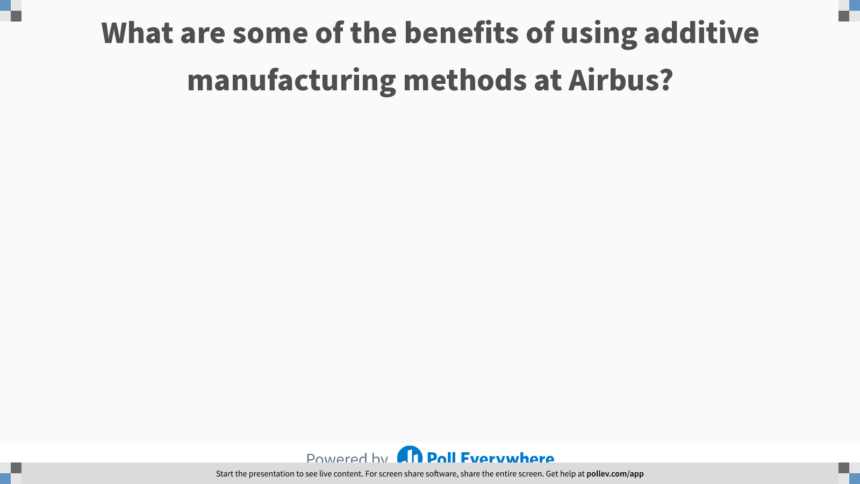
Notes:
Poll Title: Do not modify the notes in this section to avoid tampering with the Poll Everywhere activity.
More info at polleverywhere.com/support
What are some of the benefits of using additive manufacturing methods at Airbus?
https://www.polleverywhere.com/free_text_polls/duU88VYWNh4uEbb1hU6aW

Slide 15
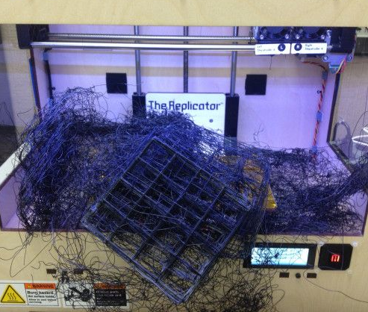
Great, so we have complete design freedom, right?
Not quite!
Like any manufacturing process, additive methods have their intrinsic constraints, including:
Limited feature size & print volumes.
Surface finishing (tribological features).
Overhanging features.
The need to minimize supports.
Component distortion & failed prints.
Material Isotropy & inhomogeneity.

Slide 16
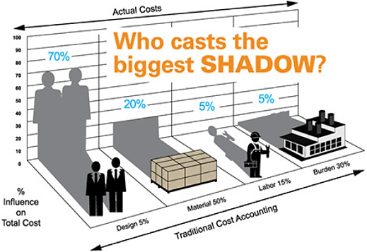
The Influence of
Design

Slide 17
Importance of Pursuing Continuous Improvement in Design
Product design is perhaps the most influential stage of production.
Many product failures and service upsets result from poor design or inadequate design processes.
Well considered designs reduce waste, direct/indirect costs and improve quality.
For example, simplifying designs often results in component consolidation, leading to fewer points of failure and less chance of assembly errors.

Slide 18
Design for X
(Also called Design for Excellence or DFX)
DFX originated from Six Sigma principles, and falls under the topic of Design for Six Sigma (DFSS).
A systematic design framework / approach used to achieve some targeted objective.
X represents the target objectives or desirable characteristics of a product or process.
X often represents features such as: cost, quality, reliability & manufacturability.

Slide 19
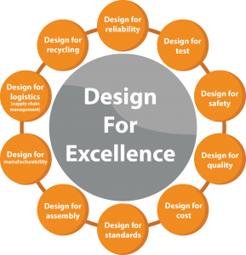
Design for X
X = Assembly (DFA)
X = Maintainability (DFM)
X = inspection (DFI)
X = Robustness (DFR)
X = Supply Chains (DFSC)
X = Safety (DFS)
X = recyclability (DFR)

Slide 20
Design for X General Principles
Constantly thinking in terms of how one can design or manufacture products better (continuous improvement).
Focusing on “doing all things right” rather than only “fixing things that have gone wrong”.
Defining customer expectations and aiming to exceed them.
Optimizing desirable design features or results.
Minimizing the overall cost without compromising quality.

Slide 21
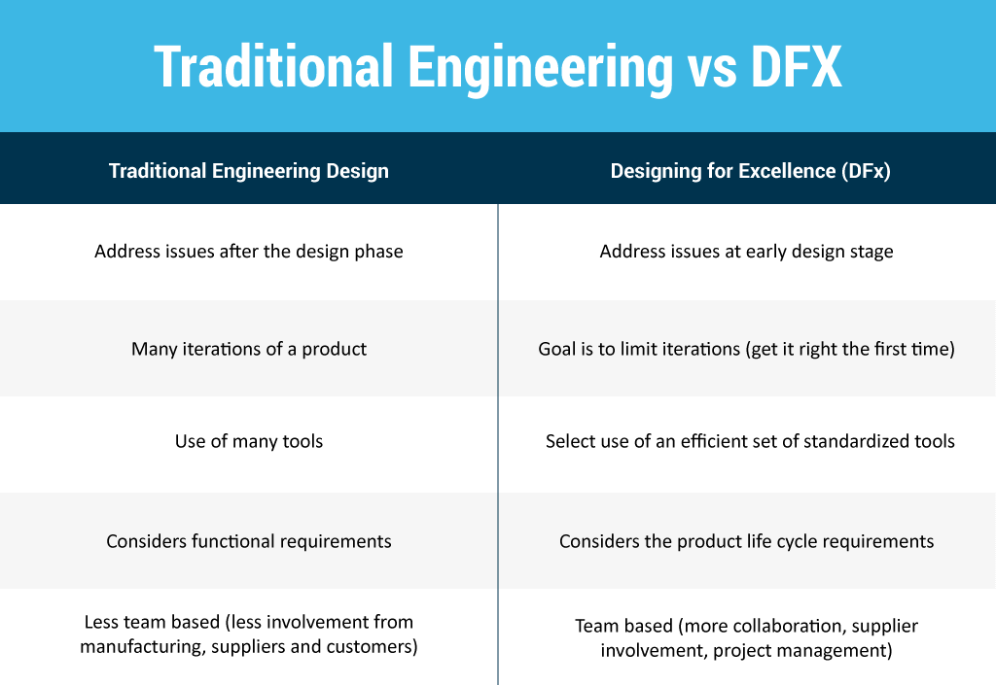

Slide 22
Design for Manufacture (DFM)
DFM is the process of designing a product for efficient production at the highest level of quality, it typically includes:
Designing/engineering a product in order to facilitate a given manufacturing process.
Reducing manufacturing cost.
Optimal deployment of all the manufacturing functions: fabrication, assembly, quality control, shipping, delivery, service, and repair.
Maintaining competitive priorities: cost, quality, reliability, regulatory compliance, safety, time-to-market, and customer satisfaction.

Slide 23
Generic DFM Roadmap
Minimize the number of parts in an assembly
Develop a modular design using standardised components
Eliminate in-process adjustments
Simplify assembly tasks (fool proof)
Use repeatable, standardised and well-understood processes
Design for Robustness
Design for efficient and adequate testing
limit engineering changes
Notes:
The reduction of the number of parts in a product is probably the best opportunity for reducing manufacturing costs. fewer parts implies less purchasing, inventory, handling, processing time, development time, equipment, engineering time, assembly difficulty, service inspection and testing, etc.
The use of modular components in product design simplifies manufacturing activities such as inspection, testing, assembly, purchasing, redesign, maintenance, service, and so on. Standard components are less expensive than custom-made items. The high availability of these components reduces product lead times. Also, their reliability is well known.
Avoid developing products that require manual adjustments or refinements during manufacturing to avoid assembly adjustment errors and eliminate adjustable components with high failure rates.
Ensure that parts cannot be assembled incorrectly, make sure its obvious when components are missing, that the part is designed around the assembly method/tooling, parts are self securing and that there is no force fitting of parts to avoid damage and improve serviceability.
Using repeatable, standardised and well-understood manufacturing processes allows us to have better control over component quality and assembly quality compared with an ad hoc/ made up as we go along approach.
The product should be able to perform its intended functions regardless of any sources of variation or external factors, such as manufacturing process variation, environmental conditions and a tolerance of incorrect/ misuse by the end user.
Design for efficient and adequate testing should allow a truer assessment of quality, minimising false positive and false negative detections and less unnecessary rework/ quality control activity.
Limiting engineering changes decreases the probability or errors due to change over, product revisions and new versions, errors are statistically most probable at the start and end of a product lifecycle, known as the bath tub curve.

Slide 24
Additive Manufacturing Design Options
Adaptation for AM (AfAM):
Redevelopment or modification of existing product designs to better suit the design constraints imposed by additive manufacturing; leveraging some of the AM specific benefits.
Existing product design specification (PDS) and system-level design reduce available design freedom.
Design for AM (DfAM):
The design and development of a new product; fully exploiting the opportunities provided by the AM technology.
Considerably more design freedom and ability to influence system-level design decisions.

Slide 25
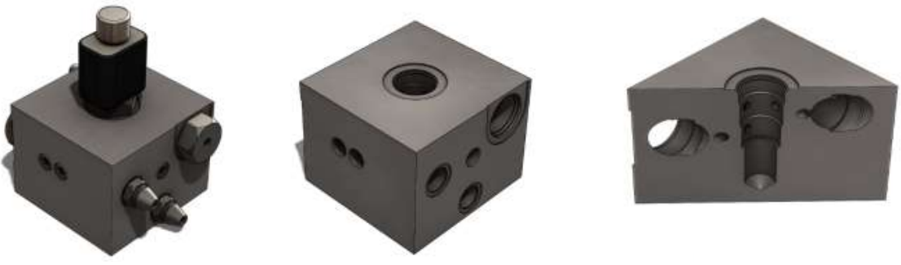
Renishaw Hydraulic Manifold Example
(Conventional Solution)
Mass = 4.6kg (10lbs)
Benefits:
Simple solution to the problem
Easy/simplistic design process
Uses traditional machining methods
Fast to manufacture (even at large volumes)
Limitations:
Sub-optimal performance due to cross drilling
Very inefficient use of materials (waste)
8 additional components required in the form of pressure plugs.

Slide 26
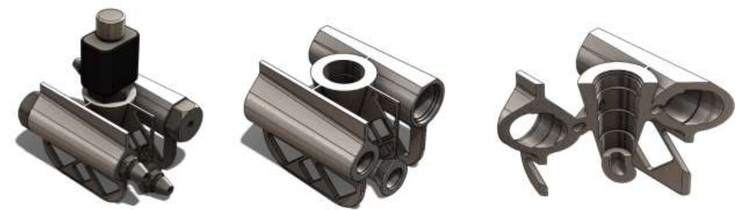
Renishaw Hydraulic Manifold Example
(Adaption for Additive Manufacturing Solution)
Mass = 1kg (2.2lbs)
Benefits:
Significant mass reduction
Improved hydraulic performance
‘Drop-in’ replacement for original part
1 part, no pressure plugs needed
Limitations:
Still requires some post-process machining
Horizontal passage ways need supports
Removal of material causes a loss of structural rigidity.

Slide 27
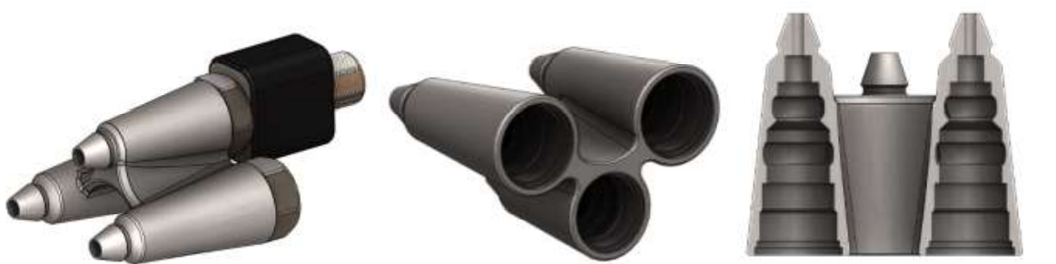
Renishaw Hydraulic Manifold Example
(Design for Additive Manufacturing Solution)
Mass = 0.4kg (0.89lbs)
Benefits:
Highly efficient use of material (little waste)
Aligned valves allows the part to be entirely self supported.
Consolidation of outlet ports into design.
Dramatic mass reduction
Limitations:
High degree of CAD complexity/difficulty
Not a ‘drop-in’ replacement for original parts, requires system redesign.

Slide 28
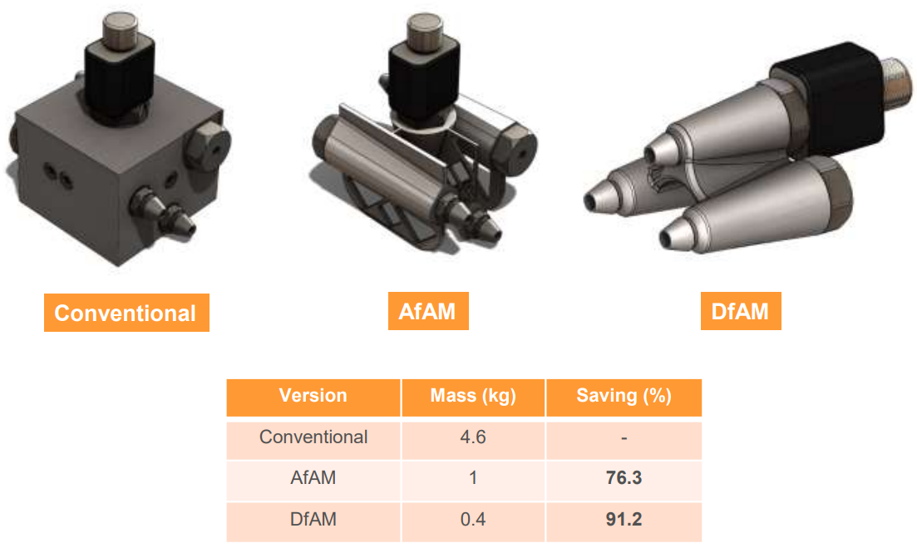
Summary
(Available at: https://resources.renishaw.com/en/details/--101495)

Slide 29
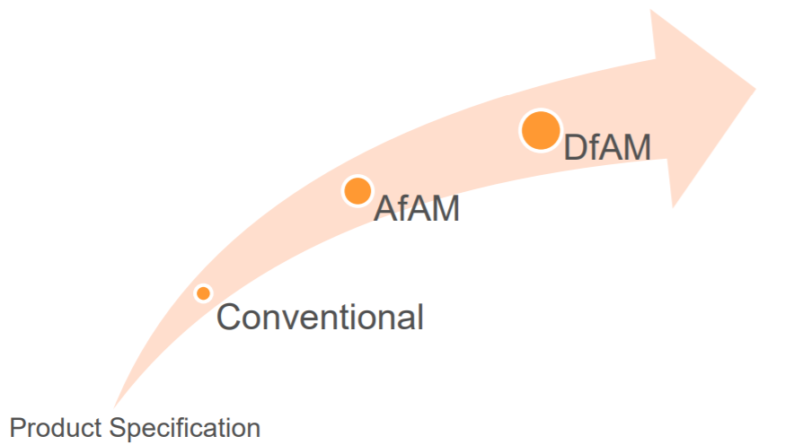
Evolution of Design

Slide 30
Design for Additive Manufacturing
A true DfAM optimised product is always a ‘clean sheet’ design that focuses on maximising performance for a particular application.
Innovation in the process requires innovation In design.
DfAM optimised parts will be lighter, higher performing, faster to build and therefore more cost-effective than direct replacements or adapted designs.

Slide 31
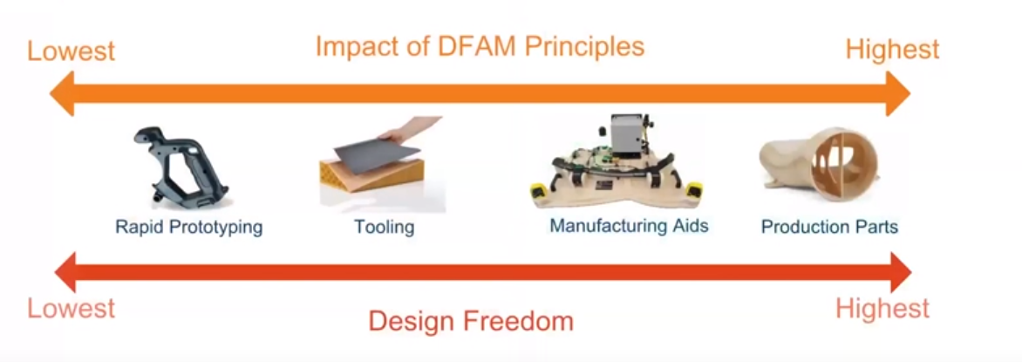
DfAM Impact

Slide 32
DfAM Benefits & Limitations
Pros | Cons
Increased design flexibility and freedom | A steep learning curve
Part consolidation | Design becomes process specific
Stronger, lighter & more complex components | Requires expert knowledge
Accelerated development cycle | Machine and software requirements can be costly
Reduced reliance on parametric optimisation | Unknowns – new, emerging and unproven technology
Immediate design testing and validation | Material limitations

Slide 33
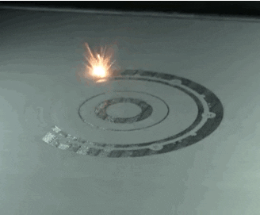
Some DfAM Considerations
Consider feature size
Define layer resolution
Avoid large overhangs
Minimise the use of supports
Optimise the print orientation
Minimise residual stresses
Optimise the design
Consolidate components
Use Infill
Optimise the Print Volume

Slide 34
1. Consider Feature Size & Layer Resolution
In machining, the minimum feature size is governed by the cutting tool size, it is easy to change over the tooling to adjust for the desired feature size.
In AM, the minimum size of features is limited by the laser spot or nozzle/print head diameter.
A particular problem for PBF methods as sintering of neighbouring powder means minimum feature size is larger than the laser spot size, thus the feature size depends on:
  - The thermal conductivity of the powder
  - The energy imparted by the laser
For Example, a laser with a 70 µm spot can produce features down to 150 – 200 µm.

Slide 35
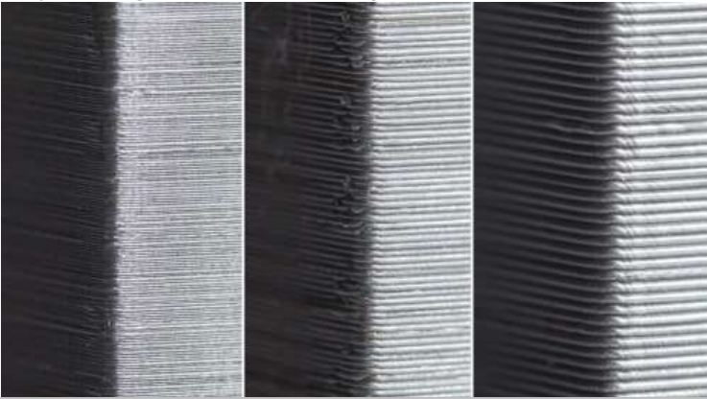
2. Layer Resolution
When possible, the part height should be divisible by the layer resolution (layer thickness) to ensure an accurate part height is achieved.
AM systems can only print multiples of the layer height in the Z direction, so if the part is not divisible by the layer height, the part may end up shorter than designed.
Example 1: the part is 16mm tall and the layer height is .1mm, then the part is sliced into 160 layers.
Example 2: the part is 56.58mm tall and the layer height is .1mm, then the part would be sliced into 565.8 layers. Not possible, can not print 0.8 of a layer.

Slide 36
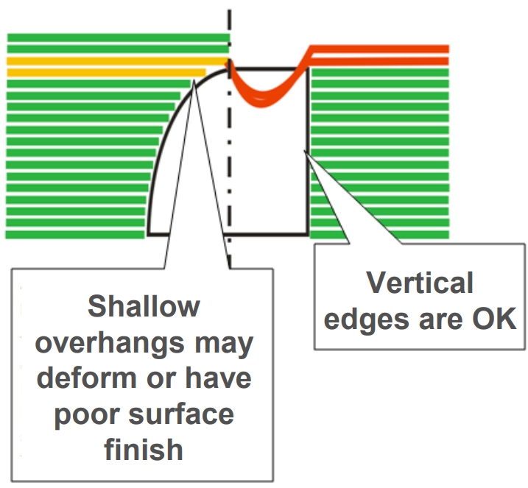
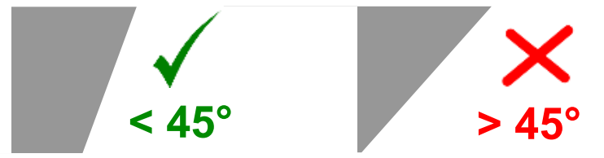
3. Avoid Large Overhangs
Avoid Large Overhangs during product design:
  Green = prints okay
  Amber = poor surface finish
  Red = distortion
Avoid Overhangs above a 45-degree angle (or add supports)

Slide 37
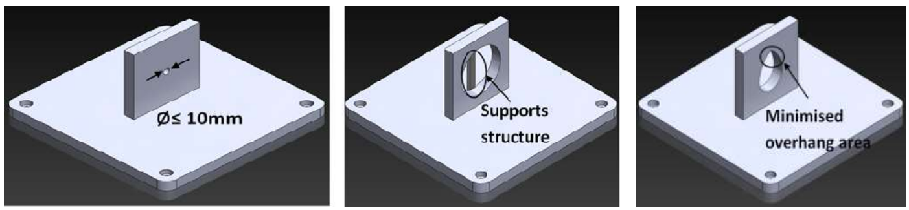
Hole Overhangs
Remember, holes in the side (X or Y-axis) also cause overhangs.
Generally, holes with a diameter <10mm will not distort.
Large holes will either need supports, to be modified, or aligned in the Z-axis to prevent overhangs and distortion.

Slide 38
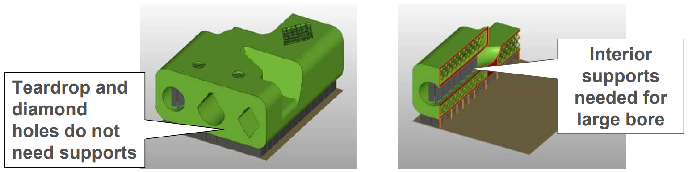
4. Minimise the use of Supports
Overhangs are often built using supports.
Supports can result in waste, and may cause surface finish problems.
Supports have to be removed after the build is complete.
Changing the shape of lateral holes (where practical) can reduce / remove the need for supports.

Slide 39
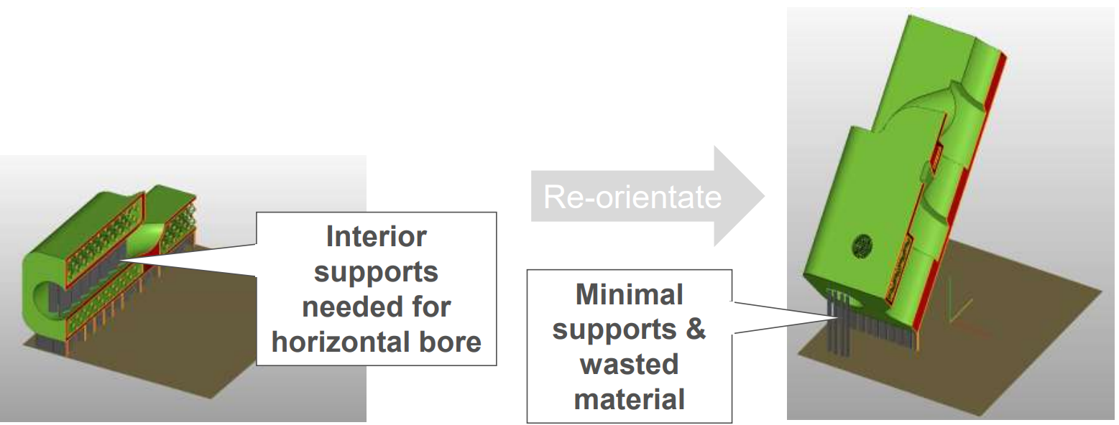
Re-orientation can be used to minimize supports. However, this may require addition layers and build time.

Slide 40
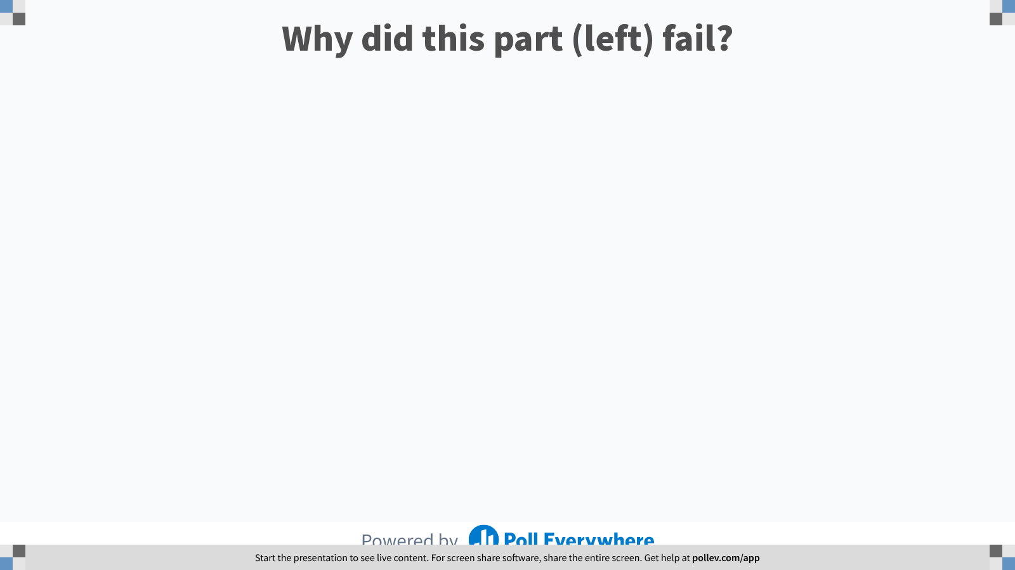
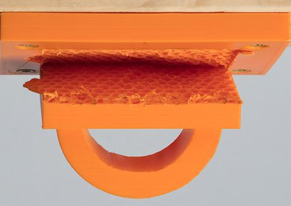
Notes:
Poll Title: Do not modify the notes in this section to avoid tampering with the Poll Everywhere activity.
More info at polleverywhere.com/support
Why did this part (left) fail?
https://www.polleverywhere.com/free_text_polls/Ea9cPZd9bTWlQ3hDJ39gW

Slide 41
Isotropy
(Directional properties of materials)
Materials can be classified as either isotropic or anisotropic.
Materials in which the measured mechanical properties are independent of the direction of measurement are isotropic. A steel billet is an example of an isotropic material.
Materials in which the measured mechanical properties vary with the direction of measurement are anisotropic. Wood and composites are common examples of anisotropic materials.
Notes:
Tensile Strength, fracture Toughness, Ductility, hardness, Creep resistance etc

Slide 42
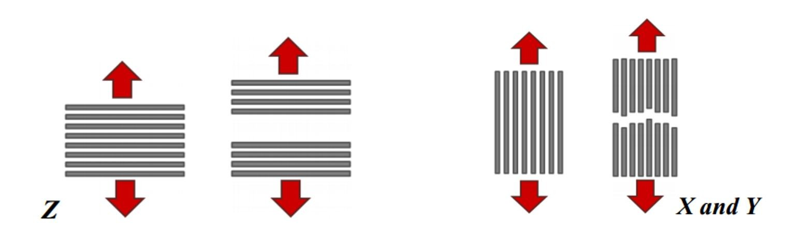
Anisotropy in Additive Manufacturing
The layer-by-layer fabrication of most AM components means that they are considered anisotropic.
For example, FDM printers melt plastic layers on top of layers. This creates a mechanical adhesion (not chemical). FDM layer surfaces are not fully adhered to each other.
Even when the previous layer is partially melted, the surrounding layers are only partially adhered to their neighbouring layers.
As a result, the emerging printed components exhibit different mechanical properties based on which direction the load is applied to them.
This means printed components are significantly weaker in the Z-Axis than they are in the X & Y-Axes.

Slide 43
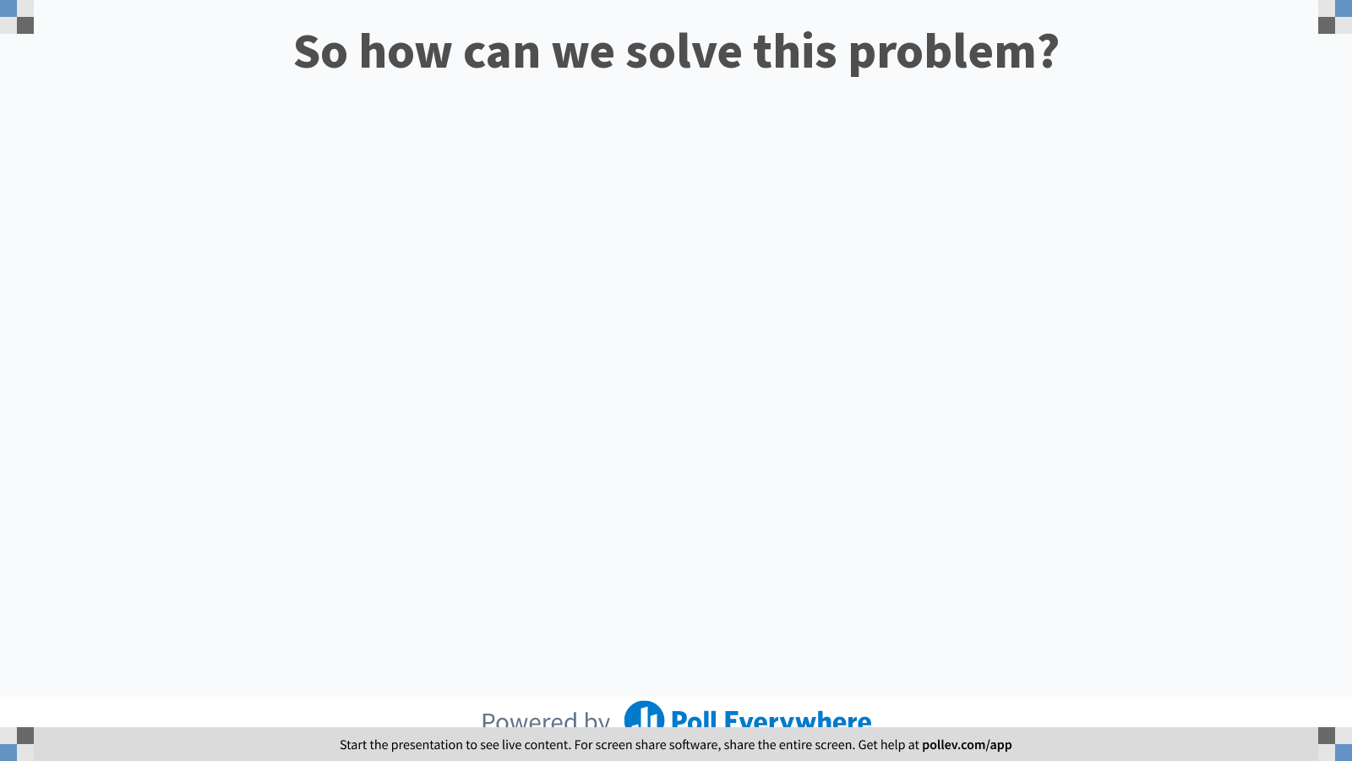
Notes:
Poll Title: Do not modify the notes in this section to avoid tampering with the Poll Everywhere activity.
More info at polleverywhere.com/support
So how can we solve this problem?
https://www.polleverywhere.com/free_text_polls/imlHlC0mmlKiwBs0f6cSC

Slide 44
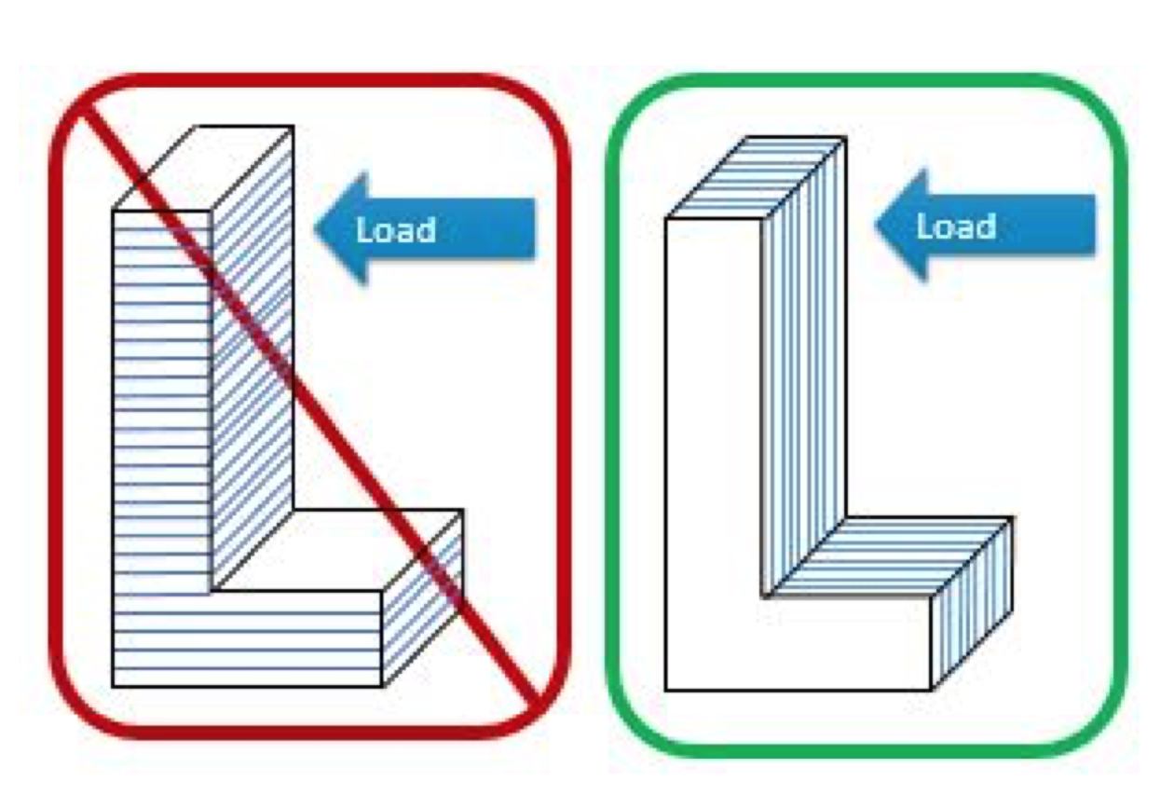
5. Optimise the Print Orientation
Sometimes, changing the orientation of the 3D model before commencing the print is the easiest and most effective way to avoid the anisotropic failure (delamination).
The direction of the intended loading should be perpendicular to the Z-Axis (vertical axis) of the 3D printer where possible.

Slide 45
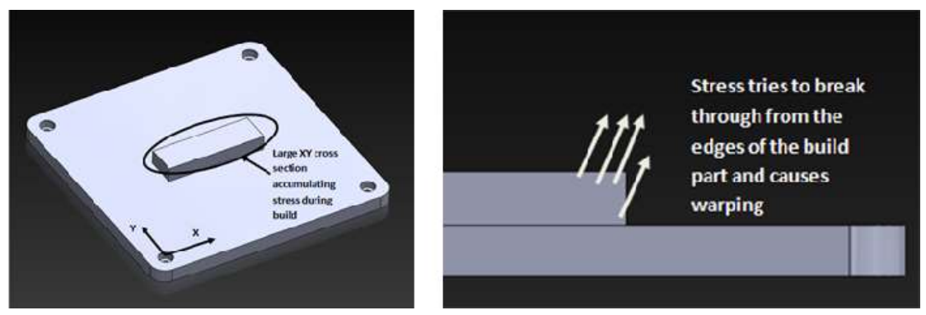
6. Minimise residual stresses
AM is similar to a welding process, although the fusion zone is small, the energy density is high. Residual Stress concentrations can build up where cross sections vary in thickness.

Slide 46
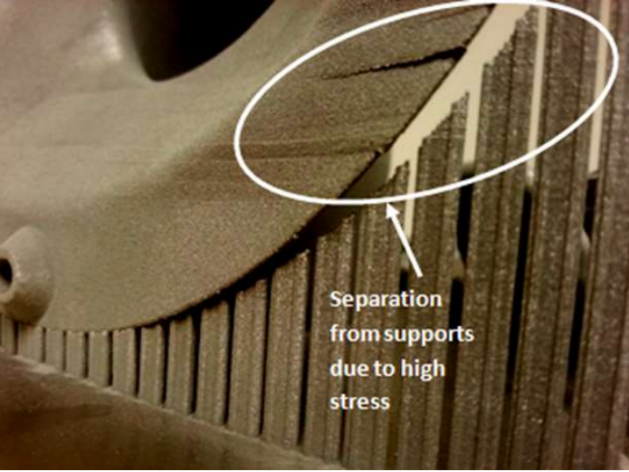

Residual stresses cause warping and distortion.
Avoid needlessly thick part sections.
Thin and consistent sections are best.
Use more supports where stress concentrations are likely to occur.
Add radiused or chamfered edges to corners where possible.

Slide 47
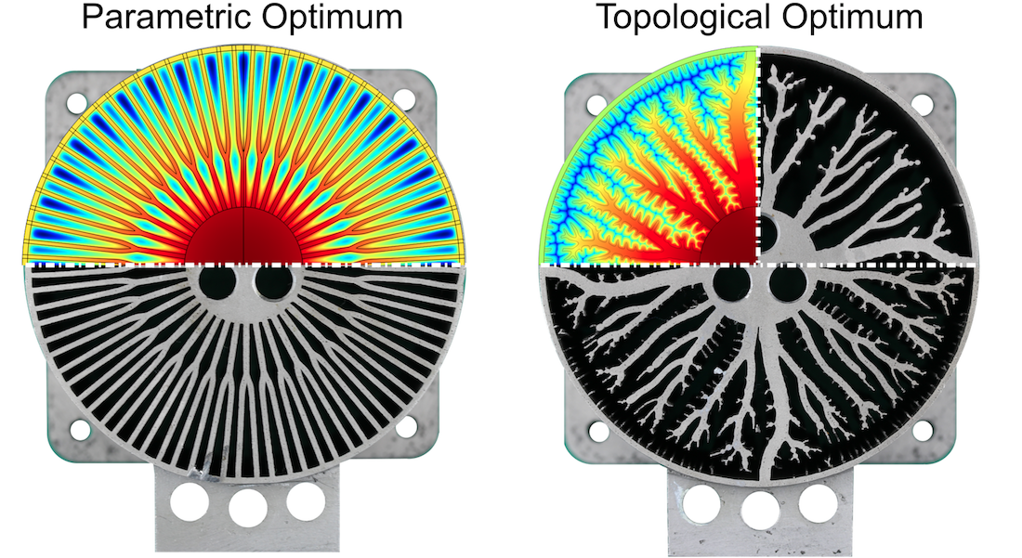
7. Optimise the Design
Two main forms of design optimisation are parametric and topology optimisation.
Parametric optimization is a Incremental mathematical procedure that involves iteratively altering some design variable (parameter) in order to identify the best design configuration for a given situation/application.
(Heat Sink Example)
Notes:
Parameter Sensitivity analysis.

Slide 48
Topology Optimisation
What is Topology Optimization?
A Mathematical optimisation technique used to identify optimal material distribution in a given design volume.
Finite element software is used to map the distribution of stress through the component under load, and thus redundant material is removed.
AMs ability to create extremely complex geometry now allows us to create topology optimised components (design freedom).
Why perform topology optimization?
Topology optimisation often improves the mechanical stiffness & rigidity of a component, whilst dramatically reducing the material required and thus the component mass.
can offer novel design insights / optimisation opportunities, outside of the ability of skilled design engineers using conventional optimisation strategies.
More powerful than shape and size optimization alone.

Slide 49
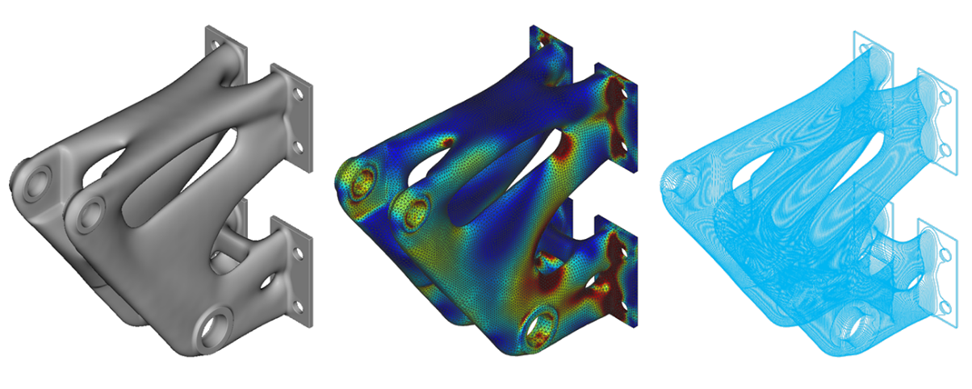
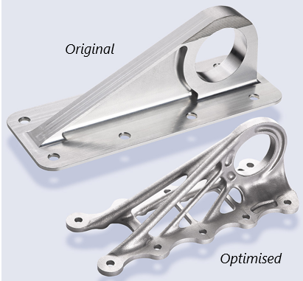
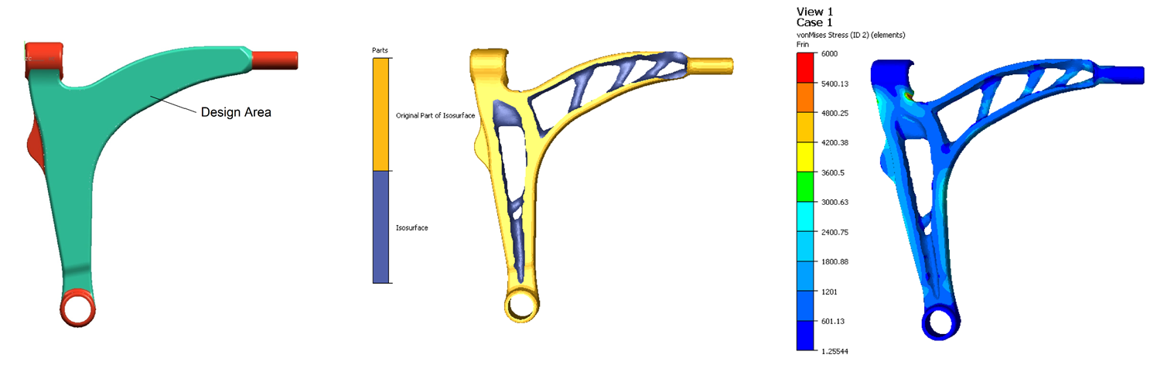
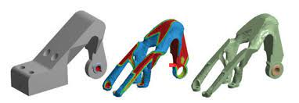
(Airbus A350 XWB Topology)

Slide 50
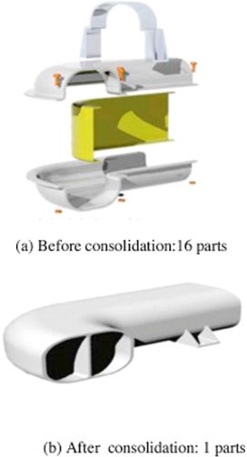
8. Consolidate Components
Also known as Part Count Reduction (PCR)
Reduces the number of components that need to be designed (and manufactured) to create the final assembly.
Goes far beyond just lowering the overall cost of production, parts consolidation also has a dramatic impact on lead times and time to market, procurement, inventory, materials handling, assembly and maintenance requirements etc.
For example, GE used additive manufacturing to reduce the number of components on a sub assembly of a Turboprop Catalyst engine from 855 down to just 12!
Notes:
Also called part count reduction.

Slide 51
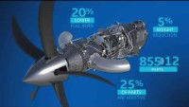
Consolidate Components / Assembly – Example
GE Advanced Turboprop (ATP) Case Study

Slide 52
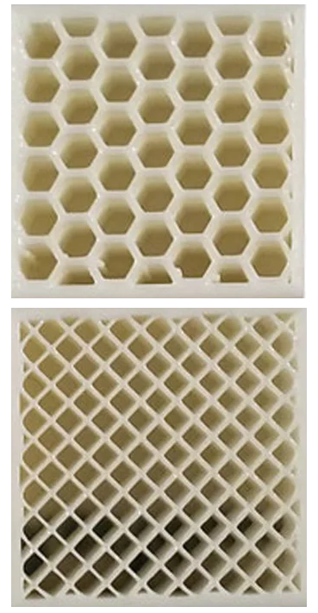
9. Optimise Use of Infill
Infill is used to avoid wasting unnecessary material within closed geometry in the generated model.
Infill plays a huge role in the components structural rigidity/strength and mass.
Infill helps avoid warping and distortion (due to changes in cross-section thickness) during printing.
Honeycomb and grid pattern infills are by far the most commonly used.
The infill density (percentage) can be adjusted to alter the components mass and structural properties.
Although, unnecessary use of infill is also a source of waste!

Slide 53
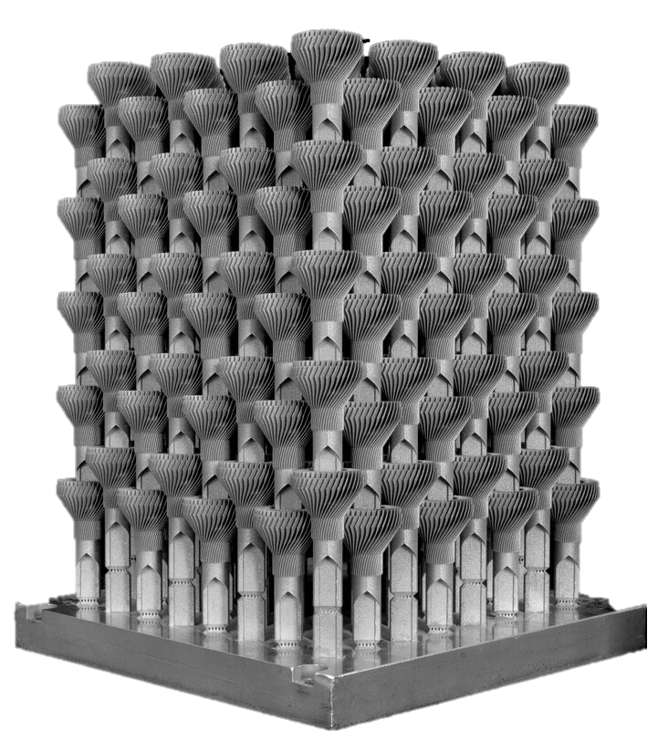
10. Optimise use of Print Volume / Capacity
In high-volume production scenarios, the more components that can be created in one printing procedure, the better.
As such, it becomes crucial to identify the optimal print orientation to fit the largest number of components on the available print bed space.
we should consider nesting and tessellation of components during the design phase.
Components can often be stacked in the Z-axis.
Print volume optimisation can drastically reduce the cost per unit manufactured.
Nowadays, this optimisation process is largely handled by the printers internal execution software.
(LED Bulb Heat Exchanger Z-Axis Stack)

