Slide 1
Teaching by Twitter
Extending the classroom via Social Media?
Andrew Smith
@OUCisco or @teraknor

Slide 2
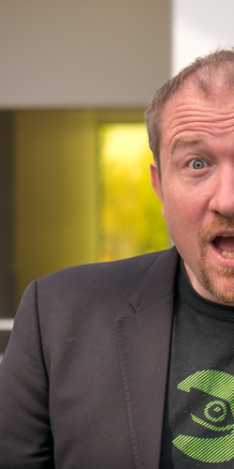
Brief - who am I
Senior Lecturer in Networking - STEM
    Work recognised by JISC in UK as one of UK Higher Education’s top #50 Social Media Influencers
I specialise in teaching Cisco CCNA and CCNP networking to undergraduate as well as postgraduate students as well as Security (CyberSecurity / Network Security / Digital Forensics and Linux
I have been active in the vocational computing academic communities for too long to be polite
Find me as @teraknor on twitter or follow @OUCisco / @OUCyberSec

Slide 3
Teaching by Twitter
Setting the Context

Slide 4
Context
STEM has c600-800 students every year studying CCNA or CCNP based modules, having reached 8000+ Cisco Academy students since 2005
While in OU terms, this may not seem significant, in vocational computing we are seen as ‘giants’
Engaged in social media activity since September 2013
We teach nerds network engineering - so far the focus has been Cisco moving to @OULinux
We have 2200+ students following our CyberSecurity MOOC twitter feed

Slide 5

A light bulb moment ...
Lets use social media to enhance the teaching of one of our Network Engineering modules. Ensuring that it leaks out onto the Internet as well as supports the learning of our current students.
Using social media to deliver a form of knowledge nugget or intellectual reinforcement technique.
While the focus has been on ‘Cisco’ we know that this translates to all.

Slide 6

Free is a price we are willing to pay
we cannot predict what platform our students/customers prefer to use
  it could be a smart phone
  or a web browser
  or a specific application
nor should we care
developers everywhere have created the software for us
so, lets use them all

Slide 7
Teaching by Twitter
What platforms do we use?

Slide 8

So what platforms do we use (1)
Creation of an ‘Open University Cisco’ group
Currently over 550+ members
Tends to attract a variety of professionals (which is obvious)
  Cisco CCNA/CCNP engineers beyond the confines of the module being taught
  Open University Cisco Alumni

Slide 9

So what platforms do we use (2)
Created a fan page (630+) more from within Open University Course
Also specialist Packet Tracer >> Mac group (1630+)
  Linked to my pedagogical simulation work
Very eclectic mix of members
Occasional questions come in via this route

Slide 10

So what platforms do we use (3)
930 followers
30% seem to be from within the course itself
some we pick up from retweets, faves and exchanges with @CiscoNetAcad
we do get frequent twitter exchanges with a small section (25-30 est) members of this community
also embedded within moodle - reaching 450 students on current module presentation
we will discuss ‘impressions’ later

Slide 11

So what platforms do we use (4)
130 followers
the quietest of all …
however it does help in search engine rank
but … I use the Google to RSS site …
  http://gplus-to-rss.appspot.com/
  we see some using RSS readers

Slide 12

So what platforms do we use (5)
Allows depth to some of the content
has been useful in sharing some internal ideas, externally
looking to evolve as a source of additional content

Slide 13

So what platforms do we use (6)
we have some deliberate short ‘named’ URLs
used when we link to internal university content
also used for occasional course promotion

Slide 14

So what platforms do we use (7a)
Periscope - Mini Monday Networking
Practical Streaming Video Show Tell sessions around one specific network engineering topic/concept/skill
Persistent for 24 hours
Session length ten mins
Typical audience varies from 40 to 120 per session
EXPERIMENTAL

Slide 15

So what platforms do we use (7b)
Facebook Live – NetNerd – a series of short webinars, over five evenings for one week
Practical Streaming Video Show Tell sessions around one specific network engineering topic/concept/skill
Persistent forever
Session length ten mins
Typical audience 250+
EXPERIMENTAL

Slide 16

So what platforms do we use (8)
Micro PodCasting
No more than ten minutes of audio
Idea stolen from Curtin Cisco Academy for Vision Impaired and supported by Royal National College for the Blind (in the UK)
Demo/Explanation entirely audio yet kept deliberately short in keeping with affordance of Social Media
Is 1/2 an hour too long for a podcast in the social media space

Slide 17

So what platforms do we use (9)
IFTTT - IF This Then That
Creation of Rule (recipes) for social media integration - also works with IoE technology
You do one thing on social media - it will automatically syndicate to other platforms
One input becomes multiple outputs

Slide 18

So what platforms do we use (10)
Hoot suite
Multi Social Media Platform Scheduling and Automation
Allows you to schedule one message at a time on multiple accounts (for free)
Allows you to schedule multiple (350) messages on multiple accounts via CSV for USD$ 9.99 per month
We use this for Facebook, Twitter, LinkedIN and Google+

Slide 19



Then stringing it together
$9.99 per month

Slide 20
Teaching by Twitter
Engagement Methods!

Slide 21

Engagement Methods (1a)
Sequential CSV’s* of Course related content
  We know our study calendar (you may know this as a scheme of work)
  We know more-or-less when students will be covering content
Use a separate CSV with weekly reminders
  what should you be studying
  what assignments are due
  day schools (classes) or other module events
As we are externally facing, occasional information on the course opportunities we offer
  Covert rather than overt
*Comma Separated Values

Slide 22
Engagement Methods (1b)
The sequence must follow the study plan - however, the student can be:
  Ahead as this is a reminder
  On time as this is reinforcement
  or behind as this is foresight

Slide 23
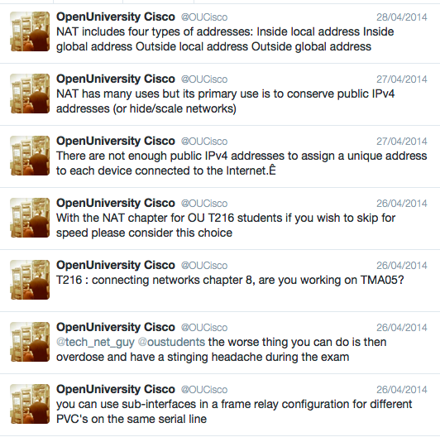
Engagement Methods (2)
Why CSV …
  they work with the Hootsuite publisher tools
  but no repetition
  there has to be less than 140 characters, as Twitter is the lowest denominator
I generated around 1100 automated updates, which can be reused, amended, added to etc
I am actually lazy by default and wonder why we automate so little ☺

Slide 24
Engagement Methods (2a)
I am automating at this precise moment - there are updates going out every 5 - 10 minutes on @OUCisco

Slide 25
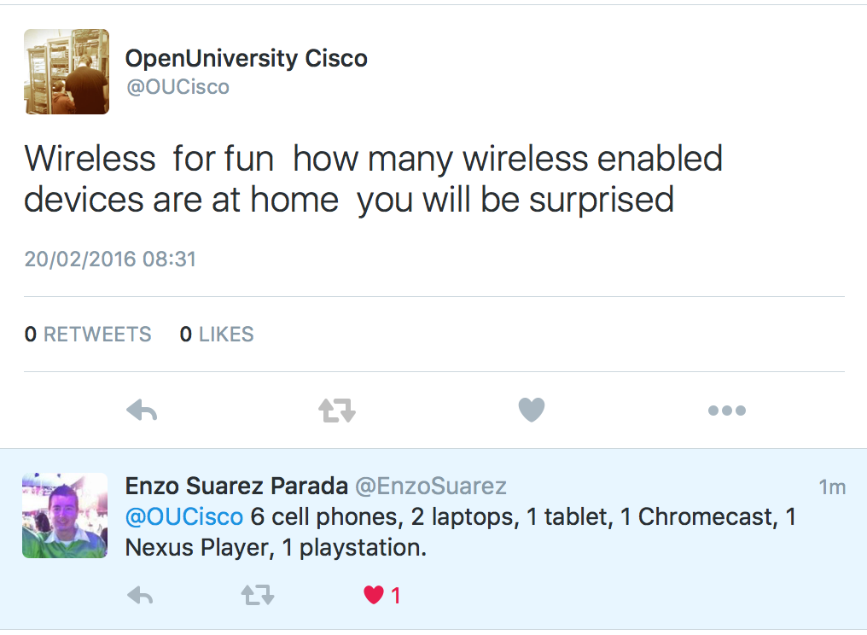
Engagement Methods (2b)
Do not underestimate your reach
You will easily go beyond your own ‘campus’
Do not simply stick to local times as community is potentially global
You will eventually discover the best times per presentation

Slide 26
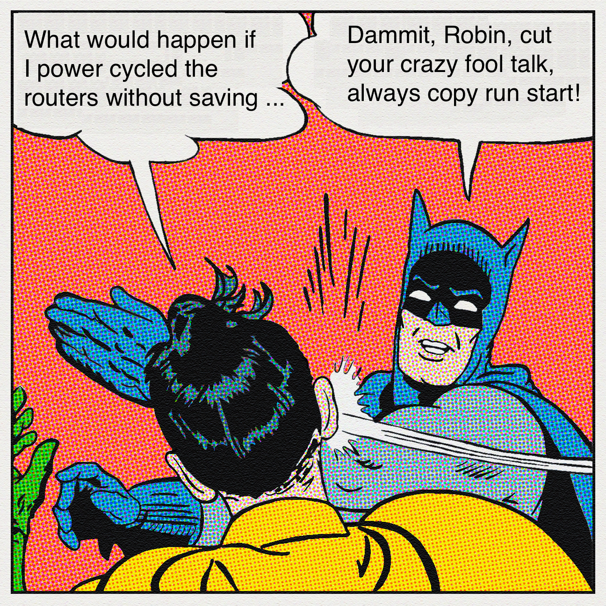
Engagement Methods (3)
Do not fear memes
Use plenty of images
  Humour is needed to break up the technical/academic content
  You have to decide on what the right mix is
  this is a module, where written word is priority, yet images help

Slide 27

Engagement Methods (4)
YouTube and other video sources
  These consume time … therefore for this run I focussed on humour
  I used …
    the day the routers died
    Mr Bean taking an exam
    the medieval help desk
    elders of the internet
I am looking to expand these with some teccie vid’s, I have already produced two with our Knowledge Media Institute which we have already shared in the next course
Also one of our associate lecturers has been producing short teccie YouTube clips – which we are sharing

Slide 28

Engagement Methods (5)
Talk to them via social media … they do not bite!!!
Questions do come in via the different social media outlets
  Engage, but also allow others to engage as well
  Encourage those who are also engaging, they are your greatest allies

Slide 29

Engagement Methods (6)
Open questions work … followers like to answer these
Enquiring about the opinion of the audience also gets a response.
Take note of which posts get a reaction, it will surprise you … some of the tougher subjects are more likely to get a response
Be prepared to ditch posts or reuse posts

Slide 30

Finding your allies
There is nothing wrong with a getting a few ‘friends’ or ‘colleagues’ involved
Very useful for …
  RT’s in Twitter
  Shares in Facebook
  Likes on LinkedIN

Slide 31
Teaching by Twitter
Impact?

Slide 32
Analysis: Twitter

Slide 33
Opportunity!
I believe that …
We do not understand impact – it goes beyond followership.
We could create a social media curated course that is driven by Facebook (or Twitter)

Slide 34

Any Questions & discussion

