Slide 1
BMSk4003
Digital Skills and Research Methods
Week 3

Slide 2

Google Accounts
Google Drive and
Google’s web-based software office suite

Slide 3

Objectives
Google Account
Google Drive & Gmail
Google Web Office suite

Slide 4
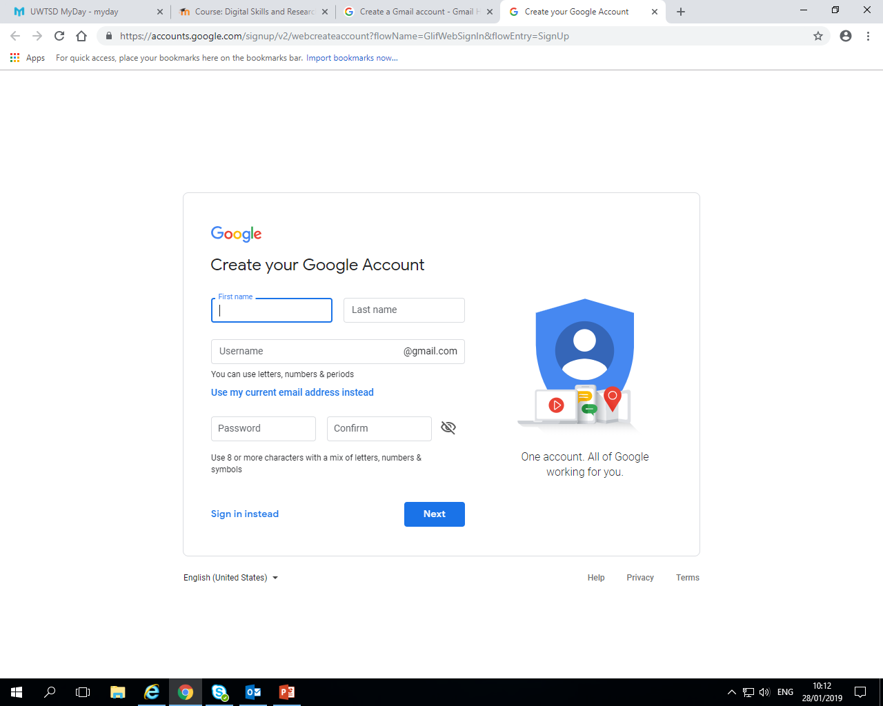
Create a G-mail account
Create a Gmail account only specific for this module by typing in
Create a Gmail account
Username: First name and studentID@gmail.com

Slide 5
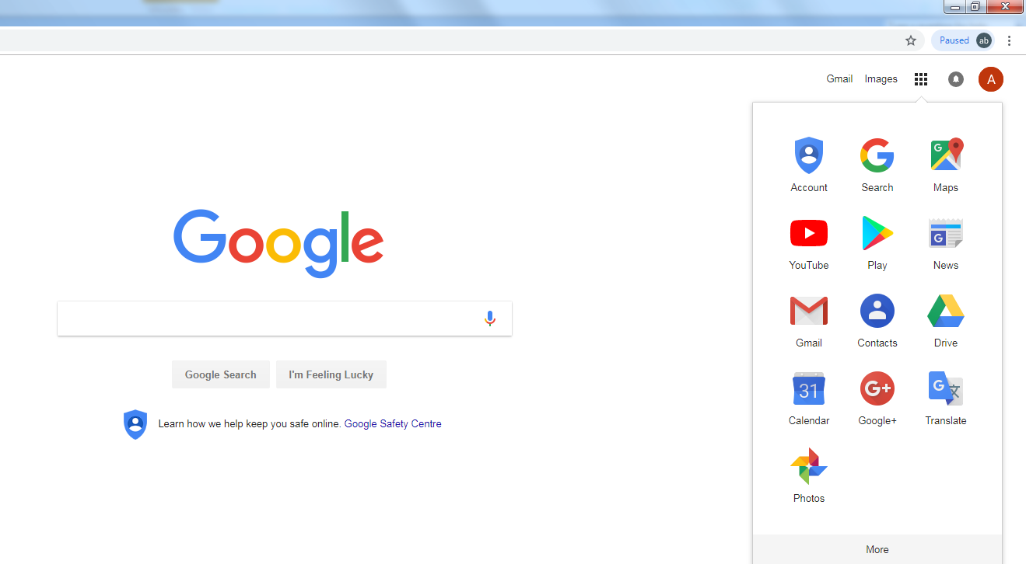
How to access GoogleDrive, Gmail etc.
Notes:
Once you are logged in just click on the 9 dots button to access Gmail, Google Drive

Slide 6
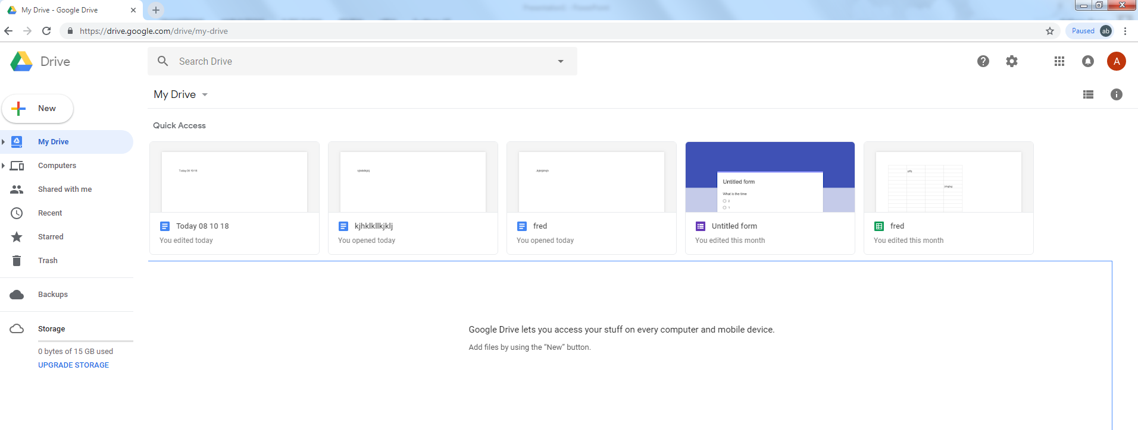
Google Drive
Notes:
Google Drive is a file storage and synchronization service developed by Google. Launched on April 24, 2012, Google Drive allows users to store files on their servers, synchronize files across devices, and share files. In addition to a website, Google Drive offers apps with offline capabilities for Windows and macOS computers, and Android and iOS smartphones and tablets. Google Drive encompasses Google Docs, Sheets and Slides, an office suite that permits collaborative editing of documents, spreadsheets, presentations, drawings, forms, and more. Files created and edited through the office suite are saved in Google Drive.
Google Drive offers users 15 gigabytes of free storage, with 100 gigabytes, 1 terabyte, 2 terabytes, 10 terabytes, 20 terabytes, and 30 terabytes offered through optional paid plans. Files uploaded can be up to 5 terabytes in size. Users can change privacy settings for individual files and folders, including enabling sharing with other users or making content public. On the website, users can search for an image by describing its visuals, and use natural language to find specific files, such as "find my budget spreadsheet from last December".

Slide 7
Google Drive and Google Web Office Suite
How to use Google Drive and Apps video
https://www.youtube.com/watch?v=nVNi6uSSckU

Slide 8
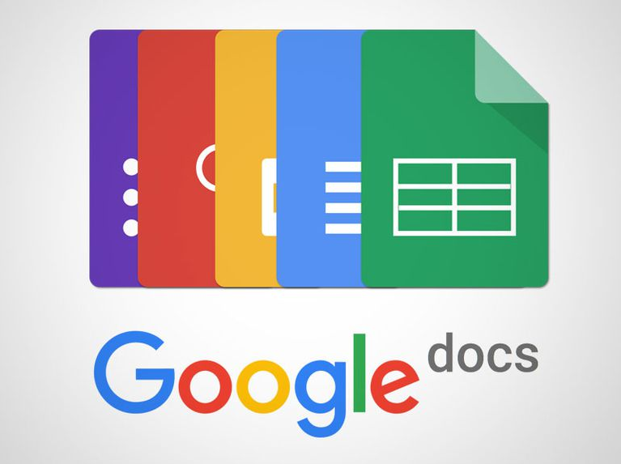
Google’s Web-based Office software suite
Includes Google Docs, Google Sheets, Google Slides and Google Forms etc.
Notes:
Google Docs, Google Sheets, and Google Slides are a word processor, a spreadsheet and a presentation program respectively, all part of a free, web-based software office suite offered by Google within its Google Drive service. The three apps are available as web applications, mobile apps for Android, iOS, Windows, BlackBerry, and desktop applications on Google's ChromeOS. The apps are compatible with Microsoft Office file formats. The suite also includes Google Forms (survey software), Google Drawings (diagramming software), Google Sites (web building software), Google My Maps (map overlay editor), Google Apps Script (code editor for the G-Apps Script coding language) and Google Fusion Tables (database manager and map application; experimental[11]).
The suite allows users to create and edit files online while collaborating with other users in real-time. Edits are tracked by user with a revision history presenting changes. An editor's position is highlighted with an editor-specific color and cursor. A permissions system regulates what users can do. Updates have introduced features using machine learning, including "Explore", offering search results based on the contents of a document, answers based on natural language questions in a spreadsheet, and dynamic design suggestions based on contents of a slideshow, and "Action items", allowing users to assign tasks to other users.
While Google Docs has been criticized for lacking the functionality of Microsoft Office, it has received praise for its simplicity, ease of collaboration and frequent product updates.

Slide 9
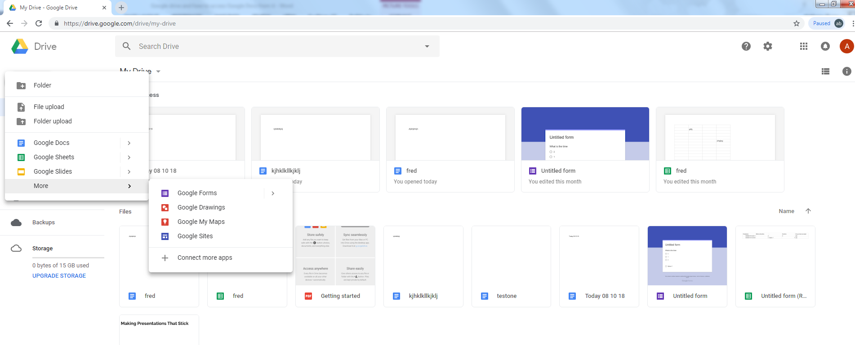
How to access Google Office Suite from GoogleDrive
Notes:
When in Google Drive to go to Google Forms, Slides, Docs, Sheets etc. just click on “New” then options will come up giving the opportunity to open a document of each time in its application

Slide 10

Google Docs
In groups create a document with company name and share with other group members via GMAIL accounts then each group members adds a section to the document
Who are members and their roles
Aims and objectives
Product or service it will be providing
Graphical location and why
Target audience and why

Slide 11

Google slides
Create a presentation with the information gathered form google docs with each member creating a slide to add to the presentation (by sharing the slides)
Present to the class

Slide 12

How can Google Docs/ sheets and slides be used in practice in a business environment and what are the benefits of using these packages over other conventional packages such as Microsoft Word/ Excel and PowerPoint.
Could you see any disadvantages in using this approach?
Has this session enhanced your employability skills, or something you would do differently as a result of today's session on Google drive and google packages.

Slide 13
How to get to Google Office Suite without going to Google Drive
https://www.google.co.uk/docs/about/
Notes:
This gives you access to the main Google web-based software office suite apps when you sign in at the page using your Google Account details

Slide 14
Summary
Google Account
Google Drive & Gmail
Google Web Office suite

