Slide 1
AHHI 5004 – ORIGINS OF THE GREAT WAR
ADRIAN GREGORY – THE LAST GREAT WAR : BRITISH SOCIETY AND THE FIRST WORLD WAR

Slide 2
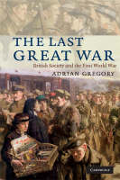
‘THE LAST GREAT WAR’
ADRIAN GREGORY:
THE LAST GREAT WAR: BRITISH SOCIETY AND THE FIRST WORLD WAR , (Cambridge: Cambridge University Press, 2008).

Slide 3
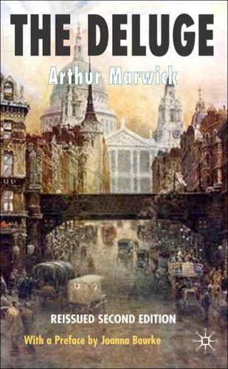
ON THE BRINK OF WAR
Conventional view of Britain in August 1914:
‘British society in 1914 was strongly jingoistic and showed marked enthusiasm for the outbreak of war’ Marwick, 1965,1989, p. 309, (quoted in Gregory, p,9)

Slide 4
WAR ENTHUSIASM
DAVID LLOYD GEORGE (memoirs, 1938) :
‘I shall never forget the war-like crusades that thronged Whitehall and poured into Downing Street...multitudes of young people concentrating on Westminster demonstrating for war against Germany’. Gregory,p.10
BERTRAND RUSSELL (autobiography):
‘I discovered to my amazement that average men and women were delighted at the prospect of war’, Gregory, p.10.

Slide 5
WAR ENTHUSIASM
Despite these observations, Gregory questions British enthusiasm for war in August 1914:
‘the evidence of mass enthusiasm at the time is surprisingly weak’ , p.11. Claiming:
1. historians must look beyond the occasional crowd scenes on 4th August
2. historians must look beyond editorials in newspapers
3. even the ‘Rush to the Colours’, at the end of August is unreliable evidence
4. need to take on board regional, national, class, gender divisions within Edwardian society and examine specific groups

Slide 6
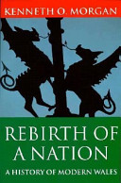
WAR ENTHUSIASM
1. Wales in August 1914: conventional view (pp.11-13):
‘the overwhelming mass of the Welsh people cast aside their political and industrial divisions and threw themselves into the war with gusto’, Morgan, 1981, p.159.

Slide 7
WAR ENTHUSIASM
1.Wales contd...
Gregory questions Welsh enthusiasm for war, citing:
South Wales Miners Federation (the Fed) reluctance to curtail miner’s holidays – only on 1st September did union agree to working extra hours
Anti-war sentiment expressed in Baptist and Methodist journals

Slide 8
WAR ENTHUSIASM
2. London (pp.13-16):
Gregory questions the motivation of London crowds in August 1918 – cites The Globe account of an orderly crowd enjoying a Bank Holiday break, of ‘interested spectators not a jingoistic mob’ – an audience crowd
Crowd estimates - 6000 at Buckingham Palace (Evening Standard); or 10,000 (the Star); i.e. 8000 = 1: 1000 of London population!
Trafalgar Square anti-war demo 2nd August – despite Daily Telegraph talking of disturbances by pro-war groups, Daily Herald talks of ‘a few rowdy clerks’. Ben Tillett and Henry Hyndman well received

Slide 9
WAR ENTHUSIASM
3. Newspapers (p.15):
Hampstead Record, 7th August 1914:
‘nowhere was there the slightest sign of ‘mafficking’ and it was obvious to the observer that the idea of war was distasteful to all’
Manchester Guardian, 3rd August 1914:
‘what seemed unanimous was that no one seemed to want war’

Slide 10
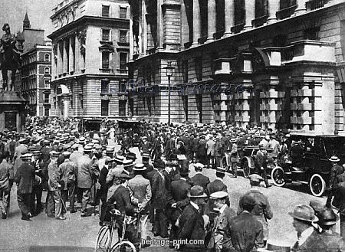
WAR ENTHUSIASM
4. Class and Gender, p.16:
‘the most vocally element of crowds appear to have been middle-class male youths’
Gregory highlights photographic evidence showing more ‘boaters’ than ‘cloth caps’ in pro-interventionist meetings
Concludes ‘pro-interventionist sentiment was almost certainly a minority opinion as late as 2nd August’ and possibly up to 4th August, p.16.

Slide 11
THE PRESS
Gregory cites (pp.16-18):
Liberal Daily News and Manchester Guardian, generally anti-war up to 4th August
Huddersfield Daily Examiner – do not join hostilities unless attacked directly
Cambridge Daily News – remain outside as Britain has negligible interest
Yorkshire Post – ‘happily we can see no reason why Great Britain should be drawn in’
Oxford Chronicle – ‘preserve our neutrality!’

Slide 12
INNOCENCE?
Gregory (pp.18-20) questions the view that Britons remained innocent about the reality of any forthcoming conflict, claiming:
‘the idea that the war would be over by Xmas is almost entirely absent in diaries and newspapers in August...because of South Africa, the British were probably the least ignorant in Western Europe about modern land warfare’

Slide 13
INNOCENCE?
Realism and the Press(pp.18-20):
Yorkshire Post:
‘war is death and destruction. All who participate in war...intend to put the death and destruction on his enemies; but history shows that crushing punishment has often fallen on those who thought they could impose it on others’
Hackney Spectator:
‘we go to war in silence, every man, nay every child knows that war means red ruin’

Slide 14
PUBLIC OPINION
Gregory on the public and war enthusiasm (pp.20-25):
Avoid generalisations about the public mood in July/August 1914, there existed:
Indecision about Britain’s participation
Sympathy for France, but also dislike of Russia and Serbia
Pro and anti-German sentiments
Class differences – broadly middle-class support for war, and the working-classes against
Provincial mood – more anti-war than London
The young more pro-interventionist than the old, Anglicans more than Nonconformists, men more than women

Slide 15
OUTBREAK
Gregory on changing mood from August 4th(pp.25-30):
Daily Chronicle reports increase in ‘mafficking’ and ‘war fever’ (although he expresses caution about the journalism that failed to reflect the ‘Hidden Transcript)
Highlights regional differences – reports of war enthusiasm in Chester and shock and horror in Portsmouth (a Royal Navy port!)

Slide 16
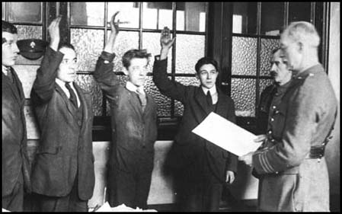
THE ‘KING’S SHILLING’
Gregory on recruitment in 1914 (pp.30-33):
Key date 25th August and the ‘Mons Despatch’ in the Times
By 31st August daily figure topped 20k (3rd Sept -33k); Week 30th Aug-5th Sept -175k.
Why this increase a month into the war? – because the war became serious!

Slide 17
CONCLUSIONS
Gregory on attitudes to war, pp.36-9. cites Martin Ceadel, Thinking about Peace and War, (Oxford, 1987); the five stances:
PACIFISM – WAR IS EVIL
PACIFICISM – WAR TO BE AVOIDED
DEFENCISM – DEFEND VITAL INTERESTS
CRUSADING – PROTECT AND IMPOSE VALUES
MILITARISM – WAR A SOCIAL GOOD
‘the most striking development was the speed of conversion of the majority of pacificists to defencism and even to crusading’ p.37.

