Slide 1




Lecturer: Efua Adams
Fadul Mikail Omar: 1912914
Master of Business Administration (MBA)
Marketing Management

Slide 2
Table of contents
Introduction of the marketing process.
Porter’s competitive advantage.
Segmentation, Targeting, and Position (STP) theory.
Total Quantity Management (TQT) theory.

Slide 3
Introduction: to marketing strategies
F
Marketing process
Marking concept
Marketing analysis
Competitive advantage
References
Conclusion
Notes:
Introduction
Marketing is becoming very essential for any business whether provides products or services are measured by customers’ behavior for every small benefit that customers can get because the use of the internet makes things easier for shoppers can access similar products or services and choose to shift from one to another for most successful companies first identifying and understanding customers want and need to build trust and loyalty and more importantly knowing surrounding competitors are using similar products or services in terms of quality, prices, environment and how customer are treated in general company’s staff are trained and satisfied and have enough knowledge and awareness to deal with customers in daily basis. “A marketing model may be an instrument that sponsors, and businesses utilize to get the quality and gaining potential of their commerce. Marketing models audit the, by and large, procedures and parameters included with publicizing a company and its product” Gozali et al. (2022, p. 2).
Marketing analysis creates market forces protection from failure by analyzing resources capabilities to achieve a competitive advantage to meat meet the point when sellers and buyers have common objectives. According to Weller (2017) defines the marketing process as the strategic purposeful number of stages to assist companies to identify and reach their goals and more importantly discovering what customers want and developing products or services to meet their needs by following the marketing process steps.

Slide 4
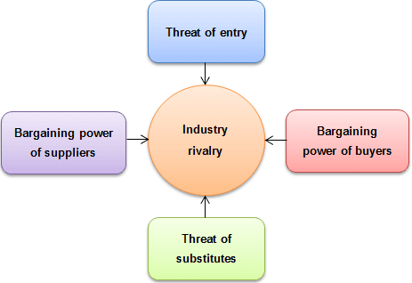
Accourding to Catalão (2022, p. 16-17) argue that Portee’s five forces are used in Tesco Supermarket effectively to discourage new entrants and advantage to sustain a competitive marking advantage.
Threat of entry to differentiate prices, and product quality.
Bargaining buyers: Tesco uses lower prices or comparatively similar ones.
Threat of substitutes Tesco used standard services and food quality.
Industry rivalry: Tesco is able to use resources in a safe competitive position.
Bargaining power of suppliers: Tesco uses large suppliers to enforce its market position.
The image was adopted from (Jurevicius, 2021)
Notes:
Accourding to Catalão (2022, p. 16-17) argue that Portee’s five forces are used in Tesco Supermarket effectively to discourage new entrants and advantage to sustain a competitive marking advantage.
Threat of entry: to differentiate prices, and product quality and this could create disadvantages for small retailers which have got a few lines of suppliers is difficult to manage to reduce costs but some shift to e-commerce to lower prices, and that creates a major threat for those base stores only.
Bargaining buyers: Tesco uses lower prices or comparatively similar then customers’ behaviours could change but the Tesco club card creates a potential consumer loyalty discount and many other advantages Tesco customers’ sensitivity is lower to exit because of trust and reputation of Tesco management able to fight to bring more customers.
Threat of substitutes: Tesco used standard services and food quality.
Industry rivalry: Tesco is able to use resources in a safe competitive position. Tesco creates a loyalty system to collect consumers’ information and know what customers want and use it a gain others’ rivalry.
Bargaining power of suppliers: Tesco uses large suppliers to enforce its market position. Tesco is one of the largest supermarkets and has multiple suppliers and this is an advantage to strengthen Tesco to reduce costs because of the large number of suppliers is easy for Tesco to negotiate a lower price and gain bigger bargaining power. “Bargaining power of Tesco suppliers is low. Tesco has hundreds of suppliers and there is a minimum or no supplier switching cost for the supermarket chain” (Dudovskiy, 2016).

Slide 5
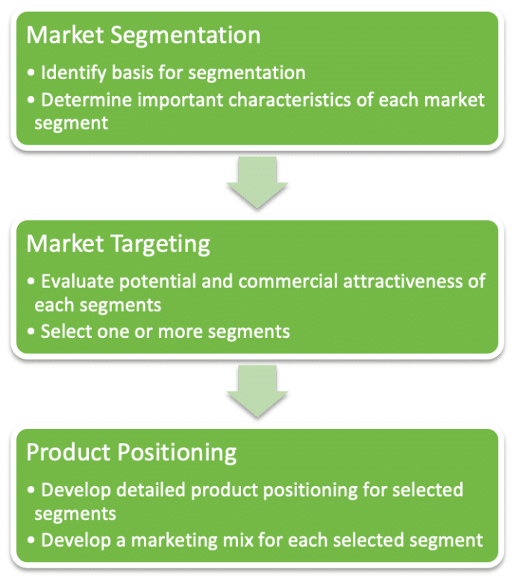
Accounting to Hanlon (2022) argues that the Segmentation, Targeting, and Position (STP) marketing Model is easy to understand, used by many companies, and the most commonly applied for marketing practices with efficient market focus.
MacDonald’s uses Segmentation to important locations for market advantage
MacDonald’s Target market is identified in the chosen segments.
MacDonald Positioning set product development in each selection requires different needs.
Image was adopted from (Hanlon, 2022)
Notes:
Accounting to Hanlon (2022) argues that the Segmentation, Targeting, and Position (STP) marketing Model is easy to understand and use by many companies and the most applied for marketing practices with efficient market focus on businesses. First identify a segment then target identify groups for marketing development in different locations, position products strategy for each section, and with STP model useful for marketers able to create marketing communication to prioritize which positions need more development when targeting identified.
According to Kuang (2022, p. 1) argues in the history of e-commerce a Chinese company Pinduoduo is one of the successful using STP and the 4Ps marking strategies with the implementation of STP Pinduoduo uses segmentation to identify a group that acts similarly.
The STP Model is used by many companies to identify potential marketing advantages. For example, Macdonald’s serves worldwide fast food. “McDonald’s is a multinational veteran brand with a large and complex global audience. The best way to understand what McDonald’s target age group is and how McDonald’s advertising works is via a McDonald’s segmentation analysis that covers demographic, geographic, behavioural, and psychographic data. Let’s dive right in” (Carmely, 2022)
According to Wright (2020) claims that the STP marketing model is segmentation is the first step for MacDonald to create different customer segments based on specific criteria and characteristics chosen. The four main types of audience segmentation include Geographic segmentation: identified audiences in different locations of the country. Demographic segmentation: selected groups on age, gender, education level, and occupation. Behavioral segmentation: this group has been selected based on interaction with the business. Psychographic segmentation: Dividing an audience based on a potential customer’s lifestyle, hobbies, activities, and opinions.
MacDonald’s uses a geographical selection to understand the cultural background of the consumers’ menus and deliver as customers’ choices MacDonald’s does not use the same menu in different countries, for example, India is the most populated country which is MacDonald’s target but unfortunately to respect the Indian culture or religion belief MacDonald remove the beef products from the menu. For example, “McDonald's is well known throughout the world for its high level of respect for regional customs and culture. McDonald's has built a menu to fit Indian tastes and preferences, particularly for India with vegetarian offerings. In keeping with this, in India, McDonald's provides no beef or pork products” (Rajawat et al, 2020, p. 2)
Targeting: the selected segments now the time to decide to choose one for marketing implementation but depend on the marketing campaign that products can generate a sale, profits at a competitive price and need to consider the segment size and future potential growth and customers value in the chosen segment and will slowly increase to meet the demands.
Position: time to place the products or services for targeted groups and provide opinions to grow competitively. “Once the other two steps are completed, a natural question arises how to best position the product or service? The goal of positioning is to connect with the audience on a personal level and, possibly more importantly, set yourself apart from the competition” (Mackeviciute, 2022).

Slide 6

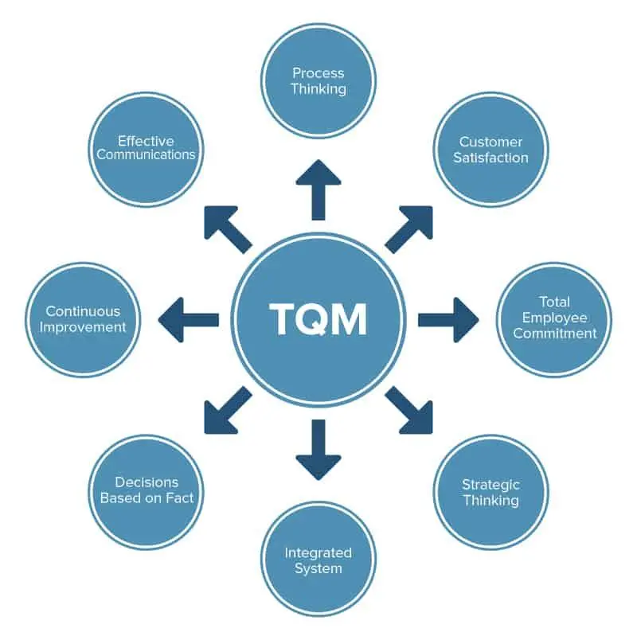
According to Eby (2023) argues that Total Quantity Management is:
Management is a structure to helps an organization achieve innovation
commitment to customer requirements
empower everyone in the company
continuous improvement.
Notes:
The total quality management system is a leading process for high-quality customer satisfaction within a minimum cost to the company in calumnious practice to improve quality management in order to satisfy the overall elements of the organization. According to Eby (2023) argues that Total Quality Management is a structure to helps an organization achieve innovation through a commitment to customer requirements and can empower everyone in the company to meet the standard requirements for continuous improvement. Employees training one of the customers focused and needs when quality is integrated into the system employee’s awareness creates an acceptable environment between customers and step forward for the organization progress. “Total employee involvement: All employees participate in working toward common goals. Total employee commitment can only be obtained after fear has been driven from the workplace, when empowerment has occurred, and when management has provided the proper environment. High-performance work systems integrate continuous improvement efforts with normal business operations. Self-managed work teams are one form of empowerment” (American Society Qualify, 2023).
According to Watts (2022) argues that first looking at customers’ satisfaction in the total quality management gives a clear experience relevant to the company engagement through permanent support in the priority list. And treat employees as owners to be part of any related involvement to ensure fully engage in quality control. Process-based on organization functionality to support the implementation of the process through the Total Quality Management steps and communication has to be run effectively across all team members to add value, and trust in successful practice while systems strategies integrate to bring every asset to the company data-driven is a piece of information that regularly updated to make a decision for company improvement judgment based on quality.
Constant improvement requires Total Quality Management for an organization to be fitting into the pillars. According to Kannan and Tan (2005, p. 3) argue that the Total Quality Management drivers call for the development and implementation of to corporate-wide culture highlighting customer focus, continuous improvement, employee empowerment, and data-driven decision-making. supporting product design with customer expectations and focusing on quality at all steps of developing the production process, are seen as drivers of improved product quality and in turn to improve business performance.

Slide 7
Conclusion
Identify three articles’ theories about marketing management
Explained how marketing strategy support organization to achieve competitive advantage.

Slide 8
References
Catalão, I.D.P., 2022. Equity research: Tesco PLC (Doctoral dissertation, Instituto Superior de Economia e Gestão).
Kampamba, J. (2015) 'An analysis of the potential target market through the application of the STP principle/model', Mediterranean Journal of Social Sciences, 6(4), pp. 324.
Gozali, L. et al. (2022) 'The Development of Several Marketing Models in Performance Measurement in Industrial and Business Management Systems’,.
Jurevicius, O. (2021) Porter's Five Forces: The Ultimate Guide - SM Insight. Available at: https://strategicmanagementinsight.com/tools/porters-five-forces/ (Accessed: Mar 4, 2023).
Eby, K. (2023) All About Total Quality Management (TQM) | Smartsheet. Available at: https://www.smartsheet.com/total-quality-management (Accessed: Mar 16, 2023).

Slide 9
Mackeviciute, C. (2022) STP Marketing: Segmentation, Targeting, Positioning Model. Available at: https://www.sender.net/blog/stp-marketing/ (Accessed: Mar 4, 2023).
Hanlon, A. (2022) The segmentation, targeting, positioning (STP) marketing model. Available at: https://www.smartinsights.com/digital-marketing-strategy/customer-segmentation-targeting/segmentation-targeting-and-positioning/ (Accessed: Mar 4, 2023).
Watts, S. (2022) What Is TQM? Total Quality Management Explained. Available at: https://www.bmc.com/blogs/tqm-total-quality-management/ (Accessed: Mar 16, 2023).
American Society quality (2023) 'Total Quality Management (TQM): What is TQM? | ASQ', Available at: https://asq.org/quality-resources/total-quality-management.
Kannan, V.R. and Tan, K.C. (2005) 'Just in time, total quality management, and supply chain management: understanding their linkages and impact on business performance', Omega, 33(2), pp. 153-162.
Weller, J. (2017) Here’s How the Marketing Process Works | Smartsheet. Available at: https://www.smartsheet.com/strategic-marketing-processes-and-planning (Accessed: Mar 16, 2023).

Slide 10
Thank you

