Slide 1
Sustainability and Marketing
The consumption conundrum.
Will Fleming

Slide 2
Learning Outcomes for today
Consider some of the sustainability issues facing companies and marketers
Put sustainability into context in terms of consumers and business…and government
Understand the role in marketing in relation to the concepts of “green” and “sustainability” marketing
Consider how sustainability is the agenda at present
Be able to distinguish the difference between “sustainable marketing” and “green marketing”

Slide 3

Student task
? - What do you understand by the concept of sustainability?
? - What issues does mankind face with regard to sustainability?

Slide 4
Sustainability – is it different?
“Meeting the needs of the present without compromising the ability of future generations to meet their needs”
World Commission on Environment and Development (1987)
Key principles
  Human needs
  Equity
  Intergenerationality
  Global environmentalism

Slide 5
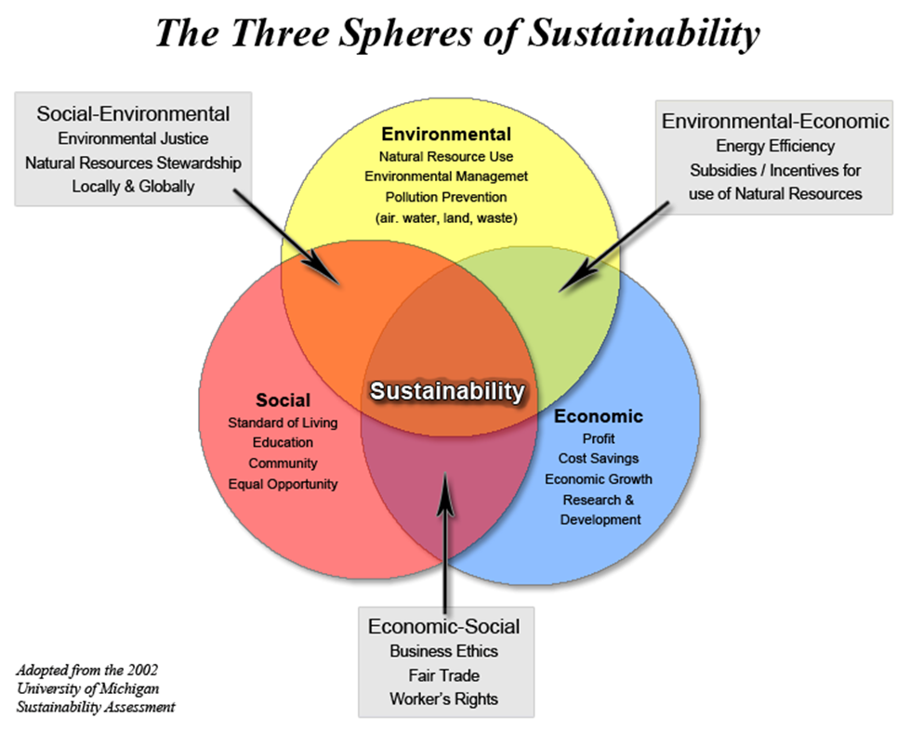
What is needed for sustainability..

Slide 6
The overwhelming environmental challenges for the 21st Century
Population levels
The scale of poverty
Health issues
The growth of cities and urbanisation
Finite resources – oil, gas, coal
Ecosystem damage
Food supplies
The need for clean water
Manmade climate change
Belz & Peattie (2009)

Slide 7
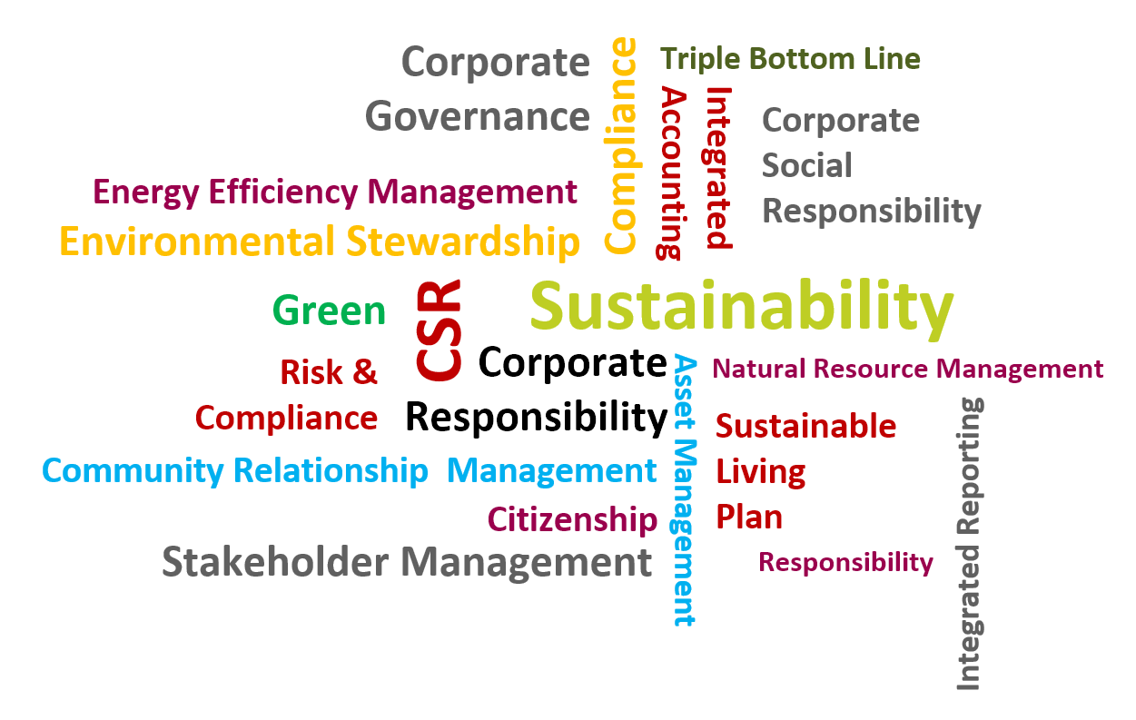
Student task
? – What is marketing all about?
? – Does marketing have anything to do with sustainability?

Slide 8
What is marketing
Marketing is the management process for identifying, anticipating and satisfying customer requirements profitably. The Chartered Institute of Marketing (CIM).
Give people what they want
Make it accessible
Make it easy to buy
Give them choice…..lots of it! https://www.youtube.com/watch?v=RCxgqHqakXc

Slide 9
Is this whole mess the fault of marketers?
Is all marketing a problem area for the concept of the sustainability agenda because it does not just respond to demand it stimulates demand!
“Marketing is a business function which has been criticised for fuelling consumption and encouraging materialism by stimulating wants as a means of satisfying human needs.”
Miller (2009) in Parsons and Maclaren (eds)

Slide 10
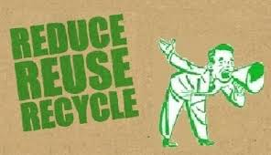
Student task
Is it possible then for marketing and sustainability agendas to live side by side, together?
The main issues involves responsibility: do consumers relate to the problem, how do marketers relate to the problem, who really wants sustainability and why?

Slide 11
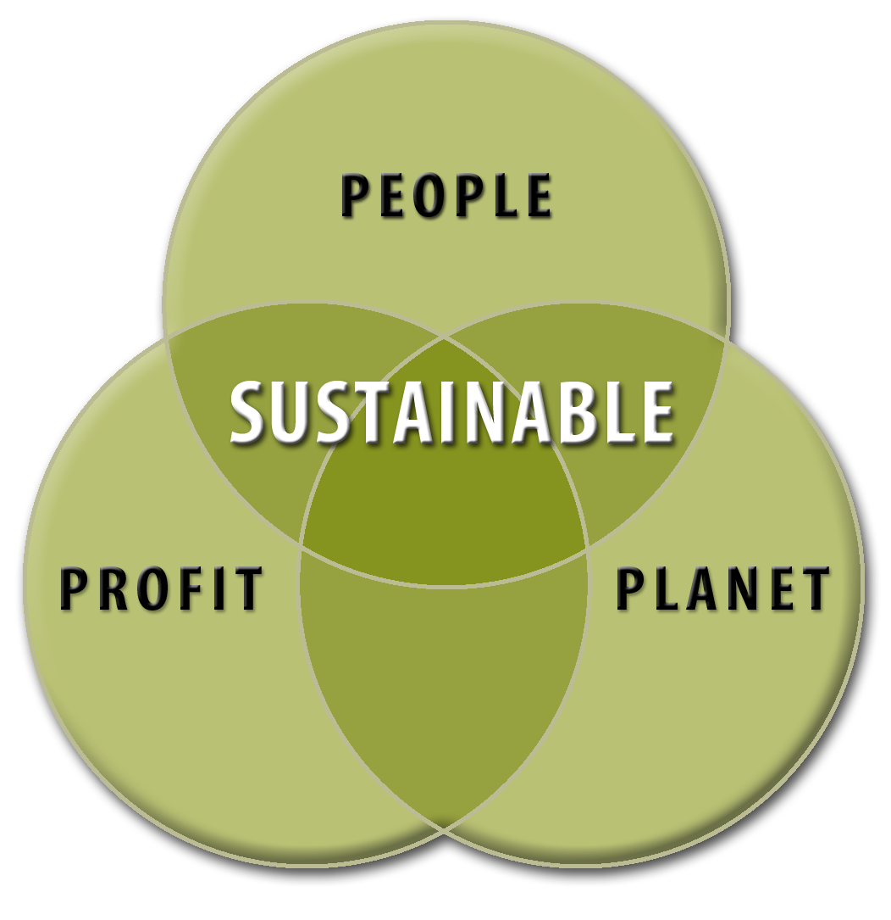
Sustainable issues and competitive markets – who is responsible?
Is it the consumer? – can consumers curb their desire for new [and more] things.
Is it business? - can organisations self-regulate?
Is it the role of the government (economists call this market failure) to regulate business behaviour?
Are legal measures the only way to ensure commitment from businesses? See Wales

Slide 12
Why there is a real problem for the sustainability agenda in marketing – “its not my fault!”
Personal needs
Environmental Impacts
Rational economic behaviour is based on the perceived and believed consequences of our actions
It is difficult for us to perceive the impact of our day-to-day actions on the environment
https://www.youtube.com/watch?v=dvZzxP3tcaM&list=UUu70-1BAiVC-U4p-Z0mX54g
? Would turkeys ever vote for christmas???

Slide 13
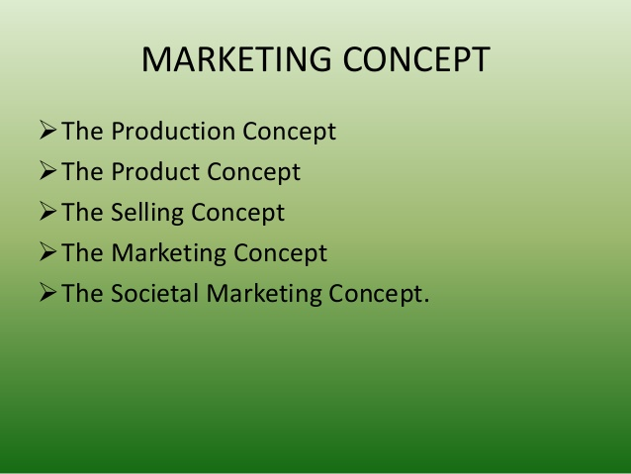
Why there is a real problem for the sustainability agenda in marketing – “it is uncompetitive!”

Slide 14
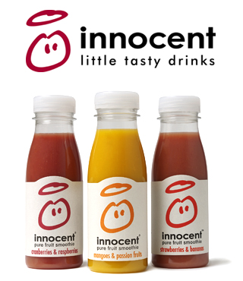
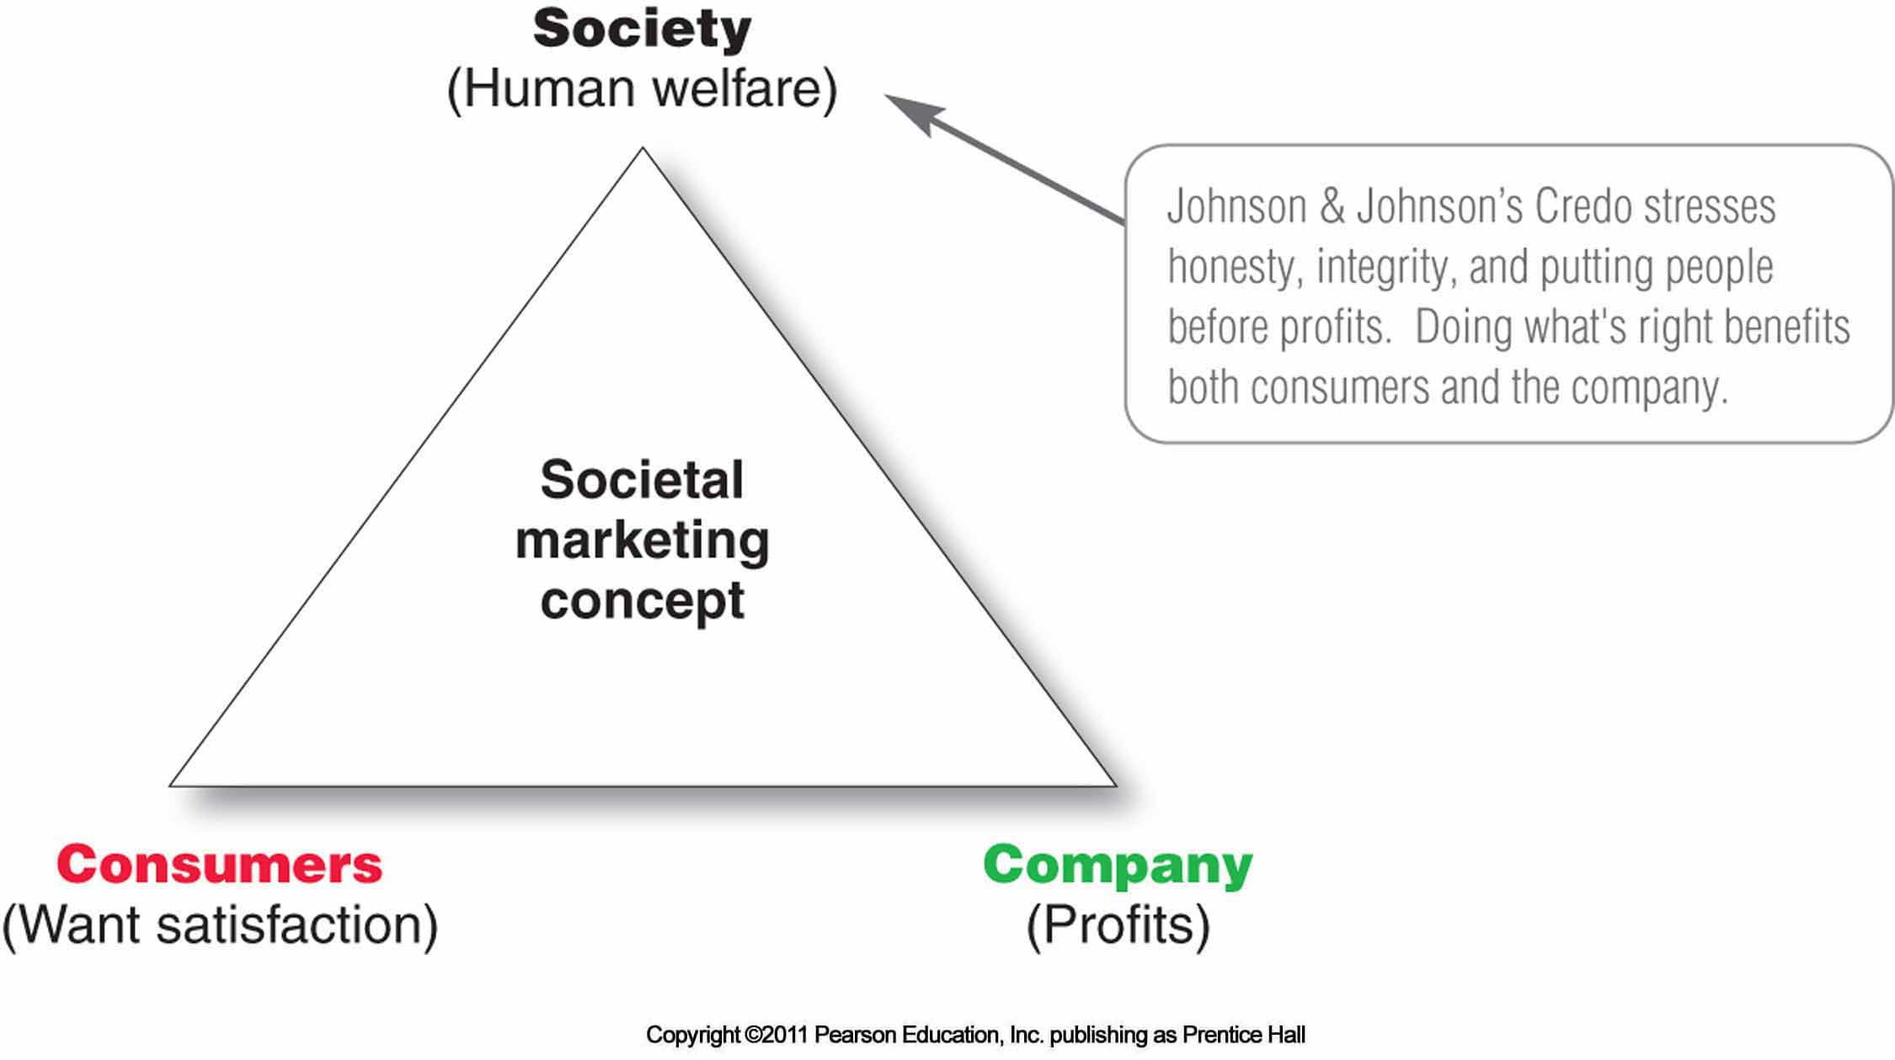
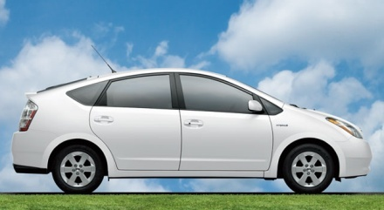

The Societal Marketing Concept
Kotler suggested we move to the societal marketing concept in the 70’s but nothing has been done; Is this Nirvana? Or is it real!
Armstrong & Kotler (2010)

Slide 15
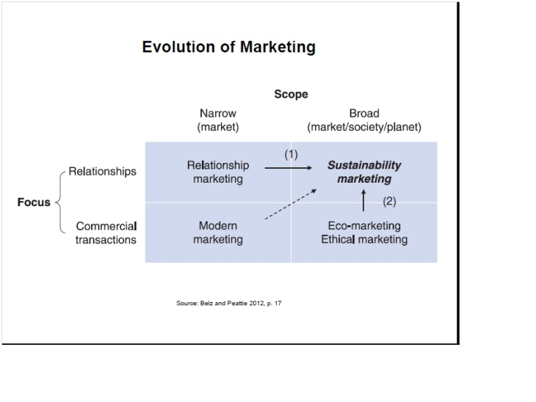
The future direction of marketing….

Slide 16
Sustainability marketing, forEVER…
E
Ecologically oriented
V
Viable
Ethical
R
Relationship-based
E
Belz & Peattie (2009)

Slide 17
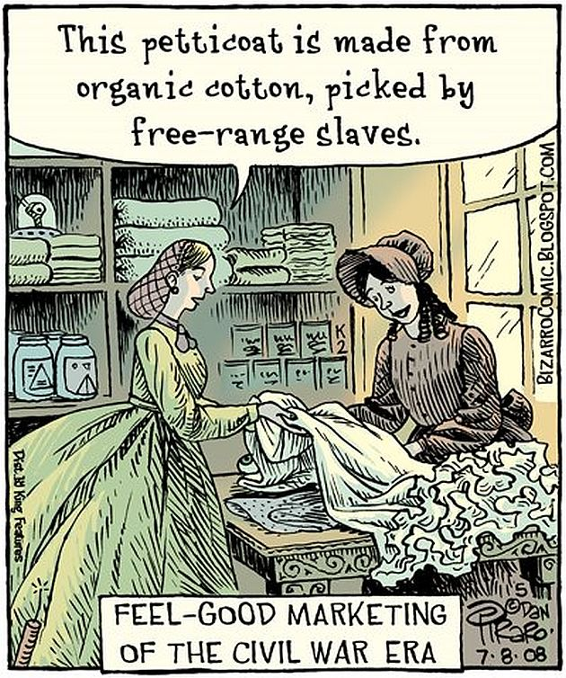
How are we doing so far? …
We can’t deliver a negative message??
So far marketers are exploiting the opportunities of “marketing” the concepts of sustainability;
Corporate Social Responsibility
Ethical marketing
‘Green’ or ‘Eco’ marketing
Sustainable Marketing
Social Marketing
Societal Marketing

Slide 18
Green or eco-marketing
‘Green’ marketing has grown in significance in the past two decades – why? Is it sales driven?
Have we become cynical about eco-friendly products and marketing?
What happens when the economy crashes, does the profit motive carry more weight?
When will we know that the planet has had enough?
“the much vaunted consumer concern for the environment and concomitant desire for green products had not subsequently translated into product sales”
Crane (2000)
“There are two real advantages for a small business becoming green. One is branding and marketing advantage. The other is the impact on the bottom line.”
Bridge (2008)

Slide 19
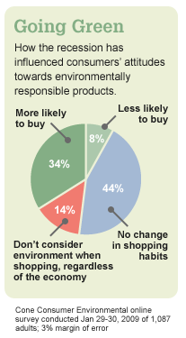
Green marketing in practice:
It’s a greenwash! …a cynics view!
Green spinning
Green selling
Promoting existing product features as green
Green harvesting
Reducing packaging/energy costs not passed on to the consumer
Enviropreneur marketing
Boutique eco products
Using PR to manage criticism of industries considered non-eco
Compliance marketing
Compliance to regulations as a means of promotion
Adapted from Peattie and Crane (2005)

Slide 20
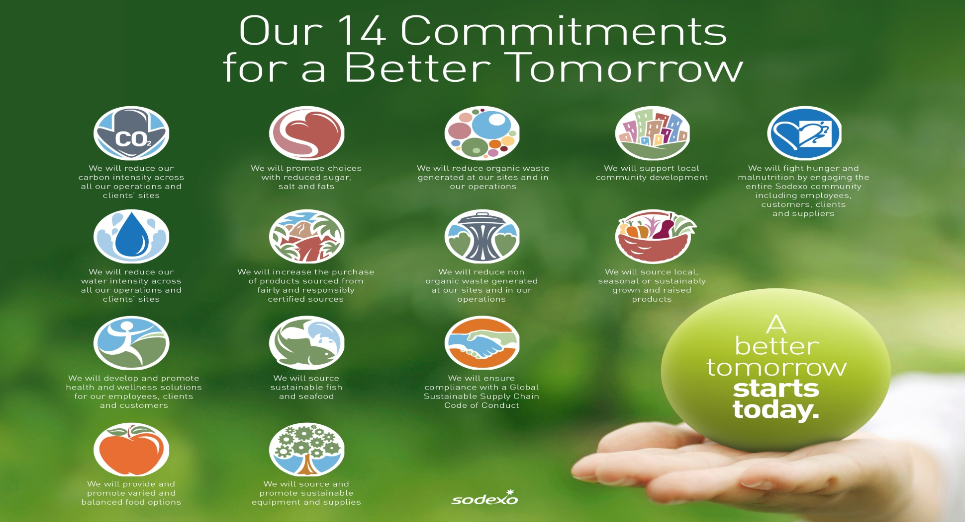
Marketing Sustainability – an example

Slide 21
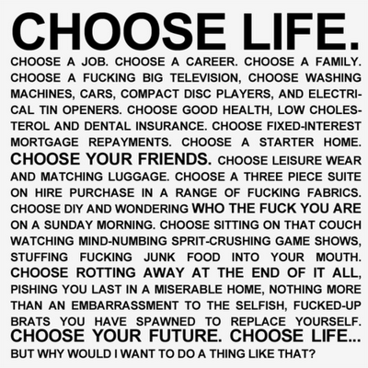
And maybe it is time to choose something else????

Slide 22
Tutorial
Do you think we can make people less demanding and accepting of lower standards of living as the norm?
Is marketing and are marketers unethical about being ethical?
Will we be able to operate ALL business concerns in a sustainable manner as per Brundtland’s definition?

Slide 23
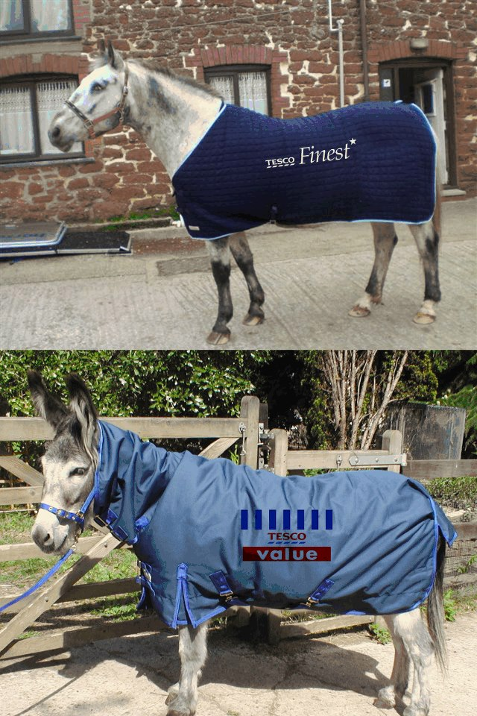
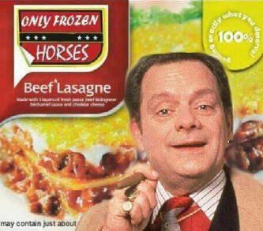
Tutorial Prep: The ‘Horsemeat’ Scandal
What are the issues for marketers?
See Google images.
https://www.youtube.com/watch?v=NO05OUjsJgs
https://www.youtube.com/watch?v=2nhTLaD1n2g

Slide 24
Reading
Chapters 1 & 2
  Belz, F.M. and Peattie, K. (2009) Sustainability Marketing, Chichester, Wiley.
Chapter 27
  Baker, M. J. and Hart, S. J. (2007) The Marketing Book (6th Ed), Oxford, Butterworth-Heinemann.
Chapter 8
  Parsons, E. and Maclaren, P. (2009) Contemporary Issues in Marketing and Consumer Behaviour, Oxford, Butterworth-Heinemann.
Chapter 14
  Tadajewski, M. and Brownlie, D. (2008) Critical Marketing, Chichester, Wiley.
You may find a copy of the South Wales Business Review “The Green Issue” 2013 Autumn Winter Vol 5 Issue 1 in the library or try http://issuu.com/lucygriffiths/docs/south_wales_business_green.

