Slide 1
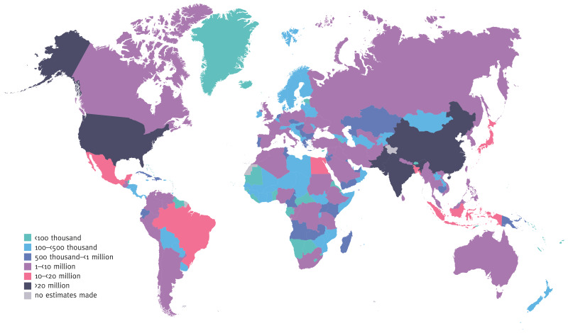
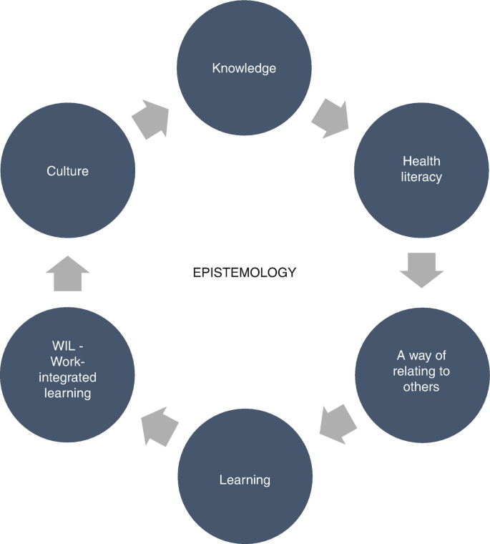
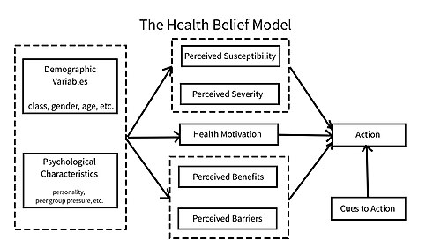
Telehealth for Diabetes Management
1. Background
Diabetes is a serious health issue that impacts millions of people globally. Currently, approximately 537 million adults are living with diabetes. By 2030, this number is projected to rise to around 643 million. According to Getie et al. (2025). Diabetes is a serious public health issue which, if not well managed, can lead to complications like heart problems and kidney failure. However, conventional approaches to the management of diabetes rely primarily on both dietary and lifestyle education with counseling as well as insulin replacement (Caturano et al. 2024).
Among these, telehealth services appear to be an attractive option. Telehealth services encompass remote monitoring, virtual consultations and digital education. They can overcome barriers of geography and cost (Olatunji, et al. 2022). There is evidence that telehealth services are enriched in glycaemic control and patient engagement. Therefore, this is in very much need in the control of increasing incidence of diabetes as it enhances health outcomes (Lee, Greenfield and Pappas, 2018).
2. Health Promotion Values and Principles
Equity, empowerment, participation and prevention are among the principles of health promotion articulated in the Ottawa Charter (Thompson, Watson and Tilford, 2018). Telehealth in particular can be closely tied to these values since it has the potential to fill gaps for underrepresented communities and provide conditions for self-managed, patient-centered care. Remote monitoring tools empower patients to own their diabetes care (Lyngbye and Møller, 2023). However, there is evidence of a digital divide between older persons or low-income individuals unable to access such telehealth technologies (Getie, et al. 2025). So while telehealth upholds inclusiveness, its efficacy lies in the disparity of digital literacy. To ensure that access to health services through digital means is available in a non-discriminatory manner, policy level interventions are warranted (Burrell, 2024).
3. Behavioral Change Theory
One of the models constituting the telehealth interventions is the Health Belief Model (HBM) for behavioral changes to manage diabetes. The model concerns perceived susceptibility, severity, benefits, barriers, cues for action and self-efficacy (Sulat et al. 2018). These concepts have successfully been incorporated into telehealth interventions. Real-time glucose monitoring aids in determining the severity of the disease, and educating patients through ever-available resources gives them an idea about their advantages (Reddy and Oliver, 2024). Being reminders for action, they enhance medication adherence and lifestyle behaviors.
Clinical trial evidence points to effective telehealth interventions for the improvement of self-management behaviors and glycaemic control. An example of this is the telemedicine intervention, which demonstrated reduced HbA1c from 9.5% to 7.9% at 12 months and highlights an effective behavioral change intervention (AlQassab, et al. 2024). Although it comes with its limitations such as technology resistance and privacy issues. By grounding telehealth intervention design principles in behavioral theory, clinicians ensure that their interventions will be not only technologically feasible but also psychologically effective leading to improved participant adherence and health outcomes (Hanlon, et al. 2017).
Estimated total number of adults (20–79 years) with diabetes in 2021
4. Expected Outcomes
Telehealth is associated with improved clinical and behavioural outcomes. Meta-analyses by Ravi et al. (2025) show significant reductions in HbA1c, with an average decrease of 0.37% compared to usual care , while other studies report reductions exceeding 1–3% in structured interventions (AlQassab, et al. 2024). Additionally, telehealth improves medication adherence, self-management, and patient-provider communication. In terms of economic benefits, it decreases hospital visits and healthcare costs. However, this is dependent on demographic factors and access to technology, where research has shown inconsistent outcomes in different groups (Oviedo, et al. 2024). Thus, although telehealth has shown significant effectiveness, it is dependent on a personalized approach.
References
AlQassab, O., Kanthajan, T., Pandey, M., Francis, A.J., Sreenivasan, C., Parikh, A. and Nwosu, M., 2024. Evaluating the Impact of Telemedicine on Diabetes Management in Rural Communities: A Systematic Review. Cureus, 16(7).
Getie, A., Amlak, B.T., Ayenew, T. and Gedfew, M., 2025. Assessing the impact of telehealth on blood glucose management among patients with diabetes: a systematic review and meta-analysis of randomized controlled trials. BMC Health Services Research, 25(1), p.285.
Lee, P.A., Greenfield, G. and Pappas, Y., 2018. The impact of telehealth remote patient monitoring on glycemic control in type 2 diabetes: a systematic review and meta-analysis of systematic reviews of randomised controlled trials. BMC health services research, 18(1), p.495.
Olatunji, G.I., Oparah, O.S., Ezeh, F.E. and Oluwanifemi, O., 2022. Telehealth Integration Framework for Ensuring Continuity of Chronic Disease Care Across Geographic Barriers.
Oviedo, S.A., McDonald, B., Gander, J.C., Ali, M.K. and Harding, J.L., 2024. Access to telehealth and changes in diabetes care patterns during the pandemic: evidence from a large integrated health system in the Southeast USA. BMJ open diabetes research & care, 12(1).
Ravi, S., Meyerowitz-Katz, G., Yung, C., Ayre, J., McCaffery, K., Maberly, G. and Bonner, C., 2025. Effect of virtual care in type 2 diabetes management–a systematic umbrella review of systematic reviews and meta-analysis. BMC health services research, 25(1), p.348.
Sulat, J.S., Prabandari, Y.S., Sanusi, R., Hapsari, E.D. and Santoso, B., 2018. The validity of health belief model variables in predicting behavioral change: A scoping review. Health Education, 118(6), pp.499-512.
5. Conclusion
The use of telehealth in diabetes management has important implications for policy, education and research. Policy-wise, in order not to worsen health inequality, access, security and connectivity must be assured. In the context of education, telemedicine competences need to be taught in health professions education at all levels. When considering the technology of telehealth to manage diabetes, key research factors include long-term impact, cost-evaluation and digital exclusion.

