Slide 1
Lecture 8
Long-term debt finance 1

Slide 2
Long-term debt finance: 1
Key characteristics of the main categories of debt finance
The nature and the main types of bonds
The main considerations for a firm when borrowing from banks
Credit ratings given to debt finance
The role of mezzanine and high-yield bonds
Convertible bonds

Slide 3
Some fundamental features of debt finance
Debt is something that has to be repaid
Debt finance is less expensive than equity
  The costs of raising the funds
  The annual return required to attract investors is less
  Tax deductibility of interest
Lenders do not, generally, share in the value created by an extraordinarily successful business
Absence of voting power
When a company pays interest the tax authorities regard this as a cost of doing business and it can be used to reduce the taxable profit
Creditors are able to claim some or all of the assets of the firm in the event of non-compliance with the terms of the loan

Slide 4
Bonds
A bond is a long-term contract in which the bondholders lend money to a company.
The company (usually) promises to pay the bond owners pre- determined payments, usually a series of coupons, until the bond matures.
At maturity the bondholder receives a specified principal sum called the par (face or nominal) value of the bond.
These negotiable (that is tradable in a secondary market) instruments come in a variety of forms:
  Straight, plain vanilla or bullet bonds
  Coupons every three months
  Zero coupon bonds
  Floating-rate or variable-rate bonds
  Linked to a wide variety of economic events

Slide 5
Debentures, loan stocks and trust deeds
Debenture
  Either a fixed or a floating charge
  As a general rule debentures are secured and loan stock is unsecured,
  If liquidation occurs unsecured loan stockholders rank beneath debenture holders
  Fixed-interest securities
Trust deed, trustees ensure compliance with the contract
Affirmative covenants
Negative (restrictive) covenants
  Limits on further debt issuance
  Dividend level
  Limits on the disposal of assets
  Financial ratios

Slide 6
Repayments
  paid entirely at maturity
  repaid before the final redemption date.
  sinking fund
  range of dates for redemption
  issuing firm to buy the outstanding bonds
  a firm is also able to purchase bonds on the open market.
  ‘irredeemable’

Slide 7
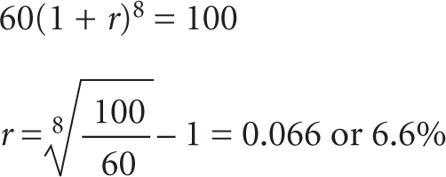
Bond variations
  deep discounted bonds
  zero coupon bond
  floating-rate note (FRN)
  London Inter-Bank Offered Rate (LIBOR)

Slide 8
Bank borrowing
Borrowing from banks is attractive to companies for the following reasons:
  Administrative and legal costs are low
  Quick
  Flexibility
  Available to small firms

Slide 9
  Factors for a firm to consider when borrowing from a bank
Costs
  Arrangement fee
  Interest rate can be either fixed or floating
  If it is floating then the rate will generally be certain percentage points above the banks’ base rate or LIBOR
  Floating-rate borrowings have advantages:
    If interest rates fall the cost of the loan falls
    Fixed rates are usually above floating rates
    Returns on the firm’s assets may go up at times of higher interest rates
  Floating rates have some disadvantages
    The firm may be caught out by a rise in interest rates
    Uncertainty about the precise cash outflow

Slide 10
Factors for a firm to consider when borrowing from a bank: Security
Banks concerned about the borrower’s competence and honesty
‘Asymmetric information’
  One party in the negotiation is ignorant of, or cannot observe, some of the information which is essential to the contracting and decision-making process
Companies may overcome bank uncertainty to some degree by providing as much information as possible
Collateral
Loan covenants place restrictions on managerial action
Personal guarantees of directors

Slide 11
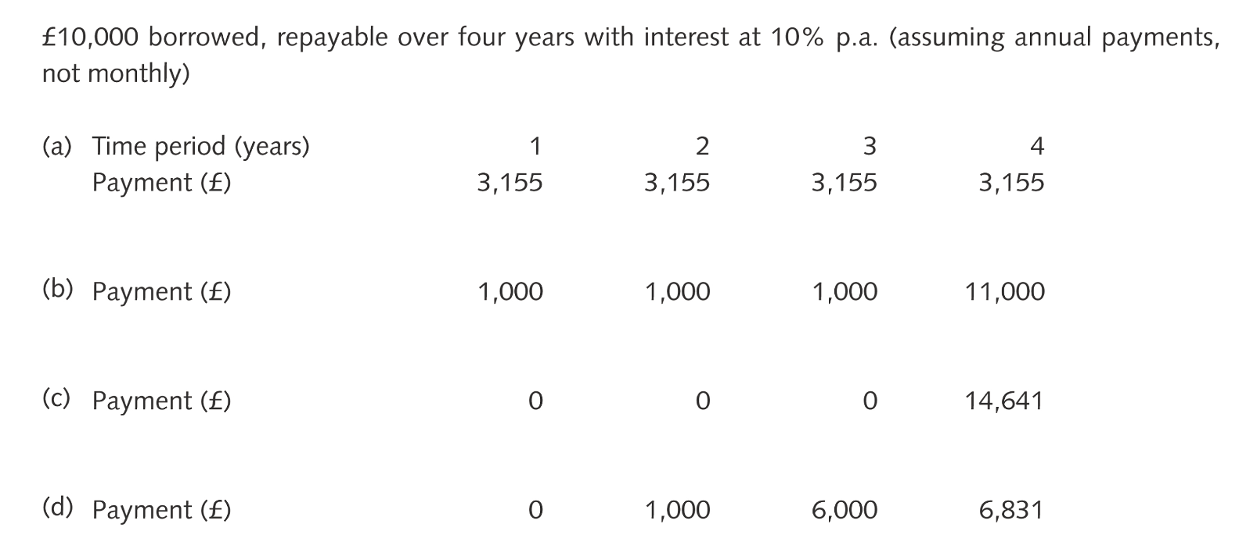
Factors for a firm to consider when borrowing from a bank
Repayment
  Carefully consider the period of the loan and the repayment schedules
  Repayment holidays or grace periods
Exhibit 11.4 Examples of loan repayment arrangements

Slide 12
Syndicated loans
A few banks each contribute a portion of the overall loan
Lead manager
  Handful of other banks to co-manage the loan
  Syndicate group
  Managing bank also underwrites much of the loan
Syndicated loans are available at short notice and can be provided discreetly
Generally offer lower returns than bond
Rank above most bonds on liquidation payouts
The loans carry covenants similar to those on bond agreements

Slide 13
Credit rating
Debt rating depends on
  Likelihood of payments of interest and/or capital not being paid (that is, default)
  The extent to which the lender is protected in the event of a default (the recoverability of the debt)
‘Investment grade’, many institutional investors are permitted to invest in investment grade bonds only
The specific loan is rated rather than the borrower

Slide 14
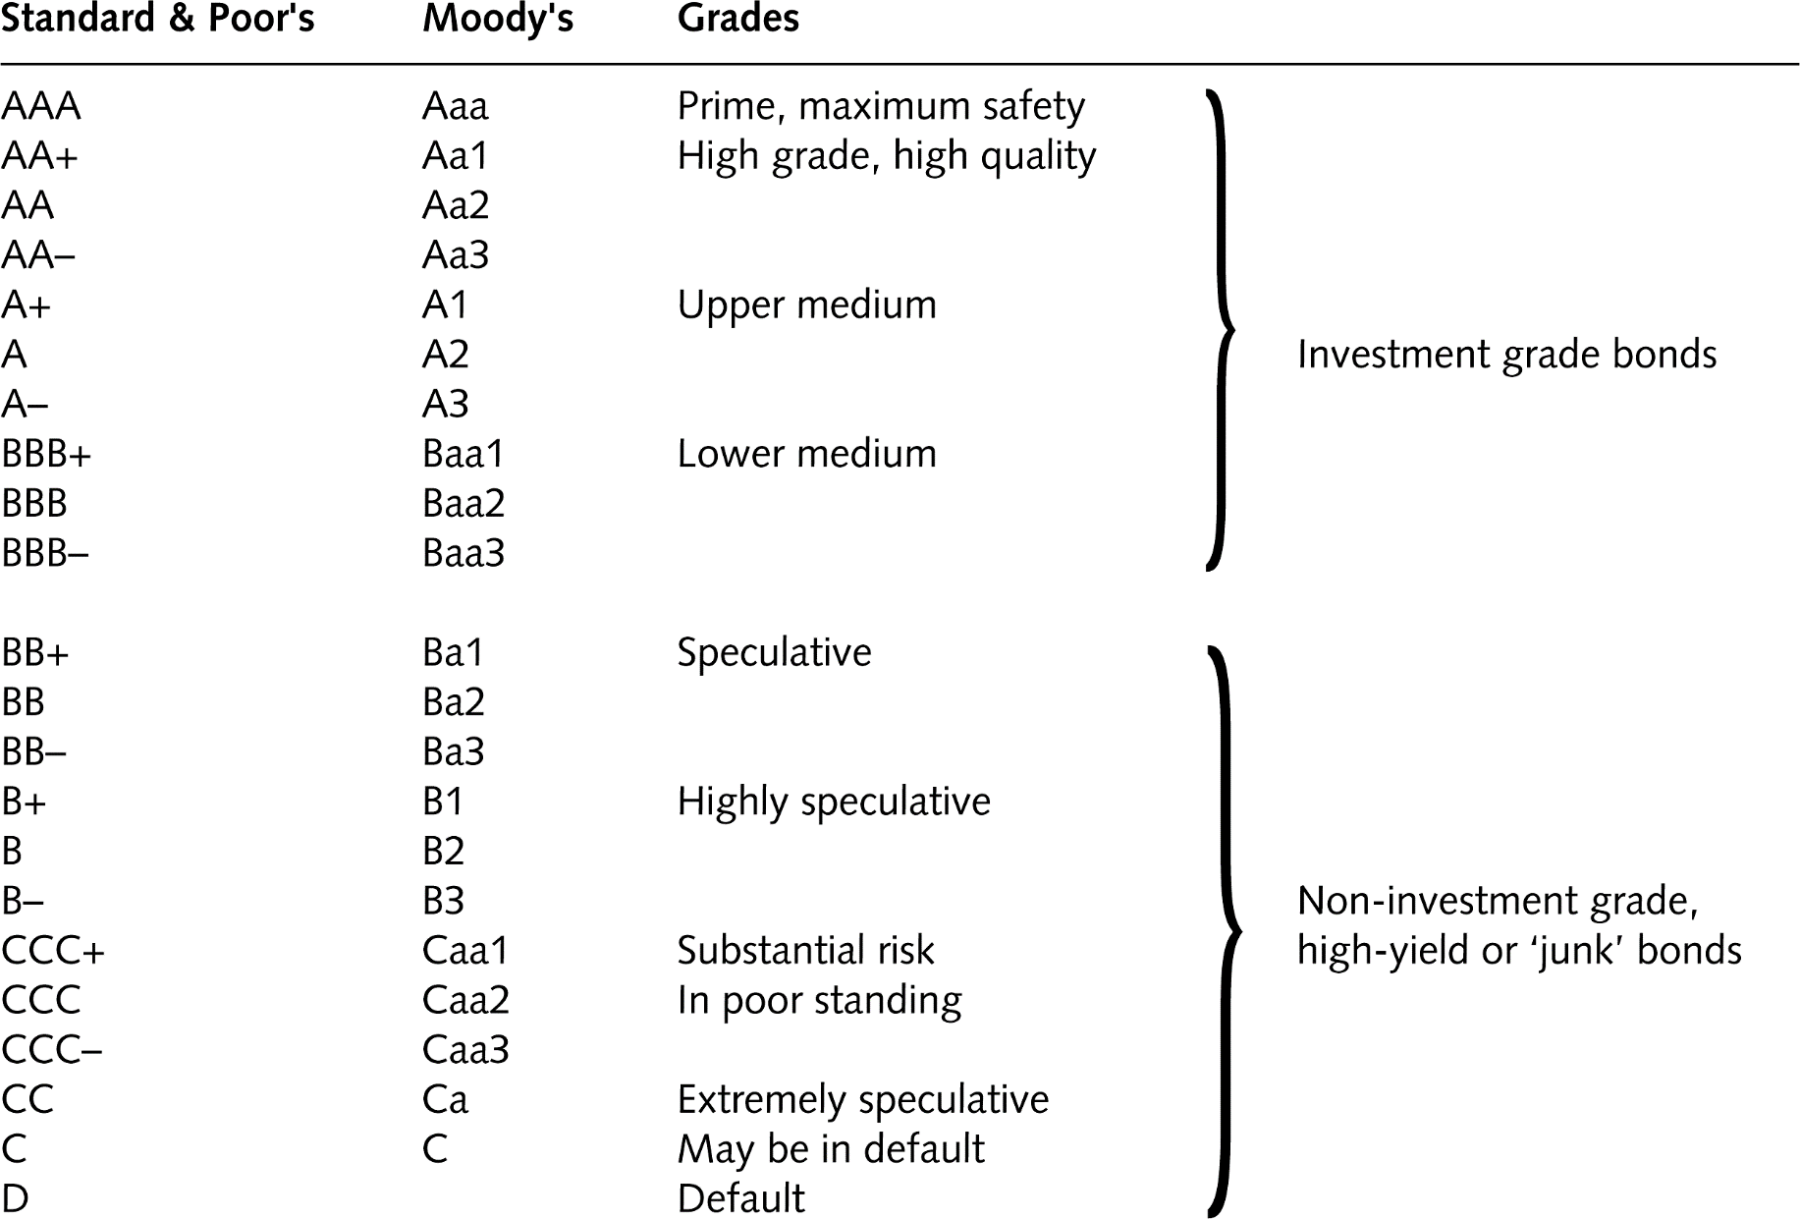
A comparison of Moody’s and Standard & Poor’s rating scales
Exhibit 11.5 A comparison of Moody’s, Standard & Poor’s and Fitch’s rating scales

Slide 15
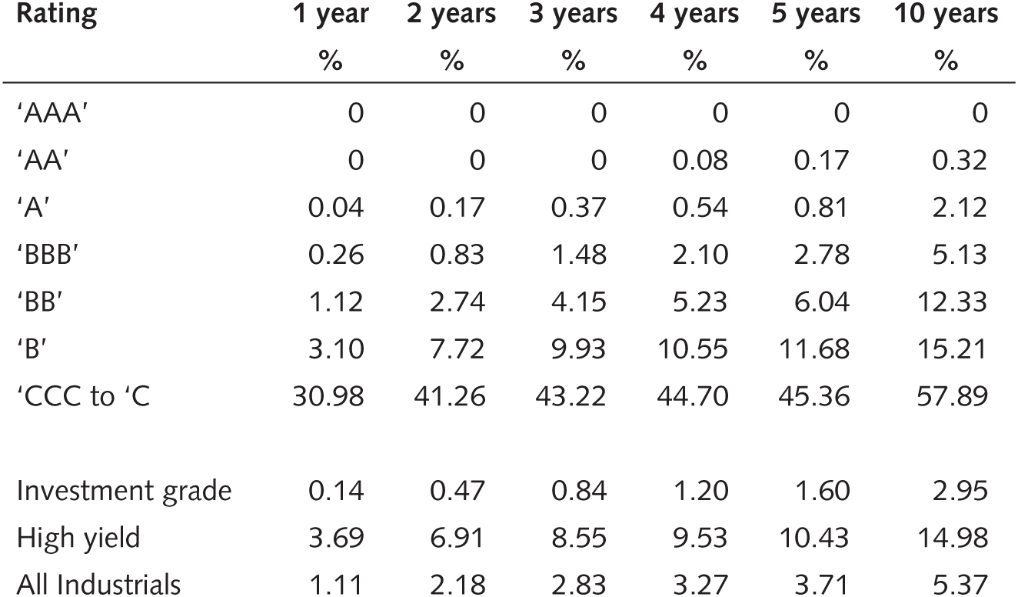
Bond default rates
Exhibit 11.7 Fitch Global Corporate Finance average cumulative default rates 1990–2010
Source: Fitch Ratings Global Corporate Finance 2010 Transition and Default Study www.fitchratings.com/creditdesk/reports/report_frame.cfm?rpt_id=606665

Slide 16
Mezzanine debt
Mezzanine debt is debt offering a high return with a high risk
Unsecured or secured but ranking behind senior loans for payment of interest and capital
Generally offers interest rates two to nine percentage points more than that on senior debt
Alternatively known as subordinated, intermediate or low grade
Often comes with equity warrant or share options attached
An ‘equity kicker’
Tends to be used when bank borrowing limits are reached and the firm cannot or will not issue more equity
Permits the firm to move beyond what is normally considered acceptable debt : equity ratios

Slide 17
High-yield (junk) bonds
Bonds with high-risk and high-return characteristics (ratings of Bs and Cs)
‘Fallen angels’ or bonds issued specifically to provide higher-risk finance instruments for investors
European high-yield bond market is in its infancy

Slide 18
Uses of mezzanine and high yield bonds
Note that mezzanine finance is usually a private form of debt (e.g. loan), rather than a publicly traded bond form of debt
Mezzanine and junk bond finance has proved to be particularly useful to:
  Managers involved in a leveraged buyouts, LBO
  Fast-growing companies also make use of mezzanine finance
  Firms ‘gearing themselves up’ to finance merger activity
  Leveraged recapitalisations

Slide 19
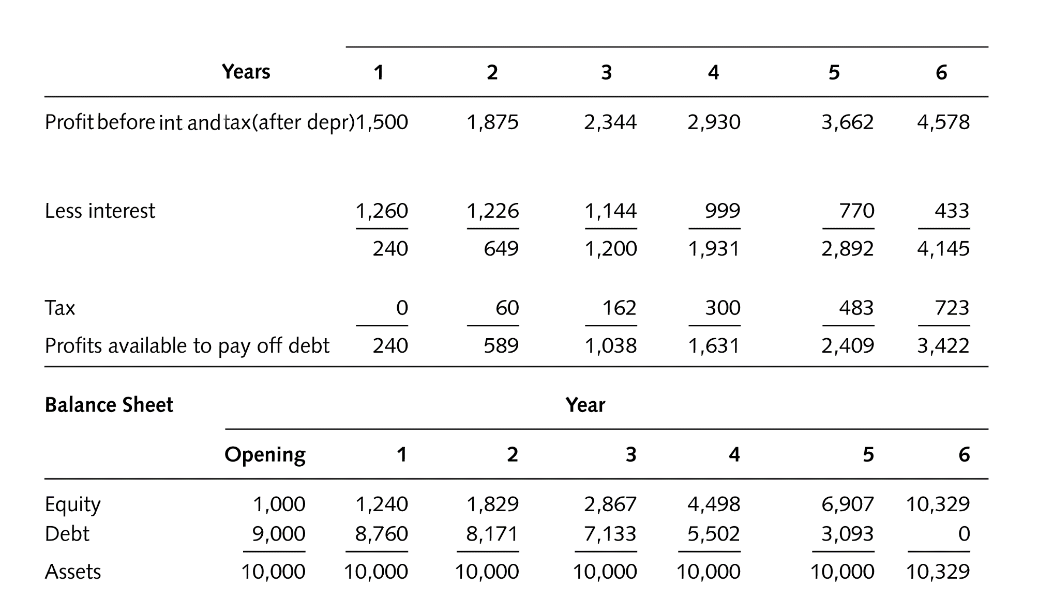
Financing a leveraged buyout
Exhibit 11.10 Sparrow – Profit and Loss Account and Balance Sheet (£000s)
Notes: Past tax liabilities have been accepted by Hawk. Money set aside for depreciation is used to replace assets to maintain £10m of assets throughout. Also depreciation equals capital allowances used for tax purposes.

Slide 20
Convertible bonds
Carry a rate of interest
Also give the holder the right to exchange the bonds at some stage in the future into ordinary shares according to some prearranged formula
Usually the conversion price is 10–30 per cent greater than the existing share price
If a £100 bond offered the right to convert to 40 ordinary shares the conversion price would be £2.50
Given the current market price of the shares of, say, £2.20, would be a conversion premium of:
  2.50 – 2.20
= 0.136 or 13.6%
2.20

Slide 21
Convertible bonds – example
Autonomy issued convertible bonds in March 2010
The issue raised £500m
The bonds were to be redeemed in March 2015
Priced at a par value of £100
Semi-annual coupon was set at 3.25 per cent pa
Conversion price was at £20.6334 per share
Nominal (par) value of bond
£100
Conversion ratio =
=
= 4.8465 shares
Conversion price
£20.6334
The conversion price was set at a premium of 36 per cent over the ordinary share price at the time of pricing which was £15.22 ((20.6334 – 15.22)/15.22 = 36%)

Slide 22
Example of a convertible bond
Autonomy sold £500m of convertible bonds in March 2010
Five-year bonds issued at a par value of £100
Semi-annual coupon of 3.25 per cent per year
The five-year bond would be converted into ordinary shares and would have an initial conversion price of £20.6334, a 36 per cent premium to the share price
at the time of issue at £15.22
Each bond carries the right to convert to 4.8465 shares, which is equivalent to paying £20.6334 for each share at the £100 par value of the bond.

Slide 23
Summary of convertible bond technical jargon
Nominal (par) value of bond
Conversion ratio =
Conversion price
Nominal (par) value of bond
Conversion price =
Number of shares into which bond may be converted
Conversion price – Market share price
Conversion premium =
× 100
Market share price
Conversion value = Current share price × Conversion ratio
Exhibit 11.11 Summary of convertible bond technical jargon

Slide 24
Advantages to the company of convertible bonds
1 Lower interest than on a similar debenture
2 The interest is tax deductible
3 Self liquidating
4 Fewer restrictive covenants
5 Underpriced shares
6 Cheap way to issue shares
7 Available finance when straight debt and equity are not available

Slide 25
Lecture review
Debt finance has a number of advantages for the company as well as drawbacks
Bonds and loan stocks
Bank borrowing
Syndicated loan
Credit rating
Mezzanine debt and high-yield bonds
Convertible bonds

