Slide 1
Evidence Based Policing
Week 4
Models of Policing & The College of Policing
Dr. Luke Roach
L.Roach@UWTSD.ac.uk

Slide 2
Lesson Plan
Evidence Based Policing Recap
Triple T
POP
SARA
Hot-Spot Policing
Techniques of Primary Prevention
College of Policing/What Works Centre
TASK

Slide 3
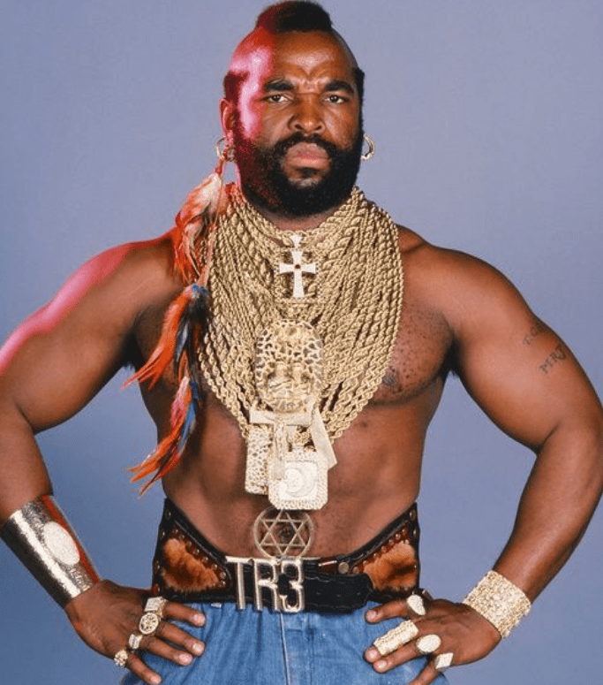
What is Triple – T?

Slide 4
Triple T
Targeting
  Police should conduct and apply good research to target scare resources on predictable concentrations of harm from crime and disorder
Testing
  Once police choose their high-priority targets, they should review or conduct tests of police methods to help chose what works best to reduce harm
Tracking
  Once police agencies use research to target their tested practices, they should generate and use internal evidence to track the daily delivery and effects of those practices, including public perceptions of police legitimacy.
(Sherman, 2013)

Slide 5
What is POP?
What does POP stand for and how is it distinct from other models of policing?

Slide 6
POP – Problem Oriented Policing
Herman Goldstein (1979
Called on the police to focus their efforts not on responding to isolated events but on dealing with clusters of related incidents, what Goldstein defined as ‘problems’

Slide 7

What is the SARA model?

Slide 8
SARA Model
Eck and Spellman (1987)
Scanning – What is the problem?
Analysis – What are the underlying issues affecting the problem (victim, offender, location)
Response – The strategy and tactics to deal with the problem, in light of the analysis
Assessment – The measurement of the impact upon the problem. (Bullock & Tilley, 2003)

Slide 9
SARA Model – From What works policing, college of policing
First, the police identify clusters of similar events affecting the community and ascertain the harm they cause. Second, they engage in structured efforts to better understand the underlying causes that generate these problems, using a wide range of relevant data, information sources and analytical techniques. Third, tailored responses are put in place to reduce the presenting problems. These, according to Goldstein, should concentrate on prevention, avoid dependency on the criminal justice system (i.e. arrest and prosecution), and involve partners who are affected by or responsible for the problem, including the local community. Fourth, the impact of implemented responses is assessed.

Slide 10
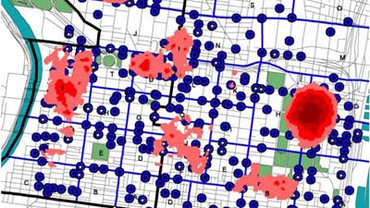
What is Hot-Spot Policing?

Slide 11
Hot-Spot Policing
Entails the allocation of police resources to places where crime concentrates. (Lum & Koper, 2017)
Numerous studies have shown that approx half of serious crime takes place in only 5% of the jurisdiction’s locations. (e.g. Pierce et al., 1988; Sherman et al., 1989; Weisburd et al., 2004)
No universally accepted definition of “Hot-Spot” (Eck, 2005)
Analysis shows they tend to bring together the 3 Routine Activity Theory states. (Lum & Koper, 2017)

Slide 12
Hot-Spot Policing
Focusing on places can make the police more effective and efficient.
People move but places don’t! (Spelman & Eck, 1989; Weisburd 2008)
Crime locations tends to be stable over time.
Increased chances of preventing crime or catching offenders.
Targeting places is more effective that targeting individual criminals (Lum & Nagin, 2016)
There is little evidence of displacement (Lum & Koper, 2017)

Slide 13
Hot-Spot Policing – What do we do?
In practice, policing efforts tend to be short-term patrol & enforcement (Koper, 2014).
However, tailored and problem-solving approaches can be more effective that general patrol (Braga et al., 2012)
Also need to analyse “Hot Times” and regularly patrol at those times. (Lum & Koper, 2017)
But what about deployment length?

Slide 14
Techniques of Primary Prevention
There are 16 Techniques, who identified them?
Increasing Effort
Increasing Risk
Reducing Reward
Removing Excuses
  Break into groups and discuss each section

Slide 15
Clarke (1997) – The 16 Techniques of Primary Prevention.
Increasing the Effort:
  Target hardening
      Steering locks
      Anti-robber screens
  Access Control
      Entry phones
      Computer Passwords
  Deflecting Offenders
      Cul-de-sacs
      Routing away fans at soccer matches
  Controlling Means
      Weapons availability
      Photographs on credit cards

Slide 16
Clarke (1997) – The 16 Techniques of Primary Prevention.
Increasing the Risk:
  Entry/Exit Screening
      Baggage Screening
      Merchandise Tags
  Formal Surveillance
      CCTV
      Automatic Number Plate Recognition (ANPR)
  Employee Surveillance
      Park Wardens
      Club Door Staff
  Natural Surveillance
      Street lighting
      Windows

Slide 17
Clarke (1997) – The 16 Techniques of Primary Prevention.
Reducing the Reward:
  Target Removal
      Keep car in garage
      Removable car radio fascia
  Identify Property
      Product serial numbers
      Vehicle licence plate
  Removing inducements
      Rapid repair of damaged property
      Removing graffiti
  Rule Setting
      Tenancy agreements
      Software copyright agreements before installation

Slide 18
Clarke (1997) – The 16 Techniques of Primary Prevention.
Removing Excuses:
  Rule Setting
      Customs declaration
      Hotel registration
  Stimulating Conscience
      Roadside speed displays
      Drink-drive campaigns
  Controlling Dis-inhibitors
      Drinking age laws
      Parental controls on internet
  Facilitating Compliance
      Fine deduction from salary
      Ample litter bins

Slide 19
Short Film on EBP
https://www.youtube.com/watch?v=af0awYdoEMg

Slide 20

What is the College of Policing?
What is the “What Works Centre”?

Slide 21
College of Policing
The College of Policing is the What Works Centre for Crime Reduction, established in 2013.
The focus of the What Works Centre for Crime Reduction is on:
Reviewing research on practices and interventions to reduce crime;
Labelling the best available evidence on interventions in terms of impact on crime reduction, how they work, where they work, how to do it and economic cost. Go to Crime Reduction Toolkit.
Providing Police and Crime Commissioners (PCCs) and other crime reduction stakeholders with the knowledge, tools and guidance to help them target their resources more effectively.
College What Works is part of a network of What Works Centres created to provide robust and comprehensive evidence that will guide decision-making on public spending. For more information, see the Gov.uk website.

Slide 22
Achievements
Identification & mapping of over 300 systematic reviews in area of crime reduction;
Design of EMMIE coding system to rate and rank the evidence to help make it more accessible to practitioners;
Development of the Crime Reduction Toolkit, providing easy access to the crime reduction evidence;
12 new systematic reviews on crime reduction interventions incl. alley-gating, retail tagging and mentoring;
Guidance on analysing costs of interventions;
Development of training package on understanding evidence-based approaches.

Slide 23
Changes in evidence use by senior officers: % “never or rarely” using
 | 2014 | 2016
Never or rarely used academic consultants | 43% | 31%*
Never or rarely used academic journals | 69% | 56%*
Never or rarely visited Campbell Collaboration website | 93% | 79%*
Never or rarely used material from the Society of Evidence Based Policing | 84% | 58%**
https://campbellcollaboration.org/
Notes: Max sample sizes were 655 in 2014 and 67 in 2016, with varying but very low rate of attrition in different questions; * and ** denote statistical significance at 5% and 1% respectively.

Slide 24
Change in perceived organisational support for EBP: % agreeing
 | 2014 | 2016
There is no organisational emphasis on the use of research evidence to inform decision-making. | 75% | 48%*
My organisation promotes collaboration with universities, in order to generate and share evidence-based learning. | 25% | 73%**
My organisation provides sufficient support and resources to implement evidence- based practice | 25% | 33%
My organisation encourages and supports its workforce to gain knowledge and understanding from research evidence. | 31% | 49%**
Notes: Max sample sizes were 655 in 2014 and 67 in 2016, with varying but very low rate of attrition in different questions; * and
** denote statistical significance at 5% and 1% respectively.

Slide 25
Challenges
No change since 2014 in perception of the main practical barriers to greater engagement with research:
Lack of time to keep up to date with the evidence base;
Limited resources to promote greater engagement with research and to build capability.
”We’re pretty pressured day to day just keeping things going and running forward. Actually having space to sit down and think about what works, what doesn’t work, what we’d like to do and how we could do it, would be real luxury.”
“I’m still really, really keen on it, and I’ll push it as much as I can in force. But, it’s going to be a long battle against the backdrop of the austerity cuts.”
Some confusion about what the ‘evidence’ in evidence-based practice can mean – only randomised control trials or including boarder range of research methods.

Slide 26
Messages to the College of Policing
Promote and publicise where evidence-based practice has been successfully applied through ‘live examples’ of its impact on policing practice;
Research needs to be locally relevant to engage practitioners;
Greater clarity about the meaning of evidence-based practice and the emphasis on the method being appropriate to the question being asked;
The College has a crucial role in coordinating how evidence-based practice is introduced across the police service and the extent to which other bodies in policing and crime reduction are focused on the importance of research.

Slide 27
Next steps
Focus on developing and sustaining the WWCCR, including the Crime Reduction Toolkit as new evidence becomes available.
More primary research about effectiveness of crime reduction but also about other police functions to ensure that evidence-based practice can continue to develop and thrive.
Building capability amongst police officers - this should be a consequence over the longer-term of the qualifications and training curriculum in policing.
Consider the future products and potential of the various policing and academic partnerships.

Slide 28
Class Task
I want you to find a crime “problem” and use the resources available to address it in the best way you can think of.

Slide 29
Class Task
What would your considerations and actions be to overcome this problem?
1. Explain the details of the problem, issue or concern, including who may be affected by it. - consider who is involved, as collaborative working plays an important part in EBP
Consider the stages of Evidenced Based Policing
• Identify Problem
• Define Problem
• Understand Problem
• Develop Ideas
• Identify Opportunities
• Plan
• Implement
• Evaluate This cannot be completed at this stage
2. Outline the key stakeholders in relation to this situation – consider what is involved, the roles and responsibilities of each organisation or individual will have in implementing a new approach
3. Where may you go to research the problem?
4. Define possible options for resolving or the issue
5. Define the preferred solution, including the rationale for the choice and likely benefits based on evidence.
6. Construct a plan for the implementation of the preferred option. This should include consideration of: cost, resources, any partner agency involvement, timescales, monitoring, recording findings and date for concluding the implementation.

Slide 30
Resources List
Swansea Crime Map
https://www.police.uk/pu/your-area/south-wales-police/swansea/?tab=CrimeMap
College of Policing
http://www.college.police.uk/Pages/Home.aspx
What Works Centre for Crime Reduction
http://whatworks.college.police.uk/Pages/default.aspx
UCL Jill Dando Institute of Security and Crime Science
http://www.ucl.ac.uk/jdi/
Cambridge Institute of Criminology
http://www.crim.cam.ac.uk/
Society for Evidence Based Policing
https://www.sebp.police.uk/
Campbell Collaboration
https://campbellcollaboration.org/
Canterbury Centre for Policing Research
https://www.canterbury.ac.uk/social-and-applied-sciences/law-criminal-justice-and-computing/canterbury-centre-for-police-research/canterbuy-centre-for-police-research.aspx

Slide 31

Week 4 Complete!
Any questions?
Well Done!
See you next week!

