Slide 1
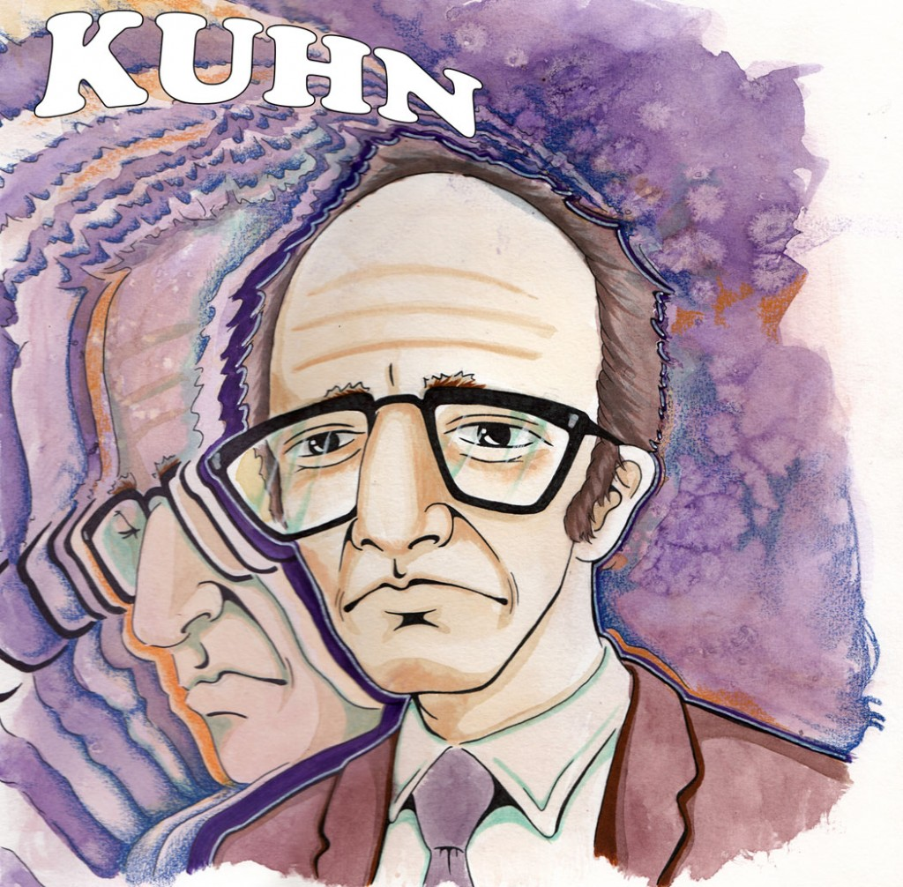
PRESENTATION by
HINA TOKEER
Advancing to Doctoral Research Stage (LCDB7012)
2419580

Slide 2


1A. PARADIGM
A universally recognized scientific achievement that provides model problems and solutions to a community of practitioners.
An accepted theory, law, and method that a scientific community takes as the foundation for its further research.
(KUHN, 1970)
The Paradigm: A cohesive "constellation of beliefs, values, and techniques" shared by a scientific community (Kuhn, 1970)
The Cognitive Map: Functions as a regulatory framework that dictates what is observed, how it is scrutinized, and how results are interpreted (kuhn, 1970).
Boundary Setter: Establishes the rules of engagement for "normal science" by choosing which problems are worth solving (Kuhn, 1970).
The Blinder: Restricts vision to a specific spectrum, meaning scientists safely ignore phenomena outside their paradigm's scope.
The Scaffolding: Serves as the hidden intellectual foundation upon which all empirical research structures are built (Crotty, 1998).
LOGICAL SEQUENCE OF A GOOD RESEARCH DESIGN:
ONTOLOGY
ESPISTEMOLOGY
AXIOLOGY
METHODOLOGY

Slide 3

1B. WHY DOCTORAL RESEARCHERS NEED IT?
INTELLECTUAL STAKES
Informed Choice: Prevents researchers from blindly adopting methods without understanding their philosophical baggage (Crotty, 1998).
Design Harmony: Eliminates the risk of mixing incompatible assumptions, protecting the thesis from structural incoherence
Defensible Stance: Provides a clear philosophical rationale to justify design choices to external examiners and critics (Creswell and Creswell 2018).
Analytical Reflexivity: Forces the researcher to acknowledge how their own values explicitly shape data interpretation (Braun and Clarke 2022).
Community Entry: Signals that the doctoral candidate understands the specific rules and boundaries of their chosen scientific community (Kuhn, 1970)
NOT KNOWING YOUR PARADIGM IS A DESIGN FLAW
ACCORDING TO KHUN:
Without one: endless competing schools, no agreed foundations, no real progress
Ends wasteful debates over first principles, so scientists can get on with research
Enables efficient puzzle-solving (normal science)
Channels and directs scientific progress

Slide 4
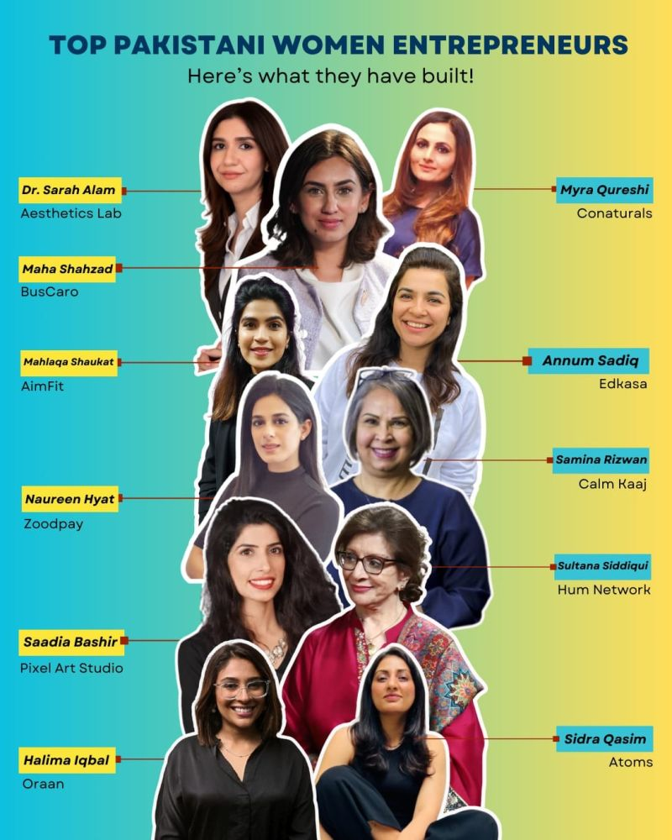
2A. DOMINANT EPISTEMOLOGICAL ASSUMPTIONS OF MY FIELD
The Research Problem: Exploring How Pakistani Women Entrepreneurs Transition From Operational Business Owners to Strategic Leaders as Their Businesses Grow.
Entrepreneurship: Multiple systematic reviews confirm the pattern. A review of nearly 2,234 articles found entrepreneurship research dominated by positivist approaches and survey-based methods, while also noting this picture is slowly changing.
Earlier work put qualitative research at only about 18% of published contributions, and a major methods handbook states the field's empirical work has "predominantly been based on structured surveys".
Anderson and Starnawska (2008) call positivism outright "the dominant paradigm of entrepreneurship research practices"
Bygrave's revisit of the field concluded that by 2007 it was "dominated by quantitative research driven almost exclusively by statistical analysis" with qualitative work seldom published in leading journals.
Leadership studies: The same holds, arguably more strongly. Spoelstra, Butler and Delaney note that "from its inception, leadership studies has embraced the positivist tradition of hypothesis testing," and argue positivist epistemology persists there "as an article of faith" even where psychometric measures fall short.
Fendt and Endrissat observe that few qualitative studies are conducted and that even many self-described qualitative leadership studies adhere wholly or partly to a positivist paradigm.
Kempster and Parry, work in The Leadership Quarterly, identify positivism as the field's "dominant 'scientific' approach"

Slide 5
2B. DOMINANT EPISTEMOLOGICAL ASSUMPTIONS OF MY FIELD
WHAT POSITIVISM LACKS
A grasp of the phenomenon itself. Anderson and Starnawska call this the field's "fundamental paradox": researchers try to measure a phenomenon that cannot properly be defined, so much entrepreneurship research becomes fragmentary, narrow slices rather than a picture of how the pieces fit together.
Context. Gronn and Ribbins argue survey-based methods "pay insufficient attention to the role played by institutional contexts in the definition and structuring of human agency"
Meaning, experience and process. The Rajasinghe et al. critique argues that positivist dominance and template-bound qualitative work have "limited the understanding of entrepreneurship" as a complex social activity, and that how people make sense of their experience is a valid way of knowing the field neglects
Methodological variety and self-awareness. The entrepreneurship field is described as dominated by descriptive, survey-based work whose "relevance and potency" are compromised by the lack of methodological variety
Honesty about its own foundations. Spoelstra, Butler and Delaney's most damaging finding: leadership researchers keep "faith in leadership concepts, even when their accompanying measures fall short of methodological standards," treating positivist epistemology "as an article of faith"

Slide 6

3A. YOUR PARADIGMATIC POSITION
THE THREE PILLARS OF MY TOPIC
EPISTEMOLOGICAL POSITIONING
the Pakistani context (Hemani et al.),
the identity transformation from entrepreneur to leader (Lewis, 2015),
and the identity-capability-growth nexus (Dhakal et al.).
No single paper combines all three, which is precisely a research gap
This study adopts an interpretivist epistemology because leadership identity transformation among Pakistani women entrepreneurs is a contextual, gendered, meaning-making process that positivist measurement has structurally failed to capture in both the entrepreneurship and leadership literatures.
Knowledge of this transformation is generated by interpreting the narratives of the women living it, within the cultural and institutional context that gives those narratives their form.
Three considerations anchor this choice:
The nature of the phenomenon
The nature of the context
The state of the parent literatures.

Slide 7
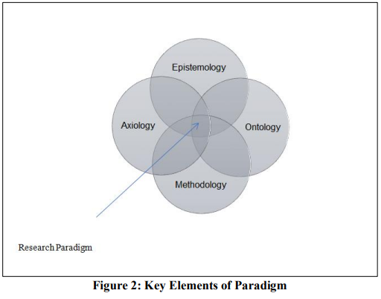
3B. YOUR PARADIGMATIC POSITION
Source: (Gamage, 2025)
Ontology:
Plural and Internal Realities: Adopts a relativist ontology, assuming that reality consists of multiple, internal, and subjective meanings constructed by the women themselves as they experience transformation (Braun & Clarke 2013).
This study adopts a subjectivist, nominalist ontology. It treats social reality, and specifically the leadership identities of women entrepreneurs, as socially constructed and continuously re-negotiated through interaction, discourse and lived experience, rather than as a fixed external reality waiting to be measured. Identity is understood not as a stable attribute possessed at a point in time, but as something enacted and revised across the entrepreneurial journey.
Epistemology:
The study adopts an interpretivist epistemology, resting on the position that valid knowledge of leadership identity transformation is produced through interpreting the meanings that entrepreneurs themselves attach to their experiences. Knowledge is not discovered through the measurement of pre-defined variables; it is generated in the interpretive encounter between researcher and participant, most directly through in-depth interviews that allow women to narrate their own journeys from founder to strategic leade. Knowledge is co-created through deep narrative engagement (Crotty, 1998).
Axiology:
Interpretivism carries value-laden (Creswell and Creswell 2018) entailments that this study embraces explicitly. The research is conducted with the recognition that the researcher's background, gender assumptions and cultural position shape both data collection and interpretation; reflexivity is therefore built into the research process rather than treated as bias to be eliminated. The study also proceeds from an explicit value commitment: that women's leadership in developing economies is under-represented in, and misrepresented by, a literature dominated by Western and androcentric perspectives. This commitment motivates the study but does not license advocacy in the analysis; findings are grounded in participants' accounts, with the researchers' interpretations made visible and auditable.
Methodology & Approach: Employs an inductive qualitative methodology to allow unexpected insights to emerge (Crotty, 1998).
Methods in Alignment: purposive selection of information-rich cases to conduct in-depth, semi-structured, and narrative interviews, analyzed via Thematic Analysis (Braun & Clarke 2022).
Quality criteria: credibility, transferability, dependability and confirmability (trustworthiness), including member reflection, thick description and an audit trail, rather than internal and statistical validity.

Slide 8
3C. PARADIGMATIC ALIGNMENT WITH RQ’s
Research Question (RQ) | Methodological Justification | Specific Data Collection Method | Data Analysis & Quality Tool
RQ1: Role Changes How does business growth change managerial/leadership roles? | Requires an inductive approach to track the fluid, lived shift from operational tasks to strategic oversight without predefined models. | In-depth semi-structured interviews with women at distinct business growth stages. | Thematic Analysis: Identifies shifts in daily operational vs. strategic themes. Audit Trail: Tracks analytical decisions.
RQ2: Identity Construction How do they construct and transform leadership identity? | Constructivist/Inductive lens is mandatory; identity is socially constructed, fluid, and cannot be measured numerically. | Narrative interviewing to allow women to tell their stories chronologically across their business journey. | Reflexive Thematic Analysis: Captures underlying psychological and identity shifts. Member Reflection: Verifies identity interpretations.
RQ3: Capabilities & Factors What strategic capabilities develop, and what enables/constrains them? | Purposive selection ensures I interview "information-rich cases" who actually possess growth-oriented strategic capabilities. | Semi-structured interview modules focused on critical incidents, business successes, and failures. | Thematic Analysis: Categorizes internal skills vs. external enablers/constraints. Thick Description: Contextualizes capabilities.
RQ4: Environmental Shaping How do gender, culture, and institutions shape the transition? | Requires an interpretivist approach to unpack how macro-level Pakistani societal norms deeply manifest in micro-level business realities. | In-depth interviews exploring cultural expectations, family dynamics, and institutional barriers. | Thematic Analysis: Extracts socio-cultural and institutional themes. Transferability: Achieved via rich context of the Pakistani ecosystem.
RQ5: Practical Strategies What practical strategies and support mechanisms facilitate transition? | Inductive methodology allows organic, grassroots solutions to emerge directly from the participants' real needs. | Semi-structured questions regarding desired resources, alongside potential Focus Groups for collaborative brainstorming. | Thematic Analysis: Generates an actionable framework of support mechanisms. Confirmability: Ensures strategies reflect participant voices.

Slide 9
4A. PHISOLOPHY MEETS PRACTICE
PARADIGM IS NOT AN ABSTRACT CONCEPT
Under an interpretivist paradigm, my philosophy: ontology, epistemology and axiology dictates my methodology.
If reality is internal and multiple, a quantitative framework is logically impossible. Therefore, my paradigm mandates a qualitative approach.
Furthermore, this paradigm fundamentally defines what counts as data.
In my study, data is not a revenue metric or a venture survival chart. Data consists entirely of the rich, spoken vocabulary, stories, and metaphors captured during in-depth, semi-structured, narrative interviews with these Pakistani women. The data is the text itself.
HOW WILL MY DATA LOOK LIKE?
I will deploy Reflexive Thematic Analysis (Braun and Clarke 2022)
This process is explicitly inductive and theory-informed.
Instead of forcing these women’s experiences into a rigid, top-down Western leadership matrix, I will allow codes and themes regarding identity and strategic capability to emerge directly from the local and cultural reality of these Pakistani women entreprenurs.

Slide 10
4B. EXAMPLES
Component Name | WHAT IS THE PURPOSE? | Example of What it Looks Like in MY Thesis
Explicit Analytical Theme (My voice as the researcher) | To identify a pattern across interviews and explain what it means in simple, academic terms. | "A major barrier to scaling businesses in Pakistan is institutional infantilization, where formal financial systems refuse to recognize a woman's independent legal and economic identity."
Raw Participant Quote (The voice of the participant) | To present the raw, unfiltered evidence directly from my transcript to prove my theme is real. | "When I applied for a business expansion loan in Lahore, the bank manager literally pushed the paperwork aside and asked, "Where is your husband? We cannot issue this asset in a female name alone." Participant G (Retail Sector, 7 years in business)
Theoretical Integration (The voice of global scholarship) | To link my field finding back to established academic literature to prove my study has scholarly value. | This empirical evidence directly illustrates how informal institutional constraints (patriarchal social norms) overpower formal regulatory frameworks in developing economies, as theorized by AuthorName (1990). Furthermore, it expands upon AuthorName and AuthorName (2012) framework by proving that these financial hurdles do not vanish once a firm exits the micro-startup phase; rather, they evolve into structural gates that actively block strategic business scaling.
Final data presentation will look like a mix of:
raw participant quotes,
explicit analytical themes,
and theoretical integrations grounded in established literature

Slide 11
4C. BY WHAT CRITERIA CAN MY WORK BE JUDGED AS RIGOROUS?
It is a philosophical error to evaluate this study using positivist concepts like 'statistical reliability' or 'external validity.’
Instead, following Lincoln and Guba (1985), this work will be judged by its trustworthiness.
I establish credibility through long, deep narrative engagement with the participants.
I ensure dependability by maintaining a transparent, step-by-step audit trail of my analytical decisions.
And I secure confirmability through explicit reflexivity, showing exactly how my positioning as a researcher was used as an asset to unlock meaning.
Ultimately, every single practical step in this design is seamlessly anchored to the philosophical iceberg below it.

Slide 12
5A. WHAT MY PARADIGM CANN’T DO?
To conclude this philosophical defense, doctoral rigour demands that I acknowledge the strict boundaries of my choices and address the strongest alternative paradigm I considered.
First, let us look at what Interpretivism cannot do in the context of my study.
Because I am committed to a relativist ontology, my study cannot generate statistically generalisable data or predictive mathematical models (Guba & Lincoln, 1994).
I cannot tell you what percentage of all Pakistani women will scale their businesses, nor can I quantify the exact causal impact of macroeconomic policies on their firms.
Interpretivism privileges micro-level meaning-making over macro-level structural mechanics (Crotty, 1998). If a participant misinterprets an institutional barrier, my lens captures her internal psychological reality, not the external factual truth.

Slide 13
5B. WHY NOT CHOOSE THE BEST ALTERNATIVE?
Critical realism deserves explicit consideration because it has been advanced as the credible alternative philosophy for leadership research. Kempster and Parry (2011) argue that critical realism allows leadership researchers to pursue contextualised understanding and explanation, attending to the interplay between structures and agency, without defaulting either to positivist generalisation or to unconstrained relativism.
This study acknowledges the force of that argument: the gendered structures within which Pakistani women operate are treated here as real and consequential.
Nevertheless, critical realism is not adopted, for a reason of fit.
Critical realism is most powerful when the research question concerns underlying causal mechanisms that generate observable patterns.
The present research question concerns participants' own meaning-making: how women entrepreneurs experience, narrate and make sense of becoming strategic leaders. The unit of analysis is the first-person account and its interpretation, which places the study squarely within the interpretive tradition.
The study therefore borrows critical realism's insight that structures are real and constrain agency, while retaining interpretivism's focus on lived meaning.

Slide 14
6. CONSLUSIONS
A research paradigm is not an abstract, optional appendix
The overarching argument is that the phenomenon under investigation, the transformation of leadership identity and capability as women entrepreneurs grow their ventures in Pakistan, is contextual, gendered and meaning-laden, and therefore demands a research philosophy and design capable of capturing participants' lived experience in its cultural setting.
Rigorous research design requires total alignment; ontology, epistemology, axiology and methodlogy
This realization highlights exactly how much my understanding of research design has transformed since the start of DBA Year 1.
At the start of Year 1, I viewed research like a technician.
Research is never a neutral activity
Chosen methods are completely restricted and bound by metaphysical commitments.
Personal values or my cultural positioning are not a source of data contamination
Through an interpretivist lens, I recognize my reflexivity as my primary analytical asset
Not a technician picking tools, but a grounded doctoral researcher capable of defending my research design.

Slide 15
References
Anderson, A.R. and Starnawska, M. (2008) 'Research practices in entrepreneurship', The International Journal of Entrepreneurship and Innovation, 9(4), pp. 271–277. https://doi.org/10.5367/000000008786208731
Braun, V. and Clarke, V. (2013) Successful qualitative research: a practical guide for beginners. London: SAGE.
Braun, V. and Clarke, V. (2022) Thematic analysis: a practical guide. London: SAGE.
Bygrave, W.D. (2008) ''The entrepreneurship paradigm' revisited seventeen years later', SSRN Electronic Journal. Available at: https://doi.org/10.2139/ssrn.1314117
Creswell, J.W. and Creswell, J.D. (2018) Research design: qualitative, quantitative, and mixed methods approaches. 5th edn. Los Angeles: SAGE.
Crotty, M. (1998) The foundations of social research: meaning and perspective in the research process. London: SAGE.
Dhakal, P., Wiesner, R. and Maraseni, T. (2022) 'When Entrepreneurial Leadership Identity and Passion Meet Venture Growth Intention', Sustainability, 14(20), 13129. Available at: https://doi.org/10.3390/su142013129
Fendt, J. and Endrissat, N. (2011) 'Pretense, pride and prejudice in qualitative leadership research: An appraisal and two examples from Europe', International Business & Economics Research Journal, 10(2), pp. 47–58. Available at: https://doi.org/10.19030/iber.v6i5.3369
Guba, E.G. and Lincoln, Y.S. (1994) 'Competing paradigms in qualitative research', in Denzin, N.K. and Lincoln, Y.S. (eds.) Handbook of qualitative research. Thousand Oaks, CA: Sage.
Hemani, S., Carter, S. and Chalmers, D. (2025) 'Microfoundations of entrepreneurial leadership: Successful women entrepreneurs in a developing economy', Journal of Small Business Management. Available at: https://doi.org/10.1080/00472778.2025.2523035

Slide 16
References
Kempster, S. and Parry, K.W. (2011) 'Grounded theory and leadership research: A critical realist perspective', The Leadership Quarterly, 22(1), pp. 106–120. Available at: https://doi.org/10.1016/j.leaqua.2010.12.010
Kuhn, T.S. (1970) The structure of scientific revolutions. 2nd edn. Chicago: University of Chicago Press.
Lewis, K. (2015) 'Enacting Entrepreneurship and Leadership: A Longitudinal Exploration of Gendered Identity Work', Journal of Small Business Management, 53(4), pp. 515–537. Available at: https://doi.org/10.1111/jsbm.12175
Lincoln, Y.S. and Guba, E.G. (1985) Naturalistic inquiry. Beverly Hills, CA: Sage.
McDonald, S., Gan, B.C., Fraser, S.S., Oke, A. and Anderson, A.R. (2015) 'A review of research methods in entrepreneurship 1985–2013', International Journal of Entrepreneurial Behaviour & Research, 21(3), pp. 291–315. Available at: https://doi.org/10.1108/ijebr-02-2014-0021
Neergaard, H. and Ulhøi, J.P. (eds.) (2007) Handbook of qualitative research methods in entrepreneurship. Cheltenham: Edward Elgar Publishing. (The "Introduction" chapter, which contains the 18%-qualitative and structured-survey statistics, is this handbook's opening chapter, DOI: 10.4337/9781847204387.00007.)
Spoelstra, S., Butler, N. and Delaney, H. (2020) 'Measures of faith: Science and belief in leadership studies', Journal of Management Inquiry, 29(1), pp. 99–112. Available at: https://doi.org/10.1177/1056492620901793

