Slide 1
Alternative organisational metaphors
Aliza
Tang
Milad
Sushil
Rahman

Slide 2
Metaphors in organisation
An organizational metaphor is a figurative comparison used to define the key aspects of an organization and/or explain its methods of operation.
Organization and management theory based on the metaphor due to the complexity of organization
Organizational metaphors provide information about the value system of a company and about employers' attitudes toward their customers and employees.
Metaphors provide a structure for approaching organization and management
Organizational metaphors operate in the background but they can strongly determine how we think about organizations and affect how we work and make decisions.

Slide 3
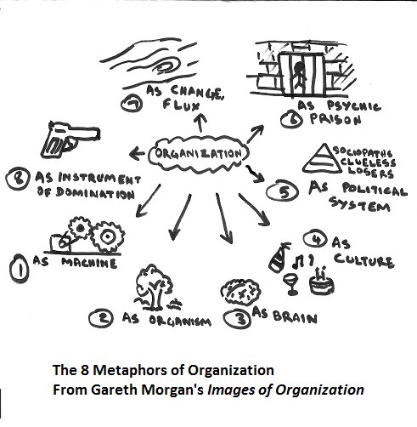

Slide 4
Metaphors in organisation
Development and technological advances resulted metaphors to have different significance
Organisations shifted from hierarchical structures to flat networks

Slide 5
Organisation as wonderland
Morgan’s (1986) 8 metaphors largely emphasizes order, rationality, stability and manageability
Organisation as wonderland places issues such as absurdity, disorder, uncertainty, and the irrational feature of the organisation
It offers alternative metaphors to “illuminate the shadow side” of organisation
For example, “ emotionality of rationality”

Slide 6
Organisation as Media
Concept of literacy and fixed objective reality
Digital and technology revolution and shift in to electronic-mediated and multi-sensory modes of understanding
For example, companies in the tradition model used to talk about mission statement (written), however, due to technology advances and mediazation it is now all about brand (image).
Or, example of emojis where nothing is written but illustration that send happiness, angry, which results in a meaning that images of organisation is not about 8 meaphors but that type of thinking that can help us to get there.
E.g. Apple with its branding strategy in the modern era.

Slide 7
Organisation as Big Data
Big Data has become a key ingredient in businesses success in the modern era to boost productivity, cut costs and improve marketing efforts.
“Global Brain” which is the source of information-theoretic ways of understanding collectives. However, different variation involves which internet is a sample and then there is this “ Big Data”.
The “Global Brain” draws attention to the neural-like interconnectedness of digital world combined with increasing significant of “Big Data”.
E.g. Lexis Risk Solutions use Data to identify individuals, including family relationships thus helping financial institutions and other clients to reduce fraud.

Slide 8
Organization AS Garden
Garden containing various vegetation
The external ecological environment of an organization is complex
Traditional diversity include age, gender, pay level, ect. Modern diversity includes product diversity, work style, supply diversity, ect.
E.g. Alibaba has a variety of businesses

Slide 9
Organization AS Brake in a CAR
Your brakes need to work correctly to allow you to reach your destination safely.
Tradition risk management, each department unit deals with own risk, Focus on preventing loss within the business unit. Modern risk management Emanates from the "top" – typically the Board of Directors. Focus on lowering risk, increasing sustainability and providing value across the entire organization.
E.g. Huawei's Risk Management System

Slide 10
Organization as pool
Modern organizations Relies on outsourcing or crowdsourcing
Crowdsourcing strategy-HP using mechanical Turk to predict box office sales.
HR, supply chain, logistics, predictive analytics, web development, design and strategy are outsourced.

Slide 11
Organisation as a plant
Senge-5th discipline-learning organisation
Growth and agility
Continuos learning, shared vision and team learning.

Slide 12
Organisation as a legoset
Putting pieces together
Visionary, creative and collaborative
Innovating ideas due to fast paced industries: software updates, bug fixation, integration of Facebook (features)

Slide 13
References
McCabe, D. (2016). Curiouser and curiouser!’: Organizations as Wonderland, a metaphorical alternative to the rational model. Available at: http://eprints.lancs.ac.uk/79261/3/Organizations_as_Wonderland_october.pdf. Last accessed [12 March. 2019].
Oswick, C. Grant, D. (2015). Re-Imagining Images of Organization: A Conversation With Gareth Morgan. Journal of Management Inquiry. Available at: http://citeseerx.ist.psu.edu/viewdoc/download?doi=10.1.1.1005.7484&rep=rep1&type=pdf. Last accessed at [11 March. 2019].
Risk Factors - Huawei Annual Report 2016. [Online]. Available at: https://www.huawei.com/en/press-events/annual-report/2016/risk-factors [Accessed 13 March 2019].
Weiss M., Dreary J. (2016), outsourcing in the 21st century ambient organizations [Online]. Available at: https://www-cio-com.cdn.ampproject.org/v/s/www.cio.com/article/3022545/outsourcing-in-the-21st-century-ambient-organization.amp.html?amp_js_v=a2&amp_gsa=1&usqp=mq331AQCCAE%3D#referrer=https%3A%2F%2Fwww.google.com&amp_tf=From%20%251%24s&ampshare=https%3A%2F%2Fwww.cio.com%2Farticle%2F3022545%2Foutsourcing-in-the-21st-century-ambient-organization.amp.html%23referrer%3Dhttps%253A%252F%252Fwww.google.com%26amp_tf%3DFrom%2520%25251%2524s

