Slide 1


LCDB7011 Quantitative Research Methods
Week 2 – Sampling
Dr. Helen LEE

Slide 2

LEARNING OBJECTIVES
Understand sampling
Develop an understanding of different sampling methods
Develop the ability to differentiate between probability & non probability sampling
Be aware of the advantages & disadvantages of each sampling methods

Slide 3
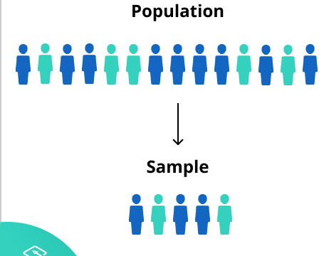
Population and Sample
https://www.scribbr.com/methodology/population-vs-sample/

Slide 4

Population and Sample (Field, 2005)
Population: Business researchers are interested in understanding organisational dynamics, be it from the marketing, consumers, strategy, accounting aspects, amongst others. Population implies the entire people in a setting.
Population could be:
a. Very general – implies all human beings in a setting
b. very small – e.g. all males of a certain age born in a certain location; all male Chinese students at UWTSD, etc.
Sample: Populations are usually large, we never have access to the entire population, So, we collect data from a sub-set. That sub-set is called Sample.

Slide 5
SAMPLING
A sample is “a smaller (but hopefully representative) collection of units from a population used to determine truths about that population” (Field, 2005)
Why sample?
  Resources (time, money) and workload – we cannot do it all!
  Gives results with known accuracy that can be calculated mathematically
The sampling frame is the list from which the potential respondents are drawn
  E.g. the population of a town
  E.g. Course participants
  Must assess sampling frame errors
Notes:
Sampling frame errors: university versus personal email addresses; changing class rosters; are all students in your population of interest represented?

Slide 6
SAMPLING……
Decide: What is your population of interest?
    To whom do you want to generalize your results?
      E.g. All people in a certain place
      E.g. Students
      Young people (18-25)
      E.g.Women aged 15-45 years
Can you sample the entire population?
Notes:
How do we determine our population of interest?
Administrators can tell us
We notice anecdotally or through qualitative research that a particular subgroup of students is experiencing higher risk
We decide to do everyone and go from there
3 factors that influence sample representativeness
Sampling procedure
Sample size
Participation (response)
When might you sample the entire population?
When your population is very small
When you have extensive resources
When you don’t expect a very high response

Slide 7
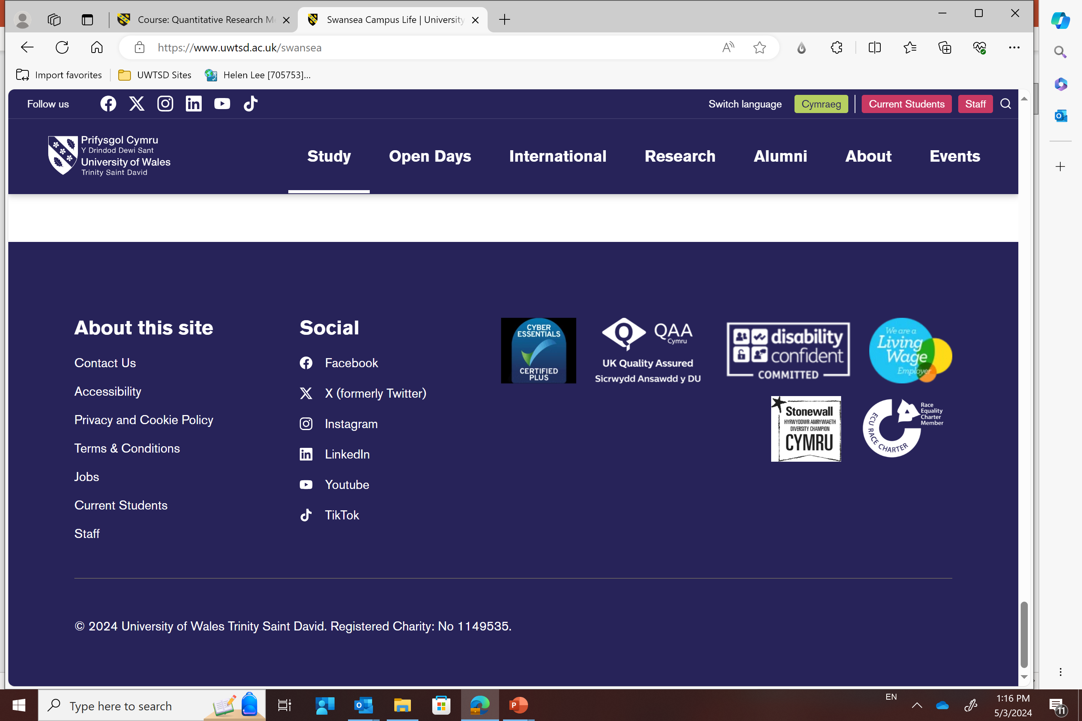
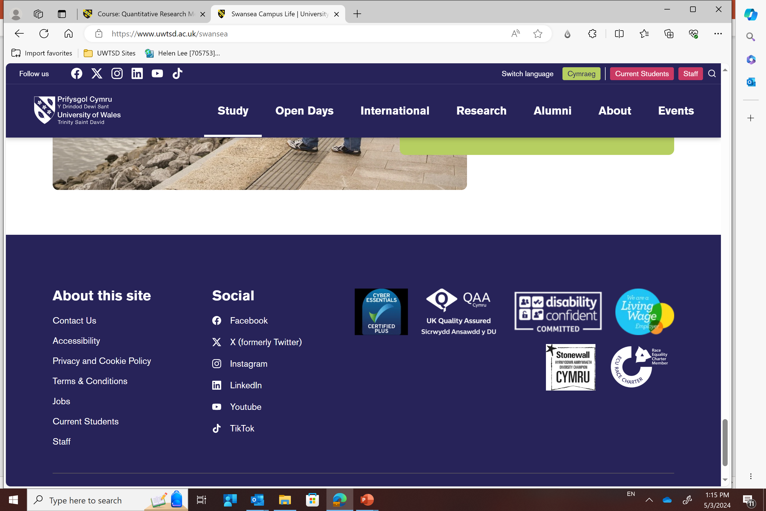
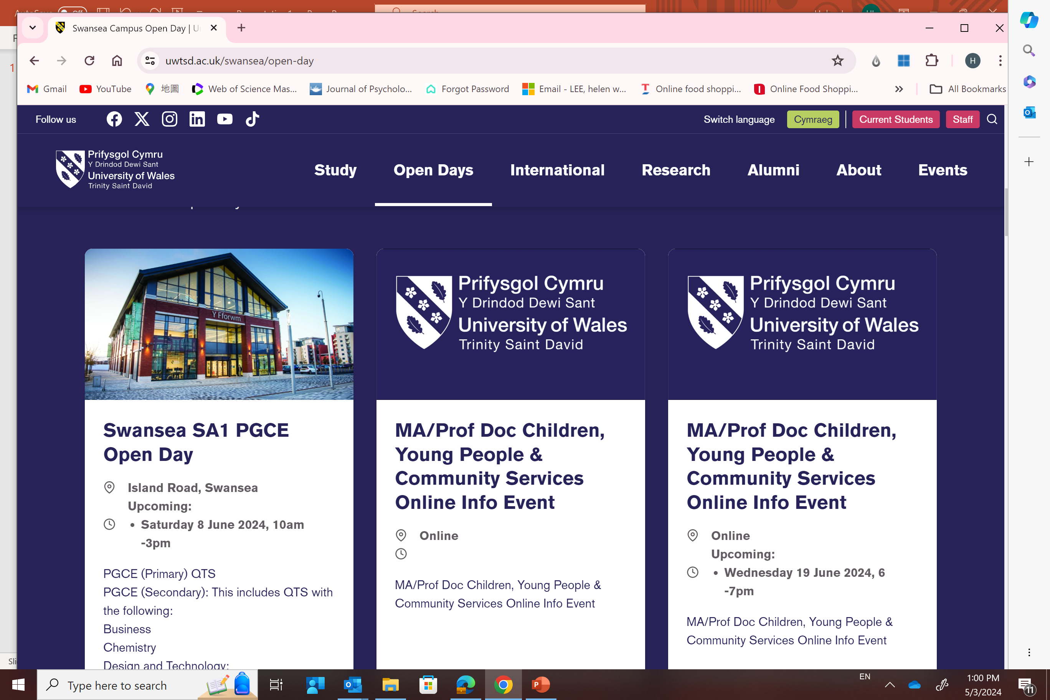
Sample Representativeness
Three factors influence sample representativeness:
1. Sampling procedure
2. Sample Size
3. Participation

Slide 8
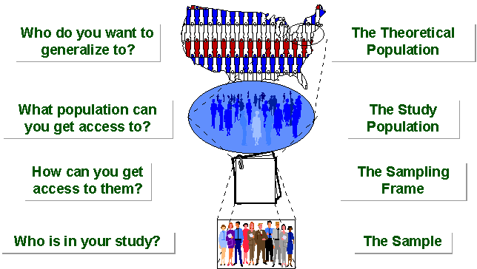
SAMPLING BREAKDOWN
Notes:
Picture of sampling breakdown

Slide 9
SAMPLING…….
3 factors that influence sample representative-ness
Sampling procedure
Sample size
Participation (response)
When might you sample the entire population?
When your population is very small
When you have extensive resources
When you don’t expect a very high response

Slide 10
Types of Samples
Probability (Random) Samples
All members of your target population have the same chance to be included in your research)
Non-Probability Samples
Only some elements of the population are included, based on convenience availability or because the researcher decides they are representative. Therefore, it is not known to which extent the sample really represents the population.

Slide 11
Process
The sampling process comprises several stages:
  Defining the population of concern
  Specifying a sampling frame, i.e.a set of items or events possible to measure
  Specifying a sampling method for selecting items or events from the frame
  Determining the sample size
  Implementing the sampling plan
  Sampling and data collecting
  Reviewing the sampling process

Slide 12
SAMPLING FRAME
Because a researcher rarely has direct access to the entire population of interest in social science research, a researcher must rely upon a sampling frame to represent all of the elements of the population of interest.
A sampling frame is a list or other device used to define a researcher's population of interest.
The sampling frame must be representative of the population.
Examples:
  Class list
  Business directory
  Client list
  (Douglas B. Currivan (2004) “Sampling Frame” Sage Encyclopedia of Research Methods, srmo.sagepub.com/view/the-sage-encyclopedia-of-social-science-research-methods/n884.xml
)

Slide 13
Practicality
Identify possible sampling frames in your area of interest. In other words, where are you going to get your respondents from?
Ensure that your suggestions are representative.

Slide 14
Random Sampling and Non-random Sampling
https://youtu.be/be9e-Q-jC-0?si=BwY8W2Hn2X5AksTW
What is sampling | Probability vs Non Probability sampling | Methods | Types & Technique Explained (youtube.com)
(6:45 mins)
Sampling: Sampling & its Types | Simple Random, Convenience, Systematic, Cluster, Stratified (13:17)
Notes:
Picture of sampling breakdown

Slide 15
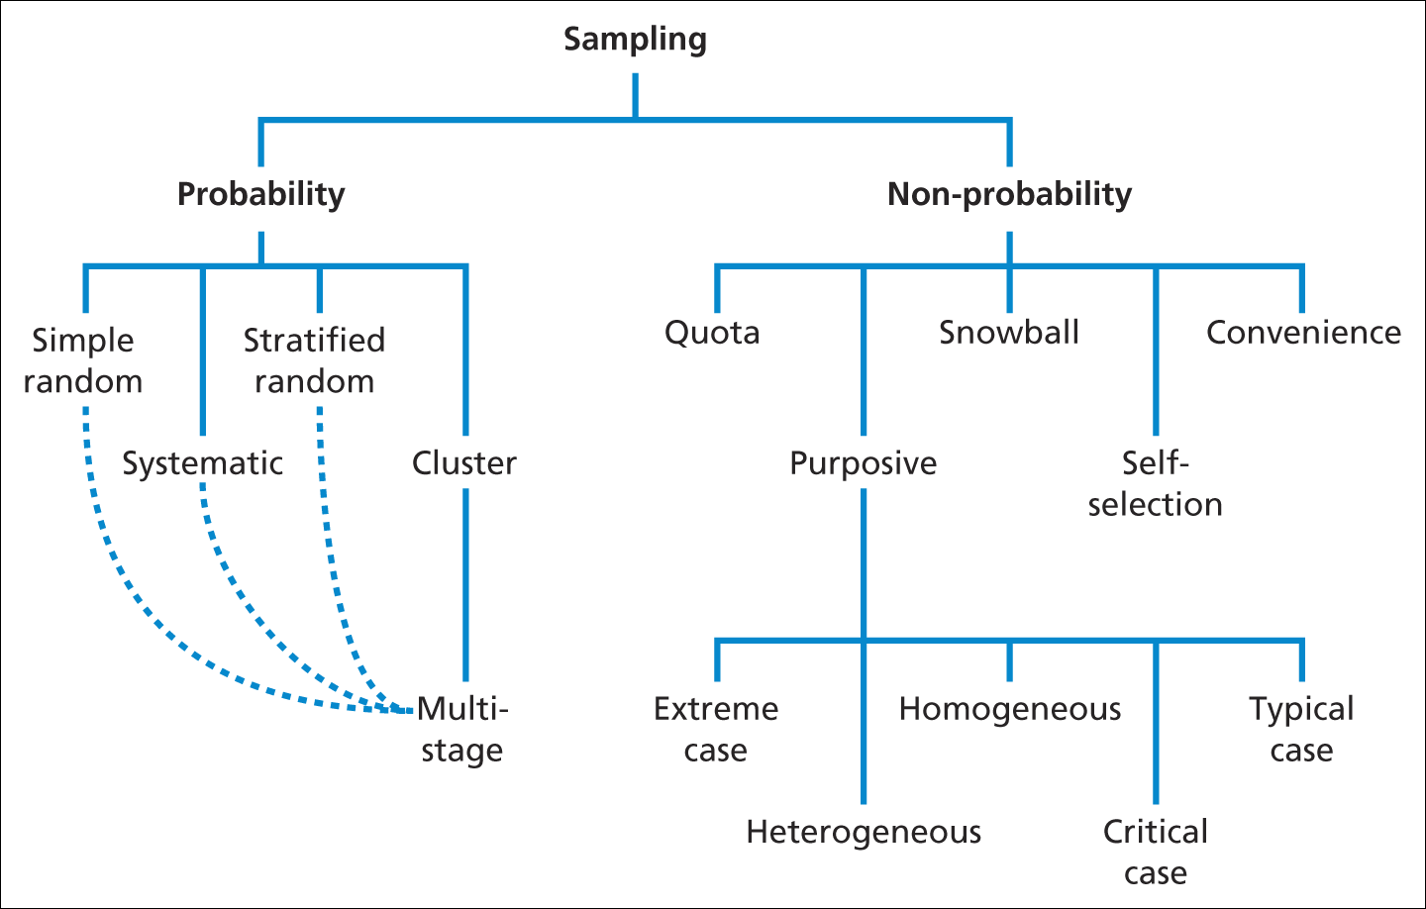
Sampling and Sample Size
Sampling techniques
Source: Saunders et al. (2009)

Slide 16
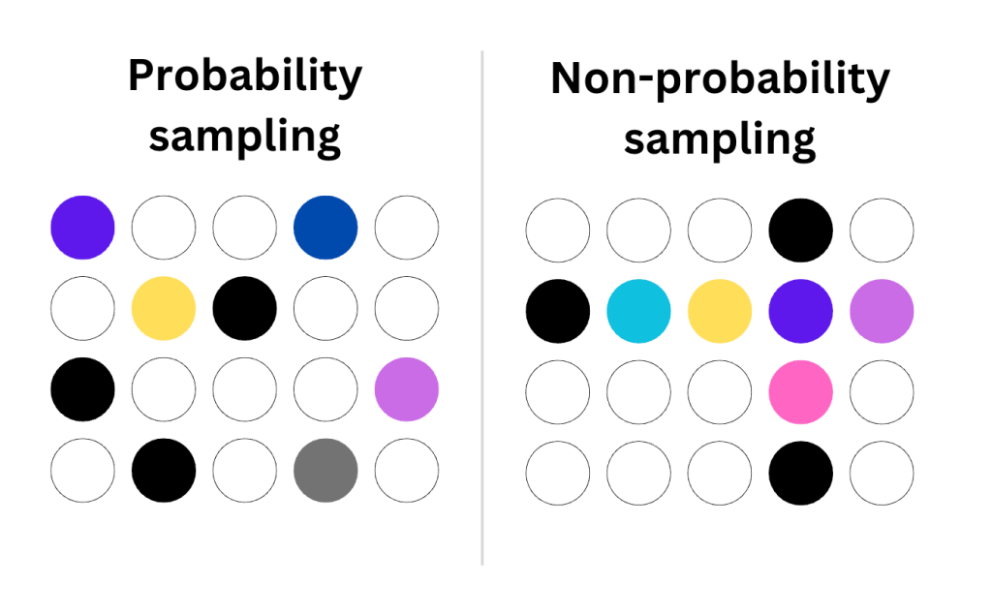
Probability Sampling Vs Non-Probability Sampling

Slide 17
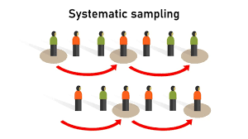
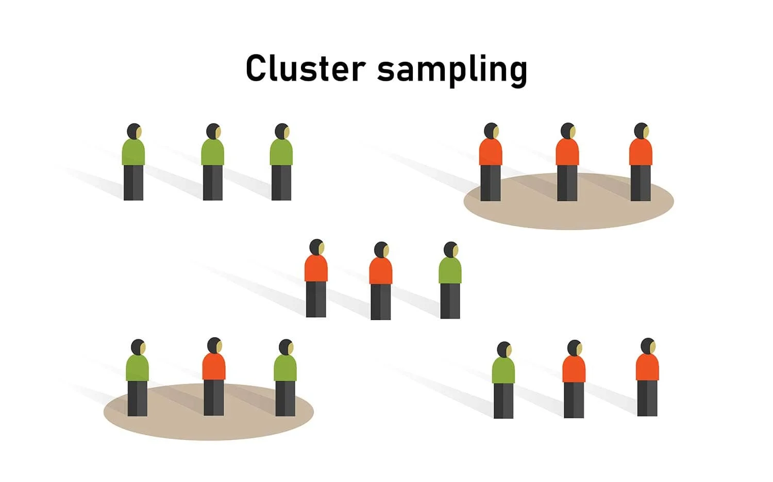
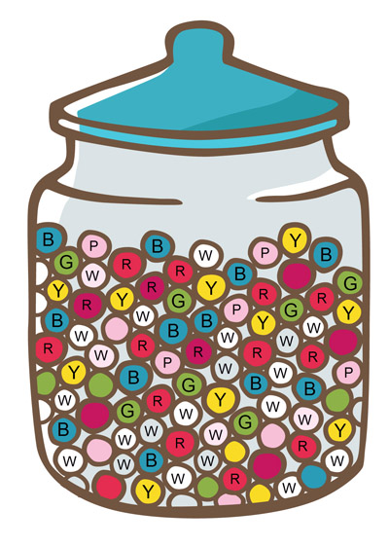
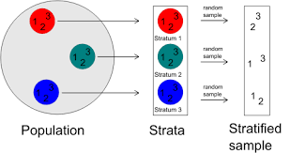
Random Sampling

Slide 18
PROBABILITY SAMPLING
A probability sampling scheme is one in which every unit in the population has a chance (greater than zero) of being selected in the sample, and this probability can be accurately determined.
Probability sampling includes:
  Simple Random Sampling → picking a sample at random
  Systematic Sampling → picking every nth respondent
  Stratified Random Sampling→ pick randomly within specified groups, e.g. same number of randomly selected men and women
  Cluster Sampling → all or randomly selected individuals within a naturally present grouping ‘cluster’ e.g. geographical area that is assumed to be representative of the sampling population

Slide 19
PROBABILITY SAMPLING
Nonresponse effects can turn any probability design into a nonprobability design.
  Who has not responded?
  Is there a pattern?
  Was there a group of late responders? Are their answers different?

Slide 20
SIMPLE RANDOM SAMPLING
Applicable when population is small, homogeneous & readily available
All members of the population are given an equal probability to be included.
A table of random number or lottery system is used to determine which units are to be selected.
Disadvantages
  If sampling frame large, this method impracticable.
  Minority subgroups of interest in population may not be present in sample in sufficient numbers for study.

Slide 21

SYSTEMATIC SAMPLING
Systematic sampling is based selecting respondents according to a pre-arranged scheme, such as choosing every 10th name from a list
All elements have the same probability of selection (in the example given, one in ten). It is not 'simple random sampling' because different subsets of the same size have different selection probabilities - e.g. the set {4,14,24,...,994} has a one-in-ten probability of selection, but the set {4,13,24,34,...} has zero probability of selection.

Slide 22
SYSTEMATIC SAMPLING
As described above, systematic sampling is an EPS method, because all elements have the same probability of selection (in the example given, one in ten). It is not 'simple random sampling' because different subsets of the same size have different selection probabilities - e.g. the set {4,14,24,...,994} has a one-in-ten probability of selection, but the set {4,13,24,34,...} has zero probability of selection.

Slide 23
STRATIFIED SAMPLING
Where a population embraces a number of distinct categories, the frame can be organized into separate "strata.“ (groups). Each stratum is then sampled as an independent sub-population, out of which individual elements can be randomly selected.
Every unit in a stratum has same chance of being selected.
Using same sampling fraction for all strata ensures proportionate representation in the sample.
Adequate representation of minority subgroups of interest can be ensured by stratification & varying sampling fraction between strata as required.
Selection of criteria can become complicated
Multiple strata may require a higher sample size

Slide 24
CLUSTER SAMPLING
Cluster sampling is an example of 'two-stage sampling'
A number of (geographical) areas is chosen;
A sample of respondents within those areas is selected.
Population divided into clusters of homogeneous units, usually based on geographical contiguity.
Sampling units are groups rather than individuals.
A sample of such clusters is then selected.
All units from the selected clusters are studied.
Can cut travel and other costs but can also lead to higher sampling error, e.g. clusters may not be representative.

Slide 25
Difference Between Strata and Clusters
Although strata and clusters are both non-overlapping subsets of the population, they differ in several ways.
All strata are represented in the sample; but only a subset of clusters are in the sample.
With stratified sampling, the best survey results occur when elements within strata are internally homogeneous. However, with cluster sampling, the best results occur when elements within clusters are internally heterogeneous

Slide 26
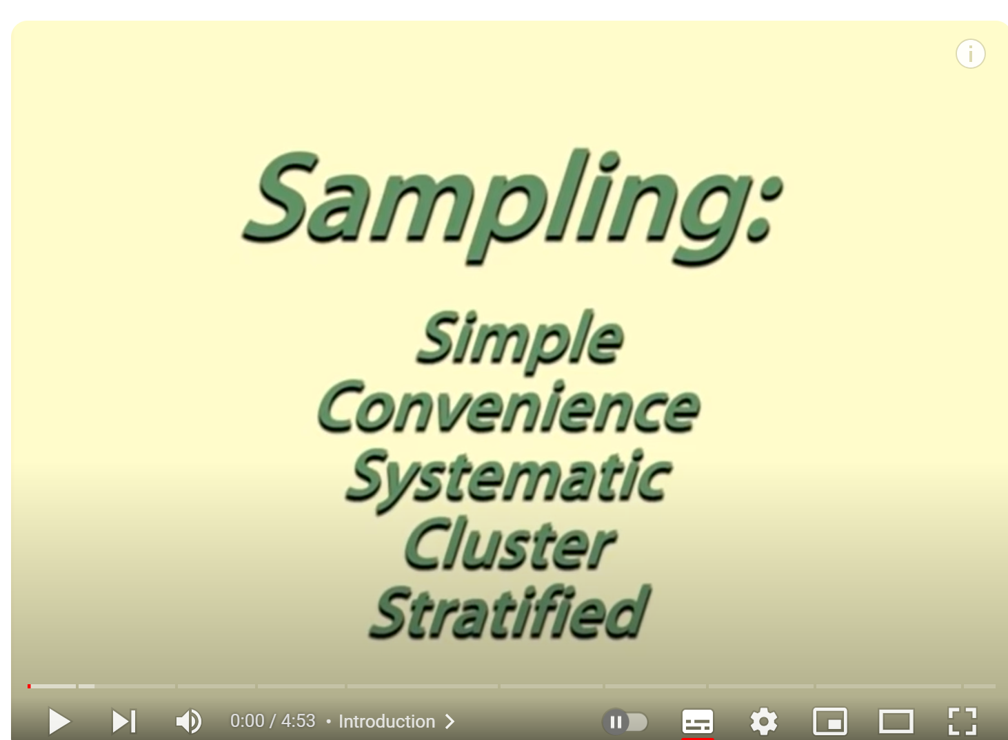
Video on Sampling
Sampling (4:55 mins)
https://youtu.be/be9e-Q-jC-0

Slide 27




NON-PROBABILITY SAMPLING

Slide 28

NON-PROBABILITY SAMPLING
Any sampling method where some elements of population have no chance of selection , or where the probability of selection can't be accurately determined. It involves the selection of elements based on assumptions regarding the population of interest,
Example: We visit every household in a given street, and interview the first person to answer the door. In any household with more than one occupant, this is a nonprobability sample, because some people are more likely to answer the door (e.g. an unemployed person who spends most of their time at home is more likely to answer than an employed housemate who might be at work when the interviewer calls) and it's not practical to calculate these probabilities.

Slide 29

NON-PROBABILITY SAMPLING
Non-probability Sampling includes:
  Convenience Sampling : based on convenience
  Snowball Sampling: based on one respondent encouraging another person to participate in the research
  Quota Sampling : based on a predetermined number of respondents from mutually exclusive groups. The ratio may or may not reflect the ratios in the target population.
  Purposive Sampling: based on the characteristics of the respondents, e.g. certain level of experience, job type held etc.
All of these methods need a strong justification in your research design chapter!

Slide 30

CONVENIENCE SAMPLING
  Use results that are easy to get
In this type of non-probability sampling, the sample is made up of those elements or units of the population that are closely available and convenient to reach.
A major disadvantage of this type of sampling is that the researcher cannot make a scientific generalisation about the total population based on the sample.
30
Notes:
30

Slide 31

Summary
Quantitative research needs to be based on a sample population and a sample frame.
Sampling methods are differentiated into probability and non probability methods.
Non probability methods generally include convenience, snowballing, quota sampling
  Probability sampling includes methods such as Simple Random Sampling, Systematic Sampling, Stratified Random Sampling, or Cluster Sampling
  Sampling: Simple Random, Convenience, systematic, cluster, stratified - Statistics Help

Slide 32


