Slide 1

Student name = Rucha Vaghela
Student ID = 2437863
Module Code = LCHS7009
Module Title = Population health and digital health promotion
Lecturer’s Name = Dr Besty Jose
Assignment Title = Component 02 (Poster)

Slide 2

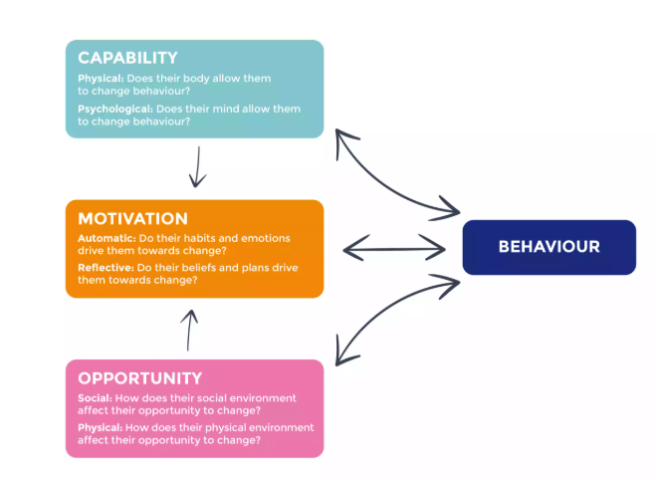
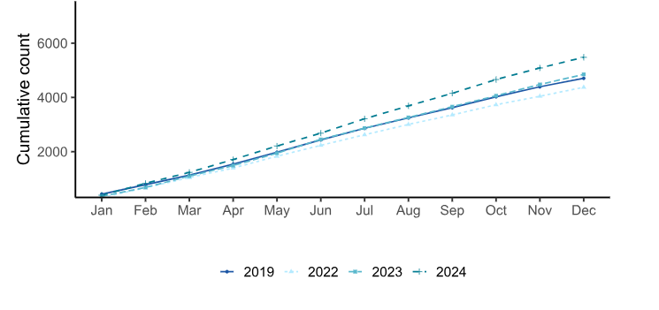
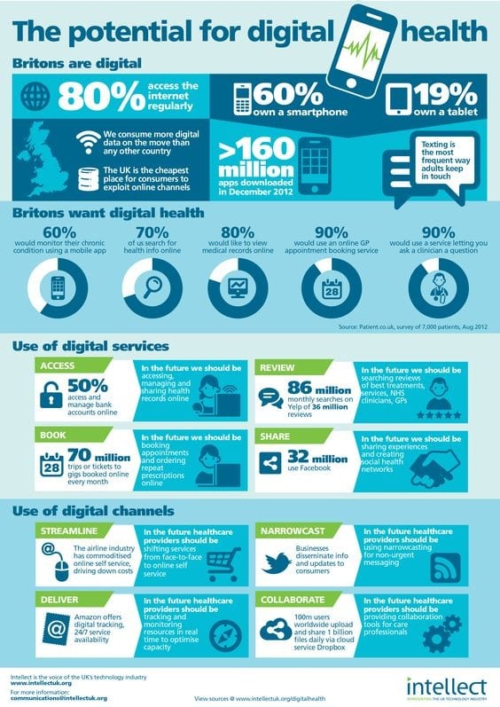
LCHS7009: POPULATION HEALTH AND DIGITAL HEALTH PROMOTION
DIGITAL INTERVENTION FOR TUBERCULOSIS (TB) CONTROL
1. Background
Tuberculosis (TB) continues to pose as a significant social health issue in the United Kingdom, particularly among the less fortunate social groups that lack access to resources, like the migrants, the homeless and drug abusers. In 2024, the number of cases of TB in England increased by 13.4% in England (4850 to 5480 cases), indicating that improved methods should be utilised to ensure people continue taking their medication (GOV.UK, 2025). TB medication requires one to use it daily for half a year. By failing to take as instructed medicine the person may fall ill again, transmit TB to others and contract drug-resistant TB. Conventional methods of ensuring that people take their medicine incorporate Directly Observed Therapy (DOT), whereby a health worker will be by the side of the patient as they take a pill. DOT is effective but consumes a lot of resources and is considered judgmental by people. These non-digital methods, such as attending the community or visiting home, are employed whereas more flexible digital methods are available such as Video-Observed Therapy (VOT). VOT allows them to record or stream them taking medicine through a secure NHS app so that health workers can determine whether the medicine was taken remotely (Canario-Guzmán et al. 2025). This allows patients to have increased control, less clinic work, and prompt digital assistance. It represents a significant new instrument of TB care, as well as for vulnerable groups.
2. Health Promotion Values and Principles
The principle of fairness is a foundation of health promotion, which includes giving people power, making them participate, and respect their needs. It assists individuals and societies to make personal health choices by considering social, individual, and environmental factors. The interventions should be equitable and accommodating to all. Moreover, it should be based on three interconnected dimensions: strategic direction, policy orientation, and implementation. VOT adheres to these concepts by providing the TB patients with control over their therapy but maintaining their confidentiality and normal conditions of life (Casalme et al. 2022). It is fairness in the sense that it reaches individuals who do not receive adequate care. The system motivates individuals to participate because it enables them to communicate with health workers using secure online platforms. However, not all people can have equal access to digital items such as a phone or the internet (Correa et al. 2020). The NHS can intervene by providing phones, subsidised data, and educating on digital skills. This ensures that no patient is omitted. Combining the usage of digital and face-to-face assistance, VOT is guided by the principle of health to all, as the care is equitable, accessible, and empowering.
3. Behavioural Change Theory
It can be an upright idea to change the health habits with the help of the COM-B Model, which is called Capability, Opportunity, Motivation-Behaviour. According to the model, there are three components of behaviour, namely: Capability, Opportunity and Motivation (Rebecca, 2025). Capability entails the ability of the patient in VOT to access the NHS app and comprehend the need to remain on medication. This is developed by using easy instructions, videos, and technological assistance. Opportunity refers to those external circumstances that enable an individual to do the right thing, like having a phone, the internet and a supportive group that provides feedback and reminders (Park et al. 2023). Motivation is both in oneself (desire to recover, belief that it is possible) and in others (inspirational, online communication). VOT promotes adherence to medicine by assisting every three components. It transforms it to an exciting treatment experience instead of a tedious task and with the individual feels empowered and responsible. The COM-B model elucidates the possibility of sustainable habit transformation through digital means of VOT to support care surrounding TB.
Figure 2: Strategic Framework for Equitable Health Promotion
(Source: WHO, 2022)
Figure 1: Increase in TB notifications over the years.
(Source: GOV.UK, 2025)
Figure 3: The dimensions of the COM-B model and Behaviour Change Wheel for an evidence-based intervention
(Source: Rebecca, 2025)
4. Expected Outcomes
The application of the COM‑B Model to VOT ought to have proven real changes in retaining people on their TB medication as well as fairer care. Capability building by having digital lessons allows patients to rely on the NHS app (Reidy et al. 2025). Enhancing opportunity through the provision of phones and data would eliminate obstacles. Enhancement of motivation through reminders and instant feedback keeps patients entertained, as nearly 80% of Britons review their medical records online (AWB, 2025). It is anticipated that more people will complete their treatment, and there will also be a reduction in drug-resistant TB, and health expenditures will be reduced. The patients must have a sense of control, confidence and be under constant care (Ekstedt et al. 2023). Care becomes efficient and effective as health workers are able to identify missed doses at an early stage. The inclusion of a balance between online and monthly physical meetings would make sure that not to leave people who are not tech-savvy behind. The COM-B-influenced VOT combined encourages a lasting change in habits by addressing deficiencies in skills, establishing enabling environments, and supporting motivation, causing healthier individuals and more robust population health.
6. Conclusion
The policy, learning, and research on the implications of adding Video-Observed Therapy to NHS TB care have a broad interpretation. Policy-wise, it is equivalent to the promise of the NHS Long Term Plan to utilise digital means and make care fairer. It also demonstrates how technology can reduce disparities and create an opportunity to access care. The policies should provide funds for phones, training sessions, and internet to benefit underprivileged patients. To assist patients remotely, health professionals must be trained in digital communication, cultural sensitivity, and behaviour change concepts in the teaching aspect. Trust and utilisation should also continue to be educated on the practice of using digital tools and the protection of their data by patients. Studies should consider the effects of VOT on the long-term retention among individuals who are taking medicine, cost reduction, and patient satisfaction. It also ought to look into other long-term disease digital approaches in which the approach is based on COM-B. After all, VOT is a tremendous shift toward an evidence-based, scientific and habit-based care system. Combining real compassion with digital creative thinking, it empowers patients, promotes equitable health, and provides lifetime management of TB within the UK.
Figure 4: Digital Health Potential of the UK
(Source: AWB, 2025)

Slide 3
REFERENCES
AWB (2025). Potential for digital healthcare infographic. [online] Available at: https://www.awbtextiles.co.uk/blog/potential-digital-healthcare-infographic/ [Accessed 29 Oct. 2025].
Canario-Guzmán, J.A., Elias-Melgen, R., Mendoza, E.R., Arias, L.F., Espinal, R., Báez, J. and Iribarren, S., 2025. A mixed-method study to inform the design of a video observed therapy app to monitor individuals with TB in the Dominican Republic. Frontiers in Public Health, 13, p.1529687. https://www.frontiersin.org/journals/public-health/articles/10.3389/fpubh.2025.1529687/pdf
Casalme, D.J.O., Marcelo, D.B., Tonquin, M., Frias, M.V.G. and Gler, M.T., 2022. Feasibility and acceptability of asynchronous VOT among patients with MDR-TB. The International Journal of Tuberculosis and Lung Disease, 26(8), pp.760-765. https://www.researchgate.net/profile/Danaida-Marcelo-2/publication/362399005_Feasibility_and_acceptability_of_asynchronous_VOT_among_patients_with_MDR-TB/links/6380791ec2cb154d2925cd09/Feasibility-and-acceptability-of-asynchronous-VOT-among-patients-with-MDR-TB.pdf
Correa, T., Pavez, I. and Contreras, J., 2020. Digital inclusion through mobile phones?: A comparison between mobile-only and computer users in internet access, skills and use. Information, Communication & Society, 23(7), pp.1074-1091. https://www.academia.edu/download/87525584/Digital_inclusion_through_mobile_phone.pdf
Ekstedt, M., Nordheim, E.S., Hellström, A., Strandberg, S. and Hagerman, H., 2023. Patient safety and sense of security when telemonitoring chronic conditions at home: the views of patients and healthcare professionals-a qualitative study. BMC health services research, 23(1), p.581. https://link.springer.com/content/pdf/10.1186/s12913-023-09428-1.pdf
GOV.UK (2025). National quarterly report of tuberculosis in England: quarter 4, 2024, provisional data. [online] Available at: https://www.gov.uk/government/statistics/tuberculosis-in-england-national-quarterly-reports/national-quarterly-report-of-tuberculosis-in-england-quarter-4-2024-provisional-data [Accessed 27 Oct. 2025].
Park, L.G., Ng, F. and Handley, M.A., 2023. The use of the Capability-Opportunity-Motivation Behavior (COM-B) model to identify barriers to medication adherence and the application of mobile health technology in adults with coronary heart disease: A qualitative study. PEC innovation, 3, p.100209. https://www.sciencedirect.com/science/article/pii/S2772628223000894
Rebecca (2025). The COM-B Model: A Helpful Guide for Coaches. [online] Available at: https://thewellnesssociety.org/the-com-b-model-a-helpful-guide-for-coaches/ [Accessed 30 Oct. 2025].
Reidy, C., Papoutsi, C., Kc, S., Gudgin, B., Laverty, A.A., Greaves, F. and Powell, J., 2025. Qualitative evaluation of the implementation and national roll-out of the NHS App in England. BMC medicine, 23(1), p.20. https://link.springer.com/content/pdf/10.1186/s12916-024-03842-w.pdf
WHO (2022). Achieving well-being . [online] Available at: https://cdn.who.int/media/docs/default-source/health-promotion/framework4wellbeing_16dec22.pd [Accessed 30 Oct. 2025].

