Slide 1
Assessment 1 - Presentation
759 Store
LAI CHUN WUI
Student ID. 2322642

Slide 2

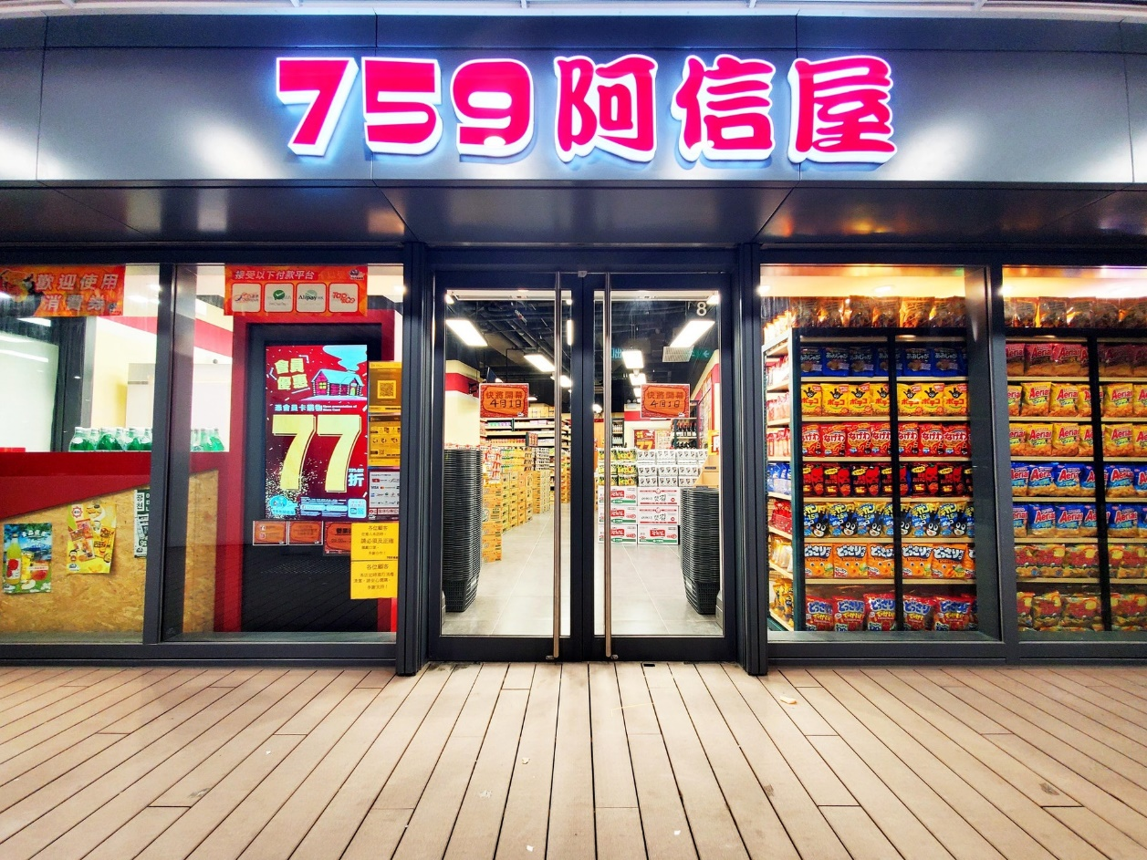
Background of 759 Store
Founded by Mr. Lam Wai Chun
originally worked in the manufacturing industry and established " Coils Electronic Co " in 1979.
listed on the Hong Kong Stock Exchange under the name CEC International Holdings Limited (Stock Code: 0759).
During the 2008 financial crisis, the business was severely affected, leading to a large-scale layoff of employees. In order to avoid repeating the same mistakes and provide new job opportunities for his employees, Lin Wai Chun shifted his focus to the retail industry and created 759 Store.

Slide 3
Background of 759 Store
Adopts a "direct from source" model, as well as a high-traffic, diverse, and small profit, large sales policy. The store displays a wide range of products, setting it apart from other retail brands and avoiding direct competition. This differentiation helps prevent intense competition within the industry.
Currently has approximately 166 branches located in residential areas across all 18 districts of Hong Kong.
Established a membership card system to provide customers with member discounts and limited-time offers.

Slide 4
Data from Annual Report
 | Operating Profit | Employment Support Scheme | Operating Profit (after deducted Employment Support Scheme) | Number of Employees | Average Number of Employees per Store | Total Employees
2012 | HK$3,101,000 | HK$0 | HK$3,101,000 | 71 | 4.1 | 291.1
2013 | HK$11,617,000 | HK$0 | HK$11,617,000 | 134 | 4.1 | 549.4
2014 | HK$51,157,000 | HK$0 | HK$51,157,000 | 192 | 4.1 | 787.2
2015 | HK$68,637,000 | HK$0 | HK$68,637,000 | 249 | 4 | 996
2016 | HK$15,840,000 | HK$0 | HK$15,840,000 | 271 | 4 | 1084
2017 | -HK$29,528,000 | HK$0 | -HK$29,528,000 | 243 | 4 | 972
2018 | HK$6,204,000 | HK$0 | HK$6,204,000 | 206 | 3.5 | 721
2019 | HK$11,874,000 | HK$0 | HK$11,874,000 | 179 | 3.6 | 644.4
2020 | HK$70,273,000 | HK$2,200,000 | HK$68,073,000 | 177 | 3.7 | 654.9
2021 | HK$153,891,000 | HK$41,263,000 | HK$112,628,000 | 174 | 4 | 696
2022 | HK$98,202,000 | HK$0 | HK$98,202,000 | 172 | 4 | 688
2023 | HK$100,703,000 | HK$18,832,000 | HK$81,871,000 | 166 | 4 | 664

Slide 5
Operating Profit
(after deducted Employment Support Scheme)

Slide 6
Number of Store & Total Employees

Slide 7
Based on these trends, we can draw the following insights:
Significant increase in profits in 2015 may be attributed to the expansion strategy of increasing the number of stores. However, despite the increase in store count, the significant drop in profits in 2016 indicates that the expansion may have led to higher operating costs without a proportional increase in revenue.
Significant operating loss in 2017 could be attributed to overexpansion, market saturation, or external economic factors. This seems to have triggered strategic decisions within the company, as the number of stores started to decrease from 2017 onwards.
The store consolidation starting from 2017 may have aimed to reduce costs and shift the operational direction. The recovery of operating profits from 2018 onwards suggests that this strategy appears to be effective.
The stability of operating profits after 2018, despite the decrease in store count, may indicate a more efficient or focused business strategy.
After 2020, there was an increase in revenue due to changes in consumer spending patterns caused by environmental factors. However, it started to decline afterwards

Slide 8
General Environment
1. CEPA
Introduction of the Individual Visit Scheme (IVS) under the Mainland and Hong Kong Closer Economic Partnership Arrangement (CEPA) in 2003
  Benefiting from this policy, the economy that was recovering from the impact of the SARS outbreak.
  This influx of tourists also led to significant growth in the tourism and retail industries in Hong Kong.
Until 2015, there was a period of adjustment in the tourism and retail industries in Hong Kong. And IVS (one-year multiple-entry) was changed to one visit per week. This change in visa policy resulted in a continuous decline in the number of visitors coming to Hong Kong, which had a significant impact on consumption.
With the decrease in the number of visitors to Hong Kong, there would have been a significant impact on the overall retail sector, including 759 Store.

Slide 9
General Environment
2. COVID-19 pandemic
Appeared in Hong Kong on January 22, 2020
From February 2020, the government implemented border restrictions, and as the situation worsened, dine-in services at restaurants were prohibited. These measures resulted in significant changes in the daily lives and consumption patterns of citizens
Due to the pandemic, 759 Store adjusted its product offerings to cater to these needs. As a result, the store experienced its highest revenue since its establishment.
As the pandemic gradually subsided and social restrictions were relaxed, citizens were allowed to go out and engage in more normal activities, including shopping, consumers had more options and reduced their shopping at 759 Store.
Furthermore, in February 2023, the government resumed cross-border travel, allowing citizens to travel to other destinations for shopping. This further impacted 759's business

Slide 10
Task Environment
In 2011, Ah Shun House faced a situation where they were blacklisted by the soft drink supplier due to pricing their Coca-Cola too low. As a result, they were denied the supply of beverages. Link
Multiple competitors emerged in the market: Mart 360°, AbouThai, PrizeMart, Don Don Donki. With the increase in competition from other retailers, consumers had more options and reduced their shopping at 759 Store.

Slide 11
Internal Environment
1. Rapid expansion
759 underwent rapid expansion driven by the flourishing retail industry, increasing its number of stores from 71 in 2012 to 249 in 2015.
The theory of strategy drift can be applied. When the external environment, in this case, the retail market, begins to decline, 759 encountered several challenges. The rapid expansion led to underperforming stores with low sales, but the company couldn't close these stores due to the remaining lease terms, which further exacerbated the losses.
The result of strategy drift was prolonged losses and a struggle to regain profitability. In response, in 2017, 759 chose to sell multiple properties to generate cash and sustain the company's operations.

Slide 12
Internal Environment
2. Problem of 759 strategy
Low-margin and high-volume sales, resulting in a very low profitability. Taking the first half of 2022 as an example, the net profit margin was only 1.7%, which means earning HK$1.7 for every HK$100 of revenue. Moreover, any changes in income costs, such as exchange rates, minimum wages, and rent, are sufficient to cause losses.
3. Iconic representative passes away
The founder, chairman, and CEO of 759 Store, Mr. Lam Wai Chun, passed away on August 18, 2018. Since then, the business has been managed by his wife and son.

Slide 13
Recommendation
Structural Change - Change New CEO
Leadership: The CEO plays a critical role as the leader of the organization. They are responsible for setting and implementing the company's strategic goals and direction. When a company is facing challenges, changing the CEO may be necessary to bring in new leadership capabilities and perspectives to address the changing business environment.
Performance Improvement: If a company is experiencing problems in its performance or operations. A new CEO may bring fresh ideas and strategies to reinvigorate the organization’s growth and innovation.
Management Style: Different CEOs have different management styles and abilities. Changing the CEO may be necessary to adjust the organization's culture and values to better adapt to changing market demands.

Slide 14
Reference
‌
‌
‌
‌

Slide 15
‌

