Slide 1
LCBB6014
Independent Project
Reviewing the Literature
Week 2: Session 2

Slide 2
Learning Objectives
searching the literature and engaging critically with the ideas of other writers;
what is expected in a literature review and the criteria used to evaluate it;
how to assess the quality of existing research in your subject area;
the role of the bibliography and the importance of referencing the work of others;
the importance of understanding what constitutes plagiarism and the penalties that are associated with it.

Slide 3
The Literature Review
A literature review should allow you explore the following:
  What is already known about this area?
  Which concepts and theories are relevant?
  Which research methods and strategies have been used in this area?
  Are there any controversies?
  Are there any inconsistencies in findings?
  Are there unanswered questions?

Slide 4
The Literature Review
A literature review can be:
  a list of relevant theories;
  a search for relevant information;
  a survey of writing on the subject;
  a way of learning about the subject;
  a help in finding dissertation topics and research methods;
  an important component of a dissertation or report.
Adapted from Bruce (1994)
It is important to critically analyse the material you are reading
Academic journal articles are a premier source for a literature review.

Slide 5
Why Write A Literature Review?
You need to know what is already known about your research area;
You can learn from the mistakes of others;
You can learn about different theoretical and methodological approaches to your research area;
It may help you to develop an analytic framework;
It may lead you to consider including variables in your research of which you might not have thought;
It may suggest further research questions;
It is required!

Slide 6
Getting The Most From Your Reading
Take lots of notes (including references)
Ask yourself questions about what you read (its value to your topic, methods used, conclusions) (i.e. Demonstrate critical thinking)
Find research questions (perhaps because what you read indicates contention)
Identify sources to which you will want to return later on;
Be selective (read for relevance)
Don’t stop reading!

Slide 7
How To Search The Literature
Read books and articles you know, or are recommended by your supervisor.
Keep notes based on your reading.
Note the keywords used.
Note other literature which might be interesting later.
Generate your own keywords.
Search your institution’s library.
Search online (using an appropriate database).
Examine titles and abstracts for relevance.
Retrieve selected items, read, take notes.
Check regularly for new material.

Slide 8
Two Main Approaches To A Literature Review
Systematic review:
Very extensive search of the specific research field;
Grouping of sources into categories:
  very relevant, based on good research,
  very relevant, weak research,
  low relevance, or too general;
Giving a step-by-step report on the search method used, decisions taken and derived conclusions.
(Tranfield et al, 2003:209)

Slide 9
Two Main Approaches To A Literature Review
2. Narrative Review:
Limited search for the most interesting contributions
Concentration on connections between sources located and research questions
Revision of research questions in the light of readings

Slide 10
Systematic Vs. Narrative Review
Systematic:
Positivist
“Quantity” focus
Theory informs the search
Synthesis is the research goal
Narrative:
Intrepretivist
“Quality” focus
Theory emerges from the search
Identifying the discourse is the research goal

Slide 11
Warning: Using Internet Sources
Search engines find sites but do not evaluate them.
Dictionaries and encyclopaedias are fine for basic definitions, but little else.
Many Internet sites serve a commercial purpose, so don’t be taken in by propaganda.
Rely on academic sites (usually.ac or .edu), government sites (.gov), not-for-profit institutions (.org), in that order.
Download and save all material found on the Internet. Sites are dynamic and you may not find the data a second time. Your institution may also require proof when defending your thesis.

Slide 12
Searching For Books And Articles
Start with module reading-lists
Consult the references and bibliographies of recommended textbooks
Use the library of UWTSD
  to find out what is available
  to find out UWTSD’s subscriptions to on-line databases
Use electronic databases
  SSCI (Social Sciences Citation Index) (wok.mimas.ac.uk), ABI/INFORM (proquest.com)
  EBSCO (epnet.com)
  Use key words and define search parameters

Slide 13
Referencing your work
A source is usually referenced in two parts:
1) the citation, in your text at the point of use;
2) full publication details, in a reference list, or bibliography, at the end of your dissertation or report.
There are two main referencing conventions:
1) the author-date system, of which the Harvard system is most used;
2) the footnote system.
Bibliography
  Always include a list of references (bibliography) at the end of your work.
  Don’t be tempted to have a longer bibliography - only list those resources actually cited.

Slide 14
Plagiarism
Plagiarism means pretending that we, ourselves, wrote what others actually wrote.
Plagiarism is always a crime, since it destroys the foundations of the research edifice.
Institutions vary in terms of the seriousness with which they view the offence.
  Punishment can range from resubmission to expulsion.
  Reputation is always lost.

Slide 15
Key Points
Writing a literature review: review the main ideas and research relating to your chosen area of interest.
Key skills can be acquired to help you get the most from your reading.
Systematic reviewing enhances the reliability of literature searching and review.
Narrative reviewing is flexible which can make it more appropriate for inductive research and qualitative research designs.

Slide 16
From where to begin? Map Out A Search Strategy
A search strategy is a systematic plan for tracking down sources.
To create a search strategy appropriate for your research question:
  Consult a reference librarian and take a look at your library’s Web site, which will give you an overview of available resources.
  Use Technology Effectively:
  http://library.iugaza.edu.ps/
  https://scholar.google.com.my/
  https://www.researchgate.net/home
  https://www.academia.edu/

Slide 17
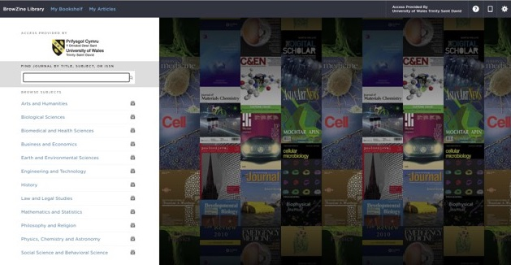
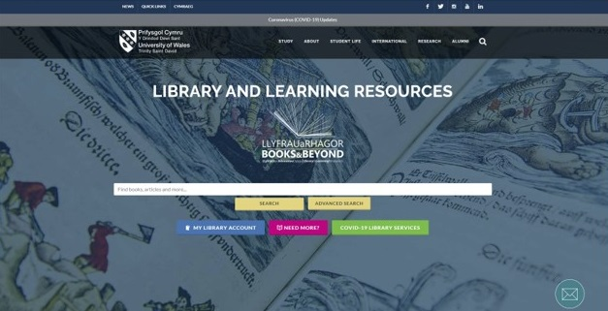
From where to begin? Use Technology Effectively

Slide 18
From where to begin? Locate Other Sources
You can find a variety of reliable sources using online tools. For example:
  https://www.oecd.org/competition/publicationsdocuments/reports/
  https://www.un.org/en/development/desa/publications/
  https://www.worldbank.org/en/research
  https://www.gov.uk/government/collections/publications
  https://www.librariesconnected.org.uk/page/librariesfromhome

Slide 19
Are Wikis (Wikipedia) a Good Source?
In general, Wikipedia may be helpful if you’re checking for something that is common knowledge (facts available in multiple sources, such as dates and well-known historical events).
However, many scholars do not consider Wikipedia and wikis in general to be appropriate sources for college research. Authorship is not limited to experts; articles may be written by amateurs who are not well informed.
And because the articles can be changed by anyone, controversial texts are often altered to reflect a particular perspective and are susceptible to bias.
When possible, locate and cite another, more reliable source for any useful information you find in a wiki.

Slide 20
From where to begin? Select Sources Worth Your Time & Attention
how to scan through the results for the most promising sources and
how to preview them to see whether they are likely to live up to your expectations and meet your needs.
As you scan through a list of search results, watch for clues indicating whether a source might be useful for your purposes or is not worth pursuing.

Slide 21
From where to begin? Select Sources Worth Your Time & Attention
Decide if a source is:
  Relevant,
  Current,
  Scholarly enough,
  and a suitable length for your purposes.

Slide 22

From where to begin? Guidelines for effective use of the scholar
Start with the dependent variable.
Look for papers (most cited).
Look for Review papers.
Look for meta-analysis.
Search within cited papers.

Slide 23
From where to begin? Read with an open mind and a critical eye
As you begin reading the sources you have chosen, keep an open mind.
Do not let your personal beliefs prevent you from listening to new ideas and opposing viewpoints.
Your research question — not a snap judgment about the question — should guide your reading.
When you read critically, you are not necessarily judging an author’s work harshly; you are simply examining its assumptions, assessing its evidence, and weighing its conclusions.

Slide 24
From where to begin? Read with an open mind and a critical eye

Slide 25
From where to begin? How sources contribute to your writing?
Do you need old or new papers? Why?
Which is more important: books or papers?
Where to look in the paper?
How you plan to use sources will affect how you evaluate them. Not every source must directly support your thesis; sources can have other functions in a paper. They can:
  provide background information or context for your topic
  explain terms or concepts that your readers might not understand
  provide evidence for your argument
  lend authority to your argument
  offer alternative interpretations and counterevidence to your argument

Slide 26

Any Questions?
Thank You ☺

Slide 27
Sources:
Saunders, M.N.K. (2019) Research methods for business students. 8th ed. Harlow: Pearson.
Adams, J. (2014) Research Methods for Business and Social Science Students. New Delhi: SAGE Publications.
O’Gorman, K. (2015) Research methods for business & management: a guide to writing your dissertation. 2nd ed. Oxford, England: Goodfellow Publishers Ltd.
Zikmund, W. G. (2010) Business research methods. 8Th ed. Mason, OH: South-Western Cengage Learning.
Clippinger, D. (2017) Business research reporting. Business Expert Press.

