Slide 1
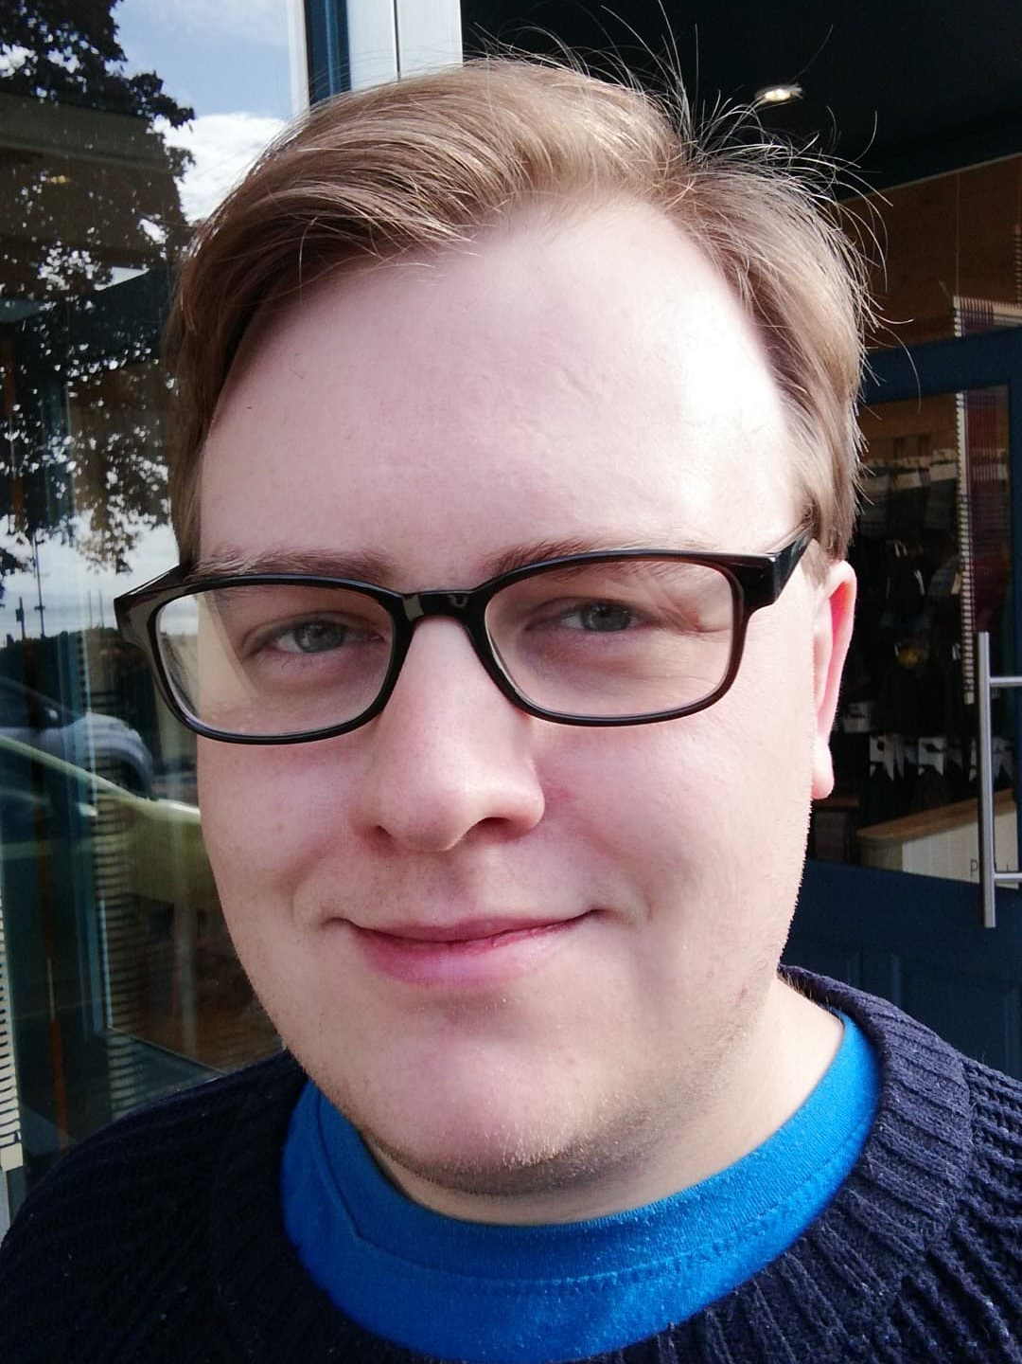


Amdana i
About Me
Jamie Harper-Harrison
Born in Swansea, Wales in 1990. I have a passion for reading and writing. I have worked for 8 years in administration for the Civil Service and NHS since graduating. I have also been a member of a community theatre group for 12 years.
Profiad addysgu blaenorol
Previous teaching experiences
Two weeks’ observation in Olchfa School.
Due to begin student-teacher placement in Olchfa School in October 2019.
Y math o athro hoffaf bod
The kind of teacher I aspire to be
Kind
Calm
Respectful
Knowledgeable
Passionate
Rhesymau dros ddewis addysgu fel proffesiwn
Reasons for entering the teaching profession
I am very enthusiastic about English as a subject and want to work in a job where I get to engage with it every day.
I am keen to work alongside young learners and help them develop knowledge, skills and passions.
I am excited to do a job where every day will be different and challenging.
I want to be involved in a vibrant school community.
Meysydd / pynciau medraf eu haddysgu
Areas / subjects I could teach
English
Cefndir academaidd
Academic history
Graduated from Swansea University with a BA in English Literature in 2011.
A-Level in English Language and Literature, AS-Level in Pure Mathematics.

