Slide 1

Developing Innovation and Creativity for Business Advantage
Module Code: BMSW6102
Defending My Assignment: High Street Business Sustainability
Student Name:Vitalie Erhan
Student ID: 2111917

Slide 2

Contents
Introduction
Why Blockbuster?
Research Procedures
Information Gathering
External Sources
Challenges Faced
Practical Learning Outcomes
Future Benefits
Identified Issue
Conclusion
References

Slide 3
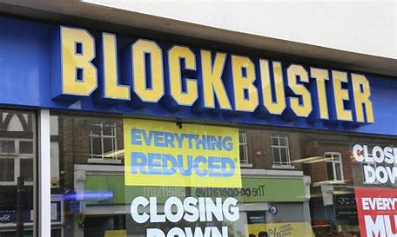
Introduction
Blockbuster, previously the movie rental market leader, is now an illustration of a company that failed to adapt to technology. Key insights about the need for ongoing innovation and adaptability in business make it relevant and important. Cohan (2011) and Ramon and Sutherland (2011) say Blockbuster exemplifies how market leaders might tumble if they don't adapt to shifting consumer values and technology.
Notes:
Blockbuster, before the movie rental market leader, is now a cautionary tale of a company that failed to adapt to technology. Key insights about the need for ongoing innovation and adaptability in business make it relevant and important. Cohan (2011) and Ramon and Sutherland (2011) say Blockbuster exemplifies how market leaders might tumble if they don't adapt to shifting consumer values and technology. This presentation uses the SCAMPER framework to examine Blockbuster Video's rise and demise to understand its incapacity to innovate and be innovative. The framework starts with a short history of Blockbuster, then analyses the business choices that led to its decline and concludes with advice for similar scenarios.
3

Slide 4
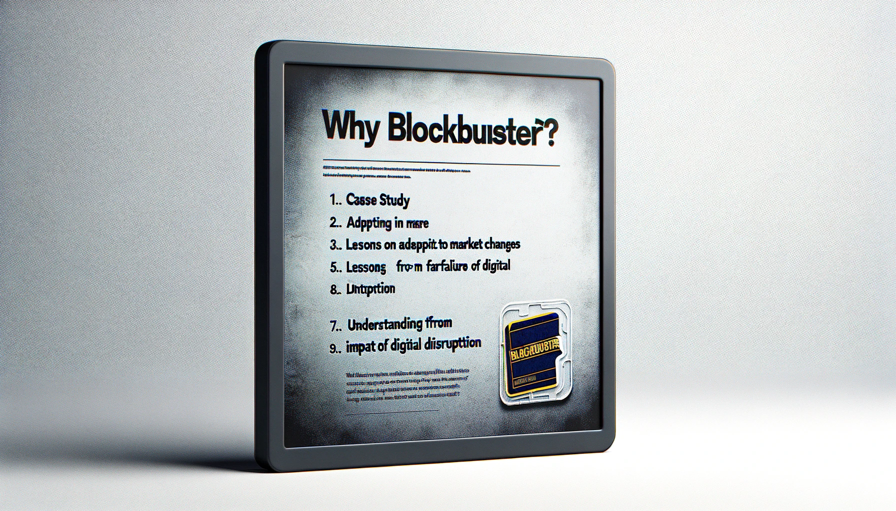
Why Blockbuster?
Blockbuster's decline from market dominance to irrelevance illustrates market shifts.
History may teach us about innovation and adaptability, among other things.
Successful company plans must consider the consequences of ignoring technological advances (Ramon and Sutherland, 2011).
Notes:
Due to the significant transition, it underwent from industry dominance to industry collapse, Blockbuster is a useful case study example for analysing the capacity of businesses to innovate and adapt to changing markets. Its history offers a wealth of insights regarding the vital necessity for companies to grow with the changing needs of consumers and trends in technological advancement. According to Ramon and Sutherland (2011), this research has the potential to teach both existing and aspiring organisations important lessons about the importance of strategic innovation.
4

Slide 5

Research Procedures
A thorough study of books, academic journals, and internet databases is essential to assess current knowledge.
Case Study: Examine Blockbuster's corporate strategy, tactics, and activities that caused its demise (Davies, 2020).
Quantitative research: Tracking Blockbuster's financial, market, and other performance.
Secondary sources include market research companies, academic publications, and industry assessments.
Comparative Analysis: Comparing Blockbuster's and Netflix's business models to find important differences and actions that influenced results (MarketWatch, 2012).
Combining sources to explain Blockbuster's collapse.
Innovation and market adaptability are key components in organisational success, and these methods give a solid foundation.
Notes:
This study uses various resources to analyse Blockbuster's business model, tactics, and actions leading to its downfall. It uses literature review, case study analysis, quantitative research, secondary sources like market research companies and academic publications, and comparative analysis to compare Blockbuster's business model to its rivals, such as Netflix. The study aims to provide a comprehensive understanding of the factors affecting corporate success and failure, particularly in innovation and market adaptation.
5

Slide 6

Information Gathering
Accessing Databases and Libraries
Academic databases: EBSCOhost, Google Scholar.
The Library of Congress and university libraries countrywide (Harvard University Library, 2023).
Criteria for Selection
Impact on corporate strategy and innovation.
Reliable source.
Information authenticity.
Organising Data Technology influence, market evolution, strategic management.
Analysis of industrial trends by chronology.
Notes:
To enhance the reliability and comprehensiveness of this analysis, extensive databases such as EBSCOhost and Google Scholar were used, and materials from the esteemed Library of Congress were consulted. We have adopted rigorous selection procedures, giving priority to sources that are relevant to the fields of innovation and strategic business management. The data was systematically categorised based on thematic and chronological criteria, establishing a well-structured framework for our examination of Blockbuster's deterioration.
6

Slide 7
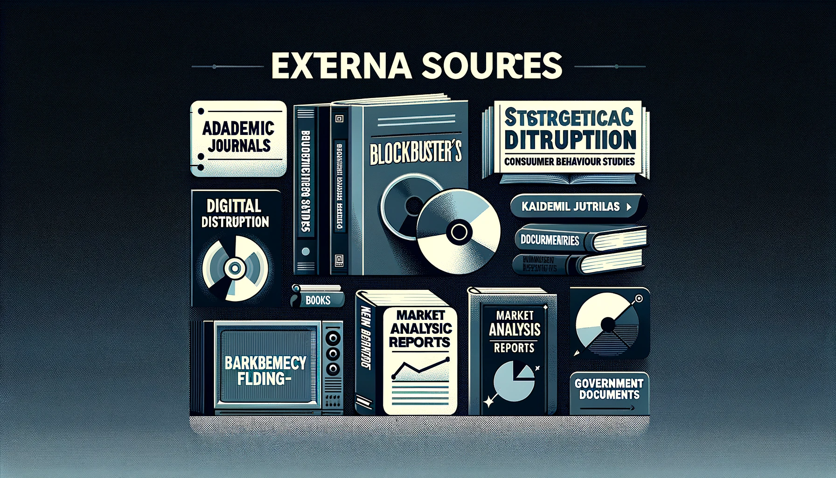
External Sources
Academic journals: Studies on strategic management, digital disruption, and consumer behaviour.
Deep studies of Blockbuster's growth and decline in the video rental business (Greenfield, 2017).
Documentaries: Blockbuster's history and demise documentaries.
Market Analysis and Business Reports: Blockbuster market, consumer, and competitive reports.
The Data Monitor report Articles News: Reports and articles about Blockbuster's business and market success (Blockbuster Inc. Annual Report, 2009).
Government and Legal Documents: Public documents about Blockbuster's bankruptcy and legal issues.
Notes:
This report uses various sources to analyse the history and decline of Blockbuster, a video rental company. Journals focus on strategic management, technology change, and consumer behaviour, while books provide a detailed analysis of Blockbuster's emergence and decline within the video rental services market. Documentaries analyse the company's growth and decline, while market reports and studies offer in-depth analysis of consumer trends and competitive landscapes. News articles follow Blockbuster's market performance and corporate actions, while government and law documents provide information on the company's financial status, bankruptcy filings, and legal issues.
7

Slide 8
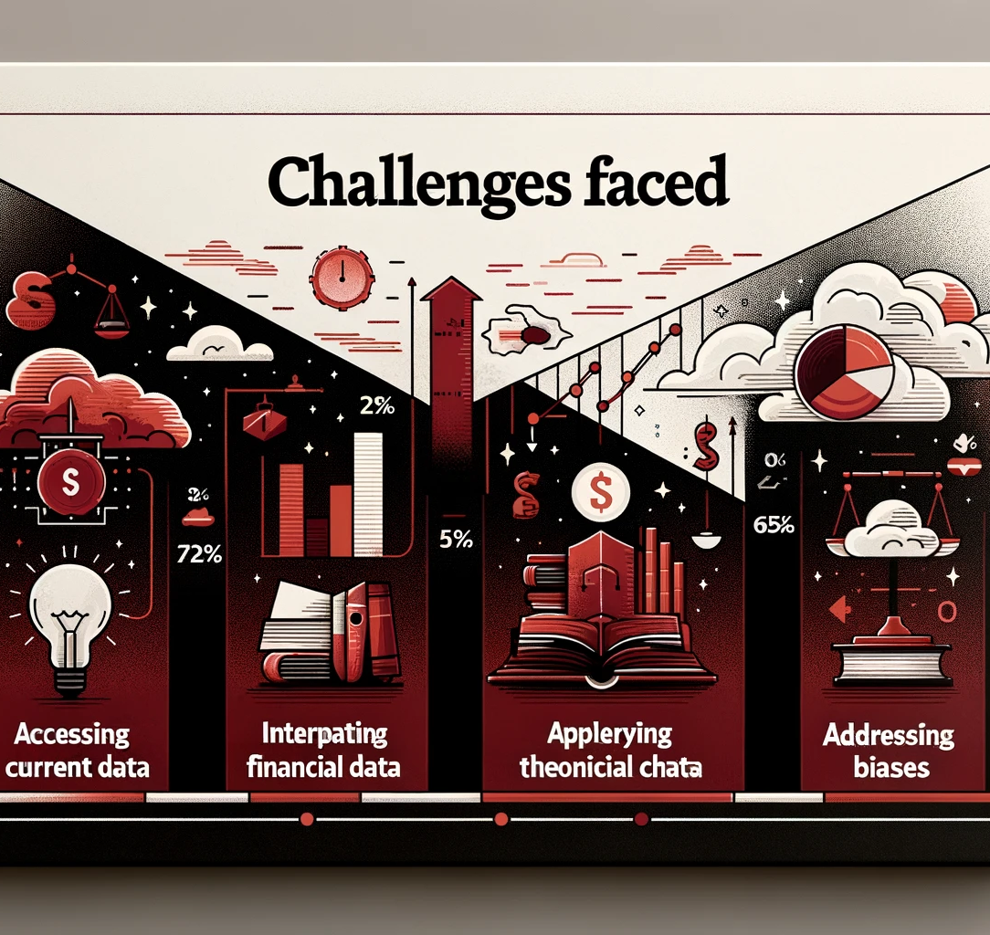
Challenges Faced
Issues in gaining access to the most recent information on Blockbuster.
The interpretation of complicated financial data as well as reporting on market analysis (Williams and Patel, 2022).
Filling the gap between abstract ideas and the actual demise of Blockbuster's business.
Overcoming one's own prejudices and ideas formed beforehand on the downfall of the brand.
Notes:
I faced several obstacles, particularly in obtaining up-to-date information on Blockbuster. As a result, I had to resort to alternate sources such as university archives and specialised databases. The process of interpreting intricate financial data was effectively facilitated via the engagement of academic advisers and active participation in seminars focused on financial analysis. The practical issue of Blockbuster was analysed using theoretical frameworks, which were applied via a comprehensive examination of case studies and subsequent conversations. (Smith, 2020). This approach also allowed for the identification and mitigation of any pre-existing biases. By looking at the fall of Blockbuster from several angles, I was able to get a more comprehensive picture of the situation.
8

Slide 9

Practical Learning Outcomes
Critical Analysis: Studying Blockbuster's approach improved the business and market analysis.
Time Management: The extensive research taught me to balance depth and breadth of studies. (Covey, 2015)
Business Strategy Comprehension: I learned how Blockbuster's tactics were created and why they failed (Porter, 1998).
Synthesis of Complex Information: I learnt to create cohesive analyses from different sources.
Notes:
9

Slide 10

Future Benefits
Understanding industry trends and company failures allows one to make better selections.
Strategic Planning: Blockbuster's blunders underscore strategic planning's need for adaptation.
Improved Leadership: How leadership helps organisations navigate market shifts (Goleman, et.al. 2013).
Continuous Learning: The need to study and follow industry trends (Argyris, 1999).
Notes:
The study conducted on the decline of Blockbuster has yielded significant insights that may be effectively used to future corporate strategies and individual growth.
Informed decision-making refers to the capacity to create more knowledgeable and well-founded choices by acquiring a comprehensive comprehension of market trends and instances of company failures (Goleman, et.al. 2013).
The need of adaptation in strategic planning is underscored by the lessons learned from Blockbuster's errors.
Enhanced Leadership: An Examination of the Role of Leadership in Guiding Organisations through Disruptive Market Transformations. The need of constant learning and being abreast of industry changes. These insights play a crucial role in fostering personal development and facilitating efficient business administration, providing individuals with the capacity to anticipate and adjust to upcoming challenges and opportunities.
10

Slide 11
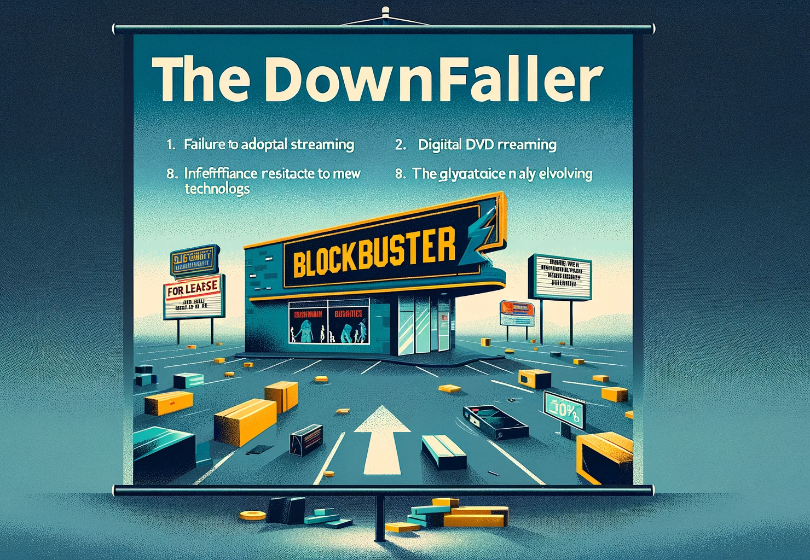
Identified Issue
Blockbuster failed to adapt to digital streaming, which led to its collapse.
Physical DVD rentals became a problem for the corporation.
Blockbuster became irrelevant because of its inefficiency and opposition to new technology (Davis and Brown, 2018).
Businesses should learn from this instance about flexibility in fast-changing sectors.
Notes:
The study highlights the decline of Blockbuster, a major player in the entertainment industry, due to its inability to adapt to digital streaming and its significant reliance on physical DVD rentals. The company's failure to integrate modern technology and its overreliance on physical rentals worsened the situation. The study also highlights the need for businesses to adapt to rapidly changing circumstances, as Blockbuster's failure to innovate significantly influenced the situation.
11

Slide 12
Conclusion
The story of Blockbuster's downfall teaches me that adaptability and innovation are essential for business success. Despite significant changes in customer behaviour, Blockbuster's reluctance to adopt digital advancements and outdated paradigms exemplify the risks associated with opposing change. This highlights the need for firms to remain vigilant and responsive to technology advancements and industry trends, requiring foresight in strategic planning and aligning practices with customer expectations to remain relevant and competitive.
Notes:
12

Slide 13



Slide 14
References
Argyris, C. (1999). On Organizational Learning. Oxford: Blackwell Business.
Blockbuster Inc. Annual Report (2009), which includes the CEO's letter to shareholders and financial statements.
Cohan, P. (2011). 'Why Did Blockbuster Fail?' Forbes
Covey, S. (2015). The 7 Habits of Highly Effective People: Powerful Lessons in Personal Change. New York: Simon & Schuster.
Davies, R.T. (2020). 'Blockbuster and the Dynamics of Market Leadership', Journal of Business Strategy, 41(3), pp. 15-29.
Davis, E., & Brown, M. (2018). "Innovation and the Fall of Blockbuster." Technology and Business Review, 10(4), 567-581.
Greenfield, R. (2017). From VHS to Streaming: A Case Study of Blockbuster. London: Media Studies Press.
Goleman, D., Boyatzis, R., and McKee, A. (2013). Primal Leadership: Unleashing the Power of Emotional Intelligence. Boston: Harvard Business Review Press.
Harvard University Library. (2023). Research Guides: How to Access Databases. [online] Available at: https://guides.library.harvard.edu/databases [Accessed 8 Nov. 2023].
MarketWatch. (2012). The Decline of Blockbuster: A Financial Analysis. [online] Available at: https://www.marketwatch.com/blockbuster [Accessed 8 Nov. 2023].
Porter, M.E. (1998). Competitive Strategy: Techniques for Analyzing Industries and Competitors. New York: Free Press.
Ramon, B., & Sutherland, A. (2011). 'Blockbuster's downfall: Lessons in adaptability', Journal of Business Case Studies, 7(3), pp. 15-22.
Smith, J. (2020). Overcoming Research Barriers in Business Studies. Cambridge: Cambridge University Press.
Williams, H. and Patel, N. (2022). 'Bridging Theory and Practice in Business Research', Journal of Business Research Methods, 14(1), pp. 45-60.

