Slide 1
AI GUIDANCE
I confirm that I have not used any AI tools in the research and creation of this
assignment. I confirm that I have not presented any AI generated materials as my own
work. I confirm I have copies of my drafts, notes, and other resources I used, which I
may be asked to provide evidence.

Slide 2
BPD Presentation
By Chelsey, Emily, Mia, Tiffany

Slide 3

Mia Dunbar-Bowen
Treatments for BPD
(Stock Image)
Talking therapy
Therapeutic communities
Self care
A diagnosis (according to the DSM-5) can determine one’s eligibility for certain programmes
+ The severity of the disorder influences treatments offered

Slide 4

Mia Dunbar-Bowen
None specifically approved for BPD
Antidepressants, antipsychotics, mood stabilisers are only recommended to treat associated conditions such as anxiety (NICE, 2009)
(Stock Image)
Medication
For example: SSRIs, olanzapine, lithium
May increase risk of substance abuse and worsen side effects in some individuals (not everyone will respond the same)

Slide 5
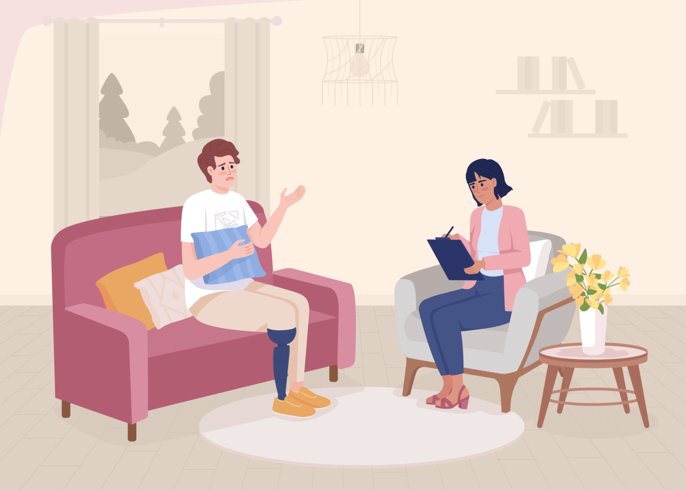
Mia Dunbar-Bowen
Types of Talking Therapies
DBT
MBT
SCHEMA THERAPY
(Stock Image)
Validates emotions
Gain acceptance of change
Improve interpersonal relationships
Mentalise efficiently (Understand own perspectives and others)
Enables changes in destructive patterns
Develop a healthier mindset
4 Main Skills Learned
Mindfulness
Emotional regulation
Interpersonal effectiveness
Distress tolerance

Slide 6

Mia Dunbar-Bowen
Therapeutic Communities
(Stock Image)
Work with a group of people with similar mental health problems to support each other
Therapy is dependent on physical environment, people in surroundings, activities
Can live together or meet up

Slide 7


Mia Dunbar-Bowen
Self Care
(Stock Image)
Journal
Meditation
Create a crisis plan; self-help strategies, how to get support, triggers
Mind (2022) recommends a ‘self-care box’ including items that are comforting or bring joy
Ground yourself in nature
Give up alcohol/ drugs (optional)

Slide 8
Mia Dunbar-Bowen
In moments of crisis
For extreme situations, hospital stays may be recommended to prevent high risk of suicide or life threatening behaviour
A short course of medication (7 days), usually a tranquiliser, can be given to manage symptoms
Contacting a crisis resolution team or therapist, e.g. Samaritans, to help feel understood
For minor crises, practicing DBT skills can be of benefit

Slide 9
Mia Dunbar-Bowen
Strengths and Limitations of Treatments
Strengths
Limations
Medication
Talking therapy
Therapeutic communities
Manages intense episodes, easier to access
Addiction/dependency, does not treat core symptoms of BPD
Targets key issues, encourages self improvement
Long term, hard to access, emotionally challenging
Builds a support network, places the individual in real-life situations
Some people may not suit group work, requires significant commitment

Slide 10
Thank you!

Slide 11
References
Anna Freud Centre. (n.d.). Mentalization-aased treatment (MBT) for adults: About MBT.
https://www.annafreud.org/training/health-and-social-care/mentalization-based-treatments-mbt/mentalization-based-treatment-adults/about-mbt/
Borderline Support UK. (n.d.). Therapeutic communities.
https://borderlinesupport.org.uk/whatisbpd/therapies/therapeutic-communities/
Health direct. (2024). Dialectical behaviour therapy.
https://www.healthdirect.gov.au/dialectical-behaviour-therapy-dbt
Linehan, M. M., Comtois, K. A., Murray, A. M., Brown, M. Z., Gallop, R. J., Heard, H. L., Korslund, K. E., Tutek, D. A., Reynolds, S. K., & Lindenboim, N. (2006). Two-year randomized controlled trial and follow-up of dialectical behavior therapy vs therapy by experts for suicidal behaviors and borderline personality disorder. Archives of General Psychiatry, 63(7), 757–766. https://doi.org/10.1001/archpsyc.63.7.757
Mayo Clinic. (2024). Borderline personality disorder: Diagnosis and treatment.
https://www.mayoclinic.org/diseases-conditions/borderline-personality-disorder/diagnosis-treatment/drc-20370242
Mind. (2022). Borderline personality disorder: Self-care.
https://www.mind.org.uk/information-support/types-of-mental-health-problems/borderline-personality-disorder-bpd/self-care/
National Health Service. (2022). Treatment – Borderline personality disorder.
https://www.nhs.uk/mental-health/conditions/borderline-personality-disorder/treatment/
National Institute for Health and Care Excellence. (2009). What treatment should I be offered for borderline personality disorder?
https://www.nice.org.uk/guidance/cg78/ifp/chapter/what-treatment-should-i-be-offered-for-borderline-personality-disorder
Talkspace. (2023). Medications for Borderline personality disorder.
https://www.talkspace.com/mental-health/conditions/borderline-personality-disorder/medications/

Slide 12
Mia Dunbar-Bowen
Slide 1: Treatments for BPD
There are various treatment options for BPD. Some of the more well-known approaches include talking therapies, or joining a therapeutic community. In addition to professional support, there are also many self-care strategies that individuals can use independently, whether that’s during an emotional episode or simply as a way to manage their wellbeing before seeking further help elsewhere. Having said this, no single treatment works for everyone due to individual differences. For example, the biopsychosocial model founded by George Engel suggests that emotional dysregulation develops through the interaction of one’s innate unstabeleness and their invalidating environment. This explains why NICE recommends a tailored approach to treatment, as individuals differ in both personality and life experiences.
Slide 2: Medication
Unlike some other mental health conditions, there is no specific medication designed solely to treat BPD. This is due to the complexity of the disorder, which cannot be addressed by a single drug. Guidelines generally advise caution when prescribing medication for BPD, as it does not typically improve core symptoms, such as interpersonal impairment. In some cases, certain medications may also carry risks, including addiction. However, medication can still be used to target specific symptoms. For example, antidepressants may help with associated depression, and antipsychotics may be used for severe distress or impulsivity.
Slide 3: Talking therapies
Talking therapies are considered one of the most effective treatments for BPD. One key example is DBT. DBT focuses on validating these emotions while also helping people develop healthier coping strategies and see perspectives that contradict their own. Research by Linehan et al. (1991) shows that DBT significantly reduces suicidal behaviours in individuals with BPD. However, the study focused largely on women, which suggests that it may not be as efficient for men. Another example is MBT, where you learn to step back from your immediate thoughts and gain the capacity to mentalise efficiently. Schema therapy is another option, which focuses on identifying and changing deeply ingrained negative patterns that have been developed earlier in life. Despite this, this treatment approach can be difficult to access.

Slide 13
Mia Dunbar-Bowen
Slide 4: Therapeutic communities
Therapeutic communities provide a supportive and structured environment where individuals with BPD can work on recovery alongside others. These communities are often residential, meaning individuals stay there for a period of time, allowing for a more immersive therapeutic experience. Within these communities, individuals with BPD have the opportunity to engage in meaningful interactions, confront interpersonal challenges, and develop essential skills for building and maintaining healthy relationships. Overall, the environment aims to be empathetic and supportive, helping individuals feel understood and accepted.
Slide 5: Self care
There are many activities that a person can do on their own accord. These might include mindfulness exercises, journaling, grounding techniques, or engaging in physical activity. Strategies such as mindfulness are consistent with cognitive-behavioural approaches, which emphasise the role of thought regulation in emotional control. Techniques such as this can help manage symptoms outlined in the DSM-5, such as affective instability. While self-care is not a replacement for professional treatment, it can be a valuable tool in supporting overall wellbeing and maintaining progress.
Slide 6: Crisis
For individuals with BPD, there may be moments where they’ll find themselves in crisis due to their impulsive behaviour. During these moments, it is important for them to seek immediate support. This could involve contacting mental health services or crisis helplines. Having a crisis plan in place can also be helpful as early intervention plays a key role in reducing harm and ensuring safety. This plan might include a list of identifiable warning signs, coping strategies, and knowing who to contact in an emergency. In extreme circumstances, an individual may be administered a hospital stay or a short course of medication to avoid the risk of harm to themselves or others.
Slide 7: Strengths and Limitations
Each treatment option for BPD has its own strengths and limitations. Overall, talking therapies such as DBT appear to be the most effective treatment, as they directly target the underlying mechanisms of BPD, particularly emotional dysregulation. In contrast, medication plays a more supportive role, addressing symptoms rather than causes. While therapeutic communities provide valuable social support, they may not be suitable for everyone due to their high commitment and interaction. Therefore, the most effective treatment is entirely dependent on what suits an individual the best.

