Slide 1


Evaluating lean manufacture systems employed in the UK automotive industry.
Kristian Kormi
Logistic Officers Contracts Course

Slide 2
Range
15 minute presentation
Aims
Introduction
Wastage occurring
Implementation
Evaluation
Conclusion
References

Slide 3
Aims
The aims of this presentation are to;
Analyse the kinds of wastes that are occurring in the UK automotive industry.
Evaluate what improvements could be made to reduce or eliminate the wastes that are occurring.

Slide 4
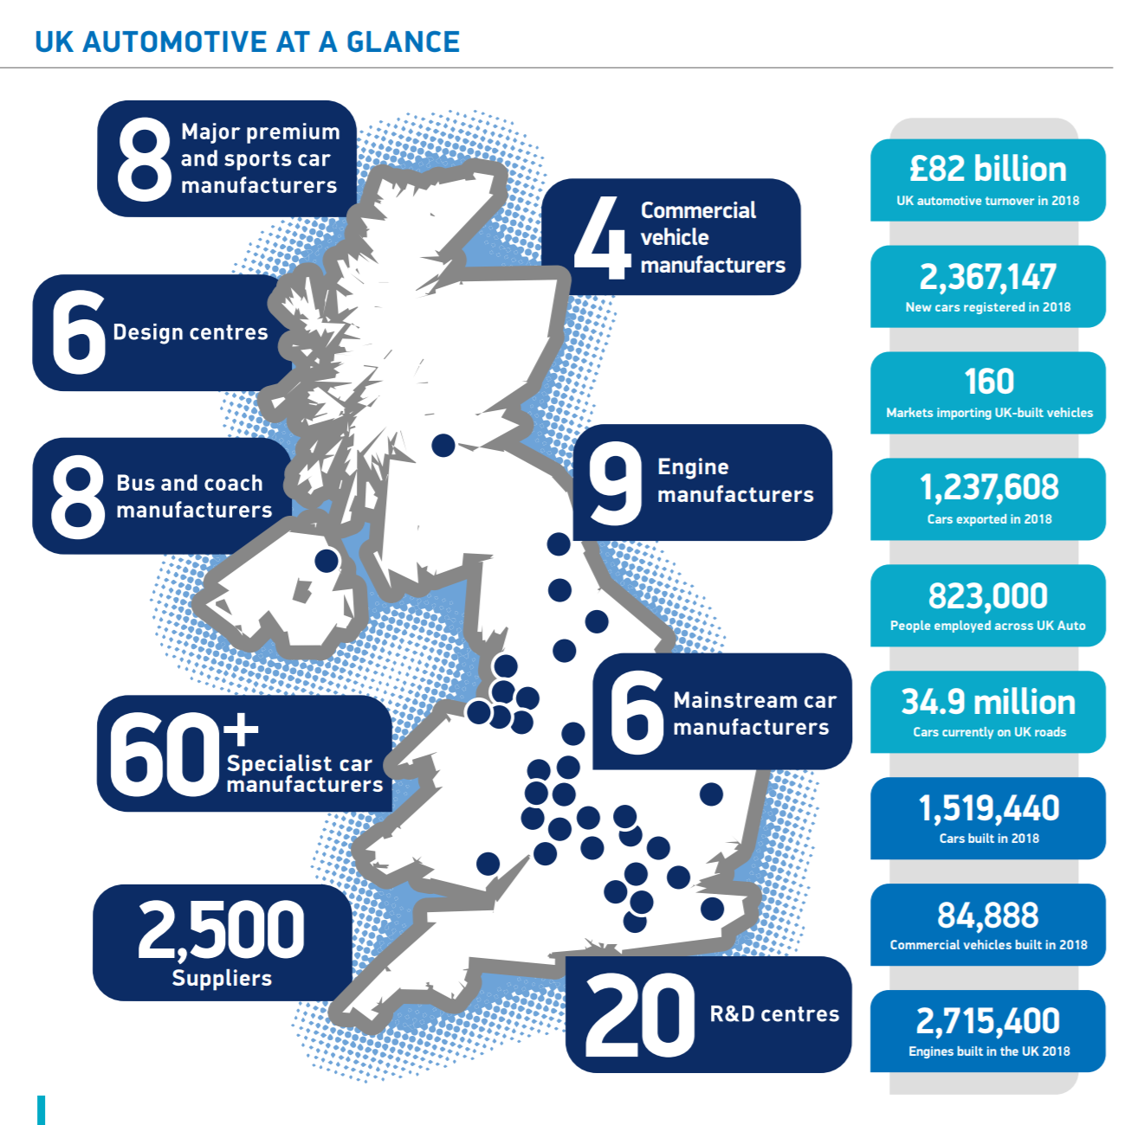
Introduction
Lean manufacture was first implemented at Toyota in 1988 by chief engineer Taiichi Ohno (Krafcik, 1988).
The UK produced 1,519,440 cars in 2018 from 60+ manufacturers (SMMT, 2019). All of these manufacturers use lean methods to different extents.
(SMMT, 2019)

Slide 5
Wastage occurring
7 Wastes in an organisation
Overproduction, storage of vehicles
Waiting, wasted time
Transport, cost and environmental impact
Inappropriate processing, overly complex tasks
Unnecessary inventory, holding stores pre-manufacture
Unnecessary motion, inefficient production lines
Defects, cost money and time to repair

Slide 6
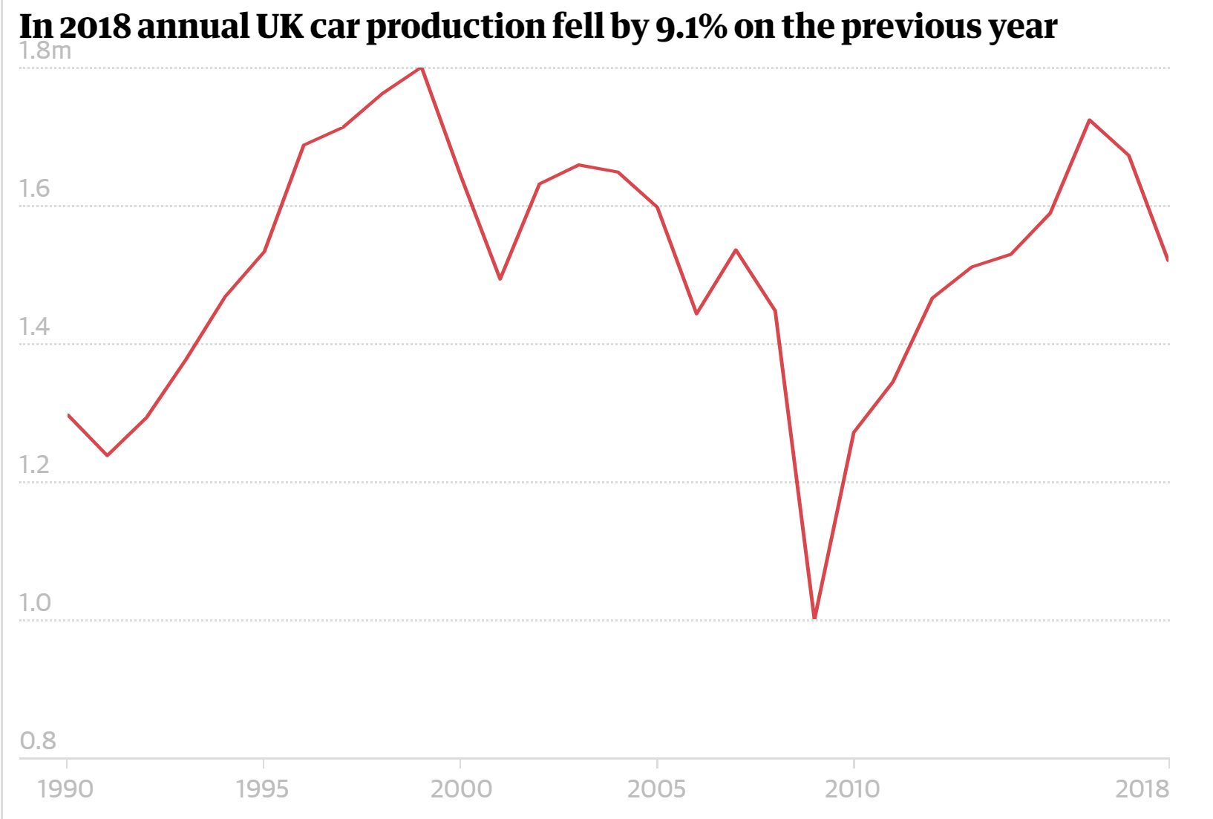
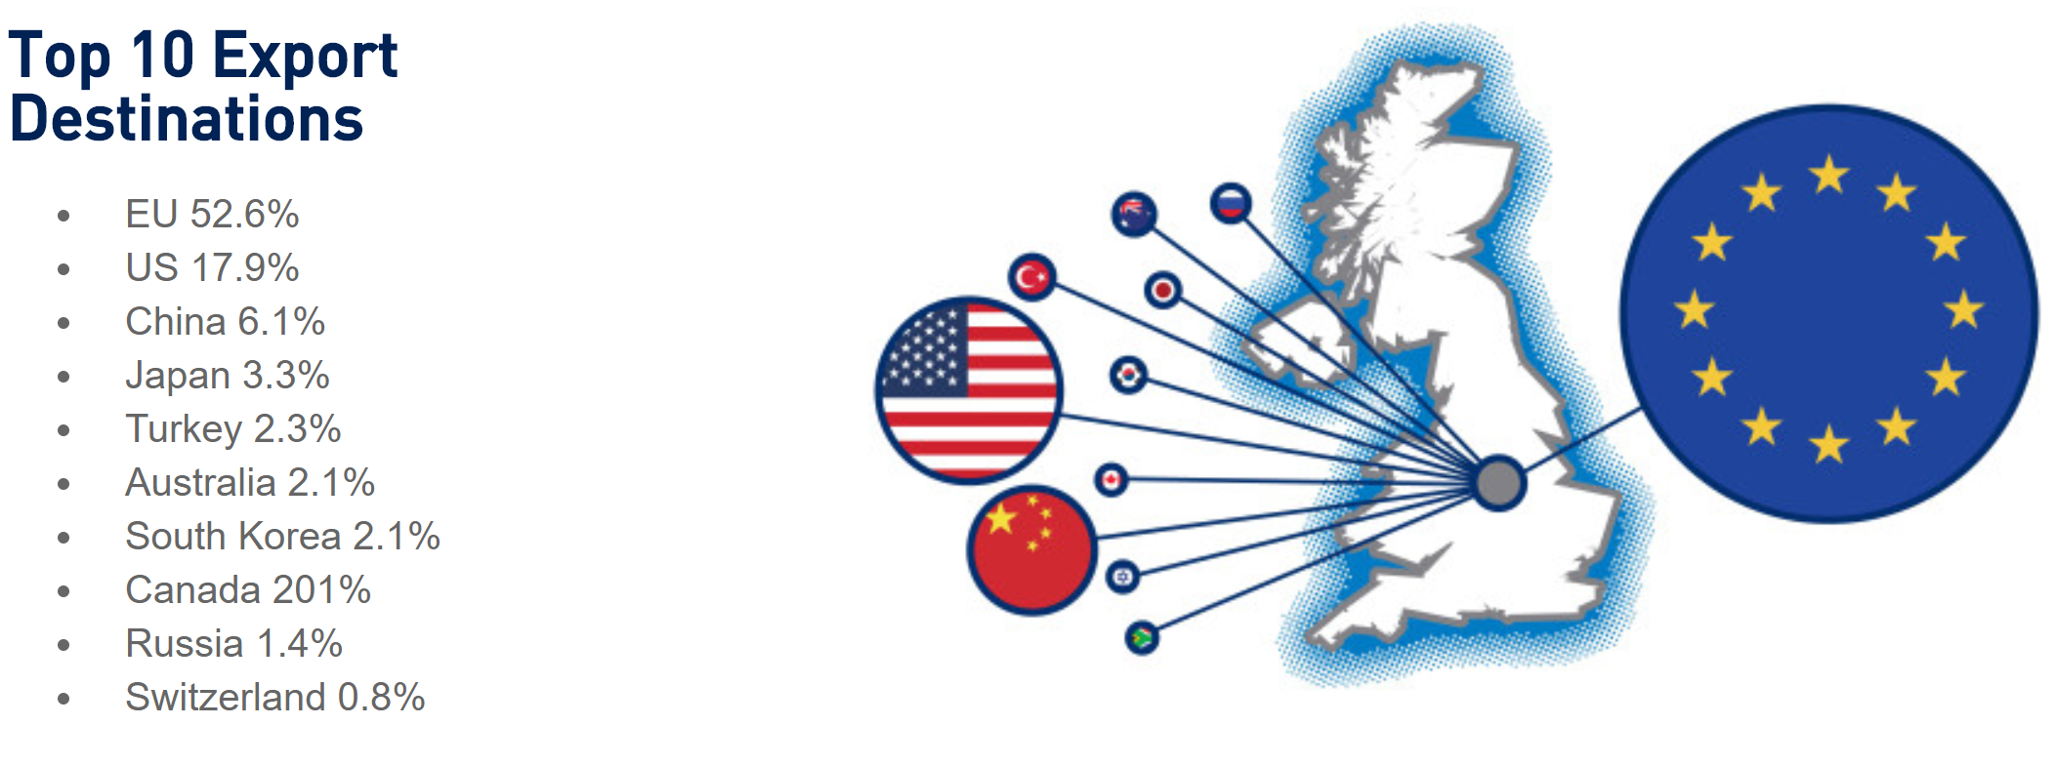
Overproduction
81.5% of cars exported (SMMT, 2019).
Brexit concerns, 52.6% of cars exported to EU
(SMMT, 2019)
(The Guardian, 2019)

Slide 7
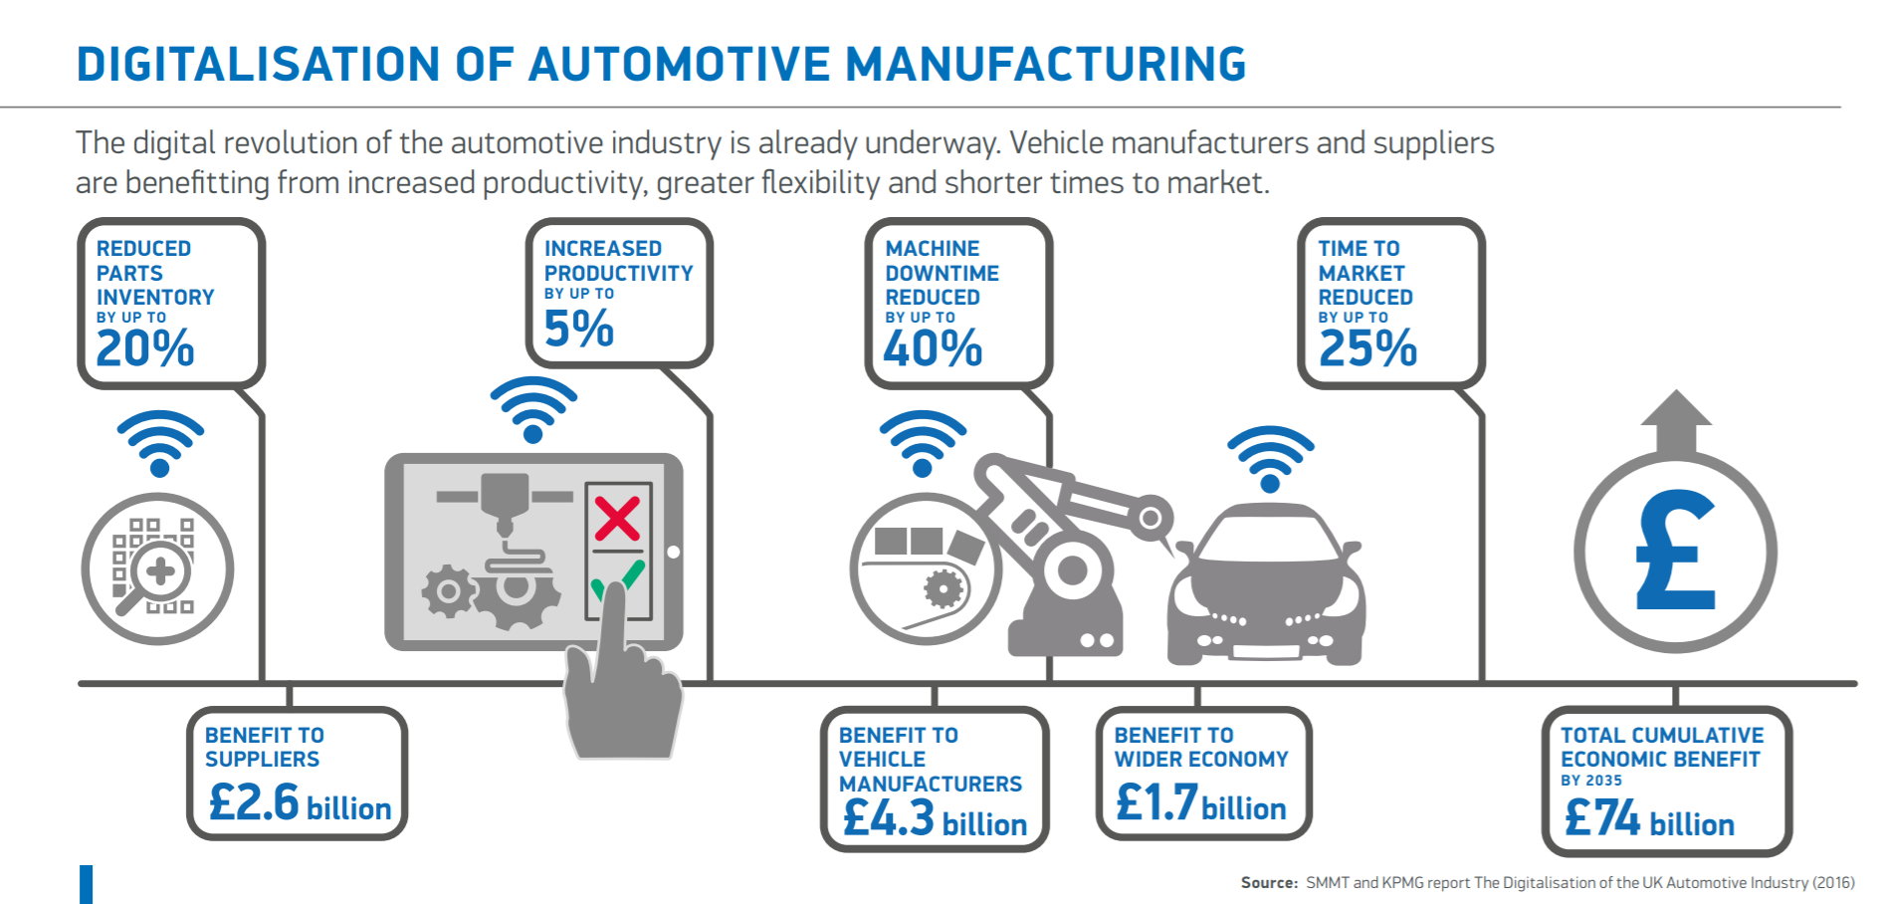
Waiting
(SMMT, 2019)

Slide 8
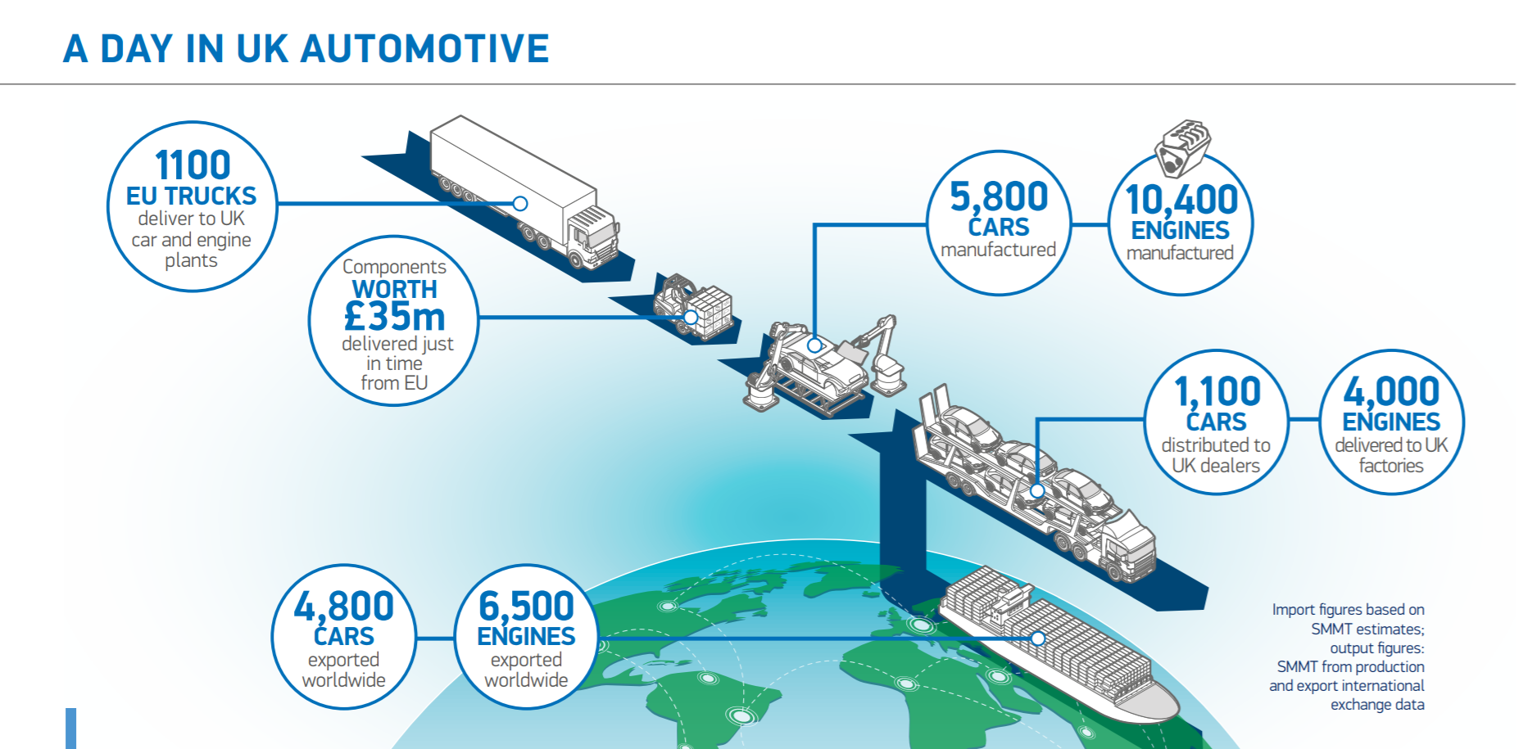
Transport
(SMMT, 2019)

Slide 9
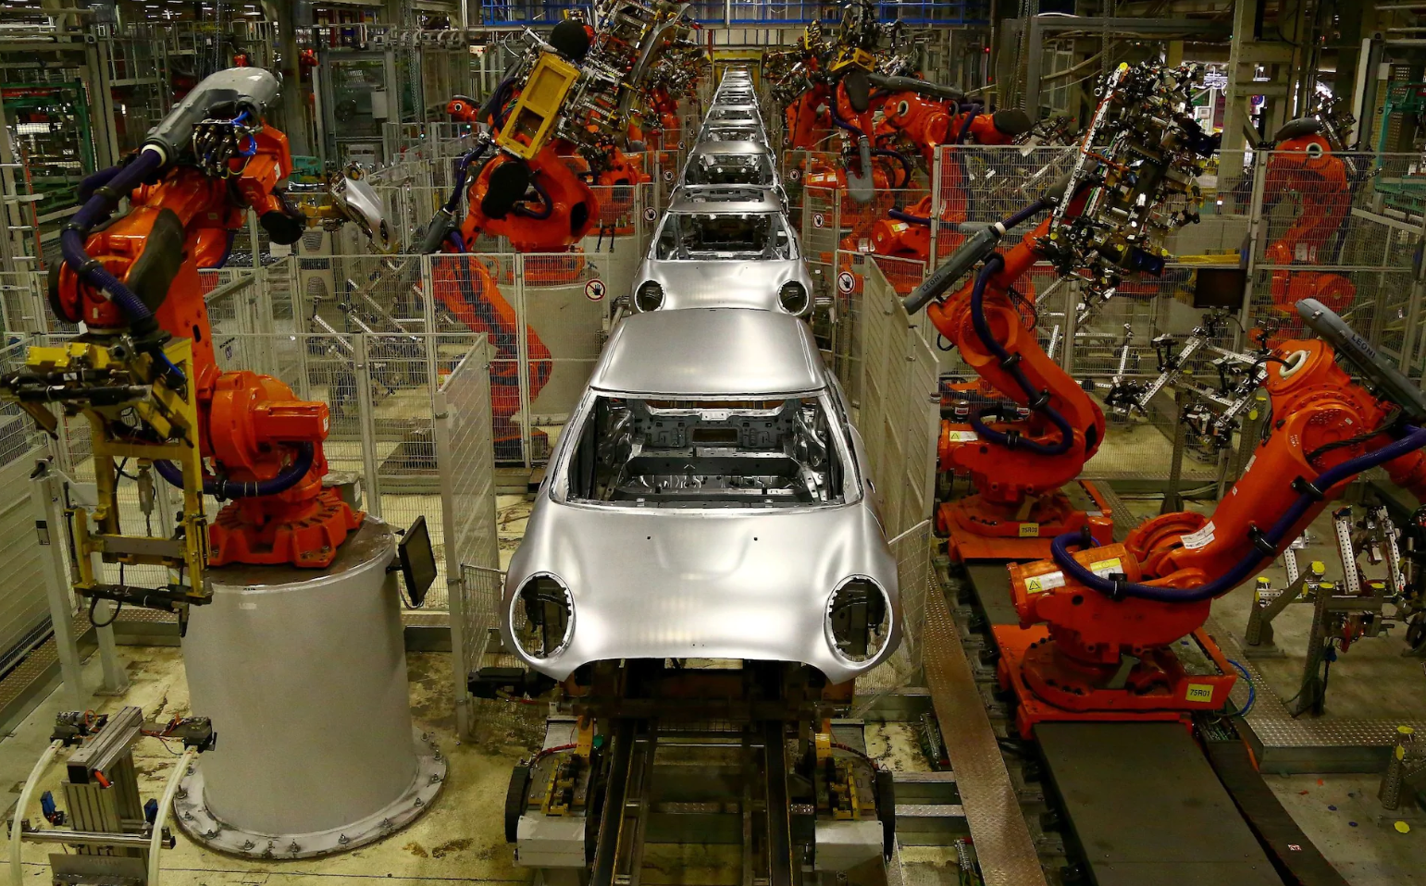
Inappropriate processing
UK factories are lagging behind German competitors using only a quarter of the level of automation relative to Germany (The Telegraph, 2018).
(The Telegraph, 2018)

Slide 10
Unnecessary inventory
Storing inventory is a cost that can be avoided.
Honda, Swindon, is a prime example of JIT. They retained just one hour’s worth of parts on the production line, and receive 350 trucks’ worth of components daily from Europe (Prospect Magazine, 2018).

Slide 11
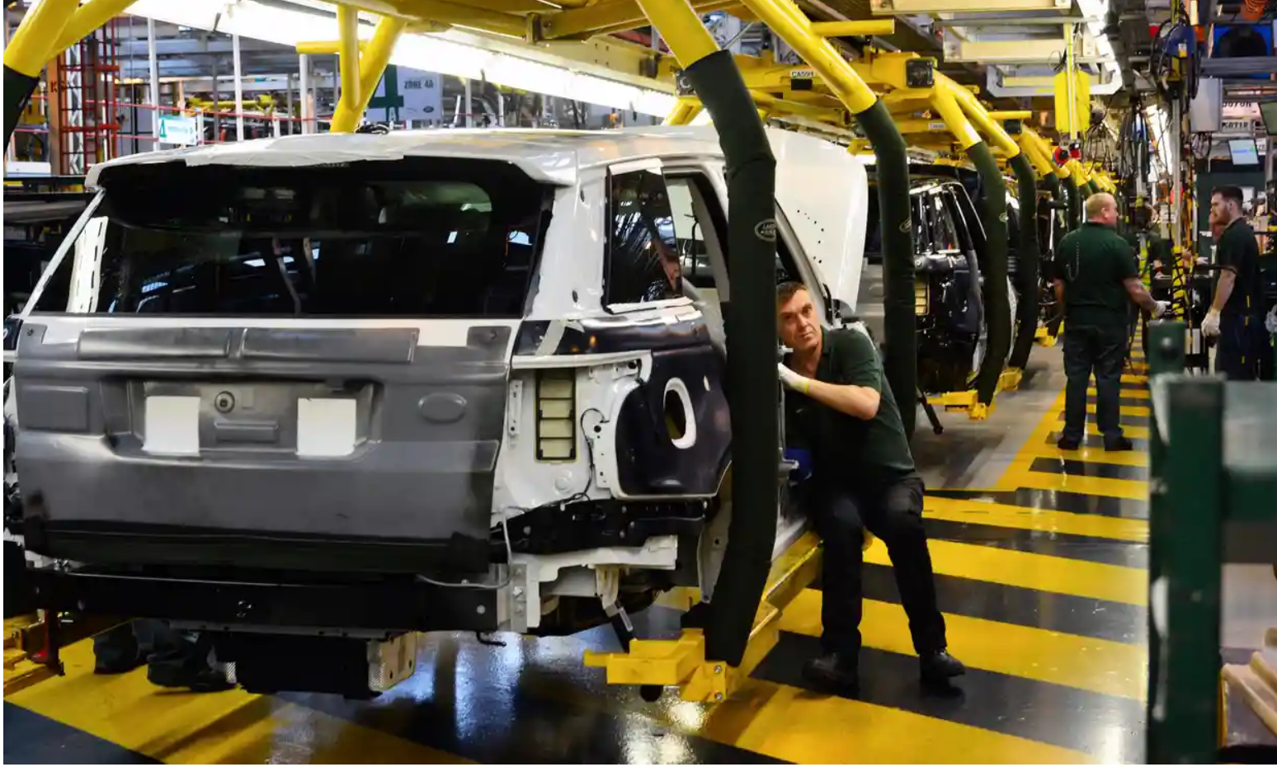
Unnecessary motion
Every 20 seconds a vehicle rolls off a UK production line (Government, 2013).
(The Guardian, 2019)

Slide 12
Defects
Recalls are on the rise within the UK. BMW group alone issued for the return of 36,000 vehicles in April 2017, then another 312,000 cars the following month (Campbell, 2018).
This is due to advanced technology and automated systems making production more complex.

Slide 13
Evaluation
Focused production, produce inline with customer demand
Efficient use of manpower
Forecasting transport is more efficient
Automation, reduces unnecessary labour
Minimal storage, JIT means suppliers hold stocks upstream
Streamlined production lines
Quality control at every stage

Slide 14
Conclusion
Lean manufacturing methods are even more critical now than ever before. With Brexit uncertainties and pressure to maintain profits alongside environmental and economic concerns, a lean manufacture system is crucial for efficiency.

Slide 15
References
Krafcik, J. F., 1988. Triumph of the Lean Production System.. Sloan Management Review, 30(1), pp. 44-52.
Hines, P. & Rich, N., 1997. The seven value stream mapping tools. International Journal of Operations & Production Management, 17(1), pp. 46-64.
SMMT, 2019. Key Exports Data. [Online]
Available at: https://www.smmt.co.uk/industry-topics/brexit/key-exports-data/
[Accessed 24 June 2019].
The Telegraph, 2018. Level of automation in the UK 'pretty rubbish', says Bank of England economist. [Online]
Available at: https://www.telegraph.co.uk/business/2018/10/09/level-automation-uk-pretty-rubbish-says-bank-england-economist/
[Accessed 24 June 2019].
Prospect Magazine, 2018. Could Brexit spell the end for “just-in-time” production?. [Online]
Available at: https://www.prospectmagazine.co.uk/economics-and-finance/could-brexit-spell-the-end-for-just-in-time-production
SMMT, 2019. SMMT Motor Industry Facts 2019. [Online]
Available at: https://www.smmt.co.uk/reports/smmt-motor-industry-facts-2019/
[Accessed 24 June 2019].
Campbell, P., 2018. Car recalls rise as industry becomes more high-tech. [Online]
Available at: https://www.ft.com/content/15e283a0-59eb-11e8-b8b2-d6ceb45fa9d0
[Accessed 24 June 2019].
Government, H., 2013. Motor Industry Facts 2013, Society of Motor Manufacturers and Traders. [Online]
Available at: https://assets.publishing.service.gov.uk/government/uploads/system/uploads/attachment_data/file/211901/13-975-driving-success-uk-automotive-strategy-for-growth-and-sustainability.pdf
[Accessed 24 June 2019].

