Slide 1
MODULE NAME: Problem Solving and Decision Making
MODULE CODE :LCLM4004
STUDENT NAME:Denisa-Alexandra-Sperlea
STUDENT ID :2439084
LECTURER:Thomas Adeyemi
Assignment 1: Presentation

Slide 2
OVERVIEW
Introduction
Company background
Problem: nature and scope
PESTLE ANALYSIS: Green Haven Florists
Cause and effect analysis: Fishbone diagram
Conclusion
References

Slide 3
Introduction
This presentation analysis the business challenges faced by green haven Florists and identifies the key causes,external influences and business implications using structured decision-making tools.

Slide 4
Company background
Green Haven Florists is a small,independent flower shop located in Norwich,Uk.The business was founded in 2016 by partners Liam and Prya Patel..the business’s identify is strongly linked to environmental responsibility,using locally sourced flowers where possible and biodegradable wrapping-an approach that appealed to environmentally conscious consumers

Slide 5
Problem: nature and scope
5W2H
Who: Liam and Priya Patel
What:Over the last year,the shop has experienced a 30% decline in in-store sales
Where:this was happened at their Norwich high-street
Why:the reason was include increased competition and shifts towards online buying behaviors
When: past 12 months

Slide 6
PESTLE ANALYSIS: Green Haven Florists
POLITICAL
Import regulations and post Brexit customs procedures affect the cost and availability of imported flowers
ECONOMIC
Rising inflation has increased wholesale flower prices and operating costs
SOCIAL
Consumers increasingly,fast delivery,and digital shopping experiences

Slide 7
PESTLE ANALYSIS:Green Haven Florists
Technological
Competitors use moderns websites,online ordering platforms,and social media marketing to attract customers
Environmental
Seasonal availability and climate impacts affect the reliability of fresh flower supply
Legal
Enivironmental and waste regulations require sustainable packing and responsible disposal

Slide 8
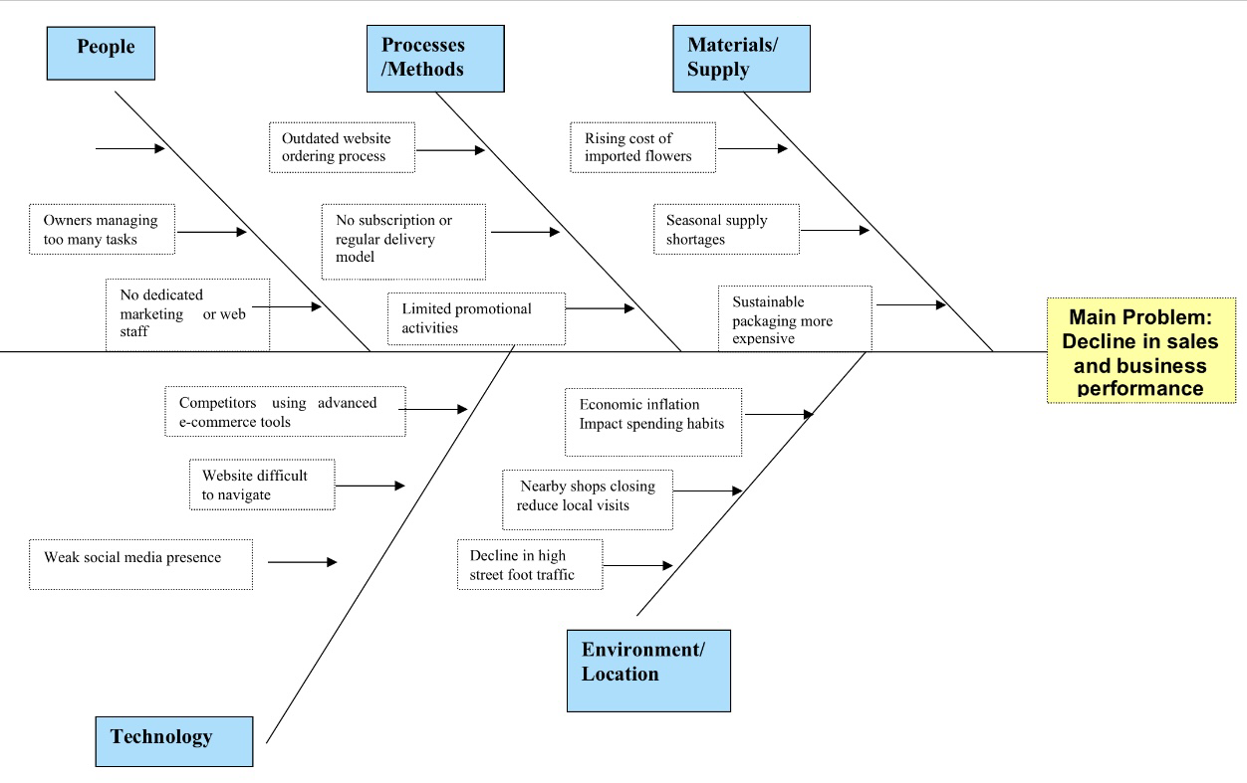
Cause and effect analysis: Fishbone diagram
The root causes include reduced walk-in customers due to high-street decline,lack of online competitiveness,increasing operating costs

Slide 9
Conclusion
However,declining foot traffic,rising supply costs,and increased competition are negatively impacting performance.

Slide 10
References
Calculator Ultra (2025) Find More Calculator Available at: Drop in Sales Calculator & Formula Online Calculator Ultra (Accessed: 6 October 2025).
5 sources
British Florist Association (2023)UK Floristry Market Report.Available at:https://www.britishfloristassociation.org(Accessed 9 November 2025)
Mintel (2023) Flowers and plant Gifting-UK –industry Analysis.Mintel Market Research.Available at:https://www.mintel.com (Accessed 9 November 2025)

Slide 11

Questions

