Slide 1
How school A uses theoretical approaches in its classrooms.

Slide 2
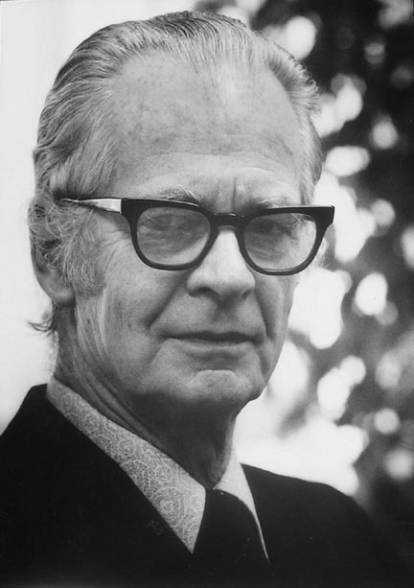
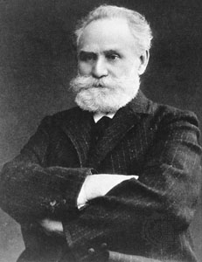
Theorists
B. F. Skinner his theory was operant conditioning “the idea that behaviour is determined by its consequences, be they reinforcements or punishments, which make it more or less likely that the behaviour will occur again.” psychologistanywhereanytime.com
Pavlov his theory was classical conditioning “is learning through association and was discovered by Pavlov, a Russian physiologist. In simple terms two stimuli are linked together to produce a new learned response in a person or animal.” simplypsychology.org/classical-conditioning.html
https://www.youtube.com/watch?v=NmZpabCYzhE
https://www.youtube.com/watch?v=qSqWiTG-o2Y

Slide 3
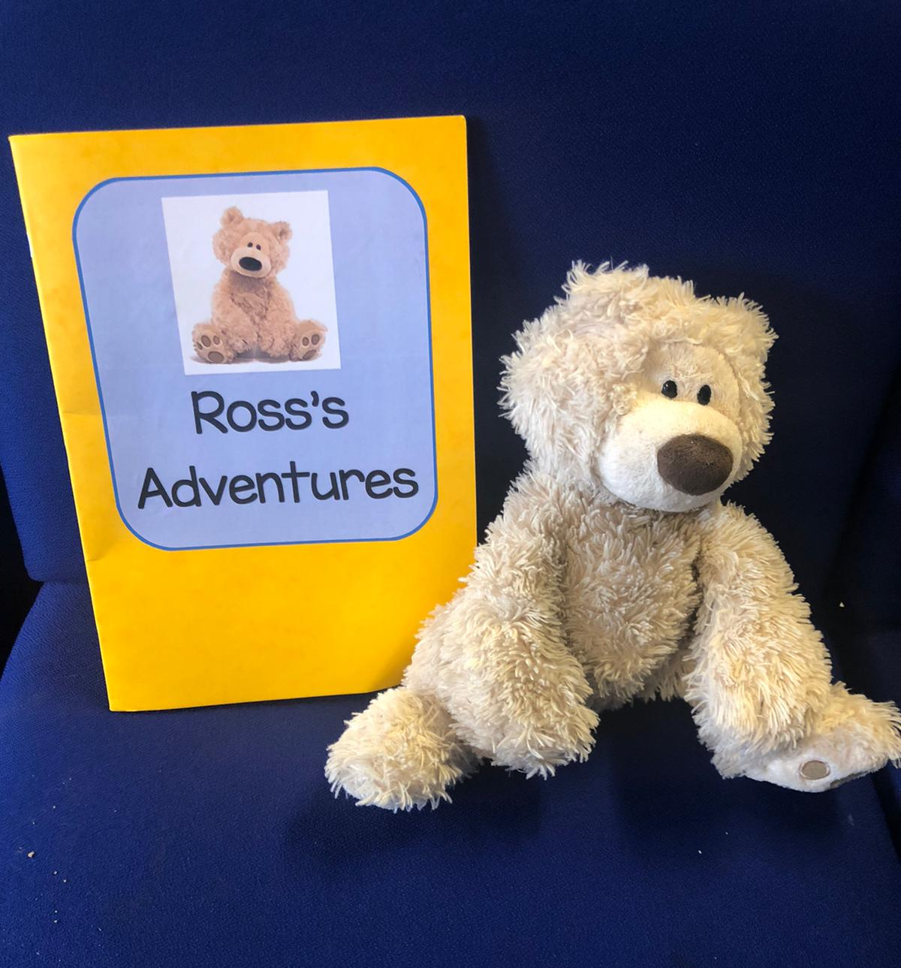
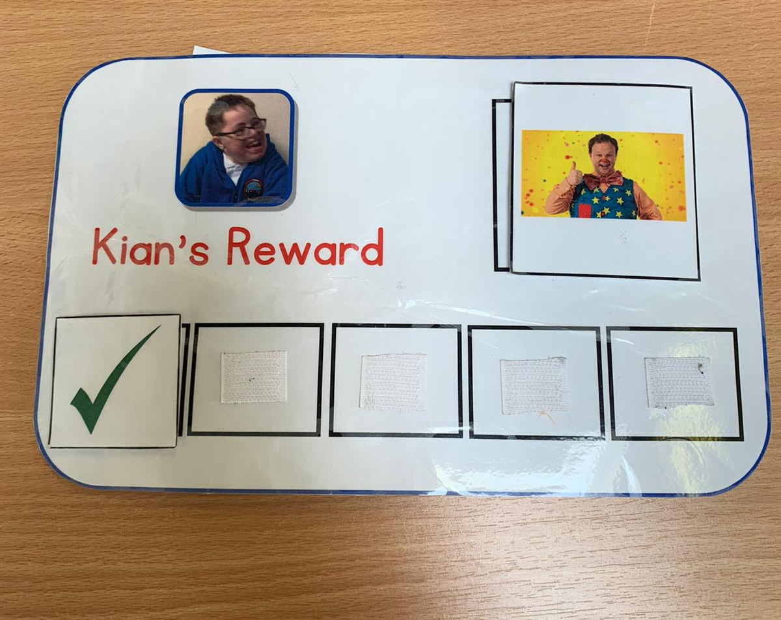
Ross
Ross is a mascot for class B in school A. At the end of every week there is an assembly where a child from each class receives a star of the week certificate, the child that wins the certificate from class B then gets to take ross home for the weekend.
Personal Reward chart
In school A we use these to motivate the children to complete a task and once the task is completed they get 5 minutes of what they’ve chosen as a reward. For example to introduce these we would give the child a tick just for sitting for a short period or engaging a small bit. Eventually you would extend the periods of time between rewards.
Name

Slide 4
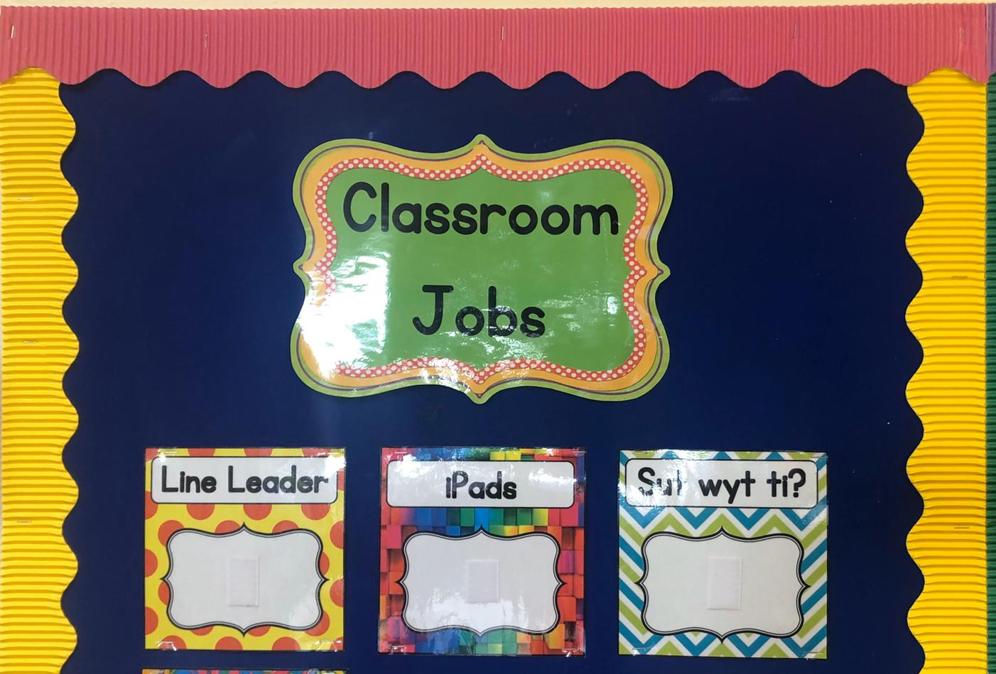
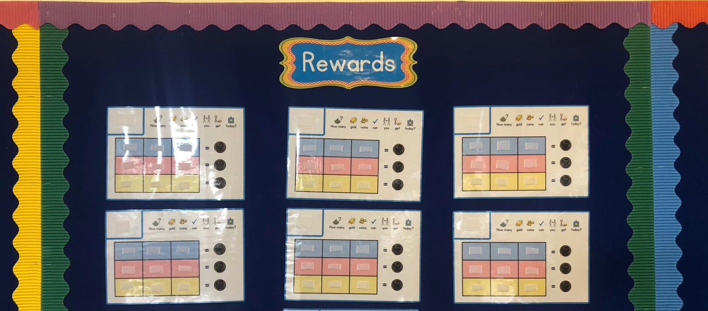
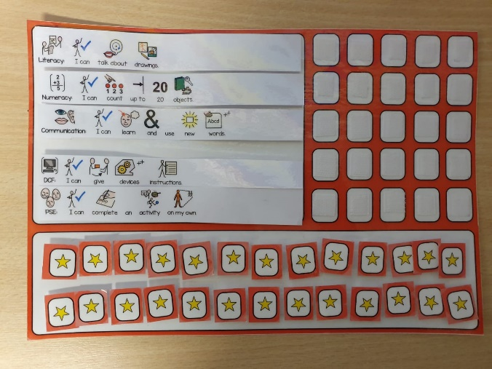
IEP Targets
These are our target boards, everyone different for each child, once a child have complteted a target they get a star and they must do it on 5 different occasions before being able to say its completed.
Reward chart
We have reward charts for the children and throughout the day the children are given smiley faces. At the end of the day the smiley faces are counted and for every 3 smiley faces they get a gold coin.
Class jobs
In class B there are class room jobs which are rotated weekly for the children to have independence and learn to take turns.

Slide 5
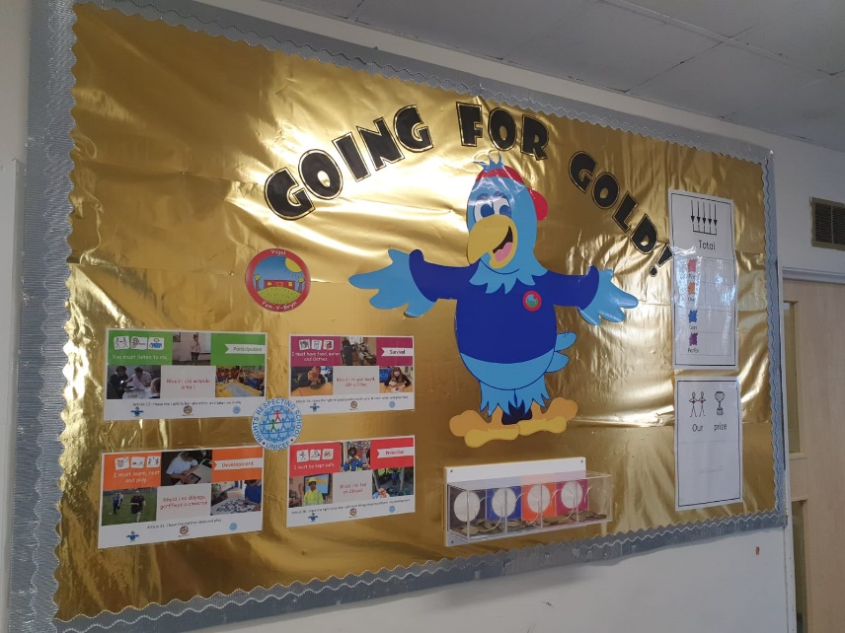
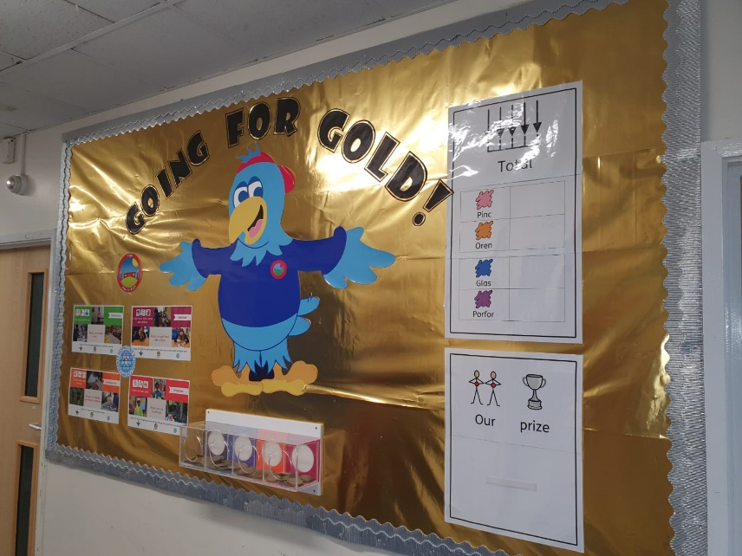
Gold Coins
In school A we have a gold coin system. Gold coins are given out to the children for being good or doing something good. The children are given a colour that will travel through school with them they then post the gold coin into that colour tube and at the end of every term the coins are counted and the colour that wind gets an exiting treat, from discos to film afternoons.

Slide 6
Conclusion
As I have shown in the previous pages the approaches we use in school A are all connected to the theories of Pavlov and Skinner. Each approach is used to eventually get the desired behaviour from the children weather it be using a reward chart which is similar to Pavlovs dogs “Pavlov formulated a theory about the relationship between stimuli and
responses that he believed could be applied to humans as well as to other animals. He called the dogs' salivation in response to the actual taste and smell of meat” Gormezano, I., Prosy, W.F., & Thompson, R.F. (1987). Eventually the child with reward chart will do the desired tasks without needing the ticks or only seeing the reward chart will trigger the child rather than wait to be rewarded. Skinner was slightly different to Pavlov though Skinner was influenced by Pavlovs work. Skinner decided to take a different approach “He believed that the best way to study behavior was to look at the cause of an action and its consequences”. (McLeod, 2007) This is where the reward chart comes into it if the child does good things then they have a smiley face/faces if the child misbehaves they lose a smiley face and at the end of the day they get to see if they have had a good or bad day and also seeing their class mates getting what they would like will push them to work harder. In conclusion I feel that school A is working very well using the approaches that they do as they are very similar to two famous theorists who’s theories have been proven to work.

Slide 7
References
Gormezano, I., Prosy, W.F., & Thompson, R.F. (1987).Classical Conditioning. New Jersey: Lawrence Erlbaum Associates.
https://www.youtube.com/watch?v=qSqWiTG-o2Y
https://www.youtube.com/watch?v=NmZpabCYzhE
McLeod, S. A. (2007). Skinner - Operant Conditioning. Retrieved from http://www.simplypsychology.org/operant-conditioning.html
McLeod, S. A. (2018, Jan, 21). Skinner - operant conditioning. Simply Psychology. https://www.simplypsychology.org/operant-conditioning.html
Pavlov, I. (1927). Conditioned reflexes. Oxford University Press Oxford England.
www.psychologistanywhereanytime.com/famous_psychologist_and_psychologists/psychologist_famous_b_f_skinner.html

