Slide 1

LECTURE 3
THE CREATIVE BRIEF

Slide 2
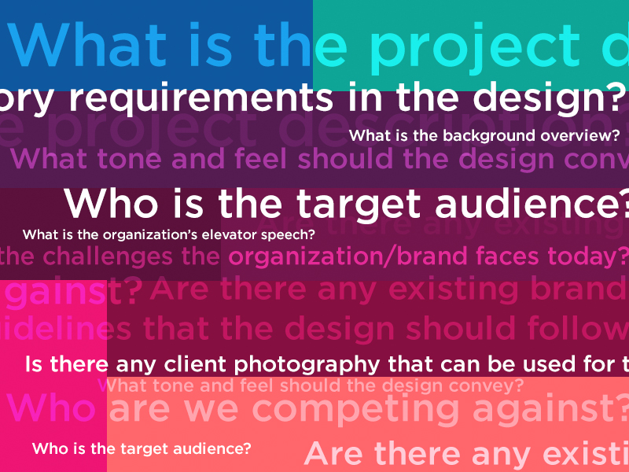
THE CREATIVE BRIEF

Slide 3
ASSESSMENT 1
This assessment will require you to produce a strategy for a fictional business. You are able to make up any aspect of the business, such as audience, ambitions and values. You are the Brand Manager for a new ‘subscription cooking box’ company who will be launching at the end of the year. You have been asked to create an effective 30 second television / online advertisement and have commissioned a creative agency to help.
To ensure the agency produces the most effective advert you have been asked to present your brief to them. This brief should include:
  A comprehensive description of the product
  Key product benefits
  The target audience and what is important to them
  Market place positioning and main competitors
  The objective of the TV advert
  Key messages and tone of voice
  Anything else which may be of use to the agency
The assessment will be in the form of a pre-recorded presentation of no longer than 15 minutes. You will need to submit your video and references in the template provided to Turnitin. Please check your link to ensure it works before submission.

Slide 4
WHAT IS A CREATIVE BRIEF?
A document/verbal request sent to a creative, designer or an agency
This document outlines what you need to create and when you need to create it by
It gives information to help the creative produce something suitable
It contains mandatory requirements but does not lead

Slide 5
DEFINITION
“The creative brief provides the creative department with the appropriate guidance to the development of the creative materials in a succinct and easily comprehensible form”
Tony Yeshin

Slide 6
ROLE OF THE CREATIVE BRIEF
The creative brief is the basis of all advertising development
It summarises the major findings of research and other inputs on which the advertising will eventually be based

Slide 7
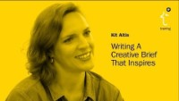

Slide 8


Slide 9
THE ROLE OF THE CREATIVE BRIEF
Most advertising agencies use a very precise format for the purpose of briefing creative work
Topic headings in the brief may differ from agency to agency
The fundamental aspects are the same in all cases

Slide 10
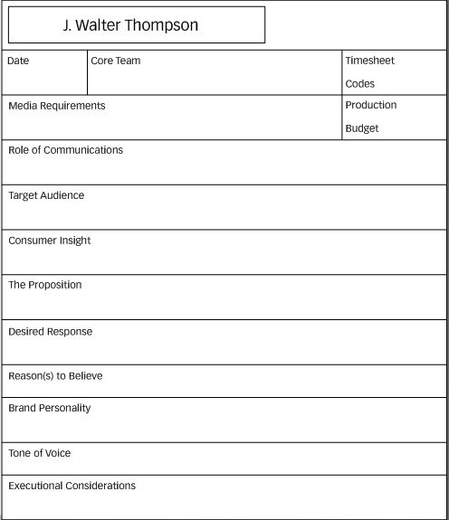
EXAMPLE CREATIVE BRIEF TEMPLATE (Yeshin)

Slide 11

THE CREATIVE BRIEF SHOULD BE 1-2 PAGES LONG

Slide 12
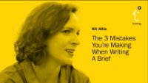

Slide 13
ELEMENTS OF A CREATIVE BRIEF
Campaign objective/background
Deliverables ( including specs, due date)
Target audience
Product info
Key benefits
Competition
Challenges
Market Position
Mandatory inclusion

Slide 14
THE CREATIVE BRIEF ADDRESSES A NUMBER OF AREAS:
1. The Role of Communication
  The context in which the advertising campaign is being developed
    Current brand situation
    Competitive environment
    Summary of the main reason for doing the advertising
    Main task the campaign will be required to perform
    E.g. May build on a previous campaign or be new campaign to support a product launch

Slide 15
CREATIVE BRIEF ELEMENTS
2. The Target Audience
    Demographic data
    PLUS - attitudinal and lifestyle factors
    The creative team can adapt the tone and style of the message to appeal to the target audience
    Language, imagery and values can be adapted to meet the audience needs
    The media department can also select the most appropriate cost effective media to reach the target audience

Slide 16
CREATIVE BRIEF ELEMENTS
2. The Target Audience – what to include
Demographics - Simple demographic information gives your team insight into exactly who the audience is. This includes data points like age, income, education, ethnicity, and occupation
Behaviours - Buying behaviours, trends, and other customer history make up the target audience behaviours. These provide important context to the creative brief because they explain where the customer is in their buyer journey.
Psychographics - This is how the audience thinks and feels about your brand and the product or service you sell, in general.
Geographics - Digital, physical, and hybrid campaigns will benefit from having geographics stated explicitly in the creative brief so that media buyers can price ad slots in each market.

Slide 17
CREATIVE BRIEF ELEMENTS
3. Consumer Insight
  Specific aspects that will differentiate the brand from competitors
  Based on detailed understanding of consumer needs and wants
  This could be related to a specific aspect of the brand or an emotional need satisfied by the product/concept

Slide 18
CREATIVE BRIEF ELEMENTS
4. The Proposition
  The specific message we want to convey
  The element that sets our brand/concept apart
  Main distinguishing feature physical or emotional that will set us apart
  Based on research into consumer perceptions of the brand’s characteristics or key concept features

Slide 19
CREATIVE BRIEF ELEMENTS
4. The Proposition – the message
The key message can be the most difficult to develop
Ask yourself – so what? Why should the target audience stop what they are doing and pay attention to your advert?
Could include a ‘pain point’ and what the audience’s experience would be without the pain point – e.g. the benefit they will receive as a result of your company’s solution.
This framework places the customer in the spotlight of the campaign rather than just telling them about your product / service

Slide 20
CREATIVE BRIEF ELEMENTS
5. Desired Response
  What we want the consumer to do or feel as a result of seeing the advert
  Could be an action or an emotional response

Slide 21
CREATIVE BRIEF ELEMENTS
6. Reason to Believe
  What information will be required to ensure the consumer believes the proposition?
  Specific evidence
  Physical or emotional characteristics of the brand

Slide 22
CREATIVE BRIEF ELEMENTS
7. Tone of Voice
  What approach will the advert take?
  Authoritative, light-hearted, amusing, stylish, approachable, serious etc...

Slide 23
CREATIVE BRIEF ELEMENTS
8. Execution Considerations
  Reflect a previous advert or take a new direction
  Elements that must be included
  Should the Logo or parent company be used in the advert?
  Any other requirements

Slide 24

WHEN MIGHT YOU USE ONE?
TV / Digital Media ad script/production
Email
Posters
Radio
Website design
Create a brand
Changes to brand assets

Slide 25
WHAT MAKES A BAD CREATIVE BRIEF?
Not enough information
Not the right information
Too leading
Too long
Unfocused
Not engaging enough
Too much jargon

Slide 26
WHAT DOES A GOOD CREATIVE BRIEF DO?
I really know the product well
I know the most important benefits to communicate
I know who the competitors are
I feel like I can visualize the target audience
I know exactly what I need to include
I know exactly what I need to deliver and when I need to do so by

Slide 27
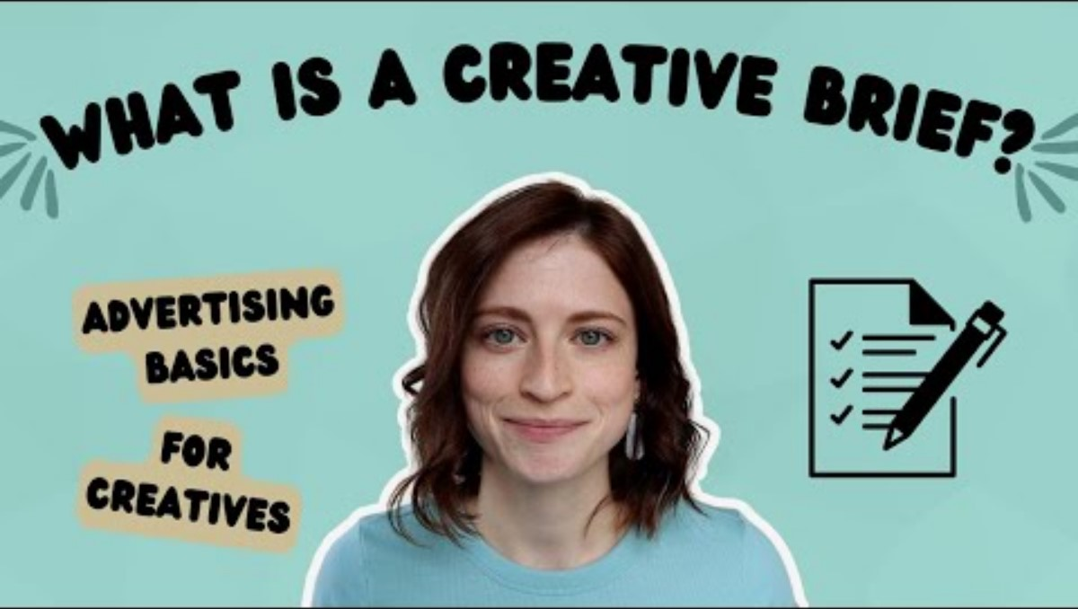

Slide 29


EXAMPLE ADVERTISING BRIEFS https://www.youtube.com/watch?v=XJTuC5LuMf0

Slide 30
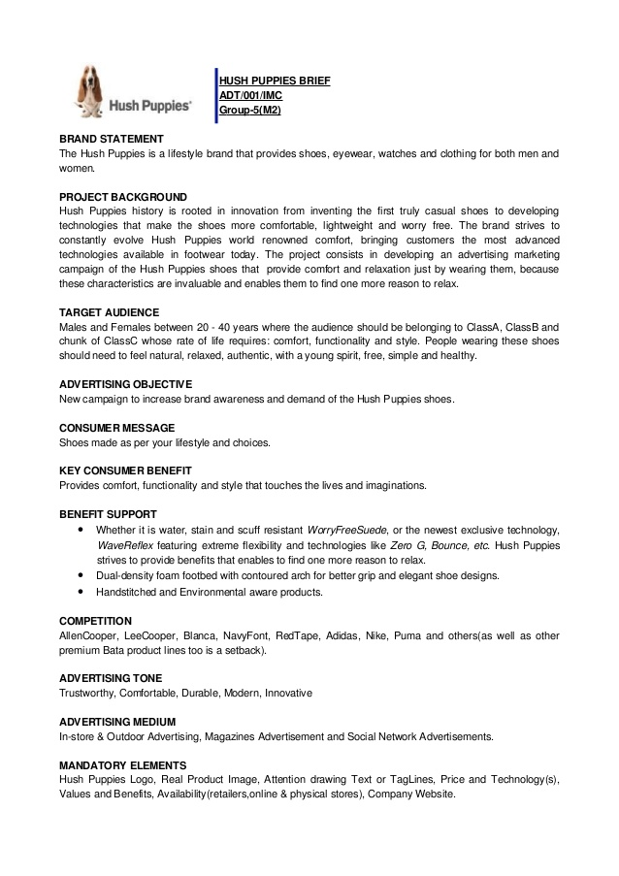

Slide 31
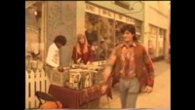

Slide 32
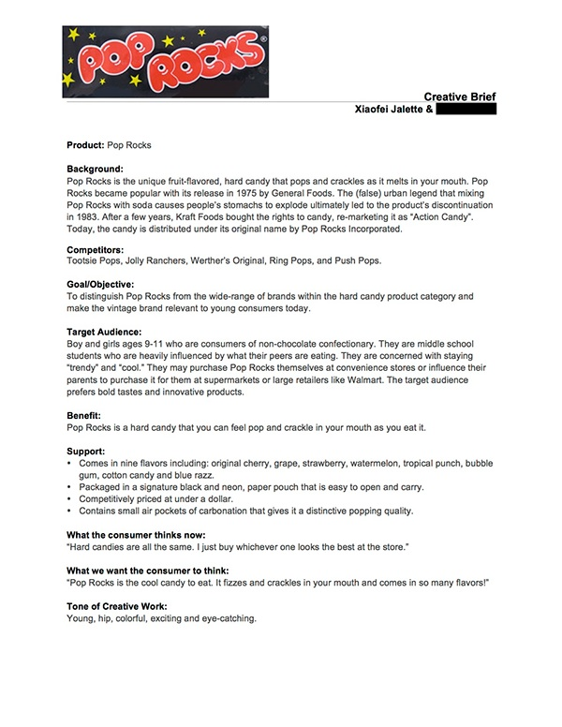

Slide 33
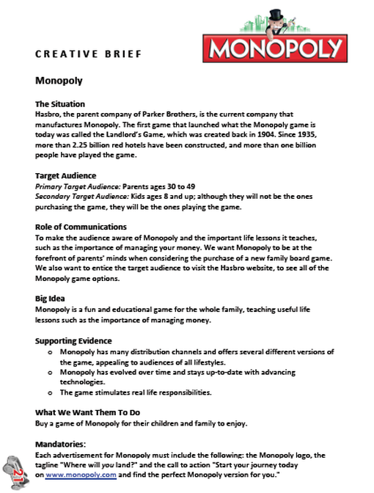

Slide 34
Class exercise – TV ads
Lets chose some TV ads
I would like us as a class critically evaluate them
Breaking ads (thinkbox.tv)

Slide 35
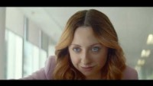

Slide 36
McDonalds ‘Raise Your Arches’ Advert
Ad Agency Leo Burnett
Ad campaign breaks in January 2023
Media – TV, Digital, Instore, Social - Snapchat & Instagram
Directed by Edgar Wright
Unusual move to not show any McDonalds restaurants or food
Built around the idea that an invite to grab a Maccie D’s is so universal it can be communicated with a mere eyebrow wiggle.
Michelle Graham-Clare, the chief marketing officer for McDonald’s UK & Ireland, said: “In a challenging time, our ’Raise Your Arches’ invitation to McDonald’s provides the nation with a small but much-needed moment to let go and feel good. We hope the campaign raises arches and smiles across the country and I can’t wait to see everyone get involved.”

Slide 37
McDonalds ‘Raise Your Arches’ Advert
On social media, it has created special Snapchat and Instagram lenses that will raise the user’s arches, with the hope that people will use it to invite their friends to get a McDonald’s.
Digital takeovers of McDonald’s Golden Arches sky signs at two restaurants will see the ‘M’ cropped and animated, replicating the eyebrow raise shown in the film.
The activity will be underpinned by a generous digital sales promotion, designed by TMS, to drive app downloads and deliver a fortnight of offers and rewards to customers from ’Blue Monday’ (January 16) onwards.
Over the next 12 months, the campaign will be amplified internationally, with almost 40 markets across the world joining the movement.

Slide 38
McDonalds ‘Raise Your Arches’ Advert
Chaka Sobhani, chief creative officer at Leo Burnett UK and Global, added: ”An invitation to McDonald’s is an opportunity to put our responsibilities aside and enjoy a little lift and we hope ’Raise Your Arches’ does exactly that, allowing everyone to momentarily let go of life’s pressures and enjoying a Maccers.
”We were beyond excited to work with the brilliant Edgar Wright to bring this idea to life – from the visual look and feel he creates to what he does with music and choreography, he’s got that knack of making work that grabs your attention for all the right reasons. We’re always looking at ways to raise a smile and create big populist entertainment for Maccers and, in the hands of Edgar, we hope we’ve created something that does both.”

Slide 39
McDonalds ‘Raise Your Arches’ Advert
Chaka Sobhani, chief creative officer at Leo Burnett UK and Global, added: ”An invitation to McDonald’s is an opportunity to put our responsibilities aside and enjoy a little lift and we hope ’Raise Your Arches’ does exactly that, allowing everyone to momentarily let go of life’s pressures and enjoying a Maccers.
”We were beyond excited to work with the brilliant Edgar Wright to bring this idea to life – from the visual look and feel he creates to what he does with music and choreography, he’s got that knack of making work that grabs your attention for all the right reasons. We’re always looking at ways to raise a smile and create big populist entertainment for Maccers and, in the hands of Edgar, we hope we’ve created something that does both.”
https://www.thedrum.com/news/2023/01/19/leo-burnett-reveals-how-it-raised-eyebrows-with-subtly-branded-mcdonald-s-ad

Slide 40

Class task

Slide 41
CLASS EXERCISE
Working in groups you will each will be given a creative brief.
Following the brief, each group should design a poster - think about a headline, Ad copy and picture.
You must NOT make up any facts about the ‘product’, but can create offers and any key messages.
You will have 20 minutes

Slide 42
BRIEF ONE
Design a poster for a new festival called Barafest. The festival will take place in Pembrokeshire in August 2024. There will be music, food stalls and talks.
Tickets will cost £200 for the weekend.
This is the first time the festival has run and it’s hoping to draw a large audience.
The festival was created by Karen Baldwin who loves the colour purple. She would like a 5 word headline, and a look that feels ‘edgy’

Slide 43
BRIEF 2
Design a poster for a new festival called Barafest. The festival will take place in Pembrokeshire on Saturday 17th & Sunday 18th August 2024. It will held on Barthundle beach and costs £200
The festival aims to be a haven for families. It offers a safe and creative environment for under 16s as well as a great event for parent’s to let their hair down. There will be music from 90s indie bands, and comedy from award winning standups. There will be boutique food stands, including vegan, world cuisine and award winning chefs. Unlike any other festival Barafest offers child minding services.
The festival’s audience are affluent families, adults tend to be 30-40 with kids 10 and under. Their favorite bands were from their youth, where they enjoyed Britpop and Indie music ( Oasis, Blur, Suede).
The vast majority of customers will not travel more than 200 miles for a festival. Cost is not important to them, they would expect to pay £200.

Slide 44
So which poster is best? The better the brief the better the output!

Slide 45
But it’s not just a creative brief. We USE briefs for OTHER REASONS
Campaign briefs
Recruitment brief
Project brief

Slide 46

Any Questions?

Slide 47
Resources
How to Write a Creative Brief: A Brief History + 5 Examples (profiletree.com)
How to Write a Creative Brief in 11 Simple Steps [Examples + Template] (hubspot.com)

