Slide 1
Graduate Project
Linking Theory and Practice

Slide 2
the opportunity to develop and realise A Major Project idea- developing innovative, creative and communicative skills
•Research at the forefront of the discipline.
•Ongoing and adaptive use of comprehensive project planning.
•Evidence of creative professional and creative skills.
•Design, realisation and defence of the artefact.

Slide 3
Learning Outcomes
•Produce an artefact that reflects contemporary thinking and practice within the film and TV industry.
•Prepare and present a critical reflection and rigorous justification of their final artefact.

Slide 4
Linking Theory and Practice

Slide 5
Graduate Project
Demonstrate you understand and are engaged in the field of study:
Use examples from the contemporary media industry linked to your project;
Explain why this field interests you and how it links to your PDP;
If possible include a quote that validates your industry’s current state and how you are working within its parameters;

Slide 6
Defending your artefact
What have you done;
Why have you done it;
How does it fit your chosen industry;
How does it contribute to your PDP;
How has your industry research informed its development;
How has your project development influenced its creation:
What’s next?

Slide 7
Why does your project matter?

Slide 8
AREAS OF FOCUS
The research and development of the project must be evidenced to demonstrate critical, academic, and industry engagement.
Critical
Academic
Industry Engagement
Reflection on your own goals aligned to practice and industry;
PDP;
​Conceptualise;
Apply;
Analyze;
Evaluate;
Research;
Backed up with theory from recognized authority;
Reflection;
Learning journey;
Definition:
  not of practical relevance; of only theoretical interest.
  "the debate has been largely academic“
relating to education and scholarship. "academic achievement"
Observing industry practice;
Speaking to experts and practitioners;
Outcomes aligned to industry expectations;

Slide 9
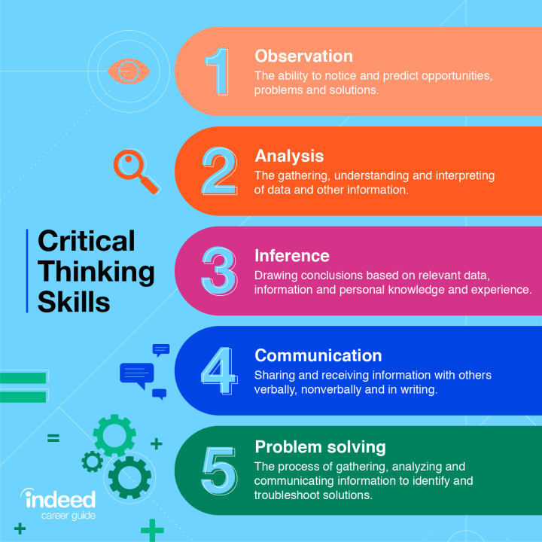
HOW WE GET THERE
NICHE MARKETS
Pursue scalable customer service through sustainable strategies​
Engage top-line web services with cutting-edge deliverables​​​

Slide 10

Academic
Ensure you demonstrate engagement with literature and scholarly activity. Cite and reference, articulate, and assimilate/synthesize.
Berger, J., 2008. Ways of seeing, London: Penguin Books.

Slide 11

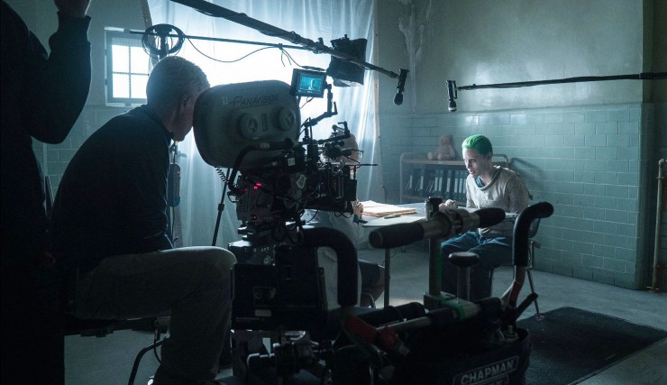
Industry Engagement
Demonstrate how your work relates to industry and how you know this. Evidence in research, methodology, and publishing.
Who have you spoken to; what are your sources; why have you chosen this approach?

Slide 12
Prepare for presentation by the 28th March 2023
A dry run of the process so far.

