Slide 1
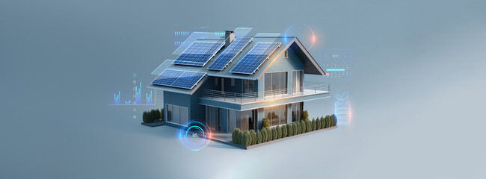

University of Wales Trinity Saint David
Emerging Trends (ACCB6019)
Dr Vijeyananthan Thayananthan
Hackathon 2026
Svetoslav Ivanov – 2322727 Date: 16.03.2026

Slide 2
TITLE
SMART ENERGY OPTIMISATION FOR THE ELDERLY USING DIGITAL HEALTH

Slide 3

TEAM MEMBERS
HAFSA
NICOLA
SAIDI
SIMRET
SVET

Slide 4
PROPOSAL
This proposal describes a digital health hackathon called Smart Energy Optimisation for vulnerable individuals.
We are looking at the elderly for this proposal. The goal is to create easy-to-use digital solutions that works across multiple platforms that help vulnerable people manage household energy safely and efficiently.
Through collaborative, multidisciplinary teamwork, participants will design and build prototype tools that track energy use and indoor conditions.
Expected results include better wellbeing, lower energy waste, and increased awareness of ethical and secure digital health design.
Overall, the hackathon encourages innovative, socially responsible technology to tackle health and energy challenges.
Objectives are:
Innovation.
Energy efficiency,
Well-being,
Cybersecurity and Ethics
Professional Development.

Slide 5
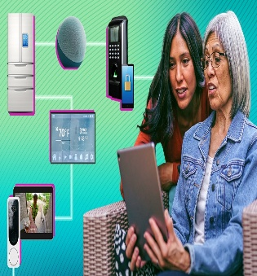
INNOVATION
This project designs and prototypes a simple digital solution to help elderly people monitor and manage their household energy safely and efficiently [1].
The solution is an easy-to-use mobile app with large text, clear buttons, and simple language.
It shows daily energy use, home temperature, and estimated costs in a clear way.
The app gives gentle, safe energy-saving tips and alerts if the home becomes too cold or unsafe.
It also includes budget support and access to help services.
Overall, the design helps elderly users feel safe, supported, and confident using energy at home [2].
SVETOSLAV

Slide 6
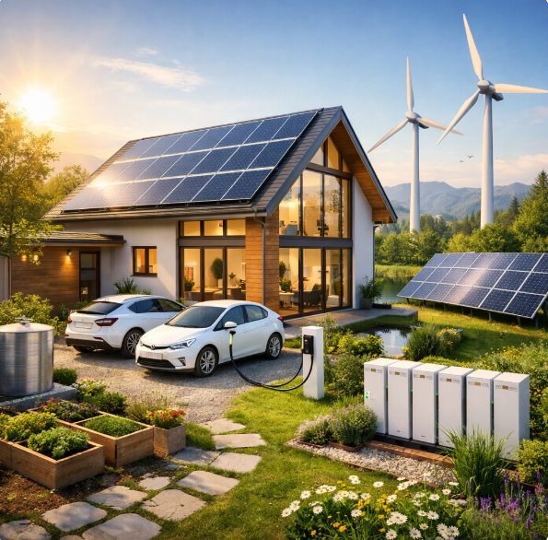
ENERGY EFFICIENCY
The given proposal is dedicated to the designing of the energy-efficient diagnostic systems that include the development of an interdisciplinary team, the organization of the working process, and the evidence-based strategies.
It relies on authoritative academic and industrial sources of literature and may be applied to fulfil the growing energy requirements of diagnostic technologies and stay valid, trustworthy, and expandable towards healthcare and engineering applications.
The aim is to build a high-calibre cross-functional unit; surveying and combining the literature and industry data; elaborating on low-power diagnostic units; and presenting energy saving implementation policies that do not affect the quality of diagnosis.
This implies that the efficient diagnostics may be achieved through the informed collaboration, intensive research, and efficient creation of the system, and deliver sustainable and cost-efficient solutions in partnership with the future technology and environmental requirements [3].
SIMRET

Slide 7
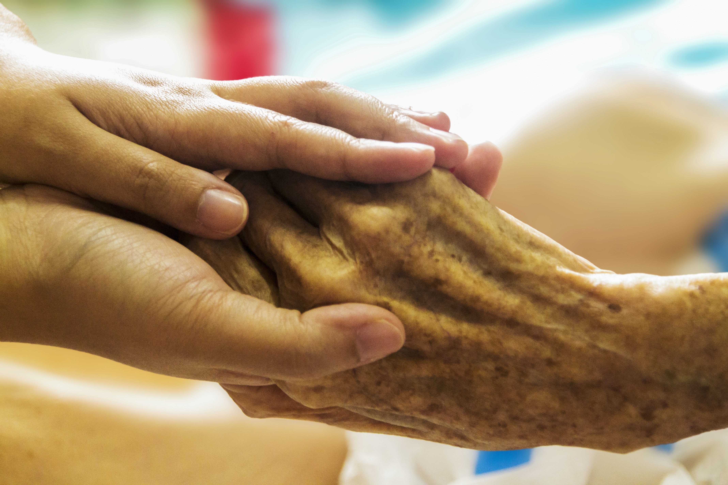
WELL -BEING
This hackathon focuses on wellbeing, especially among older and susceptible people.
Uncontrolled domestic energy may cause inconvenience, pressure, and health hazards, particularly during extreme climate conditions.
This project will assist in physical comfort, emotional reassurance, and independent living by developing digital solutions that would be easy to use.
Measuring energy consumption and indoor environment allows to sustain safe temperatures and minimize health hazards.
This can also reduce the financial strain of individuals through better control of energy, which helps the mental wellbeing.
Overall, the project promotes healthier living environment while empowering elderly users to feel safe, supported and confident in their daily lives[4]
HAFSA

Slide 8

ETHICS AND CYBERSECURITY IN DIGITAL HEALTH
In digital health, raising awareness of data privacy, cybersecurity, and ethics is vital for patient trust.
Padden and Öjehag-Pettersson (2024) explain how data protection authorities try to protect democratic values, such as fairness, transparency, and individual rights, in a society that relies heavily on data.
They suggest that while GDPR is an important legal framework, it does not fully address challenges linked to large-scale data use, algorithms, and powerful digital platforms [5].
Research shows that weak data governance can harm decision-making [6].
While cyber-resilient and ethically designed systems are needed [7].
Together, these studies highlight the importance of education, standards, and collaboration.
NICOLA

Slide 9
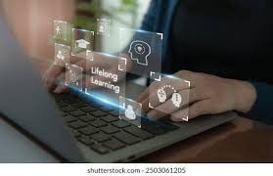
CONTINUOUS PROFESSIONAL DEVELOPMENT
This hackathon is supported by research showing that digital health innovation requires multidisciplinary skills, including health informatics, psychology, and human–computer interaction, to create effective tools for older adults [8].
Studies also highlight the need for patient-centred, ethical design, meaning participants gain experience in responsible, user-focused development practices [9].
Growing integration of technology in ageing populations further underscores the importance of building competence in digital solutions, preparing teams to design impactful, real-world applications for vulnerable users [10].
SAIDI

Slide 10
PROGRESS PRESENTATION 2
SMART ENERGY OPTIMISATION FOR THE ELDERLY

Slide 11
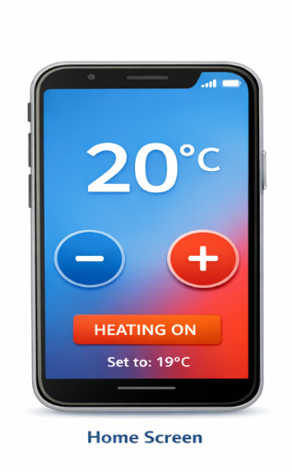
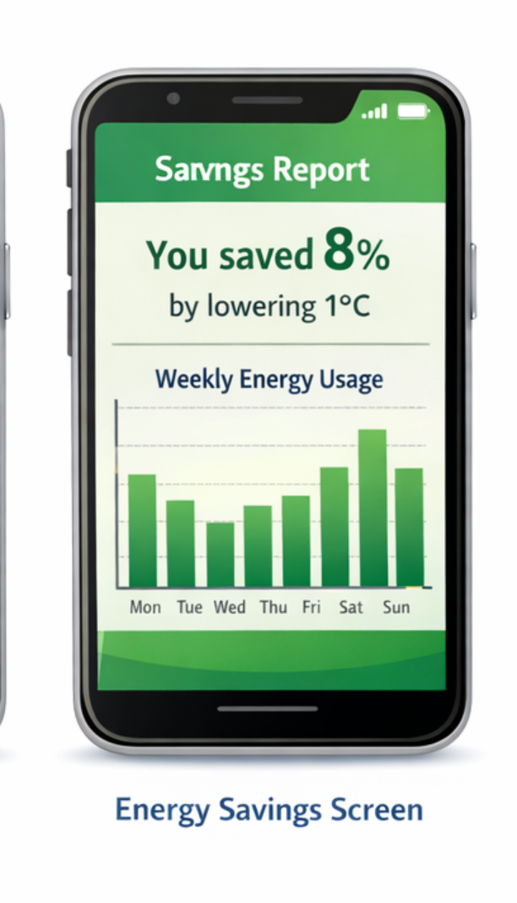
COST REDUCTION
Smart device or thermostats will reduce heating expenses incurred by the aged by optimising temperature and schedules.
One study demonstrated that a 1 °C drop in the heating setting of a home could cut the yearly energy consumption and expenditure by a significant margin; a study by University College London established that average households would save approximately £130 of energy annually due to a 1 °C drop in heating between 22 °C and 18 °C. Smart temperature controls also can be set to have automatic setbacks and heating patterns that are efficient to save on energy that goes to waste when no one is present in the room [11]. When these tools are combined, older adults will be able to maintain comfortable living spaces and reduce electricity or gas bills. (The Department of Energy's Energy.gov) By combining these tools, older adults can keep living space cosy while lowering electricity or gas bills [12].
HAFSA

Slide 12
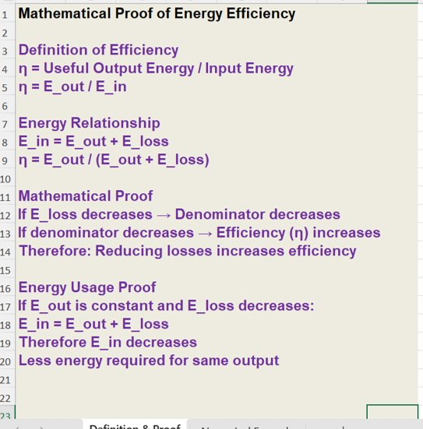
MATHEMATICAL PROOF
SIMRET

Slide 13
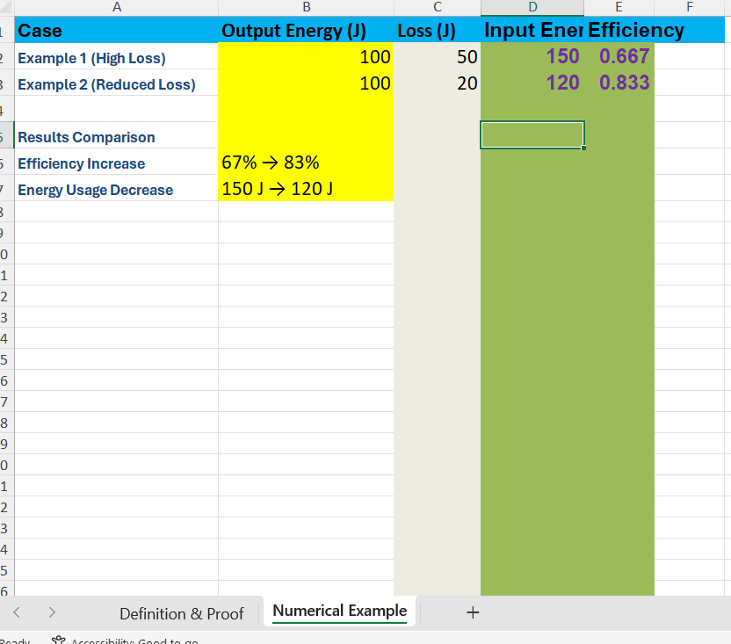

Slide 14
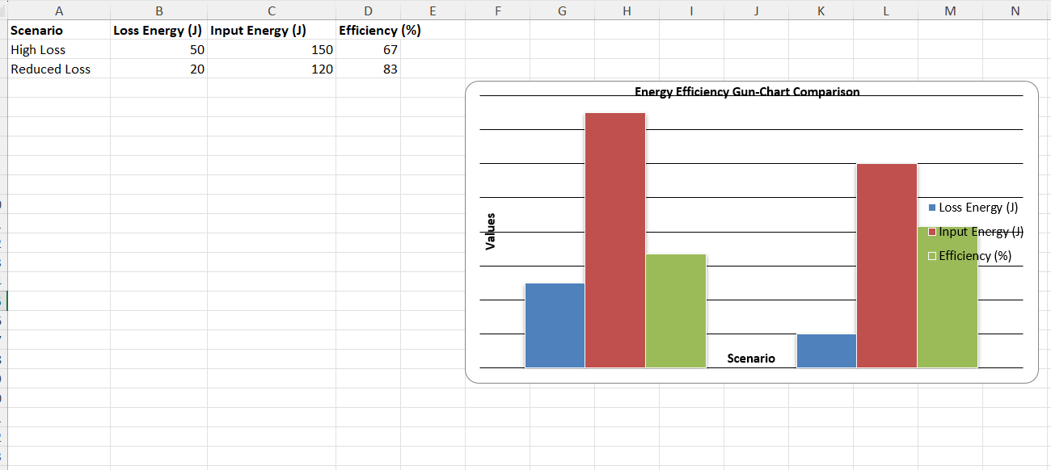

Slide 15
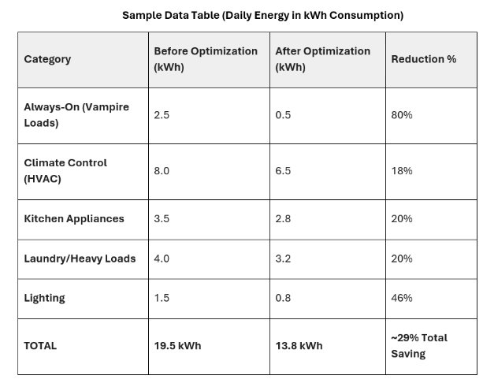
IMPACT OF OUR SMART ENERGY SYSTEM IN AN ELDERLY CARE SETTING
Scenario: A 24- Hour Energy Profile
The “Before” scenario:
Unmanaged/Risky Standard Home.
Appliances are left on stand-by, heating is inefficiently managed and high energy task (like laundry), occur during expensive peak hours.
The “After” scenario:
Smart Care Integrated Home (Optimised Safe Usage).
Our AI has implemented “Vampire” shutdowns and “Time-of-use” shifting.
SAIDI

Slide 16
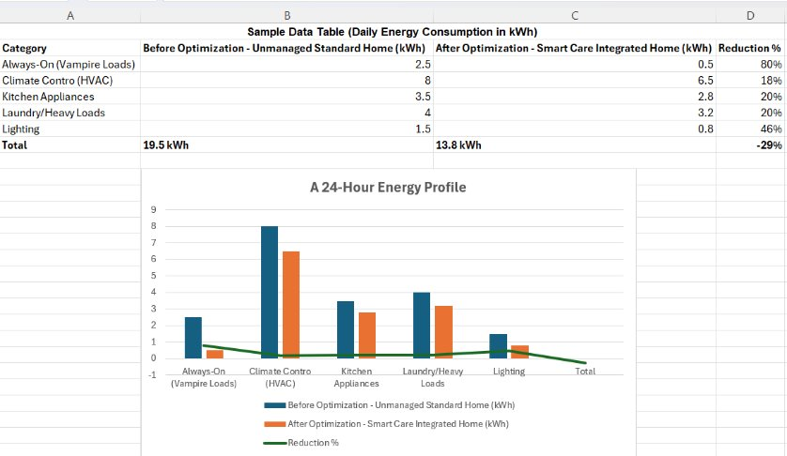
ENERGY OPTIMISATION INFOGRAPHICS

Slide 17
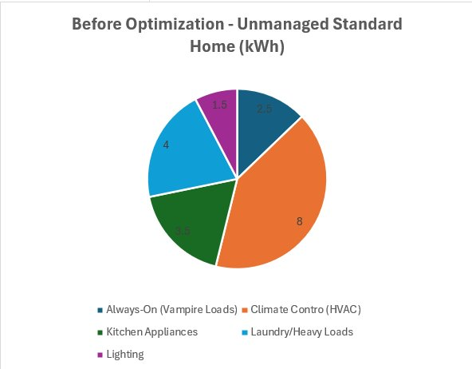
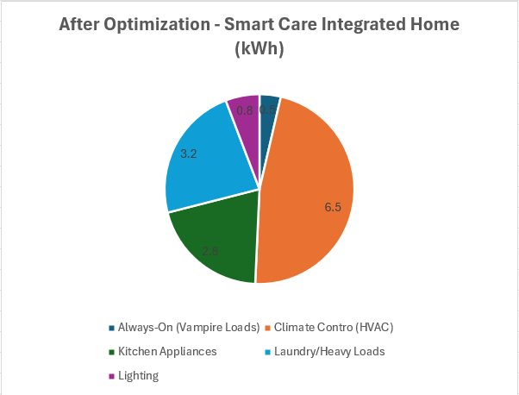
THE “WHERE DID THE ENRGY GO?” PIE CHART
After-majority of energy is now used for “Essential Comfort” (HVAC) and “Active Usage” with the “Waste” slice nearly disappearing.
Before-massive slice for “Wasted/Idle Power.”

Slide 18
WHAT IS AN ALGORITHM
An algorithm is a clear set of step-by-step instructions used to solve a problem. It takes inputs, applies logical rules, produces outputs, processes data, makes decisions, optimises performance, and ensures consistent results [15, 16].
In this algorithm, it sets a safe and efficient heating target using indoor temperature, occupancy, sleep status, tariff, and the previous setting. It lowers temperature when the home is empty or energy is expensive, enforces a safe minimum, limits sudden changes, and decides whether heating is needed. This AI-driven system will use real-time information to make smart and adaptive heating decisions, ensuring elderly safety and comfort while improving overall energy efficiency.
NICOLA

Slide 19
SMART ENERGY ALGORITHM
INPUT: indoor_temp, is_home, is_asleep, tariff, previous_target
SET safe_min_awake = 20.0
SET safe_min_sleep = 19.0
SET eco_temp = 18.0
SET max_step = 0.75
IF not is_home:
target = eco_temp
ELSE IF is_asleep:
target = safe_min_sleep
ELSE:
target = safe_min_awake
IF tariff == "peak":
target = target - 0.5
target = MAX(target, safe_min_sleep)
IF ABS(target - previous_target) > max_step:
target = previous_target + SIGN(target - previous_target) * max_step
action = "HEAT" IF indoor_temp < target ELSE "HOLD"
OUTPUT target, action

Slide 20
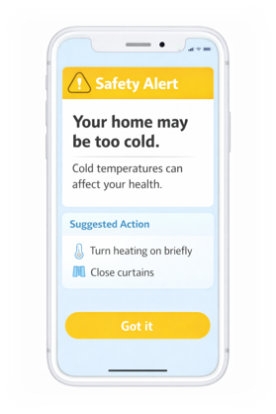
Solution Overview – “Smart Energy Home”​
A simple, accessible mobile and tablet application (with optional smart meter integration) that:​
​
Shows clear energy usage insights​
​
Provides safe, personalised energy-saving actions​
​
Alerts users to risk situations (e.g., unsafe temperatures)​
​
​
Safety Over Savings​
​
Never encourages unsafe behaviours (e.g., turning heating off in winter)​
​
Built-in temperature and health warnings​
​
Energy advice aligned with public health guidance​
SVETOSLAV

Slide 21
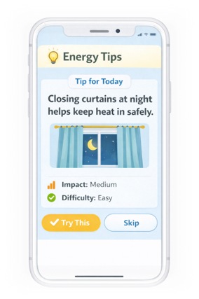
Personalised Energy Tips​
Tips are:​
​
Context-aware (weather, household type)​
Non-judgmental and realistic​
Ranked by safety and impact​
Trust & Privacy​
​
Minimal data collection​
​
Clear consent explanations​
​
No third-party ads or selling data​
SVETOSLAV

Slide 22
SMART ENERGY OPTIMISATION FOR THE ELDERLY USING DIGITAL HEALTH
FINAL HACKATHON PRESENTATION

Slide 23
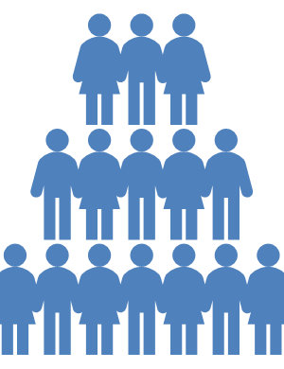

TEAM PLANNING AND COMMUNICATION

Slide 24
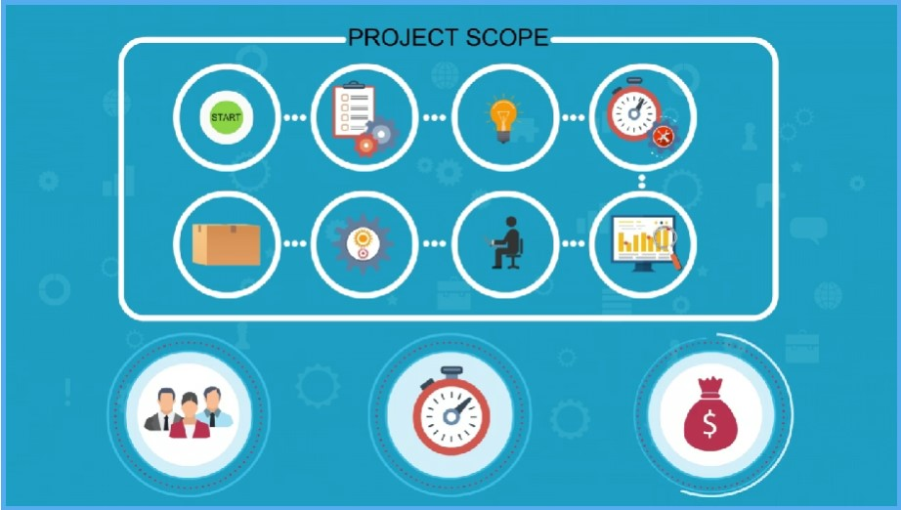
PROJECT OVERVIEW
Our project focuses on developing a smart energy optimization solution that helps reduce unnecessary daily energy consumption.
Effective teamwork and communication are essential for completing the project successfully.
Our team includes five members who collaborate through weekly Zoom meetings to discuss ideas, review progress, and plan tasks.
Clear communication and shared responsibilities help keep the project organized and ensure steady progress.

Slide 25
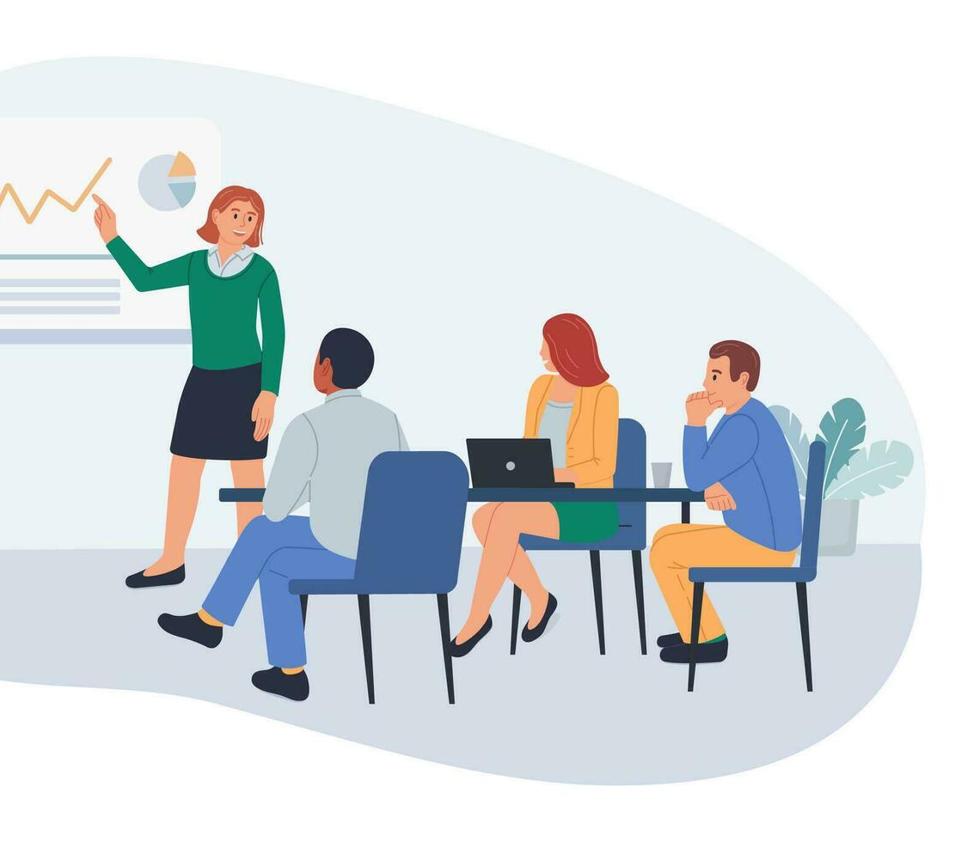
TEAM COMMUNICATION AND MEETINGS
The team meets once per week using Zoom for approximately 60-90 minutes.
Each meeting begins with progress updates from team members.
The group discusses new ideas, challenges, and possible improvements to the project.
Feedback and collaborative problem solving help strengthen the design and project outcomes.
Action points and tasks are assigned at the end of each meeting to maintain progress.

Slide 26
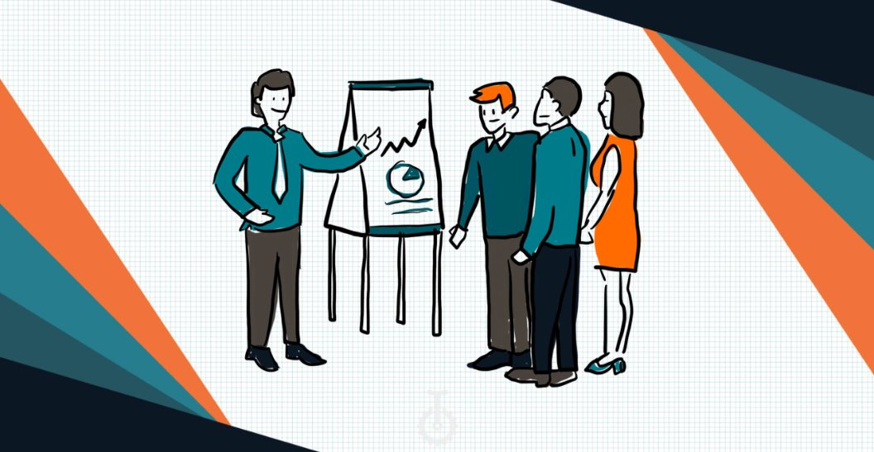
TEAM ROLES AND RESPONSIBILITIES
SIMRET – Project Planner: Organizes meetings, prepares agendas, coordinates tasks, and tracks project progress.
HAFSA – Research : Studies smart energy technologies and reviews academic research to guide the project [17], [20].
SVET – Design and Innovation: Develops creative ideas, sketches designs, and proposes innovative smart energy solutions [18].
SAIDI – Evaluation: Analyzes system effectiveness and potential energy savings while ensuring alignment with energy management principles [19].
NICOLA – Production: Focuses on materials, technologies, and practical application of the final solution [21].

Slide 27
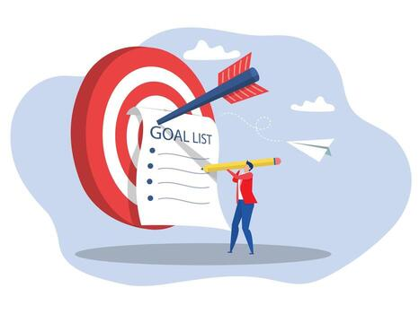
PROJECT GOAL
The main goal is to develop a smart energy optimization concept that helps individuals manage electricity consumption more effectively.
Smart grids and energy monitoring technologies allow better tracking of energy usage and improved efficiency.
Demand side management strategies can reduce energy waste and support sustainability [1], [3].
By combining research, design, evaluation, and implementation planning, the project aims to propose a practical and sustainable energy solution.

Slide 28
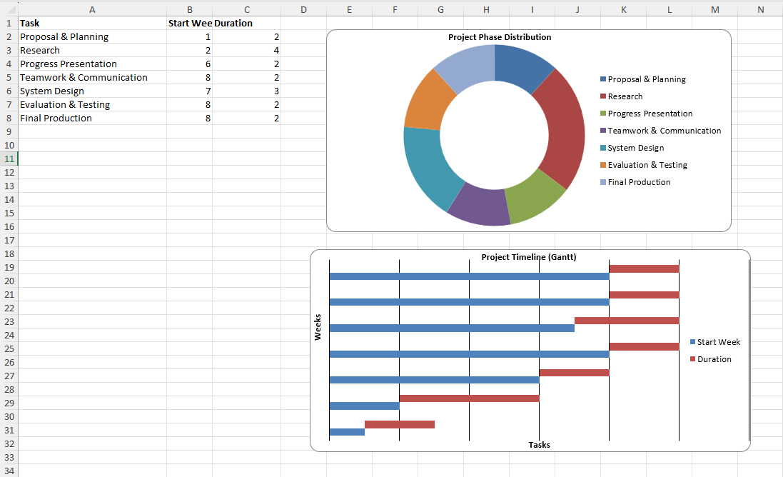
GANTT CHART

Slide 29

RESEARCH BACKGROUND, CHALLENGES, ETHICS AND SOLUTION
Our research focused on how smart energy optimisation using IoT and AI can support elderly people living alone, especially in cold weather.
Many elderly people find modern heating systems, smart meters, and energy tariffs difficult to use, making energy management harder.
Poorly monitored energy use can lead to cold indoor temperatures, discomfort, and health risks during winter.
Studies show elderly people are more likely to face fuel poverty and unsafe living conditions when technology is difficult to understand [22].
To organise the project, our team used a Gantt chart to plan tasks, share responsibilities, track progress, and develop a safe and practical solution within the ten-week timeline.
HAFSA

Slide 30
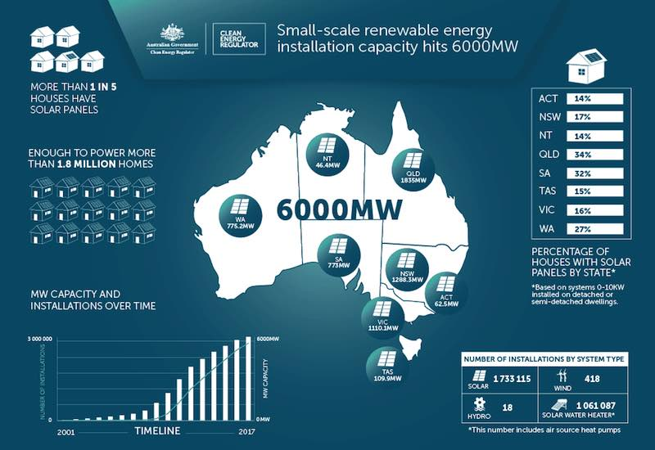
SMART ENERGY SYSTEMS AND DATA TRACKING
Smart energy systems help households track electricity usage, temperature, and home conditions in real time.
These systems use smart meters, sensors, and digital platforms to collect and analyse data from household appliances.
Smart systems can reduce energy waste, lower electricity bills, and improve comfort in the home [1].
Data from smart meters can show daily routines, such as heating, cooking, or sleeping habits [2].
Machine-learning algorithms can predict usage patterns and automatically adjust heating or appliance use to save energy [2].
The system is more effective without the elderly user needing to understand complex settings.
HAFSA

Slide 31
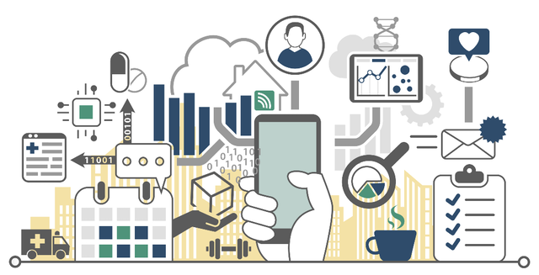
DIGITAL HEALTH AND ELDERLY CARE
Smart homes can combine energy tracking with digital health tools to improve safety and wellbeing.
Sensors can monitor temperature, movement, and appliance use inside the home.
Home monitoring systems can detect changes in daily habits that may show health risks [23].
Low temperature or lack of movement may indicate that the person needs help.
Alerts can be sent to users, family members, or carers to support safe independent living.
Studies show smart home technology improves quality of life and reduces loneliness in older adults [24].
HAFSA

Slide 32

RESEARCH GAP/ USER-FRIENDLY DESIGN
Even though smart technology is improving, many older adults are still reluctant to use them.
Research shows that hindrances include cost, difficulty and lack of basic digital skills [25].
Most of the current systems are geared towards younger users, therefore, elderly people find it hard to understand and navigate them.
Studies show that age-friendly design and accessibility standards will encourage older adults to use technology more safely and confidently [26].
Our solution combines energy monitoring, safety alerts, and a simple interface designed for elderly users.
HAFSA
ThePhoto by PhotoAuthor is licensed under CCYYSA.

Slide 33

SECURITY, GDPR AND ETHICS
Smart energy systems collect personal data such as energy use and daily routines.
If not protected, this data could be accessed or misused by attackers.
IoT and smart home devices are vulnerable to cyber-attacks without proper security [27]
Ethical design requires privacy, fairness and transparency in smart home systems [7].
GDPR require personal data to be processed lawfully and securely.
Data must be encrypted and access restricted [5].
Following GDPR increases user trust in digital systems [28].
ThePhoto by PhotoAuthor is licensed under CCYYSA.
HAFSA

Slide 34
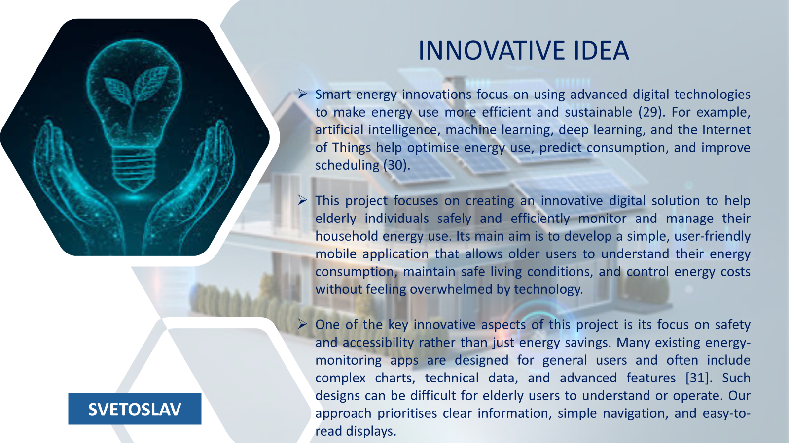

Slide 35
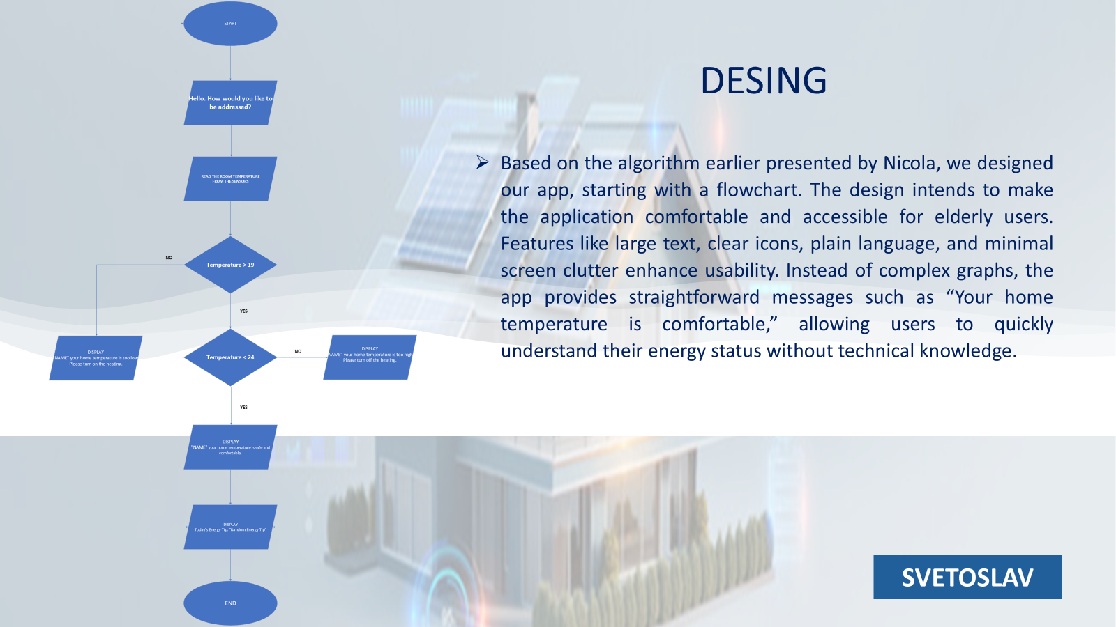

Slide 36
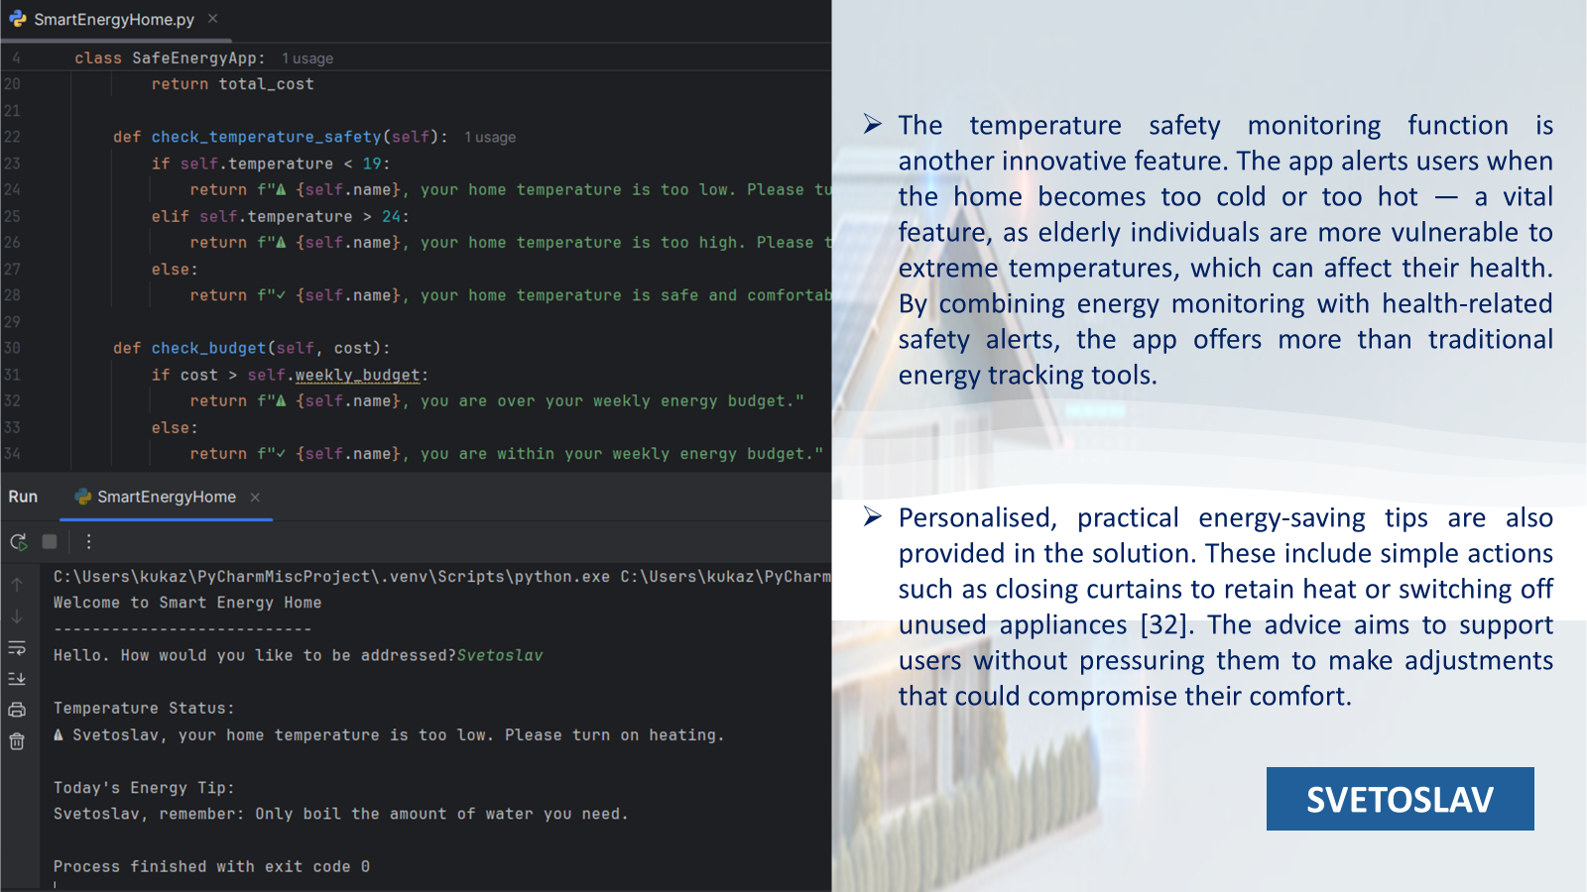

Slide 37
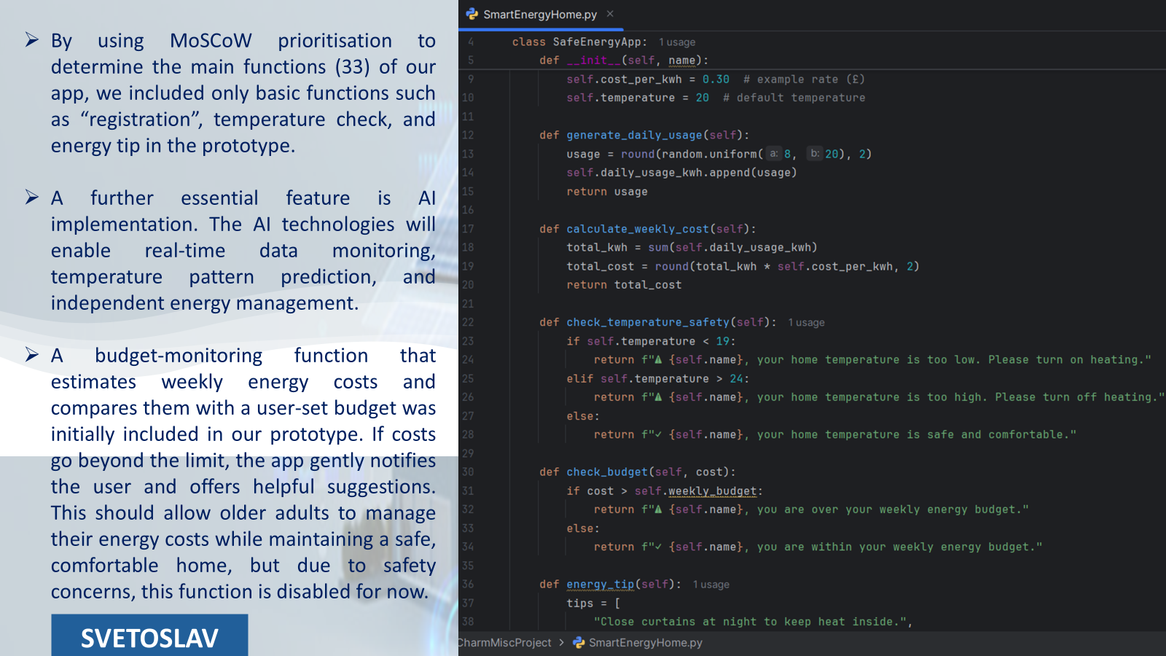

Slide 38
EVALUATION​
Aims to improve energy efficiency for the elderly by combining smart technology with healthcare solutions [1], [3].
Uses IoT devices: smart meters, smart plugs, and HVAC systems. Monitor and manage energy use in the home [1], [2].
Integrates features to support the health and safety of seniors, such as activity tracking, safety alerts [3], [2].
Designed to benefit not just individual but also care organisations and the community [2].
Creates a support system that enhances the lives of older adults.
SAIDI

Slide 39
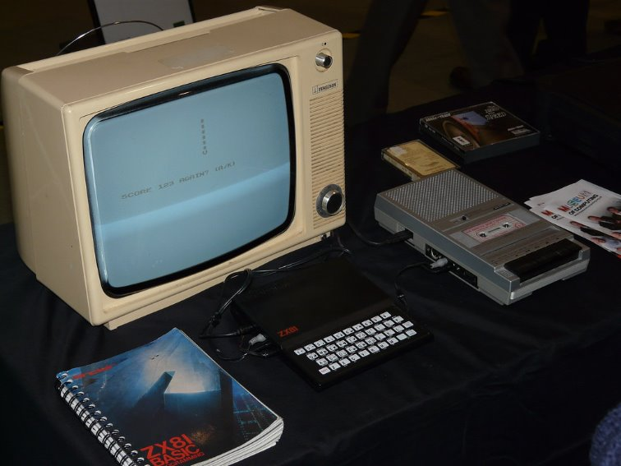
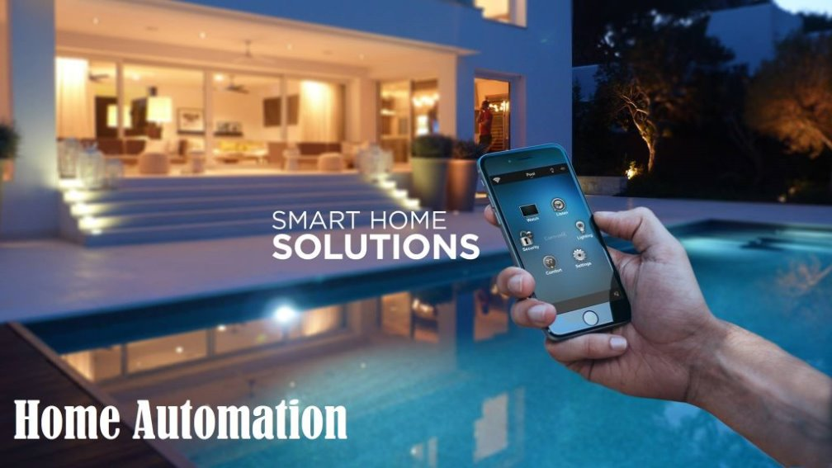
IMPACT OF THE SMART ENERGY SYSTEM IN AN ELDERLY CARE SETTING
SCENARIO: A 24- HOUR ENERGY PROFILE
The “Before” scenario: Unmanaged/Risky Standard Home. Appliances are left on stand-by, heating is inefficiently managed, and high-energy tasks (laundry) occur during expensive peak hours [2].
The “After” scenario: Smart Care Integrated Home (Optimised Safe Usage). Our Artificial Intelligence (AI) has implemented “Vampire” shutdowns and “Time-of-use” shifting [1], [2].

Slide 40
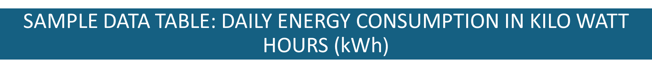

Category | Before Optimization (kWh) | After Optimization (kWh) | Reduction (%)
Always-On (Vampire Loads) | 2.5 | 0.5 | 80%
Climate Control (HVAC) | 8.0 | 6.5 | 19%
Kitchen Appliances | 3.5 | 2.8 | 20%
Laundry/Heavy Loads | 4.0 | 3.2 | 20%
Lighting | 1.5 | 0.8 | 47%
Total | 19.5kWh | 13.8kWh | Approximately 29% Total Saving [34].
Approximately 29% Total Saving [34].

Slide 41
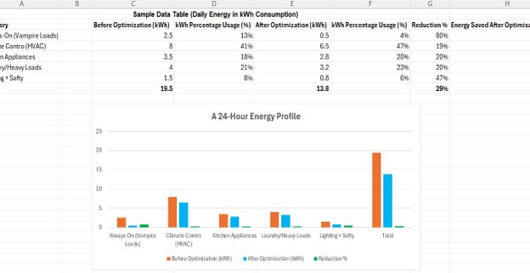
ENERGY OPTIMISATION INFOGRAPHICS – BAR CHART
Smart Energy Optmization_Infographic1.xlsx [8].
SAIDI
Fig. 1. A 24-Hour Energy Profile Bar Chart [34].

Slide 42
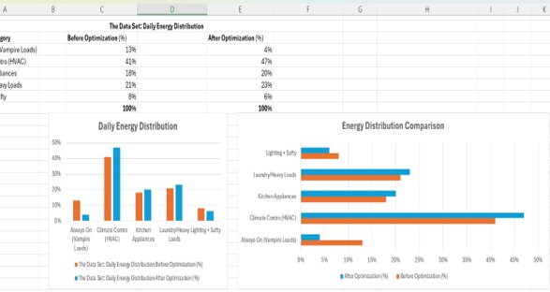
THE “WHERE DID THE ENERGY GO?” BAR CHART
SAIDI
Fig. 2. A 24-Hour Energy Profile Bar Chart [34].

Slide 43
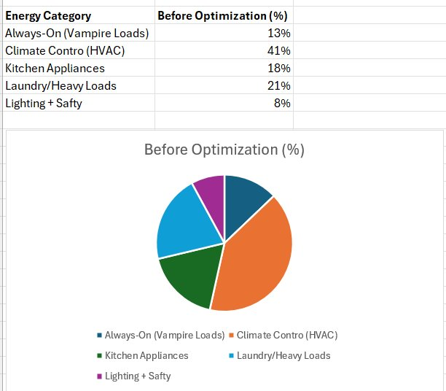
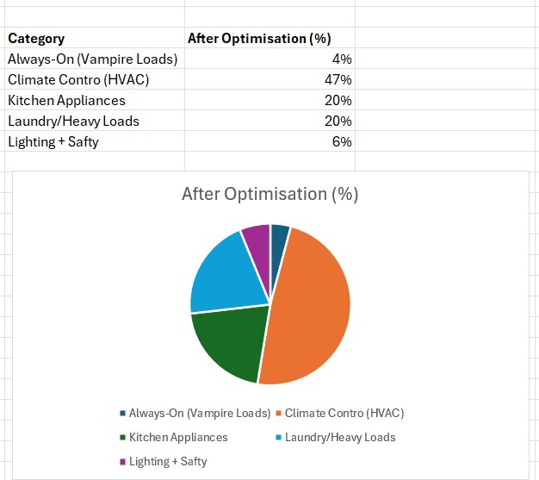
THE “WHERE DID THE ENERGY GO?” PIE CHART
Fig. 3. Before Optimisation Pie Chart [34].
Fig. 4. After Optimisation Pie Chart [34].
After- Majority of energy now used for “Essential Comfort” (HVAC) and “Active Usage”, with the “Wasted” slice nearly disappearing.
Before - A massive slice for “Wasted/Idle Power.”

Slide 44
WHAT THE DATA TELLS US
The 24‑hour profile reveals substantial gains from eliminating standby (vampire) loads and adopting smarter lighting [2].
These results are achievable through a system that incorporates appliance scheduling, standby power removal, and activity-aware HVAC control [1], [2], [3].​
The system uses signals, motion sensors, door events, and caregiver presence to make decisions [3].​
WHY DIGITAL HEALTH SIGNALS?
If a resident is asleep or away, the controller lowers heating or delays laundry, reducing energy use without compromising well‑being. Supported by smart home care research [1], [3].​
USABILITY & ACCEPTABILITY
Older adults prefer technology that is easy to understand, as this helps build trust.​
SAIDI

Slide 45

RISKS | MITIGATIONS
Misclassification (false negatives/positives). | The controller lowers heating or delays laundry when the resident is asleep or away, reducing energy use without compromising well‑being [1], [3].
Privacy and Exposure | Raw signals are processed on the device and only anonymised features sent to the cloud to comply with GDPR and reduce data‑leak risk [5], [7].
Cost Barrier | Target means-tested installs and local council or NHS pilot funding [1].
Table2. Risks and Mitigations [34].

Slide 46
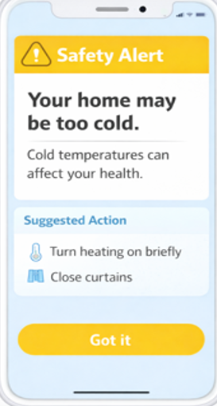
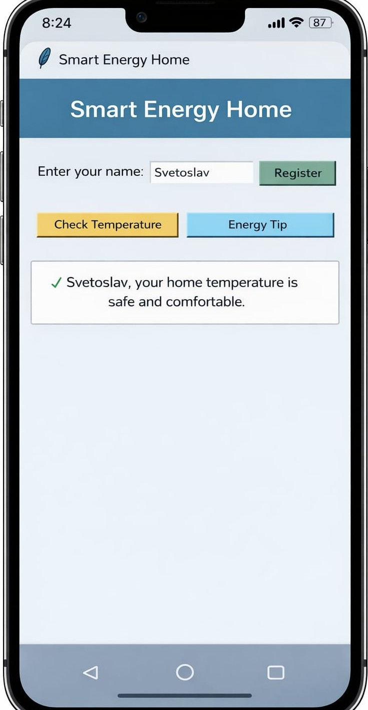
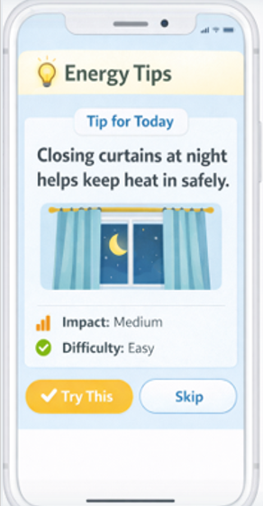
PRODUCTION

Slide 47
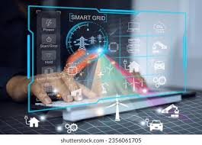
PROJECT OVERVIEW, CHALLENGES AND PROPOSED SOLUTION
Our project develops a simple smart energy optimisation system for elderly households using digital health and smart home technologies.
Many elderly people live alone and may find it difficult to manage household energy use.
Manual monitoring of electricity and heating is often difficult for elderly users.
The aim is to help older adults manage energy more efficiently while keeping their homes comfortable and safe.
The design combines smart monitoring, data analysis, and secure data management.
Homes consume large amounts of energy, highlighting the need for better energy management systems [35].
The prototype concept shows how technology can support independent living and reduce energy waste.

Slide 48
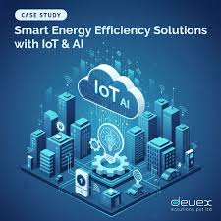
PROPOSED SMART ENERGY SOLUTIONS
We designed a smart energy management application connected to IoT devices.
Smart meters and sensors collect live data about electricity use and temperature.
The application displays this data in a clear dashboard.
The system provides suggestions to reduce unnecessary energy usage.
Smart home technology allows energy usage to be tracked and controlled more efficiently [36].
The interface is simple so elderly users can use it without technical skills.
The technology follows WCAG 2.2 guidelines [37].

Slide 49





SYSTEM ARCHITECTURE DESIGN
The system uses sensors, data processing and user interface.
Sensors collect information about heating, electricity use, and temperature.
Data is sent securely to the application.
Data analysis identifies patterns in energy usage.
The dashboard provides alerts and improvement suggestions.
Connected smart home systems improve efficiency through live monitoring [38].

Slide 50






PROTOTYPE DESIGN AND DEVELOPMENT
During the hackathon, we designed a prototype model to demonstrate the system.
Python was used to implement and test the optimisation algorithm.
Simulated household data was used to test energy usage patterns.
The model analyses energy usage patterns and shows how optimisation could work.
Smart grid technologies can improve efficiency by analysing behaviour [38].
Smart energy platforms can reduce household energy use by up to 30% [39].

Slide 51
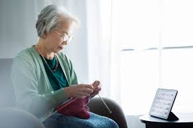
REAL- WORLD USE SCENARIO
An elderly person living alone uses the smart energy system at home.
Sensors monitor heating, electricity, and indoor temperature.
The system detects when energy use becomes too high.
The application suggests automatic adjustments.
The user does not need technical knowledge.
A caregiver or family member can check the system remotely if needed.
Smart home systems support safe and independent living for older adults [40].

Slide 52
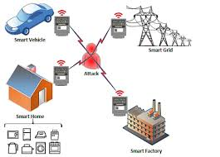
SECURITY, PRIVACY AND DATA DEVELOPMENT
The system stores personal household energy data, so strong security is essential.
IoT devices are vulnerable to cyber-attacks if not protected.
The design uses encryption, secure communication, and authentication.
Blockchain stores data in secure, tamper-resistant records.
This enables trusted data sharing between users, caregivers, and providers.
The system follows GDPR rules to keep personal data safe.
Strong cybersecurity is essential for digital health and smart home systems [5].

Slide 53
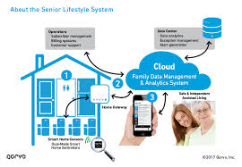
BENEFITS & IMPACT
The system helps elderly users reduce energy costs.
It protects personal data through secure design.
It keeps the home comfortable and safe.
It reduces unnecessary energy usage.
It supports independent living.
This project shows how smart energy, digital health, and secure systems support safe and independent living for elderly households.

Slide 54
]
[1] Athanasiadis et al., "A Smart Energy Management System for Elderly Households," 2022 57th International Universities Power Engineering Conference (UPEC), Istanbul, Turkey, 2022, pp. 1-6, doi: 10.1109/UPEC55022.2022.9917856 [Accessed: Feb. 07, 2026].
[2] Á. Hernández et al., “Monitoring Daily Activities in Households by Means of Energy Consumption Measurements from Smart Meters,” Journal of sensor and actuator networks, vol. 14, no. 2, p. 25, 2025, doi: 10.3390/jsan14020025 [Accessed: Feb. 07, 2026].
[3] S. a. V. A. a. C. L. Us{\'o}n, "Energy efficiency evaluation and optimization of energy intensive systems with thermoeconomic diagnosis of the operation," Applied energy, vol. 87, no. Elsevier, 1995-1999, pp. 19891995, 2010 [Accessed: Feb. 05, 2026].
[4] World Health Organisation, “WHO guideline: Recommendations on digital interventions for health system strengthening,” www.who.int, Jun. 06, 2019 [Accessed: Feb. 05, 2026].
[5] M. Padden and A. Öjehag-Pettersson, “Digitalisation, democracy and the GDPR: The efforts of DPAs to defend democratic principles despite the limitations of the GDPR,” Big Data & Society, vol. 11, no. 4, Oct. 2024, doi: https://doi.org/10.1177/20539517241291815 [Accessed: Feb. 3, 2026].
[6] A. K. Pandey et al., “Key Issues in Healthcare Data Integrity: Analysis and Recommendations,” IEEE Access, vol. 8, pp. 40612–40628, Feb. 2020, doi: https://doi.org/10.1109/ACCESS.2020.2976687 [Accessed: Feb. 03, 2026].
[7] Abdullah Algarni and Vijey Thayananthan, “Digital Health: The Cybersecurity for AI-based healthcare communication,” IEEE Access, pp. 1–1, Jan. 2025, doi: https://doi.org/10.1109/access.2025.3526666 [Accessed: Feb. 03, 2026].
[8] Oxford Academic (academic.oup.com)L. Thiamwong et al., “Integrating Digital Health Technologies With Physical and Mental Health for Motivating Low-Income Older Adults,” Innovation in Aging, vol. 9, suppl. 2, Dec. 2025 [Accessed: Feb. 03, 2026].
[9] M. M. Alruwaili, M. Shaban, and O. M. Elsayed Ramadan, “Digital Health Interventions for Promoting Healthy Aging: A Systematic Review of Adoption Patterns, Efficacy, and User Experience,” Sustainability, vol. 15, no. 23, p. 16503, Jan. 2023, doi: https://doi.org/10.3390/su152316503 [Accessed: Feb. 03, 2026].
[10] A. Ollevier, G. Aguiar, M. Palomino, and I. S. Simpelaere, “How can technology support ageing in place in healthy older adults? A systematic review,” Public Health Reviews, vol. 40, no. 20, 2020. doi: 10.1186/s40985-020-00143-4 [Accessed: Feb. 03, 2026].
[11] UCL, “Analysis: Energy bills - how much money does turning down the thermostat actually save?,” UCL News, Dec. 02, 2022. https://www.ucl.ac.uk/news/2022/dec/analysis-energy-bills-how-much-money-does-turning-down-thermostat-actually-save [Accessed: Feb. 20, 2026].

Slide 55
[12] U.S. Department of Energy, “Programmable Thermostats,” Energy.gov. https://www.energy.gov/energysaver/programmable-thermostats [Accessed: Feb. 20,2026].
[13] ÇengelY. A. and M. A. Boles, Thermodynamics : an engineering approach. New York: Mcgraw-Hill Education, Cop, 2015. [Accessed: Feb. 22, 2026].
[14] R. A. Serway, J. W. Jewett, Physics for scientists and engineers with modern physics., 10th ed. Boston, Ma: Brooks/Cole, Cengage Learning, 2018. [Accessed: Feb. 22, 2026].
[15] X. Song et al., “Evolutionary Multiobjective Spiking Neural Architecture Search for Image Classification,” IEEE Transactions on Evolutionary Computation, vol. 30, no. 1, pp. 106–120, Feb. 2026, doi: https://doi.org/10.1109/tevc.2025.3528471 [Accessed: Feb. 22, 2026].
[16] Md. A. Rahman et al., “Improving Sleep Disorder Diagnosis Through Optimized Machine Learning Approaches,” IEEE Access, vol. 13, pp. 20989–21004, 2025, doi: https://doi.org/10.1109/access.2025.3535535 [Accessed: Feb. 22, 2026].
[17] H. Farhangi, 'The path of the smart grid,' IEEE Power and Energy Magazine, 2010 [Accessed: Mar. 12, 2026].
[18] A. Ipakchi and F. Albuyeh, 'Grid of the future,' IEEE Power and Energy Magazine, 2009 [Accessed: Mar. 12, 2026].
[19] G. Strbac, 'Demand side management: Benefits and challenges,' Energy Policy, 2008 [Accessed: Mar. 12, 2026]
[20] X. Fang et al., 'Smart grid—The new and improved power grid,' IEEE Communications Surveys & Tutorials, 2012 [Accessed: Mar. 12, 2026].
[21] S. Siano, 'Demand response and smart grids,' Renewable and Sustainable Energy Reviews, 2014 [Accessed: Mar. 12, 2026].
[22] Age UK, 2022. [Accessed: Mar. 11, 2026].

Slide 56
[23] D. Kim, H. Bian, C. K. Chang, L. Dong, and J. Margrett, “In-Home Monitoring Technology for Aging in Place: Scoping Review,” Interactive Journal of Medical Research, vol. 11, no. 2, p. e39005, Sep. 2022, doi: https://doi.org/10.2196/39005. [Accessed: Mar. 11, 2026].
24] P. P. Morita, K. S. Sahu, and A. Oetomo, “Health Monitoring Using Smart Home Technologies: Scoping Review,” JMIR mHealth and uHealth, vol. 11, p. e37347, Apr. 2023, doi: https://doi.org/10.2196/37347 [Accessed: Mar. 11, 2026].
[25]H. Shi, H. Qi, and K. Yang, “Enhancing elderly care with smart homes: A comparative study of use and payment willingness,” Digital Health, vol. 11, May 2025, doi: https://doi.org/10.1177/20552076251374223 [Accessed: Mar. 11, 2026].
[26] A. Alsaeedi, “Comparing Web Accessibility Evaluation Tools and Evaluating the Accessibility of Webpages: Proposed Frameworks,” Information, vol. 11, no. 1, p. 40, Jan. 2020, doi: https://doi.org/10.3390/info11010040 [Accessed: Mar. 11, 2026].
[27] H. R. Marston, Joost van Hoof, and Y. Yon, “Digitalising the built environment for all generations: A new paradigm for equity and inclusive age-friendly cities and communities,” Indoor and Built Environment, vol. 33, no. 2, pp. 213–217, May 2023, doi: https://doi.org/10.1177/1420326x231176621 [Accessed: Mar. 11, 2026].
[28] G. Buckley, T. Caulfield, and I. Becker, “How might the GDPR evolve? A question of politics, pace and punishment,” Computer Law & Security Review, vol. 54, pp. 106033–106033, Sep. 2024, doi: https://doi.org/10.1016/j.clsr.2024.106033 [Accessed: Mar. 11, 2026].
[29] S. Li, Y. Xie, M. Shi, X. Zheng, and Y. Lu, “Hybrid intelligent algorithm aided energy consumption optimization in smart grid systems with edge computing,” Intelligent Systems with Applications, vol. 24, p. 200444, Dec. 2024, doi: https://doi.org/10.1016/j.iswa.2024.200444 [Accessed: Mar. 13, 2026].
[30] Senthil Kumar Mohan, J. A, Sanjeevikumar Padmanaban, and Y. Hamid, Hybrid Intelligent Approaches for Smart Energy. John Wiley & Sons, 2022. [Accessed: Mar. 13, 2026].
[31] D. Kim, Y. Yoon, J. Lee, P. J. Mago, K. Lee, and H. Cho, “Design and Implementation of Smart Buildings: A Review of Current Research Trend,” Energies, vol. 15, no. 12, p. 4278, Jun. 2022, doi: https://doi.org/10.3390/en15124278 [Accessed: Mar. 13, 2026].

Slide 57
[32] T. Khafiso, S. A. Adekunle, and C. Aigbavboa, “Assessment of energy-saving strategies mitigating high energy usage in residential buildings,” Property Management, Feb. 2025, doi: https://doi.org/10.1108/pm-12-2024-0126 [Accessed: Mar 13, 2026].
[33] N. S. Vijayakumar, K. Prasad, and Raviraja Holla M, “Assessing the Effectiveness of MoSCoW Prioritization in Software Development: A Holistic Analysis across Methodologies,” EAI Endorsed Transactions on Internet of Things, vol. 10, Oct. 2024, doi: https://doi.org/10.4108/eetiot.6515 [Accessed: Mar. 13, 2026].
[34] S. Saidi, “SMART ENERGY OPTIMISATION FOR THE ELDERLY — Final Hackathon,” presentation, Mar. 14. 2026
[35] S. Nižetić, N. Djilali, A. Papadopoulos, and J. J. P. C. Rodrigues, “Smart technologies for promotion of energy efficiency, utilization of sustainable resources and waste management,” Journal of Cleaner Production, vol. 231, no. 1, pp. 565–591, Sep. 2019, doi: https://doi.org/10.1016/j.jclepro.2019.04.397 [Accessed: Mar. 10, 2026
[36] D. Marikyan, S. Papagiannidis, and E. Alamanos, “A systematic review of the smart home literature: A user perspective,” Technological Forecasting and Social Change, vol. 138, no. 138, pp. 139–154, Jan. 2019, doi: https://doi.org/10.1016/j.techfore.2018.08.015. [Accessed: Mar. 10, 2026].
[37] A. Alsaeedi, “Comparing Web Accessibility Evaluation Tools and Evaluating the Accessibility of Webpages: Proposed Frameworks,” Information, vol. 11, no. 1, p. 40, Jan. 2020, doi: https://doi.org/10.3390/info11010040 [Accessed: Mar. 10, 2026].
[ 38] Samson Ajadalu, “Optimizing Energy Efficiency in Smart Home Automation through Reinforcement Learning and Iot,” Asian Journal of Research in Computer Science, vol. 17, no. 11, pp. 9–24, Nov. 2024, doi: https://doi.org/10.9734/ajrcos/2024/v17i11516. [Accessed: Mar. 10, 2026].
[39] M. S. Rahman and Ishtiak Al Mamoon, “Empowering smart homes by IoT-driven hybrid renewable energy integration for enhanced efficiency,” Scientific Reports, vol. 15, no. 1, pp. 41491–41491, Nov. 2025, doi: https://doi.org/10.1038/s41598-025-25328-2. [Accessed: Mar. 10, 2026].
[40] D. Pal, S. Funilkul, V. Vanijja, and B. Papasratorn, “Analyzing the Elderly Users’ Adoption of Smart-Home Services,” IEEE Access, vol. 6, pp. 51238–51252, 2018, doi: https://doi.org/10.1109/access.2018.2869599.

Slide 58
THANK YOU !

