Slide 1
The cause of Tesco's failure in the United States
1. Introduce 2. Goal
3. Problem 4. Conclusion

Slide 2
3
3
1
1
2
2
3
1
2

Slide 3




Introduce
Goal
Problem
Conclusion

Slide 4
Background
Tesco supermarket is the largest retailer in Britain.
TheTesco CEO wants to develop a new market.

Slide 5
Goal
Bbuild more than 1000 stores .
Middle-income population.

Slide 6
Problem
1. Shopping habits
2. Cooking habits
3. Different habits
Habits

Slide 7
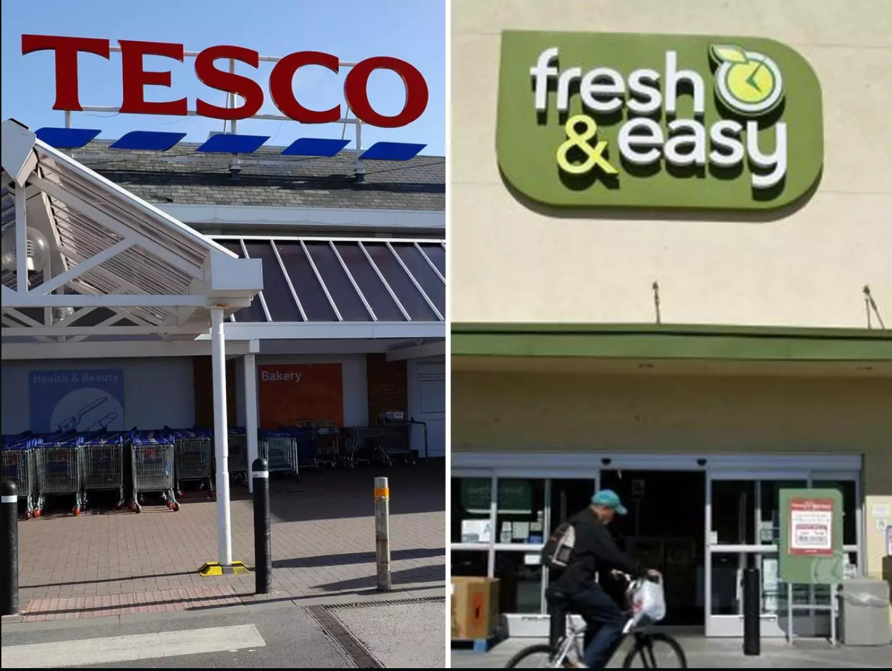
1.American suffering from the economic crisis.
2.High price of food raw materials.
3.People don't have enough money.
Habits
Time

Slide 8
Habits
Position
Tesco was established in the small city
Time

Slide 9
Habits
Position
Time
self-service payment

Slide 10
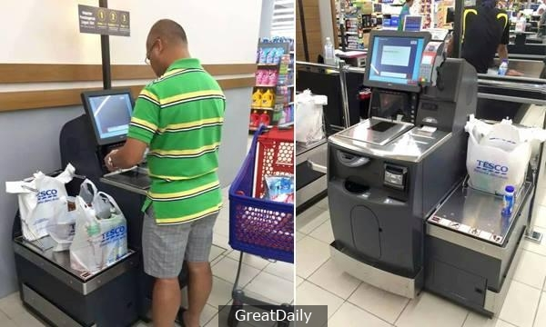
self-service payment at the time of checkout.

Slide 11
UK Competitors attack
Conclusion
Leave the United States
US market instability

