Slide 1
AHHI 5003 LECTURE 3
WAR AND CHANGE IN THE 20TH CENTURY -

Slide 2
‘PAX BRITANNICA’
The stability of Europe from 1815-1914?
British control of the sea routes – unchallenged access to her overseas dominions
Secured by a powerful naval presence world wide
Secured post 1815 through continental order and the creation of ‘spheres of influence’ in Europe and beyond

Slide 3
CHALLENGES
1. RUSSIA: the encroachment of Russian influence on Ottoman dominions in south-eastern Europe. threatening British interests in India
CRIMEAN WAR (1853-6) : Russian influence in the region curtailed by British military presence, in alliance with France
2. GERMANY :
Unification contradicted ‘sphere of influence’ model
A united Germany – who was in charge? And how best to defend against it

Slide 4
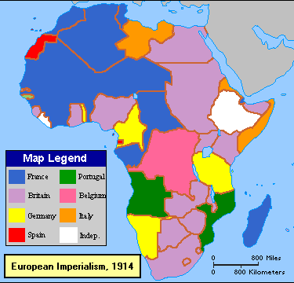
THE NEW IMPERIALISM
MAJOR FEATURE OF POWER POLITICS AND DIPLOMACY 1880’s AND 1890’s
FRANCE, GERMANY, BELGIUM EXPANDING OVERSEAS INTERESTS
PARTITION OF AFRICA REFLECTED RIVALRY WITHIN EXPORT MARKETS

Slide 5
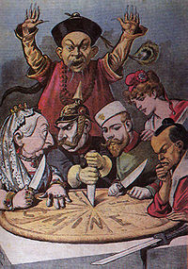
NEW IMPERIALISM
RUSSIA LOOKED EAST TO SIBERIA AND BEYOND
TENSIONS WITH CHINA AND JAPAN
U.S.A. KEPT HER FRONTIERS IN THE WEST
ALL MEANT TENSIONS BETWEEN POWERS
MOST NOTABLE THE MOROCCAN CRISES

Slide 6
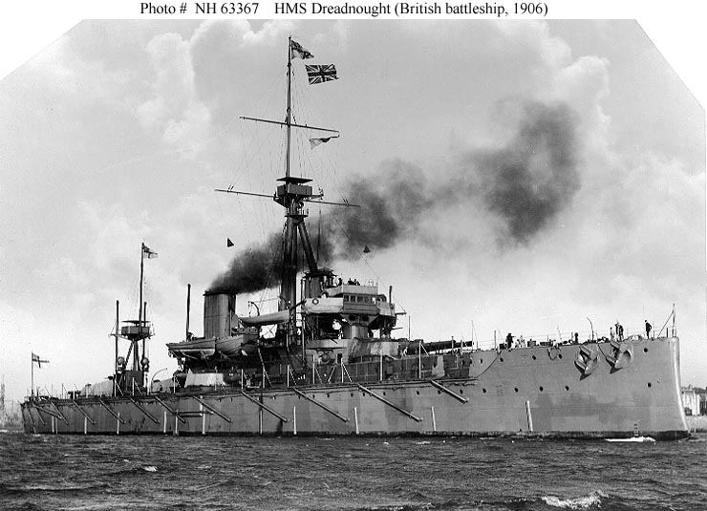
STRATEGIC ARMS RACE
LINK BETWEEN IMPERIAL GAIN AND NATIONAL PRIDE
ARMS RACE FROM 1900s
OVERSEAS GAINS AND ARMS RACE SEEN BY MANY AS MASKING FAILING DOMESTIC POLICIES IN MAJOR POWERS

Slide 7
4. DIPLOMACY AND MUTUAL DISTRUST
PRE-WAR DIPLOMACY HAD CREATED TWO COMPETING CAMPS – ‘TRIPLE ENTENTE’ AND ‘TRIPLE ALLIANCE’
A LIMITED EUROPEAN WAR WAS
UNAVOIDABLE, BORN OUT OF:
‘THE EXPECTATIONS OF BOTH THE MILITARY
AND THE PEOPLE THAT WAR WAS
NECESSARY TO MAINTAIN NATIONAL
SECURITY AND PRIDE’
SOURCE: Ian Donnachie ‘The Origins of World War One’, in Arthur Marwick, et al, Europe on the Eve of War, (London: Open University Press, 1995), p.197.

Slide 8
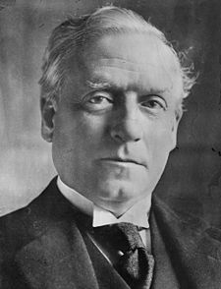
PRE-WAR DIPLOMACY - BRITAIN
VACILLATED BETWEEN NEUTRALITY AND POLICY REFLECTED FEAR OF BOTH GERMAN AND RUSSIAN EXPANSION
UPHOLDING OF BELGIAN NEUTRALITY
HERBERT HENRY ASQUITH (1852-1928)

Slide 9
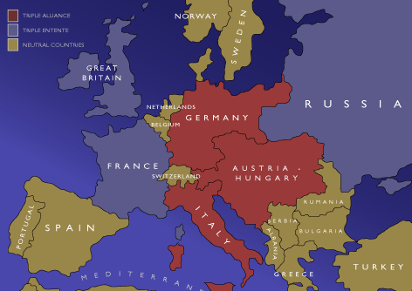
ALLIANCES – TRIPLE ENTENTE
LOOSE ALLIANCE BETWEEN BRITAIN , FRANCE , AND RUSSIA; FROM:
1894 – FRANCO-RUSSIAN ALLIANCE
1904 – ANGLO-FRENCH ENTENTE
1907 – ANGLO-RUSSIAN ENTENTE

Slide 10
ALLIANCES – TRIPLE ALLIANCE
LOOSE ALLIANCE BETWEEN GERMANY, AUSTRO-HUNGARY, AND ITALY
FORGED IN 1882
MUTUAL SUPPORT GIVEN IF ATTACKED BY TWO OR MORE POWERS

Slide 11
MOROCCAN CRISIS (1) – TANGIERS 1905-06
STATUS OF MOROCCO CHALLENGED BY WILHEMINE GERMANY
‘PROTECTORATE’ AIMS OF FRANCE CHALLENGED
KAISER VISITS TANGIERS (MARCH 1905) – GIVES SPEECH IN SUPPORT OF INDEPENDENCE
JUNE 1905 – POWERS ON THE BRINK OF WAR
ALGECIRAS CONFERENCE ISOLATES GERMANY – FRANCE RETAINS CONTROL OF REGION

Slide 12
MOROCCAN CRISIS (2) - AGADIR
JULY 1911 - LOCAL UPRISING OCCURS
GERMAN GUNBOAT ‘THE PANTHER’ SENT TO AGADIR IN SUPPORT OF REBELS
FRENCH REINFORCE FEZ TO QUELL UPRISING
WAR AVOIDED AT TREATY OF FEZ (NOVEMBER 1911)
FRENCH CONTROL MOROCCO BUT AT COST OF GERMAN GAINS IN CONGO AND CAMEROON
CRISES RAISE TENSIONS BETWEEN ‘ENTENTE’ AND GERMANY

Slide 13
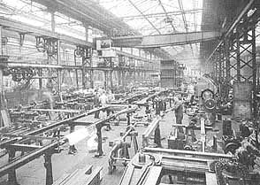
ECONOMIC RIVALRY
INDUSTRIAL
ECONOMIC
TRADING
FINANCIAL

Slide 14
BRITISH SUPREMACY
COALMINING AND IRON PRODUCTION
ENGINEERING
TEXTILES
SHIPPING
INSURANCE
BANKING
LONDON – FOCAL POINT FOR MONEY MARKETS

Slide 15
THE CHALLENGE
BETWEEN 1848-1913 INDUSTIAL GNP IN GERMANY HAD RISEN FROM 21.6% TO 44.6%
AGRICULTURAL GNP FALLEN FROM 45.2% TO 23.4%
SOURCE : MARWICK, ET AL, EUROPE ON THE EVE OF WAR (OUP, 1994). P.92.
FRANCE
UNITED STATES
JAPAN
GERMANY

Slide 16
PROGRESSIVE LIBERALISM
Liberal reforms 1906 onwards seen as marking the emergence of a modern welfare state
Shift away from ‘classical liberalism’ to a more collectivist and progressive approach to welfare, based on social justice and state involvement for the common good
Royal Commission on Poor Law provision and the ‘Majority’ and ‘Minority’ reports (generally ignored by Liberal administration)

Slide 17
PROGRESSIVE LIBERALISM
Arose out of fear of increasing poverty and deprivation
The need for state involvement to counter the problem of poverty
Influenced by the pioneering work of Seebohm Rowntree and Charles Booth – moral concern around poverty, provision for old age, and illness
Rise of the Labour party and fear of socialism and communism

Slide 18
LIBERAL REFORMS
CHILDREN:
1906 – free school meals (but not compulsory until 1912)
1907 – ‘Notification of Births Act’ – attempt at understanding I.M.R.
1907-12: free medical provision and access to school clinics (although ‘patchy’, not all local authorities complied)
1908 – ‘the Children’s Act’ (or Children’s Charter); setting up of juvenile courts, foster care provision; Borstal provision formalised
Concern for the welfare of children against ‘baby farming’ ‘wet nursing’ and fear of infanticide

Slide 19
LIBERAL REFORMS
PENSIONERS:
1908 – pension for over 70s - 5s per week (7s 6d for couple)
Means tested and only if fully employed i.e. To have worked to full potential
20 year citizenship rule (many immigrants denied)
Life expectancy of 48 meant most never reached 70!

Slide 20
LIBERAL REFORMS
EMPLOYED:
1909 – provision of labour exchanges
1911 – ‘National Insurance Act’; sick pay of 10s per week over six months (contribution 4d a week); free medical treatment – doctors paid from insurance fund (but only those at work, no family medical cover)
Part II of act gave 7s 6d a week for 15 weeks on 2.5d a week contribution
Rates seen by many as too low

Slide 21
‘TOTAL WAR’
Britain came out of 1914-18 on the winning side her overseas possessions intact – although conflict in Ireland would lead to partition, the creation of the Irish Free State and the province of Northern Ireland
Germany would lose all her recently gained overseas possessions and her immediate future would be dictated by the provisions of the Versailles treaty

Slide 22
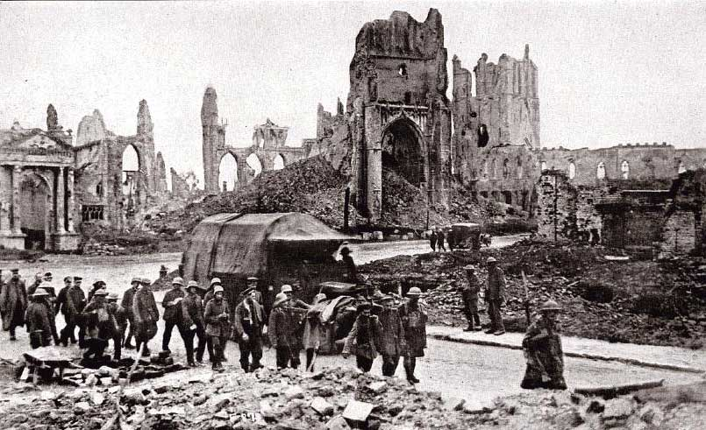
THE NATURE OF WAR
WAR AND CHANGE – THE DILEMMA: WAR IS SURELY REGRESSIVE NOT PROGRESSIVE. IT BRINGS DESTRUCTION; DEPRIVATION; DEATH
ALTERNATIVELY: THE EXPERIENCES AND HORRORS OF WAR DEMAND CHANGE – ‘A LAND FIT FOR HEROES’

Slide 23
WAR AND CHANGE
STRUCTURAL CHANGE OR BROADER FORCES – ECONOMIC ACTIVITY/INDUSTRIALISATION; TECHNOLOGICAL ADVANCE;DEMOGRAPHY
NON-STRUCTURAL CHANGE – REFORM; IDEAS;REVOLUTION

Slide 24
WAR AND CHANGE
EXAMINE EVENTS ‘BEFORE’ AND ‘AFTER’
QUANTATIVE AS WELL AS QUALITATIVE EVIDENCE
WOULD CHANGES HAVE COME ABOUT WITHOUT WAR?
‘POST HOC ERGO PROPTER HOC’ – CAN WE ASSUME THAT BECAUSE ONE EVENT FOLLOWED ANOTHER, IT WAS CAUSED BY IT?

Slide 25
WAR AND CHANGE
TO JUDGE THE IMPACT OF LONG-TERM FORCES AND CIRCUMSTANCES OF WAR
TO JUDGE THE VITALITY OF CONFLICT AND LEVELS OF PARTICIPATION, VS:
THE DESTRUCTIVE NATURE OF ‘TOTAL WAR’

Slide 26
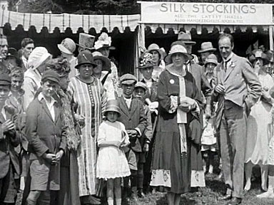
SOCIAL CHANGE
POPULATION IN BRITAIN : ‘WAR LOSSES WERE NOT SUFFICIENT TO PREVENT THE SLOW GROWTH OF THE POPULATION, WHICH INCREASED BY OVER A MILLION AND A HALF DURING THE DECADE 1910-20’, HENRY COWPER ET AL, WORLD WAR I AND ITS CONSEQUENCES (THE OPEN UNIVERSITY PRESS, 1990), P.59.

Slide 27
THE ECONOMY
THE POSITIVE:
ONLY LIMITED STRUCTURAL DAMAGE COMPARED TO CONTINENT
BY 1923 PRODUCTION LEVELS RETAINED PRE-WAR HEIGHTS
‘WAR IS THE MOTHER OF INVENTION’: ADVANCES MADE IN: SCIENCE AND MEDICINE; MOTOR TRANSPORT; AIRCRAFT TECHNOLOGY; RADIO TECHNOLOGY; HEAVY METAL TECHNOLOGY; ELECTRICAL POWER
THE NEGATIVE:
DEPENDENCE UPON LONG ESTABLISHED INDUSTRIES (COAL; COTTON; STEEL; SHIP BUILDING)
WAR MEANT THE LOSS OF WORLD MARKETS
INCREASED WORLD COMPETITION INCLUDING USE OF OIL AS OPPOSED TO COAL
EMERGENCE OF NEW INTERNATIONAL ECONOMY – BRITAIN’S STANDING AS TRADING AND FINANCE CENTRE DIMINISHING

Slide 28
CORPORATISM
STATE INTERVENTION DID NOT RECEDE IN 1918
ROLE OF THE STATE AS BUTTRESS FOR SOCIAL-ECONOMIC PROBLEMS
CORPORATIST AGENDA IN ECONOMIC PLANNING AND SOCIAL INITIATIVES INCLUDING HOUSE BUILDING AND INSURANCE AND MEDICAL SERVICES
INTERVENTION IN INDUSTRIAL DISPUTES – JOINT WHITLEY COUNCILS ETC

Slide 29
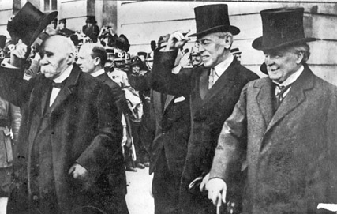
GEOPOLITICAL CHANGE
VERSAILLES TREATY 28TH JUNE 1919
WILSONIAN IDEALS OF DEMOCRACY AND SELF-DETERMINATION – THE FOURTEEN POINTS
GERMANY GUILTY PARTY – ‘THE WAR GUILT CLAUSE’
A CASE OF ‘COMPROMISE’ AND ‘CONTRADICTION’
CLEMENCEAU; WILSON AND LLOYD GEORGE AT PARIS 1919

Slide 30
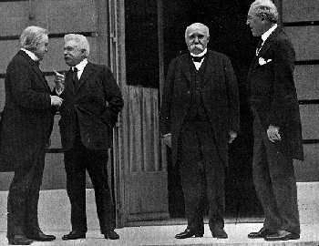
VERSAILLES
‘IT WAS A NICE PRECEPT OF MACHIAVELLI THAT THE VICTOR SHOULD EITHER CONCILIATE HIS ENEMY OR DESTROY HIM, THE TREATY OF VERSAILLES DID NEITHER’, ANTONY LENTIN,
LLOYD GEORGE, WOODROW WILSON, AND THE GUILT OF GERMANY (LEICESTER UNIVERSITY PRESS, 1985)

Slide 31
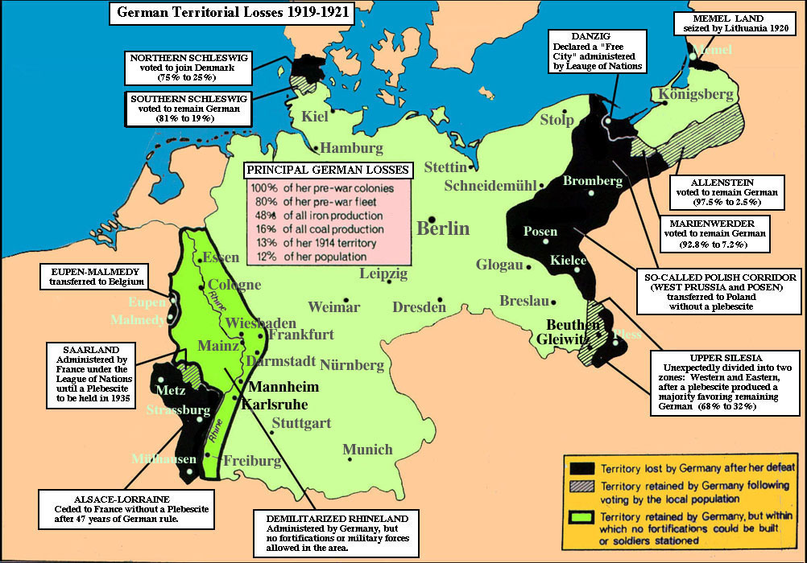
VERSAILLES AND GERMANY

Slide 32
LEAGUE OF NATIONS
Formed out of the Versailles treaty; at it’s height in the 1930s it had upwards of sixty members
Failure of the United States to ratify Versailles treaty meant they never joined the League
Policy of collective security, negotiation and arbitration; disarmament linked to sanctions
Dogged by reluctance of major powers to police the League’s goals, sanctions etc
Unable to prevent expansionist policies of Germany, Italy, Japan

Slide 33

VERSAILLES
MARGARET MACMILLAN, PEACEMAKERS: SIX MONTHS THAT CHANGED THE WORLD (LONDON: JOHN MURRAY, 2003, [2ND EDITION])

Slide 34
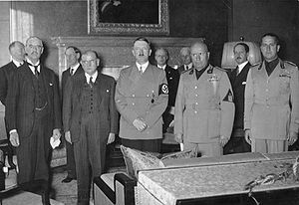
APPEASEMENT

Slide 35
APPEASEMENT
Associated with the premiership of Neville Chamberlain and the avoidance of another conflict with Germany in the aftermath of the horrors of the Great War
Term linked with weakness by those who condemned Chamberlain for appeasing Hitler and the Nazis
Alternative approach – Chamberlain had no choice and was acting in the best interests of Britain

Slide 36
APPEASEMENT
October 1935: Italy invades Ethiopia
March 1936: German troops enter the Rhineland in violation of the Versailles treaty
March 1938: Anschluss - Germany occupies and annexes Austria
September 1938: Chamberlain in Munich; Hitler’s demands over the Sudetenland met – ‘peace for our time’?
March 1939: Czech lands annexed; shift of emphasis from appeasement to preparation for war, and reiteration of guarantees over Poland

Slide 37
WILLIAM BEVERIDGE
1879-1963
Oxford educated lawyer
1908 joined the Board of Trade – involved in Labour Exchange organisation and National Insurance
1914-18 involved with manpower mobilisation and at the Ministry of Food
1919-37 Director of the LSE

Slide 38
THE BEVERIDGE REPORT
The Report on Social Insurance and Allied Services’ (1942)
To counter want; disease; ignorance; squalor; idleness
All in work should pay a weekly National Insurance contribution to cover sick benefit; unemployment benefit; retirement; widows pension
Put forward on the assumption that a National Health Service of some description on the way

Slide 39
BEVERIDGE REPORT
Attempt to appeal to all parties including industry and employers: make British industry more competitive (healthier and more motivated workers); shift health and pension costs to the public account
Aim: full employment (i.e. below 3%)
Report became the basis of the new welfare state and instantly popular in the country
Implemented in a series of acts between 1945-49 covering N.I; family allowance ; pensions etc

Slide 40
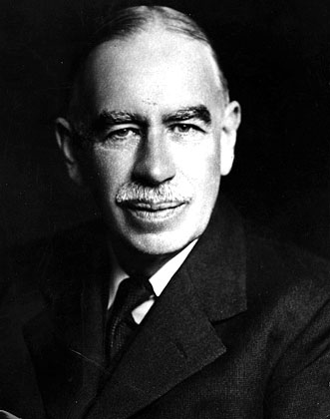
KEYNSIANISM
John Maynard Keynes (1883-1946)
Advocated a mixed economy and the active participation of the state including:
Central Bank involvement in monetary policy
Government stimulus programmes

Slide 41
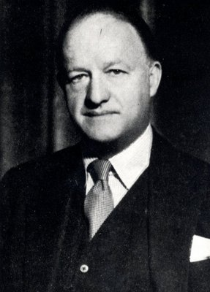
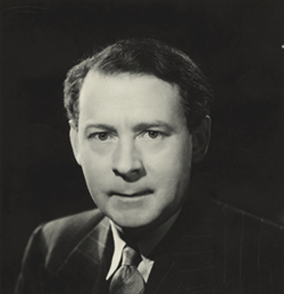
‘BUTSKELLISM’

Slide 42
‘BUTSKELLISM’
Satirical label given to the ‘Consensus’ politics and economic policy from the 1950s
Play on Rab Butler (1902-1982) Chancellor from 1952-55 under Churchill and Eden; and Hugh Gaitskill (1906-63), Chancellor 1950-51 under Attlee, and leader of the Labour Party from 1955-63
‘Consensus’ politics dominated economic policy from 1950 to the advent of Monetarism (advocating a mixed economy with state intervention over health and education policy)

Slide 43
CAPTURING ‘THATCHERISM’
1. Libertarian?:
Individual liberty and freedom
Rolling back the State – free market economics
Supply-side economics - control of the money supply
Low tax policy
‘Self Help’ approach to welfare
Privatisation of nationalised industry – steel, coal, gas and electricity,
Challenging and constraining

Slide 44
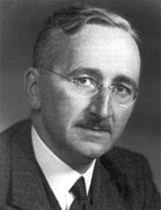
CAPTURING ‘THATCHERISM’
Friedrich Hayek (1899-1992)
Austrian-born; British citizen in 1938
Defended ‘Classical Liberalism’ and free market capitalism against socialism and collectivism

Slide 45
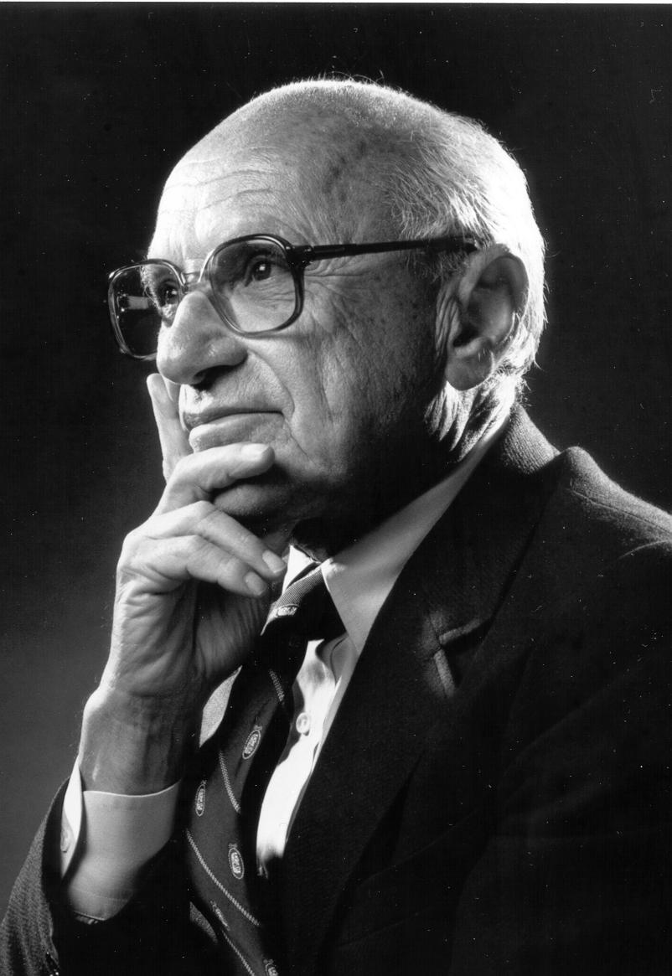
CAPTURING ‘THATCHERISM’
Milton Friedman (1912-2006)
Free market macro-economics and ‘Monetarism’
Control inflation by controlling the money supply

Slide 46
‘THATCHERISM’ contd...
Individual liberty and freedom
Minimal state involvement?
But also:
Policy of strong leadership to achieve ends e.g.
1. Law making to curb Trade Union power and the withdrawal of labour – limiting strike action and secondary picketing
2. Confrontation with miners – 1984-85
3. Privatisation of state industries – the mines, steel, energy and water industries
4. Tax Policy – late 1980s introduction of the Poll Tax (riots of 31 March 1990)

