Slide 1
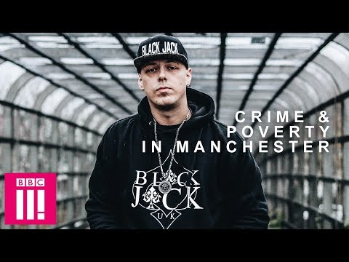

Slide 2
What Conclusions Can We Draw From This Video?
We can discuss on the 13th of March
Any Questions Please?

Slide 3

Culture & Diversity
Diversity & Crime

Slide 4
Objectives of the Lecture
Introduce ‘Police (Cop) Culture’
Recognise the breadth of meaning within the term ‘diversity’ and ‘equality’.
Consider specific examples of diversity.
Examine what Police do as an organisation to improve the service it provides to diverse groups in society (internally and outside of the organisation)

Slide 5
Introduction
The objectives are to:
Outline the social and political context in which the concept of policing diversity has developed in recent times
Explore the widening understanding of ‘diversity’ issues
Why is Diversity important as an issue?

Slide 6
Introduction
Consider why enhancing diversity is regarded as a priority for the police service
Reflect upon the limitations of the diversity agenda for contemporary policing
Contemporary problems are understood against the background of the perceived ‘golden era’ of British policing that followed World War II (Reiner, 2000). If a longer term perspective is taken, then a rather different picture of police–community relations emerges

Slide 7
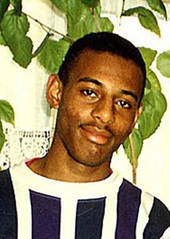
Prejudice, discrimination and extreme violence are nothing new
Eugenics Movement - Started in Britain 1800s-1900s and spread (effectively selective breeding).
Nazi Germany (Jewish people, gay people, gypsies and disabled – ‘social cleansing’)
Stephen Lawrence (racist murder 1993) numerous other hate crime victims
Quarmby, 2011
Notes:
Eugenics Movement (‘scientific’ movement focused on ‘improving the breed’; forced sterilisations). Started in Britain 1800s-1900s and spread.

Slide 8
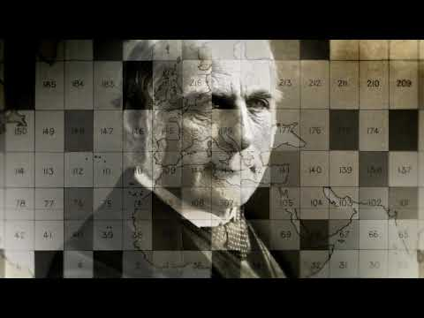

Slide 9
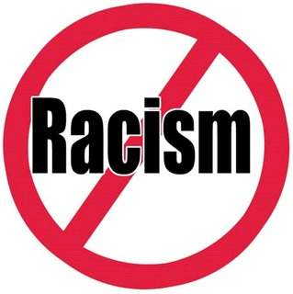
Many forms of ‘negativity’ or ‘-isms’ or ‘phobias’ are built into society and cultures –eg....
Racism
Ageism
Sexism
Disablism
Homophobia
Islamophobia
Xenophobia (fear or hatred of foreigners/strangers or their cultures)

Slide 10
Introduction
Police relations with Black and Minority Ethnic (BME) groups often have been fraught since the foundation of modern police forces in the mid-19th century. Similar concerns have applied in many other societies and have been a major issue in the US, Australia, Canada and elsewhere for many decades
Relations with BME communities have formed an important strand in debates about policing but have been added to by concern about other aspects of diversity: these have related to relations with religious and faith communities, the disabled, those defined in terms of sexual orientation.
The degree to which the ‘diversity agenda’ can be extended to include groups such as youth subcultures or sex workers has been debated in the recent past

Slide 11
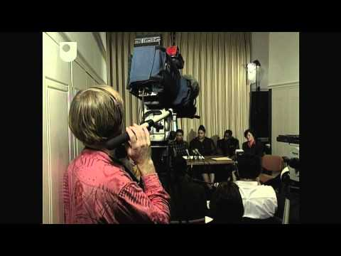

Slide 12
The impact of the Lawrence inquiry
Although the facts of the murder of 18-year-old Stephen Lawrence are relatively straightforward and incontrovertible, the impact that the case has had in terms of policing in Britain and society’s attitudes toward racism has been wide-ranging and fundamental.
While the focus here – and more widely – is on the implications that the Macpherson Report had for police relations with BME communities it is important to note that it also found professional incompetence and a failure of leadership marred the investigation into the murder of Stephen Lawrence.
Underpinning the specific recommendations was a more fundamental priority that the Home Secretary needed to improve the ‘trust and confidence’ that BME communities have in the police service.

Slide 13
The impact of the Lawrence inquiry
The Lawrence Report (1999) found that police were institutionally racist, defined as:
The collective failure of an organisation to provide an appropriate and professional service to people because of their colour, culture or ethnic origin.
It can be seen or detected in processes, attitudes and behaviour which amount to discrimination through unwitting prejudice, ignorance, thoughtlessness and racist stereotyping which disadvantages minority ethnic people
Despite its apparent radical clarity, the term continues to be badly defined and contradictory

Slide 14
The impact of the Lawrence inquiry
The development of antiracist policing
The predominant policing approach had been predicated on a ‘race relations’ or equal opportunities model. The key focus was to ensure that BME communities received an equitable service to that delivered to all members of society.
This perspective characterizes the role of the police as essentially neutral, in which officers’ proper concern is to enforce the law in a professional, even-handed, and effective manner.
Often the goal was to assure that officers refrained from behaving in certain ways considered to be illegal or morally and ethically undesirable

Slide 15
The impact of the Lawrence inquiry
Post-Lawrence, conceptualization of the police position in respect of minority groups has become one in which antiracism is a central theme.
Enshrined in the 2010 Equalities Act that prohibits discrimination on the grounds of race, age, gender, disability or sexual orientation and that police have a duty to eliminate discrimination, harassment and victimisation and to foster good relations
The principles of effective policing of a diverse society have formed part of a broader promotion of police professionalism and reflexive practice such that officers understand the impact that their actions have on the wider public

Slide 16
Two dimensions of policing diversity
The over-policing of minority ethnic officers and the under-policing of hate crime
Over-policing: Stop and search
Ministry of Justice data shows 17.9 in a 1,000 white people were stopped and searched in England and Wales in 2009/10. For black people the rate was seven times higher (125.7 per 1,000).
The discrepancy between white and Asian people was less marked but the latter still experienced a rate more than double that of the former: 40.2 per 1,000 population
But what about issues such as knife crime?

Slide 17
Two dimensions of policing diversity
Stop and search was a key aspect of police discrimination and disrespect cited as a major cause of the 2011 riots (Guardian/LSE, 2011; Riots Communities and Victims Panel, 2012)
In 2010 the Equalities and Human Rights Commission reported that disparities in the use of stop and search powers against different ethnic groups were rooted in police policies and practices that could not be justified in terms of offending rates or demographic trends

Slide 18
Overview of Race and Crime
Today, social scientists refer to race as a “social construct”
Consider the following definitions for the term “race”:
  Race . . . refers to a group of persons characterized by common physical and/or biological traits that are transmitted in descent (Flowers,1988)
  The concept of race . . . reflects self-identification by people according to the race or races with which they most closely identify (U.S. Census Bureau, 2000)
Notes:
When speaking of race, it is important to review the history of the concept and associated definitions

Slide 19
Thoughts….
Race has been used to divide populations
“Whiteness” has always been placed at the top of the racial hierarchy
The level of crime in each racial/ethnic group has varied over time, but all have engaged in crime to survive
European ethnic immigrants have assimilated and become a part of the “White” population
Other racial/ethnic groups have had difficulty assimilating
Why is this so critically important in policing

Slide 20
The implications of police culture
Police culture might not offer a definitive basis to explain police behaviour
Police culture is not ‘monolithic, universal or unchanging’ and it cannot be assumed that all officers share the values, attitudes and beliefs Reiner (2000)
If the dynamics of police working life explain culture then it needs to be explained why many officers are not racist, sexist, homophobes. Clearly police culture does not provide any absolute guide to police behaviour

Slide 21
The implications of police culture
Problematic tendency to conceive of police officers as passive dupes, unwittingly coaxed into a particular cultural domain: ‘while the culture may be powerful, it is nevertheless up to individuals to accommodate or resist its influence’ (Chan, 1997)
Culture needs also to be understood as a means of interpreting and rationalizing police work, and does not necessarily play a strong causal role in terms of shaping their behaviour (Waddington, 1999)

Slide 22
Broadening the horizon: culture and policing in wider perspective
The state, and the public police, is no longer the sole provider of policing
If the legitimate use of violence configures police subculture then it seems likely that the influence of this property will extend to other professions who have a role in policing in its extended sense

Slide 23
What is Police Culture?
Two fundamental conclusions can be drawn:
Firstly that while the concept of police culture is vital to understanding policing it provides a poor guide to police behaviour in particular circumstances
Secondly, if the defining characteristics of policing are increasingly shared with other agencies, then it seems likely that the cultural patterns that have emerged, partly in response to them, might themselves pervade networks of policing

Slide 24
Police Culture

Slide 25
Views?
How can we change Police Culture?
We have to know what it is!
Have a 10-minute comfort break and we will discuss

Slide 26
Social Identity Theory
Key SIT theorist was Henri Tajfel (1982)
SIT is concerned with the needs of individuals to identify with specific social groups
Groups give people a sense of belonging/who they are/a framework for their lives
This links to self-esteem needs
Also the development of prejudice
And discrimination as the process inevitably involves discriminating in favour of one’s own group and against the other group(s)
- see also Tajfel & Turner (1986)

Slide 27

Groups are convenient concepts but they are imagined....not ‘fact’
People often rely on views of the world based on ideas of ‘groups’
This way we put an invisible boundary around a group of people – and we tend to attach certain characteristics to that group
Malim (1997) suggests that viewed from the outside, members of a group appear to be homogenous (internally the same)
But the reality is groups are never fixed – or internally homogenous
They are made up of different individuals

Slide 28

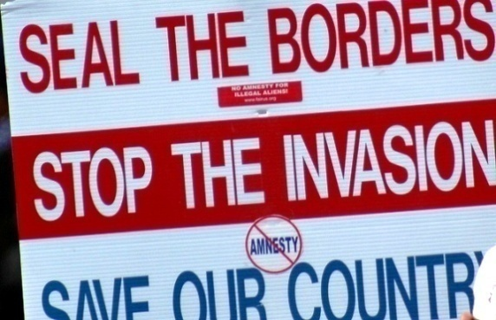
Us and them
‘Strangers’ or ‘newcomers’ can threaten boundaries and identities
Norbert Elias (in Bauman & May, 2001) refers to the ‘established’ and ‘outsiders’
Think about the current immigration concerns surrounding the issue of possible influxes of migrants from E. Europe and elsewhere
Different parts of the country will respond differently to newcomers – and the idea of newcomers

Slide 29
Police culture
‘Working personality’ recurring theme in sociological studies of Policing.
But difficult thing to define- subcultural groups – ‘patrol culture, canteen culture, cardigan squad’
Are Police officers born or made?
Presumption that a certain type of person joins the police – Ideas of their characteristics?

Slide 30
Characteristics of Police Officers
Traditionally male, white, working class, few qualifications .
Coleman and Adorno (1982) – police recruits had more illiberal and intolerance of issues such as migration and death penalty thank a control group.
Police officers enter the organisation with regressive and insular attitudes.
Tried to counter this by recruiting from diverse communities and allowing graduate entry.
Transformational leadership.
Improved training of recruits around diversity and equality.

Slide 31
But what about the nature of the job?
Shift work – restricts social relations outside of the organisation- encourages enhanced solidarity and insularity (Cain, 1973).
Probationer training – until recently, prolonged period of training away from family and wider community
Uncertainty of the everyday – officers become loyal to their group
Pressures to be loyal creates an atmosphere that makes it difficult to challenge behaviour
Nature of the job- fosters suspicion and cynicism, reinforcing stereotypes

Slide 32
Implications of police culture
Over policing of some communities
Failure to provide an adequate response to victims of some types of crimes
Media exposes of police work have contributed to a ‘folkloric construction of police deviance’ which has undermined the legitimacy of the police (Reiner, 2000)

Slide 33
However….
Police culture is not monolithic, unchanging or universal- it varies across the service & cannot be assumed that all police officers have the same values and norms (Reiner, 2000)
Police culture does not provide an absolute guide to officer behaviour – discretion an key feature of policing
Culture can be resisted – LGBT, women, BME officers
Waddington (1999) – found that the behaviour police display in the ‘canteen’ does not necessarily transcend to the street
Police work is ‘dirty work’ normalising experience is part of the police role.
Researching police culture should seek to explain police behaviour and not simply seek to condemn it!

Slide 34
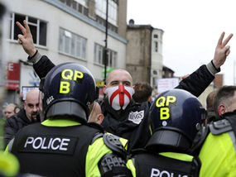
How conflict can arise in societies
Society can be seen as comprising a variety of groups
Differences in views, values, norms
Cultural or language differences
Competition over valued/scarce resources (e.g. jobs, homes, health services, school places)
People get ‘labelled’ in a certain way (eg. ‘benefits scrounger’; ‘extremist’)
Pace of change (e.g. new migrations, new technology)
Perceived loss of or sensed threat to identity, status, power
Lack of or faulty knowledge of the ‘other’
Social distance (one group not engaging with another)
Police often have to intervene, to protect people, to uphold the law,
to keep order or to safeguard people’s rights
But what happens if the Police are the source of stigma, prejudice and discrimination?
Does that enhance confidence in the Police?

Slide 35
People’s responses to ‘difference’
Positive prejudice
Biased towards
Unfair treatment in favour of
Indifferent
“Never really thought about it”
Negative prejudice
Supportive
“Don’t care either way”
Biased against (mental attitude)
Hostile (words, looks)
Hatred (powerful emotion but difficult to define?)
Behaviour (unfair treatment or violence)
“Don’t have an opinion”
Mental attitude and feelings are one thing: what about how those thoughts and feelings affect behaviour?

Slide 36
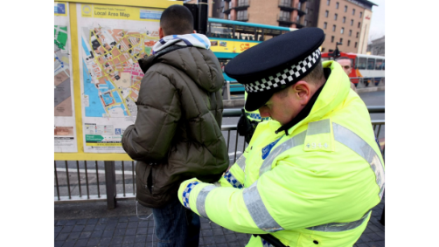
What happens when prejudice is turned into action....
Power - personal strength
Or from having a ‘gang’ around them
Or power from their position at work (the boss)
Or political power (a politician)
Or power in law (police, judge)
Prejudice becomes discrimination….

Slide 37

Discrimination
Thompson (2012: 47) defines discrimination as ‘unfair or unequal treatment of individuals or groups based on an actual or perceived difference...’.
It has been more simply defined as ‘prejudice plus power’ or ‘prejudice in action’ (see Barron and Byrne, 1994, cited in Hall, 2005: 23).

Slide 38
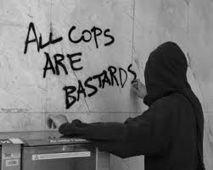
Stereotypes
The ‘pictures in our heads’ (Lippman, 1922)
They help us with everyday life
The problem with stereotypes is they are stubbornly resistant to new information
“...an over-simplified, biased and above all inflexible conception of a social group.”
- Argyle & Colman (1995: 104)

Slide 39

Stigma
“Stigma – the situation of the individual who is disqualified from full social acceptance” (Goffman, 1990: 9)
Term/concept dates back to Ancient times
Linked to idea of ‘scapegoat’ – someone ‘we’ can attach our fears and blames to in respect of everyday problems
Notes:
Being born with some form of imperfection or disability (‘cursed by the gods’: Quarmby, 2011) Connotations of ‘impurity’, ‘sin’, ‘evil’ or ‘misfortune’
(gay people, BME groups, Young people, unemployed, people with HIV, criminals, sex workers )

Slide 40
Legislation
Sex Discrimination Act 1975
Race Relations Act 1976
Disability Discrimination Act 1995
Special Educational Needs and Disability Act 2001
Maastricht Treaty 1992
Race Relations (Amendment) Act 2000
Employment Equality (Sexual Orientation) Regulations 2003
Employment Equality (Age) Regulations 2006
Equality Act 2006
Equality Act 2010 brings together these previous ‘equality’ laws

Slide 41

Equality Act (EA) 2010: Overview
The Equality Act provides a modern, single legal framework with clear, streamlined law to more effectively tackle disadvantage and discrimination.
It replaced previous anti-discrimination laws with a single Act, making the law easier to understand and strengthening protection in some situations.
It sets out the different ways in which it’s unlawful to treat someone.
Refers to ‘public authorities’ such as police
Talks about an ‘equality duty’
‘Protected characteristics’
Notes:
Aims of the Act The Equality Duty has three aims. It requires public
bodies to have due regard to the need to:
(1) eliminate unlawful discrimination, harassment, victimisation and any other conduct prohibited by the Act;
(2) advance equality of opportunity between people who share a protected characteristic and people who do not share it;
(3) foster good relations between people who share a protected characteristic and people who do not share it.

Slide 42
Example of due regard for the
Equality Duty
A police service, when reviewing its policy on hate crime, finds that 68% of all hate crime reported is described as being homophobic. The police take account of the extremely high occurrence of hate crime on the local LGBT population in drawing up and implementing its new policy addressing hate crime.
Eg – consulting more closely with LGB communities; setting up improved reporting schemes; nominating police liaison officers.

Slide 43
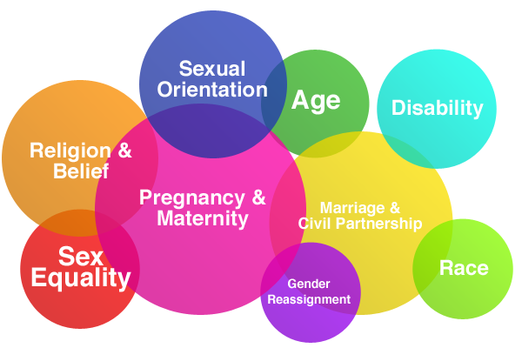
The 9 Protected Characteristics (s.4 Equality Act 2010)

Slide 44
Finally
Police have a particular role and responsibility within modern societies
They have a legal, ethical and professional responsibility to treat people fairly
Primary concern is to keep people safe
This means different things to different people and groups of people
Police must be sensitive to this diversity
And to the limitations within their own staff, culture(s) and institution – and look for continuous improvements

Slide 45
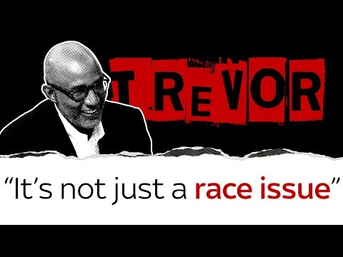

Slide 46
References/Further Reading
ACAS (2011) The Equality Act – What’s new for employers? at http://www.acas.org.uk/media/pdf/n/8/Equality_Act_2010_guide_for_employers-accessible-version-Nov-2011.pdf on 17/8/13
Mental HealthCare (2013) Employment, at http://www.mentalhealthcare.org.uk/employment on 24/10/13.
Commonwealth Human Rights Initiative (2005) Police Accountability, Too Important t Neglect, Too Urgent To Delay, New Delhi, CHRI.
Dept of Health (n.d.) Advice for employers on workplace adjustments for mental health conditions, at https://responsibilitydeal.dh.gov.uk/wp-content/uploads/2012/09/Advice-for-employers-on-workplace-adjustments-for-mental-health-conditions.pdf on 24/10/13.
Equality and Human Rights Commission: (2013a) New Equality Act Guidance, at http://www.equalityhumanrights.com/advice-and-guidance/new-equality-act-guidance/ on 24/10/13.
Equality and Human Rights Commission: (2013b) Human Rights Case Studies, at http://www.equalityhumanrights.com/advice-and-guidance/equal-rights-equal-respect/useful-information/human-rights-case-studies/ on 21/10/13
Govt. Equalities Office (2011) Equality Act 2010: Public Sector Equality Duty. What Do I Need To Know? A quick Start Guide For Public Sector Organisations, www.gov.uk/government/uploads/system/uploads/attachment_data/file/85041/equality-duty.pdf on 20/8/13

Slide 47
References/Further Reading
Gov.UK (2013a) Equality Act 2010: guidance, at https://www.gov.uk/equality-act-2010-guidance on 20/8/13
Gov.UK (2013b) Discrimination: your rights, at https://www.gov.uk/discrimination-your-rights/types-of-discrimination on 16/8/13
LJM (2013) Useful Definitions under the Equality Act 2010, at http://www.ljmu.ac.uk/EOU/116201.htm on 20/8/13
Ministry of Justice (2006) Making sense of human rights, at http://www.justice.gov.uk/downloads/human-rights/human-rights-making-sense-human-rights.pdf on 24/10/13
National Council for Civil Liberties (2010) A Parliamentarian’s Guide to the Human Right’s Act, at http://www.liberty-human-rights.org.uk/policy/reports/parliamentarian-s-guide-to-the-human-rights-act-sept-2010.pdf on 20/10/13 (p. 4; p.7); CPS (2013) Human Rights and Criminal Prosecutions at http://www.cps.gov.uk/legal/h_to_k/human_rights_and_criminal_prosecutions_general_principles/ on 20/10/13
Simpson, S. (2010) Equality Act 2010: ten example dual discrimination scenarios, Personnel Today, 08 Sept. at http://www.personneltoday.com/articles/08/09/2010/56507/equality-act-2010-ten-example-dual-discrimination-scenarios.htm on 20.8.13

