Slide 1
Integrators & Differentiators

Slide 2
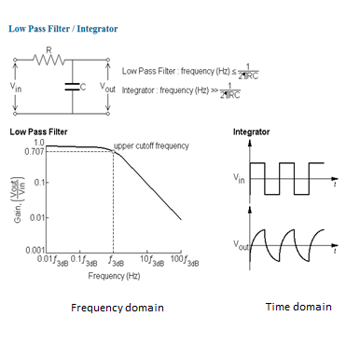

Integrators
An Integrator is an RC circuit that mathematically integrates its input to produce an integrated output.
An RC integrator circuit looks like a passive low pass filter, as shown opposite.
Whereas a filter’s performance is assessed in the frequency domain, an integrator’s performance is assessed in the time domain.
i.e. the same circuit can be used for low pass filtering or integrating depending on the domain we use to assess it.
LPF : Frequency ≤ $\frac{1}{(2xπ.R.C)}$
Integrator : Frequency >> $\frac{1}{(2xπ.R.C)}$
Frequency domain
Time domain

Slide 3
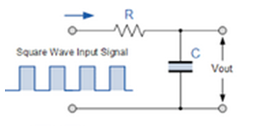
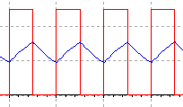
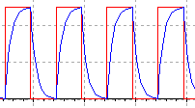
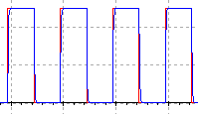
Effect of an integrator on a pulse train.
Assume we inject a 50/50 pulse train into the integrator. Assuming the duration of the pulse is “t” seconds.
The duration of the pulse (t) relative to the time-constant (τ) determines the impact of the integrator, as follows:
If (t) << 5. τ the integrator output is:
If (t) = 5. τ the integrator output is:
If (t) >> 5. τ the integrator output is:
Pulse width = t secs

Slide 4
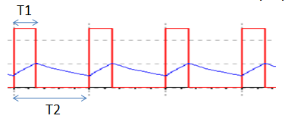
In the above diagrams the red traces represent the input pulse train , the blue traces indicate the corresponding outputs.
Mathematically, the integral (∫) of a square function is a triangular function, therefore when (t) << 5.τ the RC network is correctly integrating its input.
It is therefore possible, with correct design, to use an integrator to convert a square-wave into a triangle wave. This is,in fact, a simple and common way to achieve triangle or saw-tooth waveforms.
The diagram below shows how a saw-tooth wave is achieved if the pulse train does not have a 50% Duty Cycle i.e. T1 > or < 50% of T2.
In the example shown T1 < 50% of T2.

Slide 5
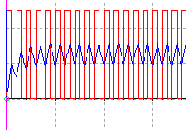
Initial charging sequence of the RC circuit.
Note: from the diagram opposite it is clear that the triangle wave takes time to establish itself and stabilise.
It should also be clear there is a charging curve associated with establishing the triangle wave.
It actually takes 5. τ seconds to establish itself.
The reason for this is that the square-wave has an average value of 0.5 times its amplitude over the whole period. In fact the integrator is effectively charging up as a result of the dc content of the waveform and is simultaneously integrating the ac content. The vertical dotted line indicates a period of 5 time constants.
V..
5 time constants (5.τ)
The dc average of the squarewave is V/2 and it takes 5τ to charge to V/2

Slide 6
Mathematics for the Integrator Circuit
The applied voltage, V_{in ,} drives a current (i) through the circuit where
i = (V_{i} – V_{out} )/R .
Now, if the pulse width is sufficiently narrow so that “t” << 5.τ then V_{out} << V_{in} and i = V_{i} / R approximately.
Also, the current in a capacitor is given by
i = C. dV/dt
Therefore C. dV_{out}/dt = V_{i} / R
Hence dV_{out}/dt = V_{i} / (R.C) if we integrate both sides with respect to t we get:
v_{i}
i

Slide 7
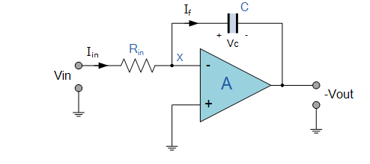


Operational Amplifier Integrator
Also
= -
Since I_{in} = I_{f} then and hence:
Note: Vout is inverted with respect to Vin, hence the negative sign.

Slide 8
Example:
Suppose Vin is a constant value of say 5V, R_{in} = 1MΩ and C = 1μF.
Hence , since V_{in} = a constant
_
Hence = -5 V/sec
The output voltage will therefore ramp downwards at a rate of 5V every second as long as the input remains constant at 5V.

Slide 9
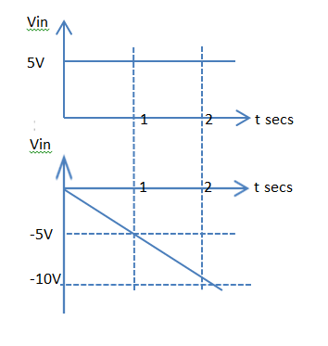
Note: Although the output ramps downwards it will eventually hit the negative rail and saturate at that level.
If V_{in} is a square-wave then V_{out} will repeatedly ramp down and then up in sympathy with the input; as seen on slide 3.
Limited eventually by power rails

Slide 10
Differentiators
As you know Low-Pass and High Pass passive filters have different responses in the frequency domain, therefore it is not surprising this is so in the time domain as well.
A Low-Pass filter can change the shape of a waveform in the time domain (i.e. it can Integrate)
A High Pass filter can change the shape of a waveform in the time domain(i.e. it can Differentiate)

Slide 11
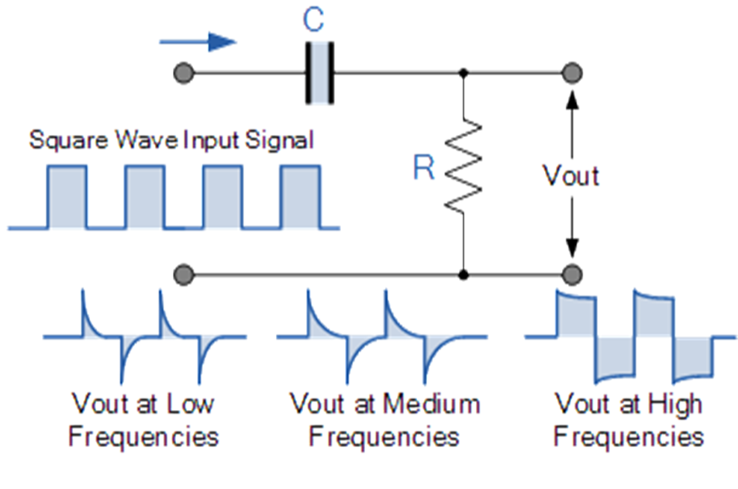
A typical set of time-domain responses are shown below: The width of the input pulses, relative to the charging time of the capacitor, will determine the shape of the output of the Differentiator (High Pass filter) circuit.
t>>5.τ t = 5.τ t << 5.τ
Typical output responses

Slide 12
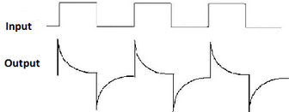
It is important to understand that it is not possible to change the voltage across a capacitor instantaneously; to do so would require infinite current, which is not practical.
Therefore if we apply a step input to one side of a capacitor, as shown below, the voltage on the other side will have to change in exactly the same way so that there is no sudden change in voltage across the capacitor.
5V
t
O V
5V
O V
-5V
t₀ t₁ t₂
t = 5.τ

Slide 13
As the input signal rises suddenly we can see that the output, on the other side of the capacitor , follows it.
Depending on the pulse width “t” relative to 5.RC or 5.τ the response we get will be different. The example shown is for t = 5τ.
Here we see that after the initial step (t₀), the capacitor charges up over a period of 5.τ. The charging process requires the right hand plate to move towards zero since the left hand plate is fixed at 5V, for example.
When the input pulse goes negative, at t₁ the output has just reached zero when there is the sudden 5V change in the negative direction of the input to the capacitor, consequently the right hand plate of the capacitor must also move in a negative direction to -5V in because there cannot be any sudden voltage change across the capacitor.

Slide 14
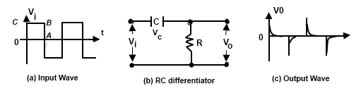
Mathematics for the Differentiator
Current in a capacitor is related to the capacitor by the equation:
I = C. dV/dt, but this is also the resistor current which is given by V/R.
Applying these general equations to the circuit above we can say:
V_{o} / R = C. dV_{i} /dt
Hence V_{o} = R.C. dV_{i} /dt
This equation tells us that the output voltage of the differentiator is proportional (R.C) to the rate of change of its input (dV_{i} /dt). Therefore for dc or slowly changing inputs the output is low but for fast changing inputs the output is large.

Slide 15
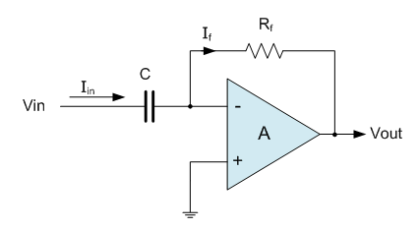
Operational Amplifier Differentiator
I_{in} = C. dVin / dt and I_{f} = (0 – Vout) / R = - Vout / R
Hence - Vout/R = C. dVin / dt
Therefore Vout = - C.R . dVin / dt

Slide 16
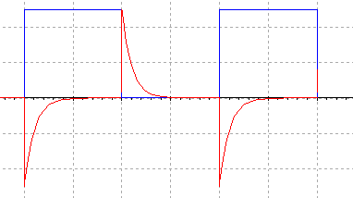
Input and Output Waveforms for an Operational Amplifier Differentiator Circuit.
Input squarewave
Differentiated output
It is important to note that although square-waves have been used for the input waveforms for both Integrator and Differentiator circuits above, the input can be any waveform, not just square-wave.

