Slide 1
Waste law
Lara Hopkinson

Slide 2
Overview
The challenges
Case studies
Policy / legislative developments
  European
  Domestic
Duty of Care
Carriage of waste
Economic instruments
Producer Responsibility

Slide 3
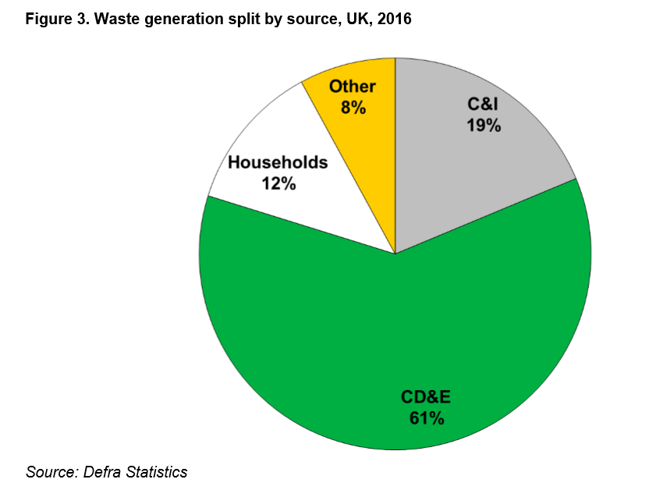
Key challenges
Practical:
  Amounts / volumes created
  Differing sources / types
    E.g. MSW, C&D, C&I, clinical….
  Disposal method – reliance on landfill
    Cheap, easy….
  Significant changes due to EU law & policy
    Brexit?
Source: UK Statistics on Waste, Feb 2019

Slide 4
Regulatory challenges
Definition of waste
  Grey areas e.g. if can be reused but discarded, is it waste?
Wastes are not necessarily ‘harmful’
  Generally arises if waste is mishandled or abandoned
Impacts not clearly understood
  Case studies should help highlight this

Slide 5
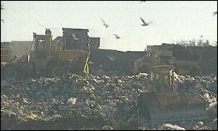
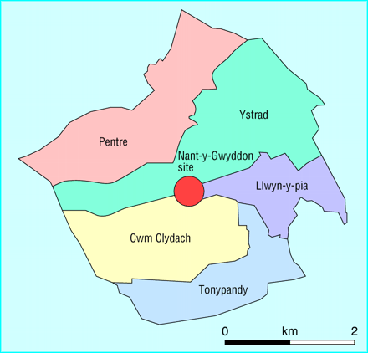
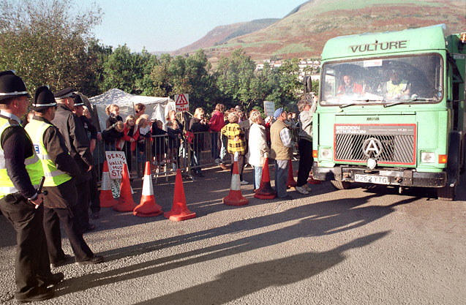
Case study – Nantygwyddon landfill
Sources: BMJ / BBC / Ian Homer Photography

Slide 6
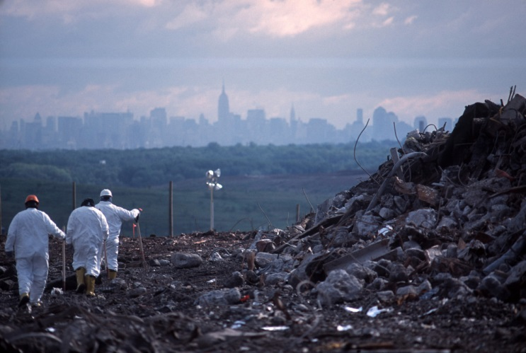
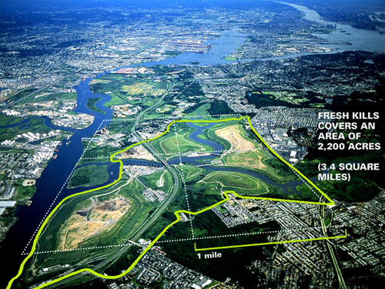
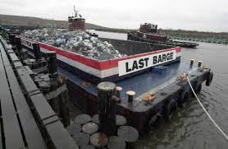
Case study – Fresh Kills landfill
Sources: Open Buildings / Fresh Kills Park / Staten Island Live

Slide 7
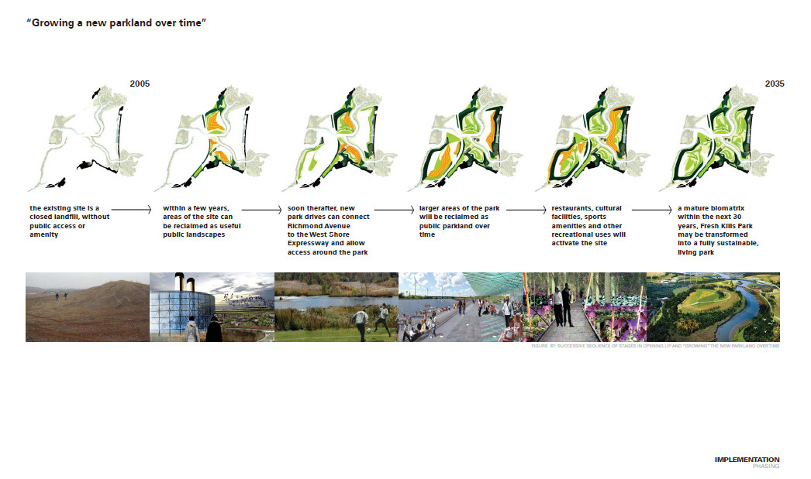
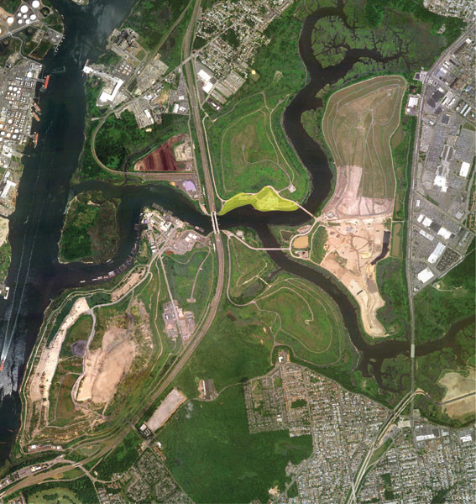

Source: Arch Daily

Slide 8
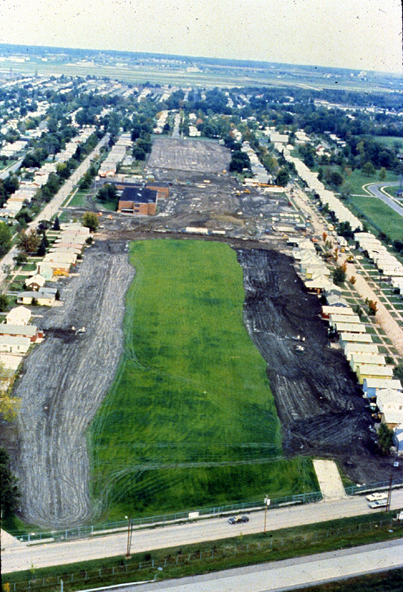
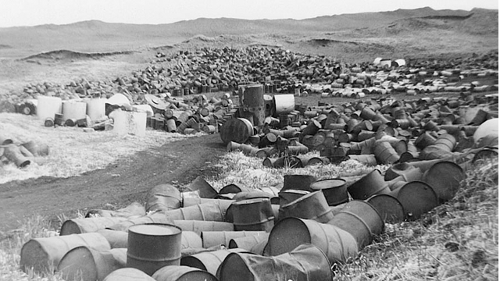
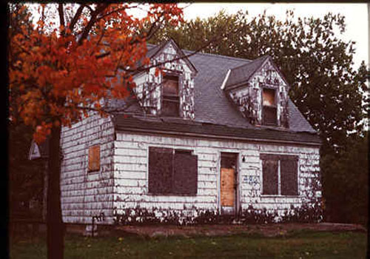
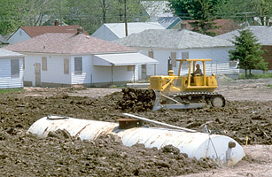
Case study – Love Canal, USA
Sources: US EPA / Time / Pinterest / Believe it or Not

Slide 9
Policy developments
EU – Environment Action Programmes
  1st – 1973; 7th – 2013
EPA90 – “Secretary of State will outline a strategy”
England & Wales – Making Waste Work (1995)
England & Wales – Waste Strategy (2000)
Wales – Wise about waste (2002)
England – Waste strategy (2007, updated 2018)
Wales – Towards Zero Waste (2010)

Slide 10
Waste Framework Directive
1975 – original WFD
  “the environment and human health by preventing or reducing the adverse impacts of the generation & management of waste”
1991 – amended, obligation on network of disposal installations
2006 – re-codified, definition highlighted
2008 – waste hierarchy within EU law
2018 – further updated with greater waste / by-product focus

Slide 11
Key provisions (2008)
Sets out collection & transport framework
Boost waste prevention & recycling
Definition of waste, recover & disposal
Procedures applicable to by-products / wastes ceasing to be waste
Duty for separate collection of certain materials
  Paper, metal, plastic, glass

Slide 12
2018 amendment
Waste definition remains the same
Update to by-product status
Key changes on end of waste status
Provision for newer quality protocols

Slide 13
European List of Wastes
Article 7 WFD – requires drawing up list of waste
European Waste Catalogue (EWC) (1994)
  20 main chapters
  Individual wastes assigned a 6-digit code
European List of Wastes (LoW) (2000), amended 2014
Required as part of Duty of Care Regulations
Standardise waste description across Europe
Enable monitoring, recording & control

Slide 14
Waste Treatment Directives
Landfill Directive (1999/31/EC)
  Prevent or reduce negative environmental effects
  Landfill classification
  Restricting certain wastes going to landfill
  Waste acceptance criteria (WAC)
Waste Incineration Directive (2000/76/EU)
  Prevent or limit negative environmental effects
  Maximum emission levels
  Environmental permits
  Recast into Industrial Emissions Directive 2010

Slide 15
Domestic waste policy
Duty to transpose Directives into domestic law
  Environmental Permitting (England & Wales) Regulations 2010, as amended
  Waste (England & Wales) Regulations 2011 (as amended)
Statutory objectives:
  Article 13 – Protection of human health & environment
  Article 16 – Principles of self-sufficiency & proximity

Slide 16
What is ‘waste’?
Definition – “any substance or object which the holder discards, intends to discard or is required to discard”
By-products are not deemed waste (Article 5)
Waste ceases to be waste in certain conditions (Article 6)
Has the substance been consigned to recovery / disposal operation?

Slide 17
Case law
C-304/94 Euro Tombesi and Adino Tombesi
C-206/88 & C-207/88 (Vessoso and Zanetti [1990])
C-129/96 (Inter-Environnement Wallonie v Région Wallone)
C-9/00 (Palin Granit Oy & Vehmassalon) [2002]
OSS Group v Environment Agency [2008]

Slide 18
Types of waste
Defined in WFD:
  Controlled
  Hazardous
  Inert
Relates to types of landfill, WAC, etc.

Slide 19
Source: Wales Waste Information 2013

Slide 20
Duty of Care
Environmental Protection (Duty of Care) Regulations 1991 (as amended)
Waste Duty of Care Code of Practice 2016
  “import, produce, carry, keep, treat, dispose of or, as a dealer or broker have control of, certain waste”
  Applies to controlled wastes (with exceptions)
  Applies until waste has reached its final destination
    Each holder will share obligations

Slide 21
Duty of Care requirements
Take ALL reasonable steps to:
  Prevent unauthorised or harmful deposit, treatment or disposal of waste
  Prevent a breach by any other person to meet the requirement to have a permit or breach permit condition
  Prevent escape of waste under your control
  Ensure person to whom waste is transferred is authorised
  Provide accurate description of waste on transfer, & retain documents

Slide 22
Waste carriage
Registration required for carriers, brokers & dealers
  Carrier – person or business transporting waste
  Broker – middle man, arranging for others wastes to be moved by other companies
  Dealer – use an agent to buy waste from others to sell on
Once registered, appear on public register

Slide 23
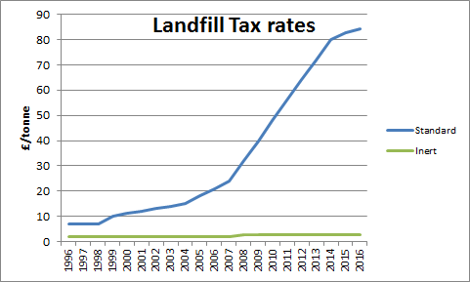
Economic instruments
More common in relation to waste management
Landfill Tax
  Introduced under the Finance Act 1996
  Standard (£96.70)
  Inert (£3.10)
Source: 360 Environmental

Slide 24
Producer Responsibility
Obligations on businesses that manufacture, import & sell products
Responsibility for end of life environmental impact
Requirements:
  Minimise waste & promote reuse
  Ensure waste products are treated, meeting recovery targets set
  Design products with reduced materials, enhanced reusability & recyclability

Slide 25
Applications
Packaging waste
Waste Electrical and Electronic Equipment (WEEE)
End of Life Vehicles (ELVs)
Batteries
Restriction of Hazardous Substances

Slide 26
Useful information
Environmental law, ch18 (Waste Management)
BBC (www.bbc.co.uk)
Arch Daily (www.archdaily.com)
Fresh Kills Park Alliance (www.freshkillspark.org)
New York Times (www.nytimes.com)
UK Government (www.gov.uk)
Natural Resources Wales (www.naturalresources.wales)

