Slide 1
ECIE6004C
Safbwyntiau Byd-eang ar Addysg
– Sesiwn 4
Heike Griffiths, Tracy Colmer 2021

Slide 2

Cefndir i Addysg Gynaliadwy
Digwyddiad allweddol Cynhadledd y Cenhedloedd Unedig ar yr Amgylchedd a Datblygu – a elwir yn Uwchgynhadledd gyntaf y Ddaear (1992)
Uwchgynhadledd y Ddaear 2002 yn Johannesburg – cyswllt wedi’i wneud rhwng cynaliadwyedd ac addysg
Gweithgarwch dynol yn bygwth yr amgylchedd
Notes:
One of key events of 20th c was 1992 un conference on environment and development attended by world leaders and activists from all over the world. This event, which became known as the first earth summit recognised that human activity was increasingly threatening the environment or biosphere – that narrow zone of earth, air and water on which all life (plants, creatures, humans) depends. It also recognised that issues of development ie. global wealth and poverty were threatening people’s life chances in both rich and poor countries. The welfare of planet and people, issues of environment and development were thus recognised as being inextricably related. One of the terms often used to describe these concerns is ‘sustainable development’. In the 2002 earth summit in johannesburg again 10 years on to discuss sustainable development. Earth summit Johannesburg - agreement was made to restore the world's depleted fisheries for 2015
Agenda 21 refers to aiming to improve education and awareness of sustainability in order to be better place for 21 century.
Un also recognised that education had a crucial part to play in exproling resolution to these issues among the terms used to describe this is educat for sustainable development and the un declared 2005 – 14 to be the decade of ed for sustainable development.
Do they remember from last year in lines of enquiry how people view sustainable development differently. Remind them of economists they believe no limits to growth whilst ecologists recognise finite nature of earth’s natural systems.
Growth ie economy getting bigger is not the same as sustainable development which should aim to improve both human and environmental well-being.

Slide 3
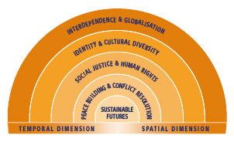
Beth yw safbwyntiau byd-eang AR addysg?

Slide 4

CYSYLLTIADAU Polisi RHYNGWLADOL
(2015)

Slide 5
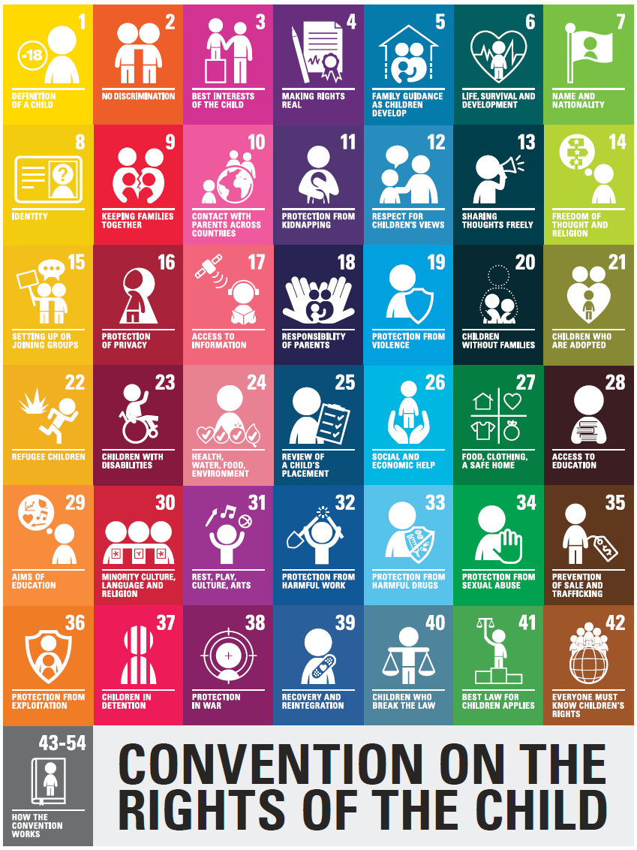
CYSYLLTIADAU POLISI RHYNGWLADOL
(1989)

Slide 6
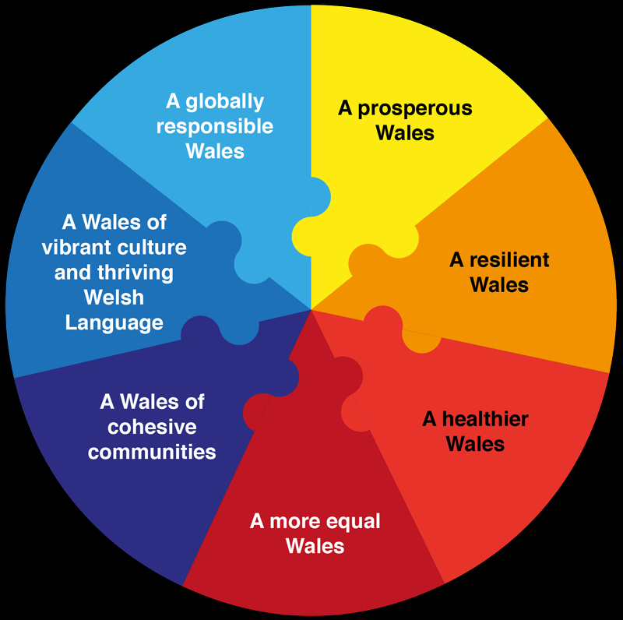
CYSYLLTIADAU POLISI CYMRU
Deddf Llesiant Cenedlaethau'r Dyfodol(2015)
Dyfodol Llwyddiannus(2015)

Slide 7

Llywodraeth Cymru ADCDF
Mae Addysg ar gyfer Datblygu Cynaliadwy a Dinasyddiaeth Fyd-eang (ADCDF) yn ceisio rhoi dealltwriaeth i ddysgwyr, ym mhob cyfnod addysg, o effaith eu dewisiadau ar bobl eraill, yr economi a'r amgylchedd
Notes:
This is what the welsh government have come up with ESDGC

Slide 8
Pam dysgu ADCDF?
Rhoi dealltwriaeth i ddysgwyr o effaith eu dewisiadau ar bobl eraill, yr economi a'r amgylchedd.
Yn herio dysgwyr i weld sut y gallan nhw gyfrannu i fywydau pobl eraill.
Gwneud cysylltiadau rhwng materion lleol, cenedlaethol a rhyngwladol – anelu at gydraddoldeb ar draws y meysydd hyn.
Creu sgiliau cynaliadwy mewn cymunedau
Notes:
Can you think of an example of some way children in schools can become aware of the impact of their choices on other people, the economy or the environment. Maybe getting them to think about choosing fair trade products, choosing to recycle, choosing to live in a green way – walking to school instead of bus/car, choosing to buy locally instead of in a supermarket – how will this affect the local town/business.
It also aims to encourage schools to challenge learners to engage in culturally diverse experiences, critically evaluate their own values and attitudes, and develop skills that will enable them to challenge injustice, prejudice and discrimination.
Impact of their choices eg. If they know that electricity comes at the press of a switch and water at the touch of a tap, but if they are not taught to ask questions about the why and how of this, they will become yet another gereration committed to unsustainable practices.
Impact of their choices – one school monitor electricity consumption this data viewed half hourly, daily weekly and monthy so that pupils can see the impact of their actions throught heir use of the system
How can they contribute to the lives of others? Oxfam water week, operation xmas child, singing at local old peoples’ home. Helping out in a charity, scouts.
Understanding the impact of their choices locally on national and international – eg shopping locally, less air miles
Sustainable skills within community – the things that will affect the community in the future. Growing own food, buying locally, supporting local business, speaking welsh to sustain the language, looking after ourselves better – less strain on nhs.

Slide 9
Rôl Ysgolion
Cydlynu ac ymgorffori ADCDF yn rhan o ethos ac addysgeg a threfniadaeth eu sefydliad
Rhoi negeseuon clir i ADCDF yn y ffordd y mae'r ysgol yn cael ei threfnu a'i rheoli
Integreiddio ADCDF ar draws yr ysgol gyfan, gan gynnwys yr holl athrawon, staff ategol, llywodraethwyr a'r partneriaethau allanol y mae'r ysgol yn eu ffurfio â sefydliadau a'r gymuned leol
Rhaid ei "wneud" yn ogystal â'i ddysgu
Notes:
How might these things look? Passion and conviction, philosophical dimention. Sustainability at heart of the school and ethos which pervades all aspects of the school and its external relationships.
Successful schools often inward looking, focussed on attainment and good management and the gloval dimension is low on priorities. But sustainable schools look owtward to engage their local communities and have a global perspective. This wider, more inclusive vision is also seen in the strong pupil voice and involvement of pupils in decision making.
Can they think of examples?
What do we mean ‘required to do as well as teach it’ – key qualiities are that school leaders are optimistic and owtward looking. Tlhey are conscious of the place of the school in the local and global community they have a sytemic understanding of the world and their place in it and can communicate this to others. They understan the interconnectedness of society, the environment and individuals within these contexts.
Everyone in the school aware of sustainablility - pupils responded well to tasks that involved practiacal activieies inside and outside the clas and enabled them to research, plan and implement projects that made a clear difference to the school and local communityl
Across national curriculum subjects - high level of engagement of te pupils in work they perceived as relevant to their lives and future well – being.

Slide 10
Role of Schools
Co-ordinate and embed ESDGC as part of the ethos, pedagogy and organisation of their institution
Give clear ESDGC messages in the way the school is organised and managed
Integrate ESDGC across the whole school, involving all teachers, ancillary staff, governors and the external partnerships that the school forms with organisations and the local community
Required to “do” it as well as teach it
Notes:
How might these things look? Passion and conviction, philosophical dimention. Sustainability at heart of the school and ethos which pervades all aspects of the school and its external relationships.
Successful schools often inward looking, focussed on attainment and good management and the gloval dimension is low on priorities. But sustainable schools look owtward to engage their local communities and have a global perspective. This wider, more inclusive vision is also seen in the strong pupil voice and involvement of pupils in decision making.
Can they think of examples?
What do we mean ‘required to do as well as teach it’ – key qualiities are that school leaders are optimistic and owtward looking. Tlhey are conscious of the place of the school in the local and global community they have a sytemic understanding of the world and their place in it and can communicate this to others. They understan the interconnectedness of society, the environment and individuals within these contexts.
Everyone in the school aware of sustainablility - pupils responded well to tasks that involved practiacal activieies inside and outside the clas and enabled them to research, plan and implement projects that made a clear difference to the school and local communityl
Across national curriculum subjects - high level of engagement of te pupils in work they perceived as relevant to their lives and future well – being.

Slide 11
Role of Schools
Co-ordinate and embed ESDGC as part of the ethos, pedagogy and organisation of their institution
Give clear ESDGC messages in the way the school is organised and managed
Integrate ESDGC across the whole school, involving all teachers, ancillary staff, governors and the external partnerships that the school forms with organisations and the local community
Required to “do” it as well as teach it
Notes:
How might these things look? Passion and conviction, philosophical dimention. Sustainability at heart of the school and ethos which pervades all aspects of the school and its external relationships.
Successful schools often inward looking, focussed on attainment and good management and the gloval dimension is low on priorities. But sustainable schools look owtward to engage their local communities and have a global perspective. This wider, more inclusive vision is also seen in the strong pupil voice and involvement of pupils in decision making.
Can they think of examples?
What do we mean ‘required to do as well as teach it’ – key qualiities are that school leaders are optimistic and owtward looking. Tlhey are conscious of the place of the school in the local and global community they have a sytemic understanding of the world and their place in it and can communicate this to others. They understan the interconnectedness of society, the environment and individuals within these contexts.
Everyone in the school aware of sustainablility - pupils responded well to tasks that involved practiacal activieies inside and outside the clas and enabled them to research, plan and implement projects that made a clear difference to the school and local communityl
Across national curriculum subjects - high level of engagement of te pupils in work they perceived as relevant to their lives and future well – being.

Slide 12
9 Cysyniad ADCDF
  Rhyngddibyniaeth
  Dinasyddiaeth a stiwardiaeth
  Anghenion a hawliau cenedlaethau'r dyfodol
  Amrywiaeth
  Ansawdd bywyd, cyfiawnder cymdeithasol ac ecwiti
  Newid cynaliadwy
  Ansicrwydd a rhagofal
  Gwerthoedd a chanfyddiadau
  Datrys gwrthdaro
Notes:
These are the 9 concepts that the gov originally introduced but they were considered complicated to bring into school so simplified it with the 7 themes

Slide 13
7 ThemA ADCDF
Yr amgylchedd naturiol
Defnydd a gwastraff
Newid hinsawdd
Cyfoeth a thlodi
Hunaniaeth a diwylliant
Dewisiadau a phenderfyniadau
Iechyd.
Allwch chi gynnwys eich pwyntiau am faterion addysgol byd-eang dan y themâu hyn?
Notes:
Task – students to fit in their global problems into these categories

Slide 14
Dinasyddiaeth Fyd-eang
Education for global citizenship helps enable young people to develop the core competencies which allow them to actively engage with the world, and help to make it a more just and sustainable place.
(Oxfam Education, 2014)
Notes:
Watch the UNESCO video. Give students time to write their own definition of global citizenship and then demonstrate the Oxfam explanation.

Slide 15
Enghreifftiau o ADCDF ar gyfer safbwyntiau byd-eang AR addysg mewn Ysgolion
Dysgu ffeithiau am anghydraddoldebau addysgol a chymdeithasol, e.e. meithrin partneriaeth ag ysgol yn Zambia
Archwilio hawliau a chyfrifoldebau o fewn cymunedau ar lefelau lleol, cenedlaethol a byd-eang, e.e. CCUHP
Datblygu’r gwaith o wneud penderfyniadau gwybodus a'r gallu i gymryd camau meddylgar, cyfrifol yn lleol ac yn fyd-eang, e.e. Masnach Deg
Datblygu'r gallu i fod yn ddinasyddion llwyddiannus, effeithiol a hyderus nawr ac yn y dyfodol, e.e. dysgu am gyfranogiad gwleidyddol

Slide 16

Addysg ar gyfer Datblygu Cynaliadwy a Dinasyddiaeth Fyd-eang
Tracy Colmer

Slide 17


Beth yw ADCDF?
Nod 4.7 SDG yw darparu addysg ar gyfer datblygu cynaliadwy a dinasyddiaeth fyd-eang (ADCDF).
Nod ADCDF yw hyrwyddo datblygu cynaliadwy gan gynnwys hawliau dynol, cydraddoldeb rhywiol, heddwch ac ymddygiad di-drais, dinasyddiaeth fyd-eang a gwerthfawrogiad o amrywiaeth ddiwylliannol a chyfraniad diwylliannau i ddatblygiad cynaliadwy (UNUSECO, 2016).
(Logo ESDGC. Blog Addysg y Byd,2016).
Dysgwr galluog uchelgeisiol
Cyfrannwr creadigol mentrus
Unigolyn hyderus iach
Dinesydd gwybodus moesegol
Llywodraeth Cymru, 2020 b)

Slide 18








Sut y caiff ADCDF ei gweithredu?
Mae'r ysgol yn defnyddio cyfuniad o ddulliau cynnil a thrwythol i ymgorffori fframwaith ADCDF yn y cwricwlwm.
Mae dulliau gwahanol yn defnyddio adnoddau a thechnegau penodol mewn gweithdai a ddarperir gan Sefydliadau Anllywodraethol.
Dulliau gwahanol yw'r strategaethau sy'n gwella addysgeg mewn addysgu bob dydd (Ridley, 2005)
(PONT, 2020)
(HHE, 2019)
(IIF, 2016)
(PCF, 2016 b)
(Keep Wales Tidy, 2020)
(AYPH, 2020)
(Sustran, 2017a)
(Size of Wales, 2020)

Slide 19

Pwnc ADCDF:
Dewisiadau a Phenderfyniadau
Erthygl 12 CCUHP: Mae gan bob plentyn yr hawl i fynegi ei farn, ei deimladau a'i ddymuniadau ym mhob mater sy'n effeithio arno, a bod eu barn yn cael ei hystyried a’i chymryd o ddifri
(UNICEF, 2016 t.5)
Mae'r egwyddorion addysgeg yn codi ymwybyddiaeth disgyblion ac yn eu cynnwys wrth ystyried atebion lleol i faterion byd-eang ac yn rhoi'r sgiliau iddyn nhw ddychmygu dyfodol newydd.
(Peterson a Warwick, 2015).
(UN, unknown date b)
(AYPH, 2020)

Slide 20
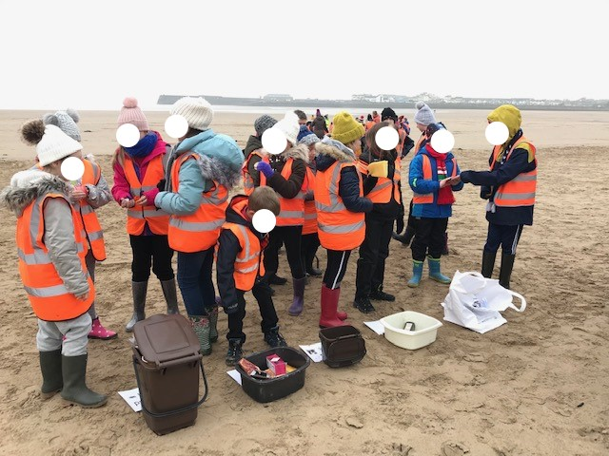


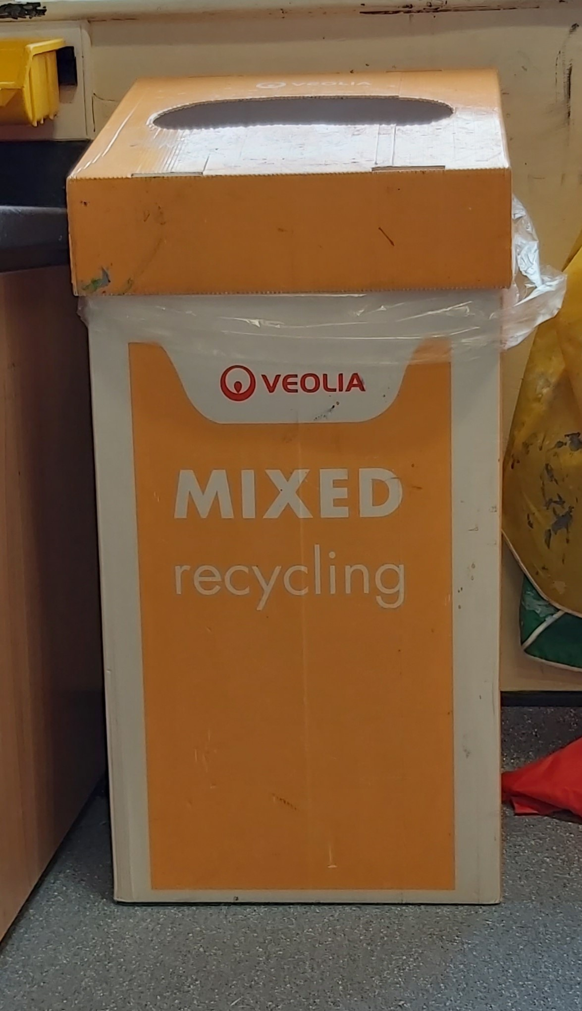
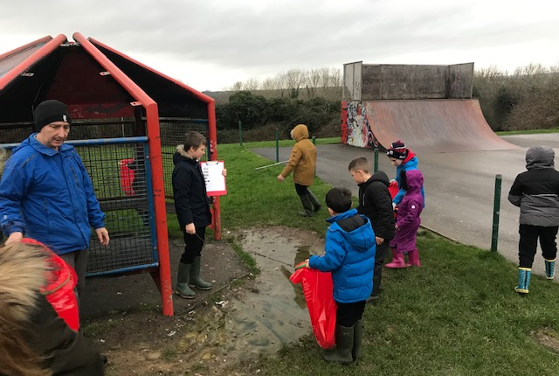

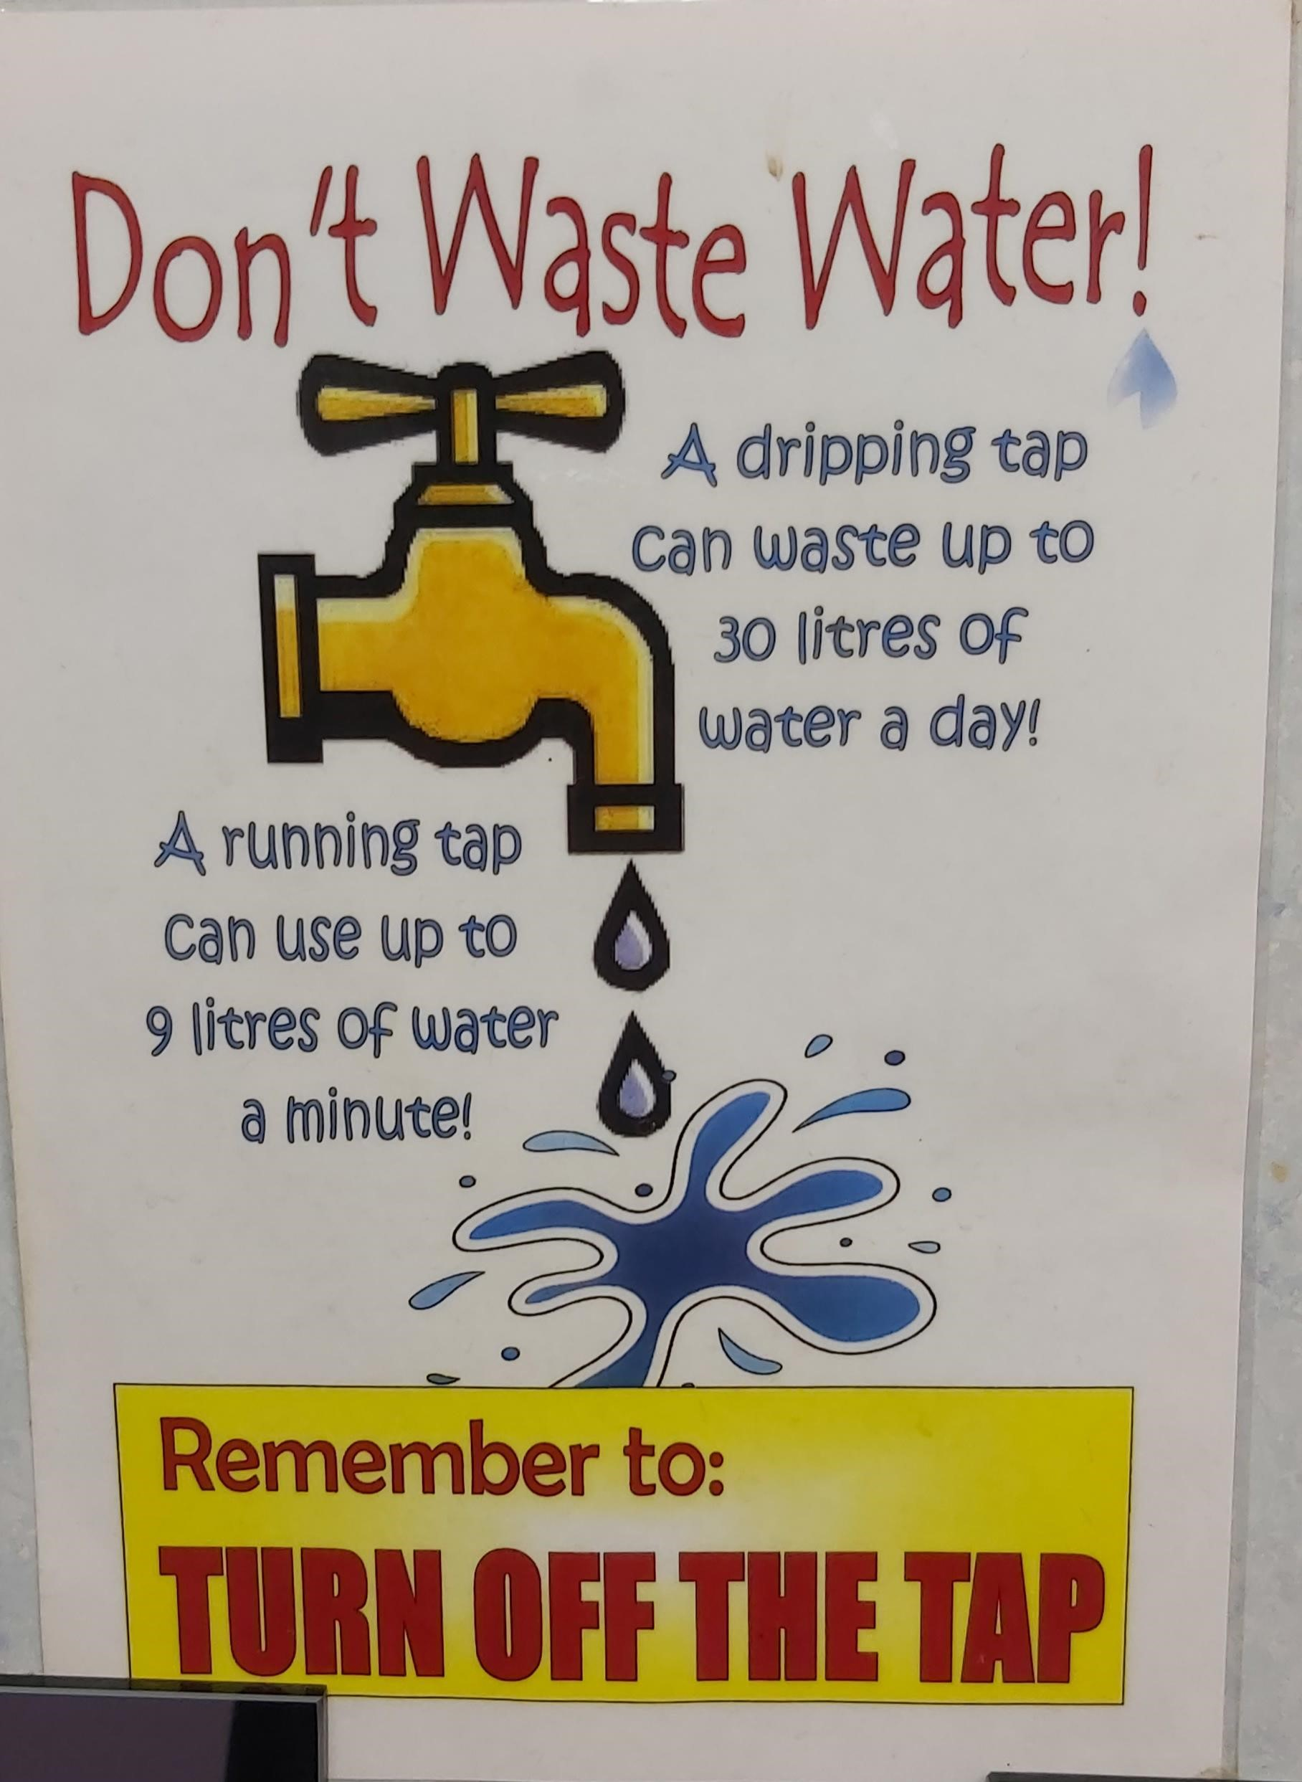
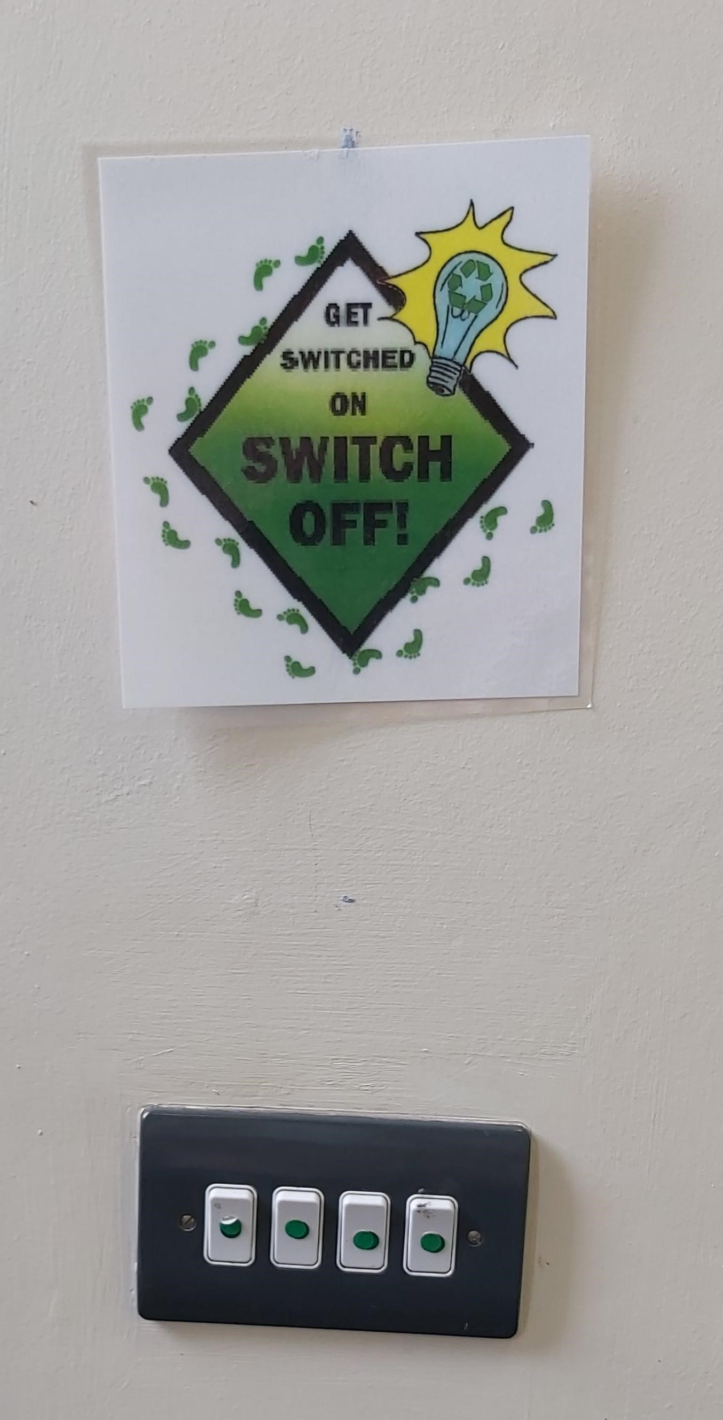

Thema ADCDF:
Defnydd a Gwastraff
Yn yr ysgol a'r cyffiniau, anogir disgyblion i ailgylchu papur a chau tapiau a diffodd goleuadau pan nad ydyn nhw’n cael eu defnyddio.
Yn y gymuned leol. Ar hyn o bryd mae'r ysgol yn cymryd rhan mewn menter i gadw'r gymuned leol yn lân ac yn daclus.
(UN, unknown date b)

Slide 21
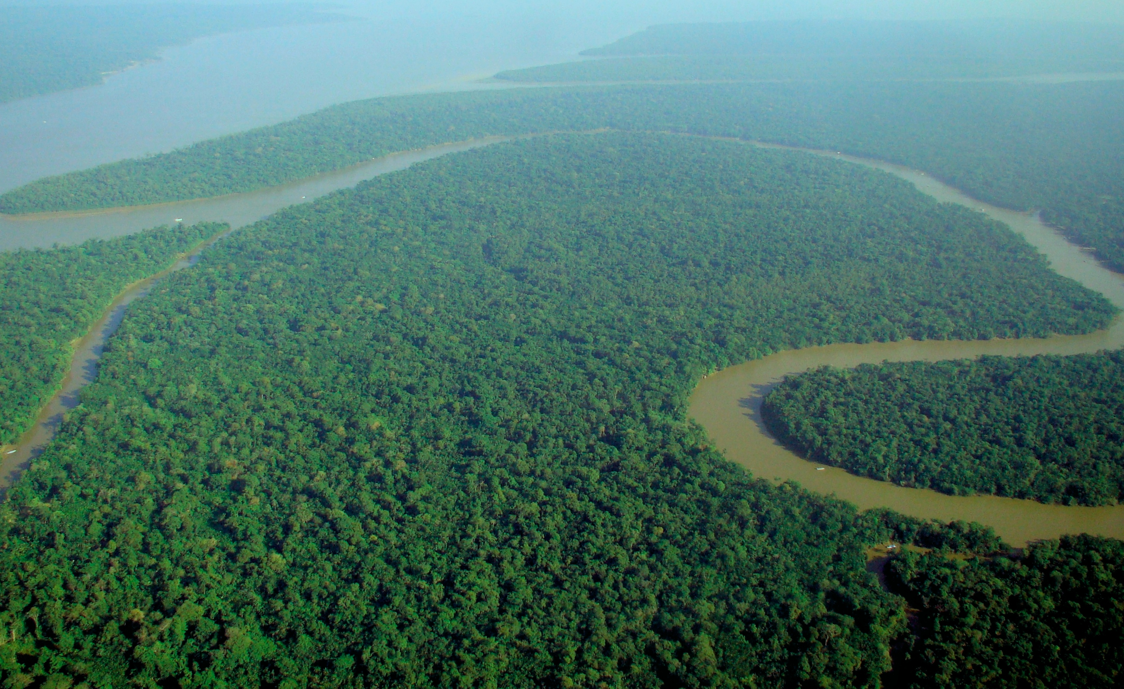

Thema ESDGC: Newid yn yr Hinsawdd
(Mae Maint Cymru yn un o Sefydliadau Anllywodraethol Cymru sy'n ceisio cynnal ardal o goedwig drofannol ddwywaith maint Cymru yn rhan o'u hymateb cenedlaethol i’r newid yn yr hinsawdd (Maint Cymru, 2020).
(UN, unknown date b)
https://upload.wikimedia.org/wikipedia/commons/d/d0/Aerial_view_of_the_Amazon_Rainforest.jpg
(Size of Wales, 2020)

Slide 22
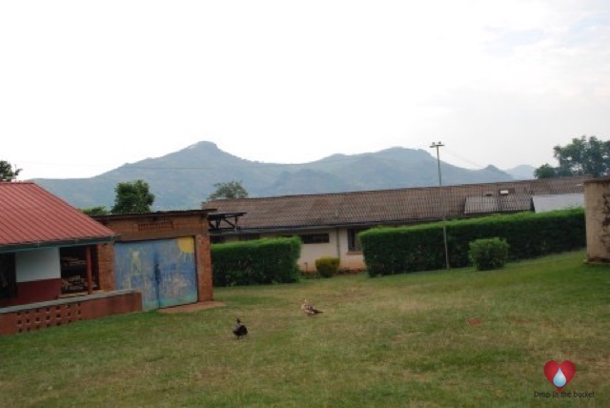



Thema ADCDF: Hunaniaeth a Diwylliant
Ysgol Gynradd Busumbu,
Mbale, Uganda.
(Drop in the Bucket, 2016)
Trefnodd disgyblion roi llyfrau gyda rhodd o £1 i dalu am y gost postio.
(PONT, 2018)
Sefydliad anllywodraethol yw Ymddiriedolaeth Partneriaethau Rhwydweithio Tramor (PONT) sy'n helpu plant yng Nghymru ac Uganda i ddysgu am eu byd trwy efeillio ysgolion yng Nghymru ag ysgolion yn Uganda. Hyd yn hyn, mae PONT wedi gefeillio dros 100 o ysgolion.
(Drop in the Bucket, 2016)
(UN, unknown date b)

Slide 23





Thema ADCDF: Cyfoeth a Thlodi
Dechreuodd Cronfa Gymunedol Philippine yn 2002 gyda'r nod o Amddiffyn Plant a Theuluoedd trwy weithio gyda'r gymuned ar gyfer y gymuned. Yn 2015, daeth yn Gronfa Gymunedol Borffor.(PCF, 2020).
Images curtesy of PCF.org (2020)
(UN, unknown date b)

Slide 24
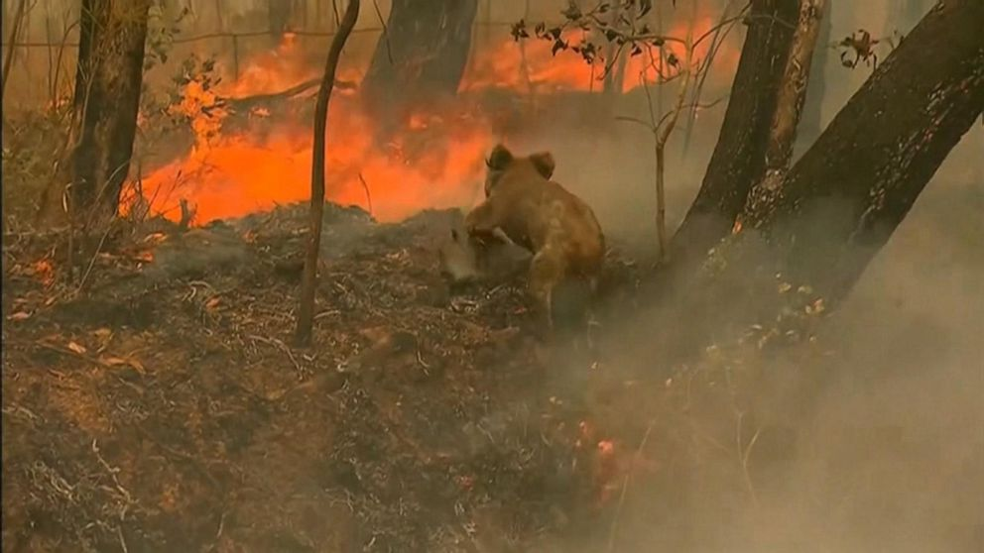
Thema ADGDF: Amgylchedd Naturiol
(UN, unknown date b)
Yn dilyn tanau coedwig diweddar yn Awstralia, cafodd y plant eu syfrdanu gan yr effaith ddinistriol ar fywyd gwyllt, yn enwedig yr eirth coala. Cymerodd y plant ran mewn diwrnod heb wisg ysgol a chodi £387.44 ar gyfer Cronfa Bywyd Gwyllt y Byd.
https://ichef.bbci.co.uk/images/ic/720x405/p07vhmyj.jpg

Slide 25

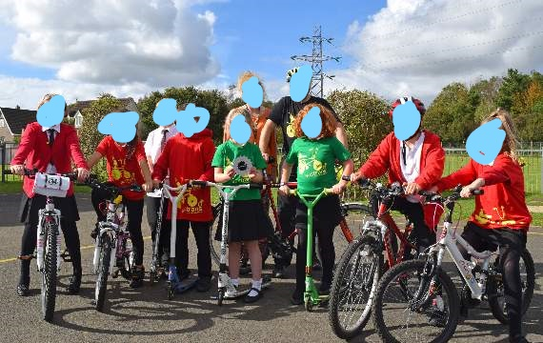

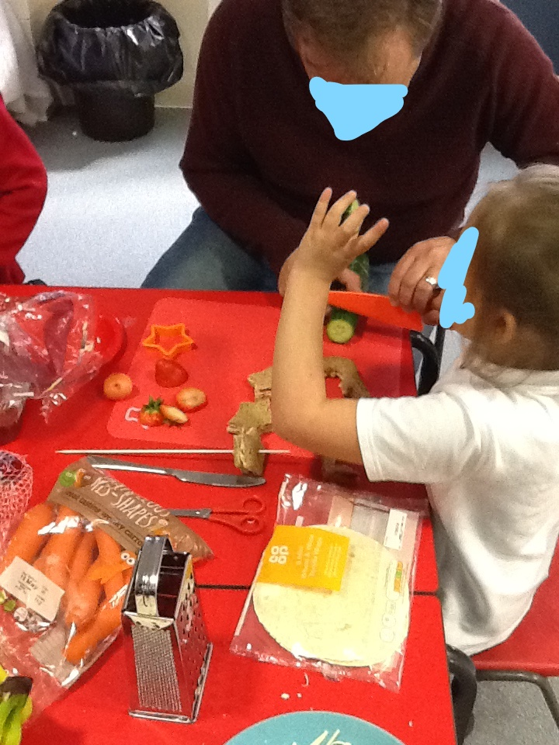
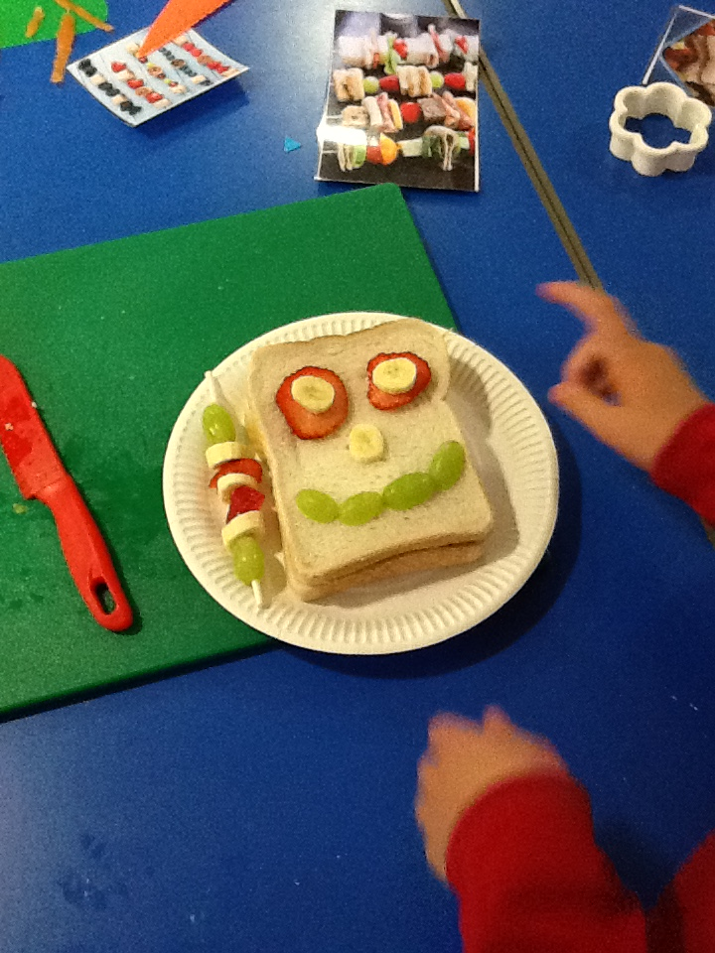

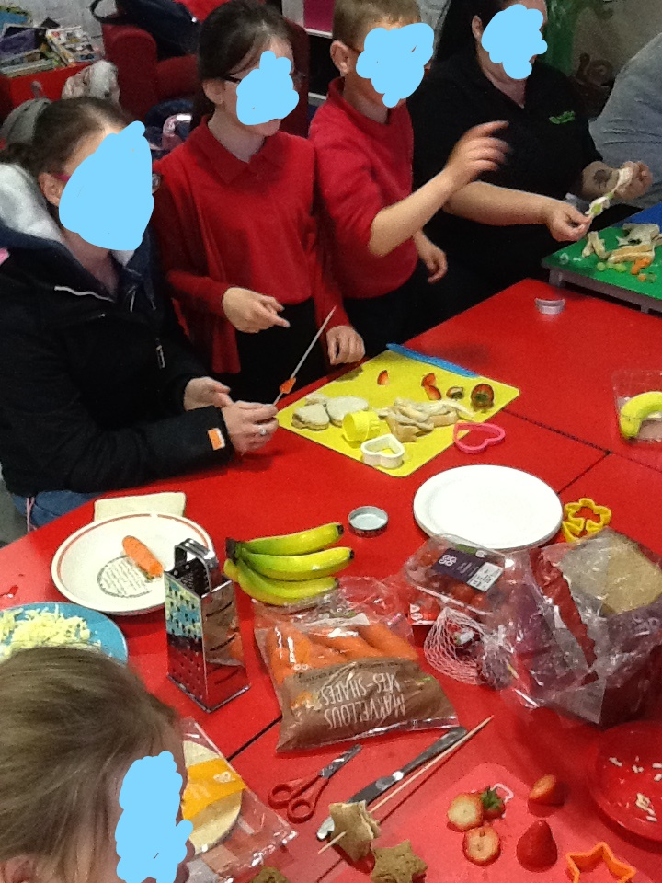
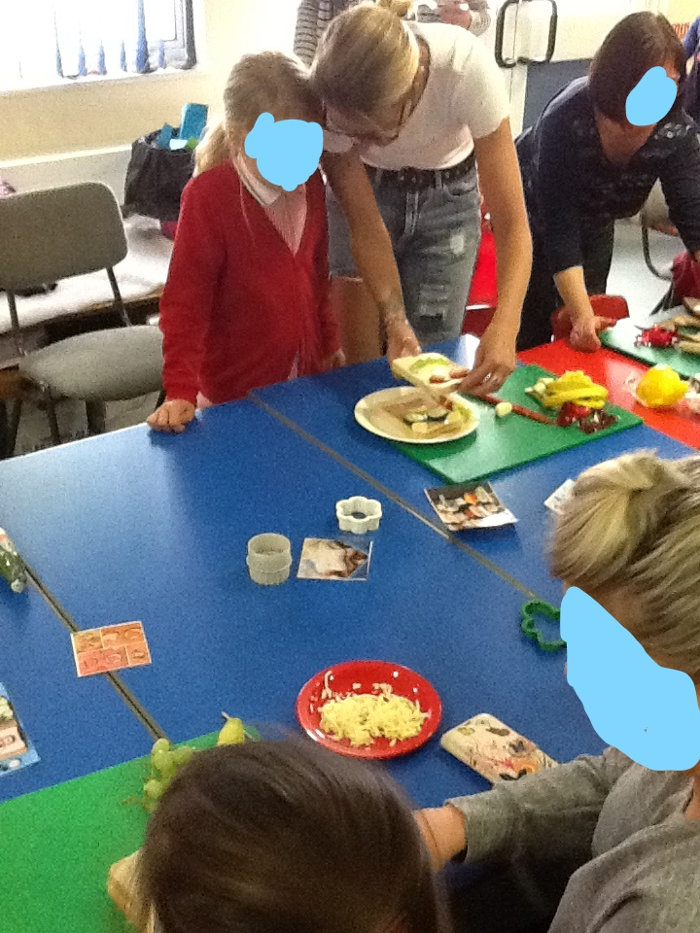
Thema ADCDF: Iechyd
Mae gweithdai ymgysylltu â theuluoedd yn helpu i hyrwyddo arferion coginio a bwyta’n iach i'r teulu cyfan.
Annog teuluoedd i fwyta'n fwy iach a gwastraffu llai o fwyd.
(Sustran, 2017a)
(Sustran, 2017 b)
Criw Beic It
(IIF, 2016)
(IIF, 2016)
Mae Sustran yn helpu plant i gadw'n heini, lleihau tagfeydd a gwella diogelwch o amgylch ysgolion(Sustran, 2017 c)
(UN, unknown date b)
Coginio Teulu
Sesiynau

Slide 26
Pa mor effeithiol yw strategaethau'r ysgol wrth hyrwyddo ADCDF?
Meysydd llwyddiant
Beirniadaeth
Mae nifer y digwyddiadau codi arian y mae'r disgyblion yn cymryd rhan ynddyn nhw yn cynyddu bob blwyddyn.
Gwrandawir ar farn y plant ac mae'r ysgol yn hwyluso ceisiadau plant i gefnogi ymgyrchoedd pan fo'n briodol.
Effeithir ar blant gan ddigwyddiadau yn y newyddion, ac yn dod yn ddinasyddion moesegol sy'n pryderu am les y blaned a'i holl drigolion.
Mae Gwaredwr gwyn yn derm a ddefnyddir i ddisgrifio pobl wyn sydd am helpu pobl nad ydyn nhw’n wyn i ddiwallu eu hanghenion eu hunain.(Bakar, 2019)
Wrth hyrwyddo ADCDF, ydy ysgolion yn bwydo syniad achubwyr gwyn trwy annog gweithgareddau codi arian?
Mae'r plant yn gyflym iawn i ddatrys problemau'r byd trwy godi arian. Ffug Elusen.

Slide 27
Dau brif ddull o ymdrin ag addysg fyd-eang–
Darllen: Rethinking global education in the 21st century by Abdullahi, S.A
http://link.springer.com/chapter/10.1007%2F978-90-481-3617-9_2#page-1
Gwahanol
TRWYTHOL
Wedi’i addysgu yn uned neu gwrs ar wahân
Gall neu ni all myfyrwyr gysylltu'r wybodaeth fyd-eang â gweddill y cwricwlwm.
Seiliedig ar wybodaeth
Yn integreiddio cynnwys a gwybodaeth fyd-eang yn eu cyfarwyddyd, gan ddefnyddio materion lleol, gwladwriaethol, cenedlaethol a rhyngwladol cyfredol.
Efallai y bydd rhai ohonyn nhw’n peri rhai anawsterau i athrawon, oherwydd efallai na fydd gan rai ohonyn nhw’r wybodaeth fyd-eang [priodoleddau, agwedd] a'r addysgeg sydd eu hangen i addysgu addysg fyd-eang

Slide 28

Cyfyngiadau a rhwystrau RHAG ADCDF effeithiol?
ADCDF ddim yn ddigon radical
Yn dal i weithio o fewn y system ysgolion / dim newid mawr i'r meddwl mewn termau cynaliadwy
Wedi'i ymgorffori'n well mewn rhai ardaloedd nag eraill
Ysgolion dan reolaeth pynciau
Ysgolion yn cael eu gyrru gan arholiadau
Ydy’r athrawon yn ei fyw neu ddim ond yn ei ddysgu?
Angen meddwl y tu hwnt i'r ysgol e.e. y Rhwydwaith Pontio (Hopkins 2008 dyfynnwyd ynClarke, 2010)
Notes:
Transition is a movement that has been growing since 2005. It is about communities stepping up to address the big challenges they face by starting local. By coming together, they are able to crowd-source solutions. They seek to nurture a caring culture, one focused on supporting each other, both as groups or as wider communities.
In practice, they are reclaiming the economy, sparking entrepreneurship, reimagining work, reskilling themselves and weaving webs of connection and support. It’s an approach that has spread now to over 50 countries, in thousands of groups: in towns, villages, cities, Universities, schools.
The 25% Local Food Shift: Working with students of the two local post-secondary institutions and a number of not-for-profit partners, including Farms at Work, TTP has published research showing that a 25% shift in spending towards locally-produced food would benefit the local economy, in 10 years time, by $400 million Cdn a year. Having a robust economic case hugely helps making the case for intentional localisation
Every year the UK throws away 15 million tonnes of food and drink, half of which was perfectly edible when thrown away. Over a million people now rely on food handouts and Food Banks. 2 members of Transition Bro Gwaun (TBG) were visiting local shops looking for food waste to feed pigs, and realised how much perfectly good food was being thrown away, and that that presented a huge opportunity.
Transition Community Café, Fishguard, Wales

Slide 29
CYNGOR asesu:
Cymharu'n feirniadol â'r themâu a'r safbwyntiau yn fframwaith ADCDF
Rethinking global education in the 21st century by Abdullahi, S.A http://link.springer.com/chapter/10.1007%2F978-90-481-3617-9_2#page-1
I gael marc uchel ar Lefel 6 gallech chi gymharu'n feirniadol y fframweithiau gwahanol a amlinellir yn y llyfr hwn (Pennod 2) â fframwaith ADCDF Cymru a'r Cwricwlwm Newydd i Gymru.

Slide 30
Newid mewn addysg
Addysg ar gyfer newid – rôl addysg wrth ddod â newid i berson neu gymdeithas. Newid drwy broses addysgol
Methodoleg Drawsnewidiol – adeiladol h.y. ennyn diddordeb dysgwr mewn adeiladu a pherchenogi’r ystyr (Stirling, 2001)
Notes:
Transformative

Slide 31
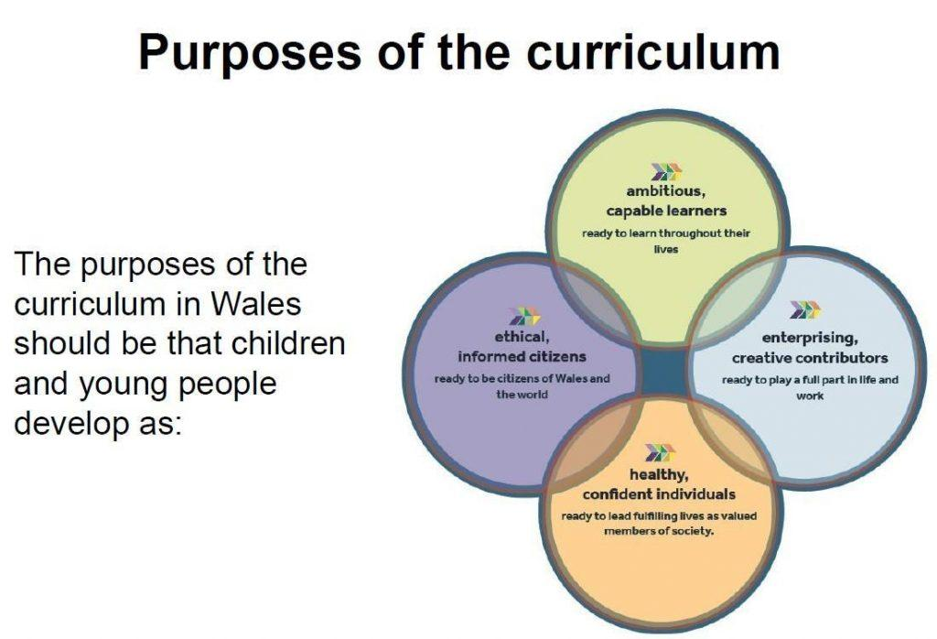
Dyfodol Llwyddiannus Successful Futures (WG, 2015)

Slide 32
CYFEIRIADAU
Clarke, P. (2010) Education for Sustainability. Available online: https://www-dawsonera-com.ezproxy.uwtsd.ac.uk/readonline/9780203136621 (Accessed 23/8/16)
Estyn (2014) ESDGC Progress in Education for Sustainable Development and Global Citizenship. Available online: https://www.estyn.gov.wales/sites/default/files/documents/ESDGC%3A%20Progress%20in%20education%20for%20sustainable%20development%20and%20global%20citizenship%20-%20June%202014.pdf (Accessed 23/8/16)
Hicks (2012) Sustainable Schools, Sustainable Futures : A resource for teachers. Available at: http://www.teaching4abetterworld.co.uk/docs/download18.pdf
Stirling, S. (2001) Sustainable Education: Re-visioning Learning and Change. Green Books Ltd: Devon
UNESCO Teaching and Learning for a Sustainable Future. Available at: http://www.unesco.org/education/tlsf/mods/theme_gs/mod0a.html (Accessed 23/8/16)
UNESCO (2016). C R E AT IN G S US TA IN A B L E F U T U R E S FOR A L L Education for people and planet: Sustainable Development Goals United Nation Educational, Scientific and Cultural Organization
Ward, S. (2013) A Student’s Guide to Education Studies. Routledge: London
Welsh Government (no date) Out of Classroom Learning. Available online at: http://gov.wales/dcells/publications/publications/guidanceandinformation/outofclassroomlearning/outofclassroomlearninge.pdf?lang=en (Accessed 23/8/16)
J. Zajda (ed.), (2010) Global Pedagogies: Schooling for the Future, Globalisation, Comparative
Education and Policy Research 12, Chapter 2 (Abdullahi, S.A.)

Slide 33
Cyfeiriadau
ACCAC. (2002). Education for Sustainable Development and Global Citizenship: Why? What? How? Birmingham: ACCAC
Association for Young People’s Health (AYPH) (2020). Children’s rights logo. Available at: https://www.youngpeopleshealth.org.uk/wp-content/uploads/2019/11/UNCRC-infographic.png/ (Accessed: 28 January 2020)
Bakar, F. (2019). What is a white saviour complex? Available at: /https://metro.co.uk/2019/03/06/what-is-a-white-saviour-complex-8793979/ (Accessed: 10 March 2020)
Drop in the Bucket (2016). Busumbu Primary School Image. Available at: http://www.dropinthebucket.org/wp-content/uploads/2016/08/WaterWells_Africa_DropInTheBucket_BusumbuPrimary-Uganda01.jpg/ (Accessed: 10 March 2020)
Helping Hand Environmental (HHE) (2019). Keeping Wales Tide Logo. Available at: https://i2.wp.com/www.hhenvironmental.co.uk/wp-content/uploads/2016/11/Logo.jpg?fit=299%2C473&ssl=1/ (Accessed 16 January 2020)
Investors in Families (IIF) (2016). Logo. Available at: https://iifwalesdotcom.files.wordpress.com/2018/11/2019-iif-logo-e1543422397725.png/ (Accessed: 8 February 2020)
Keep Wales Tidy (2020). Eco Schools Logo. Available at: https://www.keepwalestidy.cymru/Getimage.aspx?IDMF=14b4669c-c164-46ce-adc5-4a515083ee1a&w-123&h=175&src=mc/ (Accessed: 16 January 2020)
OXFAM (2015). Education for Global Citizenship A guide for schools. Oxford: OXFAM.
PONT (2018). PONT Logo. Available at: https://pont-mbale.org.uk/wp-content/uploads/2019/04/PONT-Logo-High-Res-1.jpeg/(Accessed: 8 February 2020)
PONT (2018a). Education. Available at: https://pont-mbale.org.uk/what-we-do/education/ (Accessed: 8 February 2020)
Purple Community Fund (PCF) (2016a). Images of upcycled goods. Available at: https://www.p-c-f.org/shop/ (Accessed 12 March 2020)
Purple Community Fund (PCF) (2016b). Logo. Available at: https://www.p-c-f.org/wp-content/uploads/2017/06/PCF_AW_LOGO_RGB_WHITE_S.jpg/ (Accessed: 12 March 2020)
Ridley, K. (2005). Thinking skills in the early years: a literature review. Available at: http://www.leeds.ac.uk/educol/documents/150445.htm/ (Accessed: 11 February 2020)
Size of Wales. (2020). Logo. Available at: https://cdn.sizeofwales.org.uk/wp-content/uploads/2018/04/30143830/sizeLogo-1024x670.png/ (Accessed: 16 January 2020)

Slide 34
Sustrans (2017 a). Logo Available at: https://www.sustrans.org.uk/media/1001/sustrans_logo_full.svg/ (Accessed 8 February 2020)
Sustrans (2017b). Big Pedal Logo. Available at: https://www.sustrans.org.uk/media/5784/190816-sustransbigpedal-logo2020-eng-10thann-cmyk-ws.jpg?anchor=center&mode=crop&width=340&height=190/ (Accessed: 8 February 2020)
Sustrans (2017c). Education. Available at: https://www.sustrans.org.uk/for-professionals/education/ (Accessed 8 February 2020)
UNISECO (2016). Education 2030. Incheon Declaration and Framework for Action for the implementation of Sustainable Development Goal 4. Available at: http://uis.unesco.org/sites/default/files/documents/education-2030-incheon-framework-for-action-implementation-of-sdg4-2016-en_2.pdf/ (Accessed: 8 February 2020)
UNICEF (2019). CRC Icons. Available at: https://weshare.unicef.org/archive/ENGLISH---CRC-A4-booklet-2AM408TCH6MC.html/(Accessed: 8 March 2020)
United Nations (UN) (unknown date a). Education for Sustainable Development and Global Citizenship. Available at: https://sustainabledevelopment.un.org/partnership/?p=2373/ (Accessed: 7 March 2020)
United Nations (Unknown date b). SDGs icons. Available at: http://www.un.org/sustainabledevelopment/news/communications-material/ (Accessed: 8 March 2020)
UNICEF (2016). The United Nations Convention on the Rights of the Child. London: UNICEF
United Nations (UN) (2019). SDG Logo. Available at: https://www.un.org/sustainabledevelopment/wp-content/uploads/2019/08/E_SDG-Logo-2019-01.png/(Accessed: 14 January 2020)
UN (2019). Sustainable Development Goals. Available at: https://www.un.org/sustainabledevelopment/(Accessed: 14 January 2020)
Welsh Assembly Government (2008). ‘Education for Sustainable Development and Global Citizenship: A Common Understanding for Schools’. Cardiff: Welsh assembly Government.
Welsh Government (2020 a). Curriculum for Wales. Available at: https://hwb.gov.wales/curriculum-for-wales/ (Accessed: 12 March 2020)
Welsh Government (2020 b). Curriculum logo. Available at: https://hwb.gov.wales/storage/64105e3d-b8c8-4193-b00f-0fcfb94af7aa/designing-your-curriculum.jpg/ (Accessed: 12 March 2020)
World Education Blog (2016). ESDGC logo. Available at: https://gemreportunesco.files.wordpress.com/2016/10/4-7.jpg?w=680&h=694/ (Accessed: 8 March 2020)

